Slide 1
SARC user day 2023
Workshop Probabilistic Damage Stability with PIAS
Douwe Plukkel
Notes:
Welcome
Douwe Plukkel, over 15 years of experience with probdam
And I was asked to give this presentation

Slide 2
Probabilistic Damage Stability
Topics:
Notes:
Increased cmplexity leading to longer calculation times. What is the cause and how to deal with this?
Tips en trics subjects based on commonly asked questions, recent developments. Beginners and more experienced
Q&A If a question arises related to the subject i am discussing, → shoot. If not this is your moment

Slide 3
Probabilistic Damage Stability
Topics:
Increased complexity of probabilistic damage stability and calculation times.
Notes:
Increased cmplexity leading to longer calculation times. What is the cause and how to deal with this?
Tips en trics subjects based on commonly asked questions, recent developments. Beginners and more experienced
Q&A If a question arises related to the subject i am discussing, → shoot. If not this is your moment

Slide 4
Probabilistic Damage Stability
Topics:
Increased complexity of probabilistic damage stability and calculation times.
Tips and Tricks
Notes:
Increased cmplexity leading to longer calculation times. What is the cause and how to deal with this?
Tips en trics subjects based on commonly asked questions, recent developments. Beginners and more experienced
Q&A If a question arises related to the subject i am discussing, → shoot. If not this is your moment

Slide 5
Probabilistic Damage Stability
Topics:
Increased complexity of probabilistic damage stability and calculation times.
Tips and Tricks
Q&A
Notes:
Increased cmplexity leading to longer calculation times. What is the cause and how to deal with this?
Tips en trics subjects based on commonly asked questions, recent developments. Beginners and more experienced
Q&A If a question arises related to the subject i am discussing, → shoot. If not this is your moment

Slide 6
Probabilistic Damage Stability
If questions arise during this workshop, please feel free to ask during the presentation if the question is related to the subject I am discussing.
If the questions are not related to the current subject feel free to ask them in the Q&A section after my presentation and I will see if I can answer them straight away or that we will come back on this.
After this SARC-day, I will send a summary of this workshop, including your questions and answers.
Notes:
Increased cmplexity leading to longer calculation times. What is the cause and how to deal with this?
Tips en trics subjects based on commonly asked questions, recent developments. Beginners and more experienced
Q&A If a question arises related to the subject i am discussing, → shoot. If not this is your moment

Slide 7
Increased complexity and calculation times.

Slide 8
Increased complexity and calculation times.
Coming from SOLAS 1992, the SOLAS 2009 already meant more aspects to be calculated, thus increased calculation times.

Slide 9
Increased complexity and calculation times.
Coming from SOLAS 1992, the SOLAS 2009 already meant more aspects to be calculated, thus increased calculation times.
Although the regulations of the SOLAS 2009 (2014 and 2020) haven’t changed much, we all experience longer calculation times.

Slide 10
Increased complexity and calculation times.
Coming from SOLAS 1992, the SOLAS 2009 already meant more aspects to be calculated, thus increased calculation times.
Although the regulations of the SOLAS 2009 (2014 and 2020) haven’t changed much, we all experience longer calculation times.
How is that possible?

Slide 11
Increased complexity and calculation times.
Coming from SOLAS 1992, the SOLAS 2009 already meant more aspects to be calculated, thus increased calculation times.
Although the regulations of the SOLAS 2009 (2014 and 2020) haven’t changed much, we all experience longer calculation times.
How is that possible?
Implementation and interpretations of the regulations have become more and more strict. Not only by the Classification Societies, but also by our customers and of course here at SARC.

Slide 12
Increased complexity and calculation times
Example: Progressive flooding

Slide 13
Increased complexity and calculation times
Example: Progressive flooding
In the past it was generally accepted that a major ballast water pipe was considered but other small pipes (e.g., F.O. piping which connects F.O. tanks with each other through the overflow tank) were ‘permitted’ without having to demonstrate the effects.

Slide 14
Increased complexity and calculation times
Other examples:
It was allowed to calculate the stability only ‘to the side of heel’, now the stability must be calculated to both PS and SB.

Slide 15
Increased complexity and calculation times
Other examples:
It was allowed to calculate the stability only ‘to the side of heel’, now the stability must be calculated to both PS and SB.
Minor damages were considered in a coarse manner.

Slide 16
Increased complexity and calculation times
Other examples:
It was allowed to calculate the stability only ‘to the side of heel’, now the stability must be calculated to both PS and SB.
Minor damages were considered in a coarse manner.
Now we have more advanced ship designs leading to:

Slide 17
Increased complexity and calculation times
Other examples:
It was allowed to calculate the stability only ‘to the side of heel’, now the stability must be calculated to both PS and SB.
Minor damages were considered in a coarse manner.
Now we have more advanced ship designs leading to:
Asymmetrical models (need to calculate both SB and PS).

Slide 18
Increased complexity and calculation times
Other examples:
It was allowed to calculate the stability only ‘to the side of heel’, now the stability must be calculated to both PS and SB.
Minor damages were considered in a coarse manner.
Now we have more advanced ship designs leading to:
Asymmetrical models (need to calculate both SB and PS).
Sloped bulkheads, added hull forms etc.

Slide 19
Increased complexity and calculation times
Other examples:
It was allowed to calculate the stability only ‘to the side of heel’, now the stability must be calculated to both PS and SB.
Minor damages were considered in a coarse manner.
Now we have more advanced ship designs leading to:
Asymmetrical models (need to calculate both SB and PS).
Sloped bulkheads, added hull forms etc.
More detailed drawings are available (which cannot be ignored).

Slide 20
Increased complexity and calculation times
Effect:

Slide 21
Increased complexity and calculation times
Effect:
Calculations get more complicated.

Slide 22
Increased complexity and calculation times
Effect:
Calculations get more complicated.
Lower attained index.

Slide 23
Increased complexity and calculation times
Effect:
Calculations get more complicated.
Lower attained index.
The designer must take extra effort in order to gain back the loss in the attained index, by calculation more damage cases, more iterations etc.

Slide 24
Increased complexity and calculation times
Effect:
Calculations get more complicated.
Lower attained index.
The designer must take extra effort in order to gain back the loss in the attained index, by calculation more damage cases, more iterations etc.
More detailed PIAS models (more frames, frame points, etc.)

Slide 25
Increased complexity and calculation times
Effect:
Calculations get more complicated.
Lower attained index.
The designer must take extra effort in order to gain back the loss in the attained index, by calculation more damage cases, more iterations etc.
More detailed PIAS models (more frames, frame points, etc.)
All leading to increased calculating time and effort.

Slide 26
Increased complexity and calculation times
Since we are not only developing software, but we also use it, we are facing the same issues as you.
Luckily, we are lazy people, so we try to keep up and develop new functionalities and mechanisms to be able to calculate these aspects and reduce the time one have to spend on it him/herself.
Let the computer do the hard and boring work.

Slide 27
Increased complexity and calculation times
What have we done to make life easier?

Slide 28
Increased complexity and calculation times
What have we done to make life easier?
Ability to define more complex compartment connections.

Slide 29
Increased complexity and calculation times
What have we done to make life easier?
Ability to define more complex compartment connections.
Calculation of (damage) stability to both SB and PS.

Slide 30
Increased complexity and calculation times
What have we done to make life easier?
Ability to define more complex compartment connections.
Calculation of (damage) stability to both SB and PS.
(more advanced) automatic generation of minor damages (higher sub-damages).

Slide 31
Increased complexity and calculation times
What have we done to make life easier?
Ability to define more complex compartment connections.
Calculation of (damage) stability to both SB and PS.
(more advanced) automatic generation of minor damages (higher sub-damages).
Intermediate results can now be reached within PIAS without the need to browse and open the PD0-file with a text editor.

Slide 32
Increased complexity and calculation times
What have we done to make life easier?
Ability to define more complex compartment connections.
Calculation of (damage) stability to both SB and PS.
(more advanced) automatic generation of minor damages (higher sub-damages).
Intermediate results can now be reached within PIAS without the need to browse and open the PD0-file with a text editor.
Most of this has been developed as free ‘updates’

Slide 33
Increased complexity and calculation times
This has led to enhanced accuracy but unfortunately also longer calculation times.
So, what have we done to reduce calculation times?

Slide 34
Increased complexity and calculation times
This has led to enhanced accuracy but unfortunately also longer calculation times.
So, what have we done to reduce calculation times?
Multi-threaded (dual, octo and viginity) calculation of optimizing damage boundaries.

Slide 35
Increased complexity and calculation times
This has led to enhanced accuracy but unfortunately also longer calculation times.
So, what have we done to reduce calculation times?
Multi-threaded (dual, octo and viginity) calculation of optimizing damage boundaries.
Chronology of calculations.
Notes:
Start with optimizing the damage boundaries of larger complex damages to make good use of multi threading

Slide 36
Increased complexity and calculation times
This has led to enhanced accuracy but unfortunately also longer calculation times.
So, what have we done to reduce calculation times?
Multi-threaded (dual, octo and viginity) calculation of optimizing damage boundaries.
Chronology of calculations.
Multi threaded calculation of stability (general).

Slide 37
Increased complexity and calculation times
Aspects that (likely) have to be considered in the (near) future.

Slide 38
Increased complexity and calculation times
Aspects that (likely) have to be considered in the (near) future.
More detailed ‘progressive flooding’ calculations.

Slide 39
Increased complexity and calculation times
Aspects that (likely) have to be considered in the (near) future.
More detailed ‘progressive flooding’ calculations.
Progressive flooding including time calculation.

Slide 40
Increased complexity and calculation times
Aspects that (likely) have to be considered in the (near) future.
More detailed ‘progressive flooding’ calculations.
Progressive flooding including time calculation.
Calculation of pressure heights of pipes and closing devices.

Slide 41
Increased complexity and calculation times
Aspects that (likely) have to be considered in the (near) future.
More detailed ‘progressive flooding’ calculations.
Progressive flooding including time calculation.
Calculation of pressure heights of pipes and closing devices.
More detailed calculations for ‘cross-flooding calculations’.
Notes:
A subject that has raisen in the last year and last two weeks

Slide 42
Increased complexity and calculation times
Aspects that (likely) have to be considered in the (near) future.
More detailed ‘progressive flooding’ calculations.
Progressive flooding including time calculation.
Calculation of pressure heights of pipes and closing devices.
More detailed calculations for ‘cross-flooding calculations’.
Not only calculation of cross-flooding times for a selection of critical damage cases but all damage cases with a cross-flooding arrangement.
Notes:
A couple of years ago a simple check on cross-flooding between two compartments was sufficient,
Then a selection of critical cases was demeonstrated and recently, ALL damage cases with a cross-flooding arramngements have to be dealt with

Slide 43
Increased complexity and calculation times
Aspects that (likely) have to be considered in the (near) future.
More detailed ‘progressive flooding’ calculations.
Progressive flooding including time calculation.
Calculation of pressure heights of pipes and closing devices.
More detailed calculations for ‘cross-flooding calculations’.
Not only calculation of cross-flooding times for a selection of critical damage cases but all damage cases with a cross-flooding arrangement.
Not only calculation of cross-flooding at the start and end of cross-flooding, but also intermediate stages of cross-flooding have to be calculated, including the calculation of the intermediate si values.

Slide 44
Increased complexity and calculation times
At the moment this means extensive ‘manual’ labor to calculate this. The ‘Piping’ module, which we are developing, will be the answer to ‘automatically’ take these aspects into account on a detailed level.

Slide 45
Increased complexity and calculation times
At the moment this means extensive ‘manual’ labor to calculate this. The ‘Piping’ module, which we are developing, will be the answer to ‘automatically’ take these aspects into account on a detailed level.
Now in it’s testing-fase.

Slide 46
Increased complexity and calculation times
At the moment this means extensive ‘manual’ labor to calculate this. The ‘Piping’ module, which we are developing, will be the answer to ‘automatically’ take these aspects into account on a detailed level.
Now in it’s testing-fase.
New features keep on coming to be added due to recent comments (such as calculating si values in intermediate stages).

Slide 47
Increased complexity and calculation times
At the moment this means extensive ‘manual’ labor to calculate this. The ‘Piping’ module, which we are developing, will be the answer to ‘automatically’ take these aspects into account on a detailed level.
Now in it’s testing-fase.
New features keep on coming to be added due to recent comments (such as calculating si values in intermediate stages).
This module will be a major step forward.

Slide 48
Increased complexity and calculation times
Since we are making software not only for our own use but also for you, we are interested in your experiences on increased complexity of probabilistic damage stability.

Slide 49
Increased complexity and calculation times
Since we are making software not only for our own use but also for you, we are interested in your experiences on increased complexity of probabilistic damage stability.
Do you face problems like the ones mentioned earlier?

Slide 50
Increased complexity and calculation times
Since we are making software not only for our own use but also for you, we are interested in your experiences on increased complexity of probabilistic damage stability.
Do you face problems like the ones mentioned earlier?
What are these problems?

Slide 51
Increased complexity and calculation times
Since we are making software not only for our own use but also for you, we are interested in your experiences on increased complexity of probabilistic damage stability.
Do you face problems like the ones mentioned earlier?
What are these problems?
How do you deal with these problems?

Slide 52
Increased complexity and calculation times
Since we are making software not only for our own use but also for you, we are interested in your experiences on increased complexity of probabilistic damage stability.
Do you face problems like the ones mentioned earlier?
What are these problems?
How do you deal with these problems?
What could there be done to solve these problems?
It is important to let us know. We want PIAS to be able to calculate what is needed.

Slide 53
Increased complexity and calculation times
Since developments like the ‘Piping’ module will also lead to longer calculation times, we are always trying to find ways to speed up the calculations and to automate the process as much as possible.

Slide 54
Increased complexity and calculation times
Future developments to deal with the increasing calculation times.

Slide 55
Increased complexity and calculation times
Future developments to deal with the increasing calculation times.
SARC is exploring the possibilities to:
Combining calculation of SB and PS and additional trims, in ‘one-go’.

Slide 56
Increased complexity and calculation times
Future developments to deal with the increasing calculation times.
SARC is exploring the possibilities to:
Combining calculation of SB and PS and additional trims, in ‘one-go’.
Possibility to (re-)calculate only one draft (e.g. in case of A<0,7R).

Slide 57
Increased complexity and calculation times
Future developments to deal with the increasing calculation times.
SARC is exploring the possibilities to:
Combining calculation of SB and PS and additional trims, in ‘one-go’.
Possibility to (re-)calculate only one draft (e.g. in case of A<0,7R).
Showing ‘A’ during calculations and implementing a setting which stops the calculation as soon as the required index is reached.

Slide 58
Increased complexity and calculation times
Future developments to deal with the increasing calculation times.
SARC is exploring the possibilities to:
Combining calculation of SB and PS and additional trims, in ‘one-go’.
Possibility to (re-)calculate only one draft (e.g. in case of A<0,7R).
Showing ‘A’ during calculations and implementing a setting which stops the calculation as soon as the required index is reached.
Storing the intermediate results to be printed, when using the ‘Re-use of unmodified results from former calculations’.
Notes:
Uitleggen wat the ‘Re-use of unmodified results from former calculations’ inhoud

Slide 59
Increased complexity and calculation times
Again, we would like to hear from you!
Do you have suggestions to speed up calculation times?

Slide 60
Increased complexity and calculation times

Slide 61
Increased complexity and calculation times

Slide 62
Increased complexity and calculation times
What can you do to reduce calculation times and increase the result?
Make sure that all input data is correct. (more in the T&T)

Slide 63
Increased complexity and calculation times
What can you do to reduce calculation times and increase the result?
Make sure that all input data is correct. (more in the T&T)
Don’t ‘guess’ which G’M-values are needed. (more in the T&T).

Slide 64
Increased complexity and calculation times
What can you do to reduce calculation times and increase the result?
Make sure that all input data is correct. (more in the T&T)
Don’t ‘guess’ which G’M-values are needed. (more in the T&T).
Avoid added hull forms and external defined compartments!!

Slide 65
Increased complexity and calculation times
Avoid added hull forms and external defined compartments!!
Determining damage boundaries based on coordinates of compartments is fast. There are only a few distinct coordinates which form the boundaries of a compartment.

Slide 66
Increased complexity and calculation times
Avoid added hull forms and external defined compartments!!
Determining damage boundaries based on coordinates of compartments is fast. There are only a few distinct coordinates which form the boundaries of a compartment
External defined compartments have a lot more coordinates which need to be considered to determine the damage boundaries.

Slide 67
Increased complexity and calculation times
Avoid added hull forms and external defined compartments!!
Determining damage boundaries based on coordinates of compartments is fast. There are only a few distinct coordinates which form the boundaries of a compartment
External defined compartments have a lot more coordinates which need to be considered to determine the damage boundaries.
Consider to re-model the PIAS-model without external defined compartments and added hull forms for probabilistic damage stability calculations.

Slide 68
Increased complexity and calculation times
Avoid added hull forms and external defined compartments!!
Determining damage boundaries based on coordinates of compartments is fast. There are only a few distinct coordinates which form the boundaries of a compartment
External defined compartments have a lot more coordinates which need to be considered to determine the damage boundaries.
Consider to re-model the PIAS-model without external defined compartments and added hull forms.
With this, we reduced the calculation time from over a week to a day.

Slide 69
Increased complexity and calculation times
What can you do to reduce calculation times and increase the result?
Make sure that all input data is correct. (more in the T&T)
Don’t ‘guess’ which G’M-values are needed. (more in the T&T).
Avoid added hull forms and external defined compartments!!
Use the ‘Re-use of unmodified results from former calculations’ functionality.

Slide 70
Increased complexity and calculation times
‘Re-use of unmodified results from former calculations’.
In order to increase the computation speed, this functionality stores quite some results of former calculations in memory. These can be re-used in subsequent calculations.

Slide 71
Increased complexity and calculation times
‘Re-use of unmodified results from former calculations’.
In order to increase the computation speed, this functionality stores quite some results of former calculations in memory. These can be re-used in subsequent calculations.
When this option is used, and PIAS uses the results of former calculations this will be mentioned in the intermediate calculation data. When you require complete intermediate data, this option should not be used or:

Slide 72
Increased complexity and calculation times
‘Re-use of unmodified results from former calculations’.
In order to increase the computation speed, this functionality stores quite some results of former calculations in memory. These can be re-used in subsequent calculations.
When this option is used, and PIAS uses the results of former calculations this will be mentioned in the intermediate calculation data. When you require complete intermediate data, this option should not be used or:
The results of former calculations can be removed explicitly with the ‘Remove all results of former calculations’ functionality.

Slide 73
Increased complexity and calculation times
‘Re-use of unmodified results from former calculations’.
In order to increase the computation speed, this functionality stores quite some results of former calculations in memory. These can be re-used in subsequent calculations.
When this option is used, and PIAS uses the results of former calculations this will be mentioned in the intermediate calculation data. When you require complete intermediate data, this option should not be used or:
The results of former calculations can also be removed explicitlywith the ‘Remove all results of former calculations’ functionality.

Slide 74
Increased complexity and calculation times
What can you do to reduce calculation times and increase the result?
Make sure that all input data is correct. (more in the T&T)
Don’t ‘guess’ which G’M-values are needed. (more in the T&T).
Avoid added hull forms and external defined compartments!!
Use the ‘Re-use of unmodified results from former calculations’ functionality.
Don’t start with too many compartment damages. You can easily add damages later. (more in the T&T).

Slide 75
Increased complexity and calculation times
What can you do…? (Continued)
Preferably: Install the codemeter, files and program-files locally at a dedicated fast computer used for probabilistic damage stability.

Slide 76
Increased complexity and calculation times
What can you do…? (Continued)
Preferably: Install the codemeter, files and program-files locally at a dedicated fast computer used for probabilistic damage stability.
Turn-off Windows updates!

Slide 77
Increased complexity and calculation times
What can you do…? (Continued)
Preferably: Install the codemeter, files and program-files locally at a dedicated fast computer used for probabilistic damage stability.
Turn-off Windows updates!
Try multi-threading (on dedicated hardware).

Slide 78
Increased complexity and calculation times
What can you do…? (Continued)
Preferably: Install the codemeter, files and program-files locally at a dedicated fast computer used for probabilistic damage stability.
Turn-off Windows updates!
Try multi-threading (on dedicated hardware).
When you have the need to perform multiple calculations in a short term, you can rent additional temporary ‘Probdam’, and/or ‘Multi-threading’ licenses or consult SARC for extra calculation capacity.

Slide 79
Increased complexity and calculation times
What can you do…? (Continued)
Try the ‘Numerical integration method’ for probabilistic damage calculations. (More in the T&T).

Slide 80
Increased complexity and calculation times
What can you do…? (Continued)
Try the ‘Numerical integration method’ for probabilistic damage calculations. (More in the T&T).
Easier to implement.
Faster.
More accurate.
Less arbitrary.
Less equations and prescriptions.

Slide 81
Increased complexity and calculation times
What can you do…? (Continued)
Try the ‘Numerical integration method’ for probabilistic damage calculations. (More in the T&T).
Easier to implement.
Faster.
More accurate.
Less arbitrary.
Less equations and prescriptions.
Unfortunately, not (yet) commonly used and accepted.

Slide 82
Increased complexity and calculation times
End of the topic: Increased complexity and calculation times.
Before we continue with the Tips & Tricks section
Questions?

Slide 83
Tips & Tricks.

Slide 84
Tips & Tricks
We haven’t received questions or topics for this part of the presentation on beforehand. If you do have questions, please raise them now so perhaps I can answer them.

Slide 85
Tips & Tricks
The following Tips & Tricks are based on:

Slide 86
Tips & Tricks
The following Tips & Tricks are based on:
Commonly asked questions.

Slide 87
Tips & Tricks
The following Tips & Tricks are based on:
Commonly asked questions.
Recent developments.

Slide 88
Tips & Tricks
The following Tips & Tricks are based on:
Commonly asked questions.
Recent developments.
Things I sometimes see users getting wrong.

Slide 89
Tips & Tricks
The following Tips & Tricks are based on:
Commonly asked questions.
Recent developments.
Things I sometimes see users getting wrong.
‘Basics’ but important enough to discuss.

Slide 90
Tips & Tricks
The following Tips & Tricks are based on:
Commonly asked questions.
Recent developments.
Things I sometimes see users getting wrong.
‘Basics’ but important enough to discuss.
Our own experience, not being said the only truth.

Slide 91
Tips & Tricks
The selection of topics I would like to discuss are:
Preparations:
‘Hulldef’.
‘Layout’.
‘Loading’.
And details of:
‘Prodam’

Slide 92
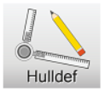
Tips & Tricks
‘Hulldef’

Slide 93
Tips & Tricks
‘Hulldef’
Particulars for SOLAS chapter 2, Part B1.
Subdivision length.
Fore and aft station.
Permeability.

Slide 94
Tips & Tricks
‘Hulldef’
Particulars for SOLAS chapter 2, Part B1.
Subdivision length.
Fore and aft station.
Permeability.
Vertical escape hatches.

Slide 95
Tips & Tricks: ‘Hulldef’
Particulars for SOLAS chapter 2, Part B1

Slide 96
Tips & Tricks: ‘Hulldef’
Particulars for SOLAS chapter 2, Part B1, Subdivision length

Slide 97
Tips & Tricks: ‘Hulldef’
Particulars for SOLAS chapter 2, Part B1, Fore and aft station.
Define the position of the most aftward station (Ls) and make sure you have defined a frame at this position.

Slide 98
Tips & Tricks: ‘Hulldef’
Particulars for SOLAS chapter 2, Part B1, Fore and aft station.
Define the position of the most aftward station (Ls) and make sure you have defined a frame at this position.
Make sure you also define the most forward frame at Ls.

Slide 99
Tips & Tricks: ‘Hulldef’
Particulars for SOLAS chapter 2, Part B1, Fore and aft station.
Correct
Incorrect

Slide 100
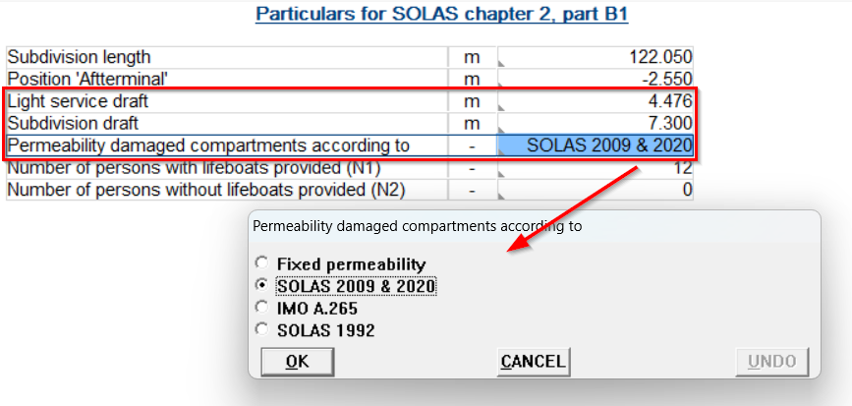
Tips & Tricks: ‘Hulldef’
Particulars for SOLAS chapter 2, Part B1, Permeabilities.
Only for ‘Loading’ and ‘Hydrotables’, in ‘Probdam’ it is the default

Slide 101
Tips & Tricks: ‘Hulldef’
Particulars for SOLAS chapter 2, Part B1, Permeabilities.
Number of persons with or without lifeboats provided (N1 & N2).

Slide 102
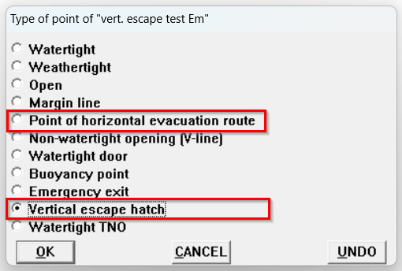
Tips & Tricks: ‘Hulldef’
Special points: ‘Vertical escape hatch’.

Slide 103
Tips & Tricks: ‘Hulldef’
Special points: ‘Vertical escape hatch’.
In the intermediate results the minimum clearance to evacuation route (horizontal and vertical) is printed.

Slide 104
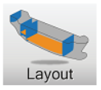
Tips & Tricks
‘Layout’

Slide 105
Tips & Tricks
‘Layout’
Make sure you have defined compartments correctly without overlap or missing parts and use the correct permeability.

Slide 106
Tips & Tricks
‘Layout’
Make sure you have defined compartments correctly without overlap or missing parts and use the correct permeability.
View overlapping compartments.

Slide 107
Tips & Tricks
‘Layout’
Make sure you have defined compartments correctly without overlap or missing parts. Use the correct permeability
View overlapping compartments.
Compare internal and external geometry

Slide 108
Tips & Tricks
‘Layout’
Make sure you have defined compartments correctly without overlap or missing parts. Use the correct permeability
View overlapping compartments.
Compare internal and external geometry
Type of space for SOLAS 2009 / 2020 (permeability)

Slide 109
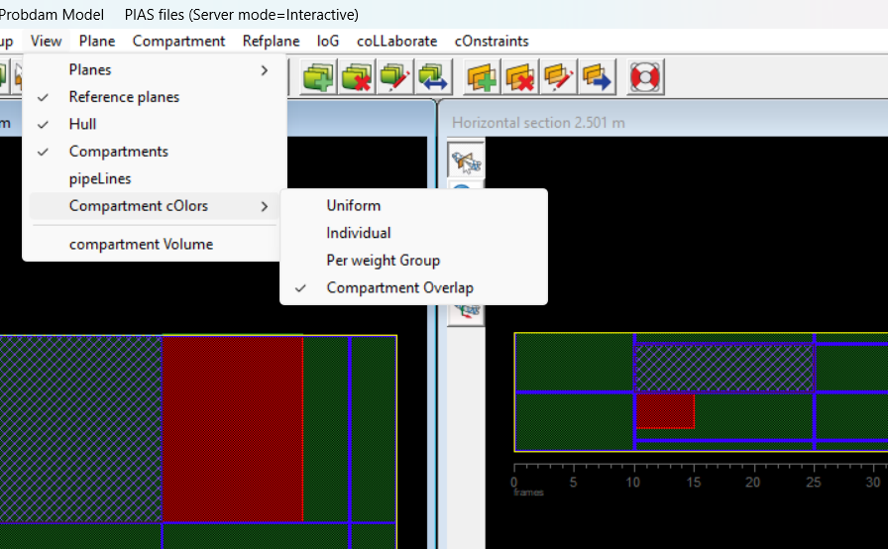
Tips & Tricks: ‘Layout’
Overlap of compartments.

Slide 110
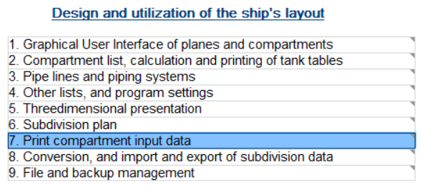
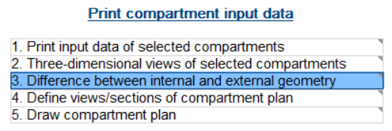
Tips & Tricks: ‘Layout’
Internal and external geometry.

Slide 111
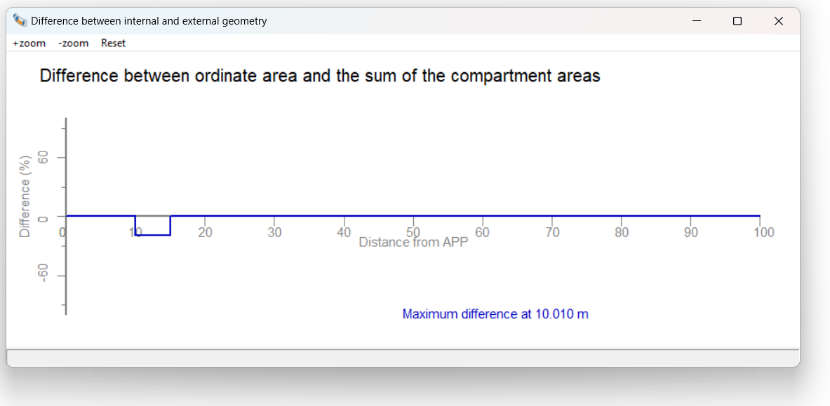
Tips & Tricks: ‘Layout’
Internal and external geometry.

Slide 112
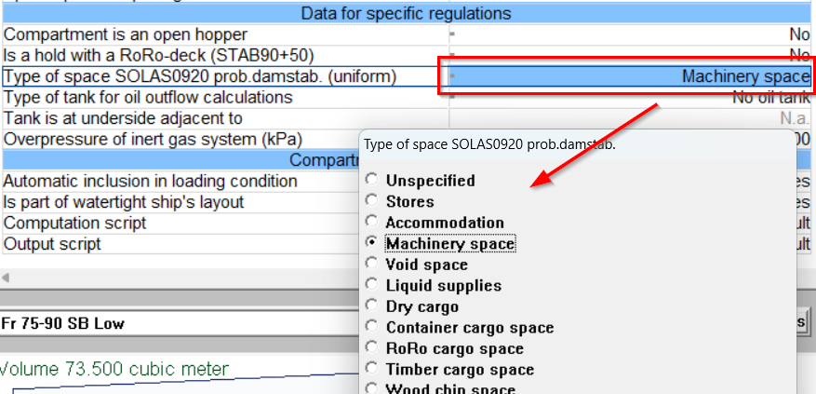
Tips & Tricks: ‘Layout’
Select ‘Type of space SOLAS’ for correct permeability for probabilistic damage stability.

Slide 113
Tips & Tricks: ‘Loading’
‘Loading’

Slide 114
Tips & Tricks: ‘Loading’
‘Loading’
Determining G’M values to be used.

Slide 115
Tips & Tricks: ‘Loading’
‘Loading’
Determining G’M values to be used.
Create Tlight, Tpartial and Tdeepest for investigating certain damage cases.

Slide 116
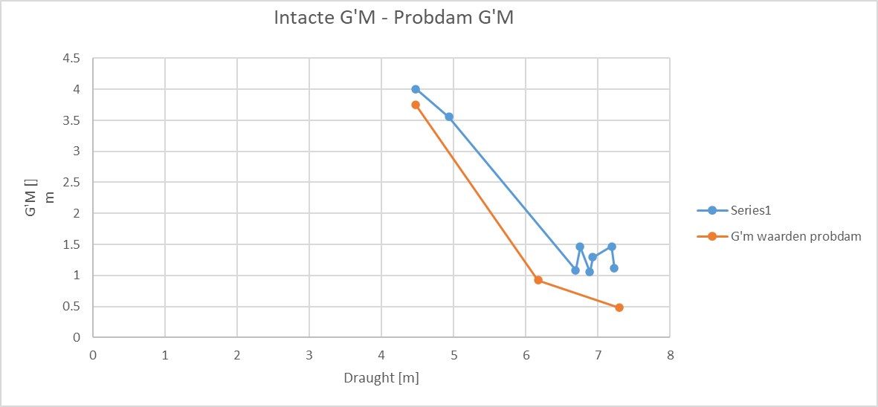
Tips & Tricks: ‘Loading’
Determining the G’M values to be used.

Slide 117
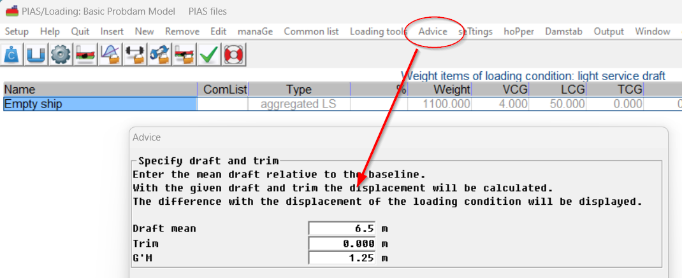
Tips & Tricks: ‘Loading’
Using ‘Advice’ to create Tlight, Tpartial and Tdeepest in Loading for investigating certain damage cases.

Slide 118
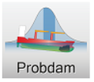
Tips & Tricks
‘Probdam’

Slide 119
Tips & Tricks
‘Probdam’
Applied regulations.

Slide 120
Tips & Tricks
‘Probdam’
Applied regulations.
Calculation method probability of flooding and configurations.

Slide 121
Tips & Tricks
‘Probdam’
Applied regulations.
Calculation method probability of flooding and configurations.
Setting: ‘Probability of damage never negative’. Yes, or no?

Slide 122
Tips & Tricks
‘Probdam’
Applied regulations.
Calculation method probability of flooding and configurations.
Setting: ‘Probability of damage never negative’. Yes, or no?
Maximum damage length and number of damaged compartments.

Slide 123
Tips & Tricks
‘Probdam’
Applied regulations.
Calculation method probability of flooding and configurations.
Probability of damage never negative. Yes, or no?
Maximum damage length and number of damaged compartments.
Drafts, trims and G’M values.

Slide 124
Tips & Tricks
‘Probdam’
Applied regulations.
Calculation method probability of flooding and configurations.
Probability of damage never negative. Yes, or no?
Maximum damage length and number of damaged compartments.
Drafts, trims and G’M values.
Compartment connections.

Slide 125
Tips & Tricks
‘Probdam’
Applied regulations.
Calculation method probability of flooding and configurations.
Probability of damage never negative. Yes, or no?
Maximum damage length and number of damaged compartments.
Drafts, trims and G’M values.
Compartment connections
New damage cases menu

Slide 126
Tips & Tricks: ‘Probdam’
Applied regulations.

Slide 127
Tips & Tricks: ‘Probdam’
Applied regulations.
Changes
SOLAS 2020.
Most significant change: raise of damage stability requirements for passenger vessels and RoRo vessels.
In case of cross-flooding arrangements for cargo vessels the SOLAS 2020 does now introduce intermediate stages.
SPS-code.
Does not state ‘as amended’ anymore but uses the formula to calculate the required index as used in the SOLAS 2009.

Slide 128
Tips & Tricks: ‘Probdam’
Calculation method probability of flooding.

Slide 129
Tips & Tricks: ‘Probdam’
Calculation method probability of flooding.
I would like to give a (simplified) explanation on:
1-damage per zone.
1-damage per (sub)compartment.
And:
Numerical integration method.

Slide 130
Tips & Tricks: ‘Probdam’
Calculation method probability of flooding.
One damage per zone:
A zone, whereas a zone is a portion of the vessel between two longitudinal boundaries (e.g. transverse bulkheads). The use of the zonal concept forces the subdivision model into regularity, thus avoiding certain pitfalls of a more refined subdivision. However, the zone-model is artificial; it is an abstraction of the actual subdivision, and as such will produce a less accurate result.

Slide 131
Tips & Tricks: ‘Probdam’
Calculation method probability of flooding.
One damage per zone:
It is funny to see that the zonal concept is rather popular, although it is not even mentioned in SOLAS 1992 (however, it is mentioned in the explanatory notes). In SOLAS 2009 the terms ‘zone’ and ‘compartment’ are entangled, however, the ‘zone’ is not defined at all.

Slide 132
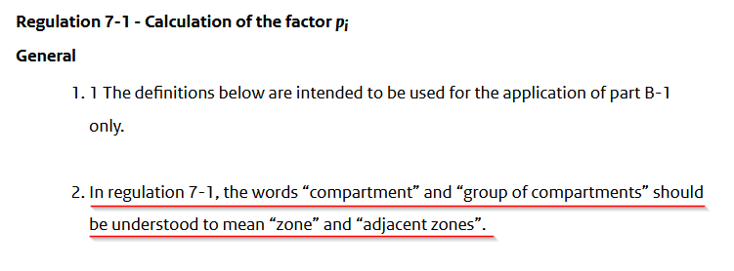
Tips & Tricks: ‘Probdam’
Calculation method probability of flooding.

Slide 133
Tips & Tricks: ‘Probdam’
Calculation method probability of flooding.
One damage per zone:
Zonal boundaries must be defined manually.

Slide 134
Tips & Tricks: ‘Probdam’
Calculation method probability of flooding.
One damage per zone:
Zonal boundaries must be defined manually.
In general, this will be a rough layout.

Slide 135
Tips & Tricks: ‘Probdam’
Calculation method probability of flooding.
One damage per (sub)compartment:
With this mechanism, PIAS uses the boundaries of compartments to automatically determine the layout of the vessel.

Slide 136
Tips & Tricks: ‘Probdam’
Calculation method probability of flooding.
One damage per (sub)compartment:
With this mechanism, PIAS uses the boundaries of compartments to automatically determine the layout of the vessel.
If one would define all the boundaries of compartments as zonal boundaries, both mechanisms will have the same result. (more or less)

Slide 137
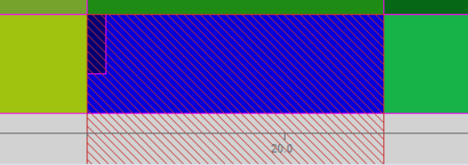
Tips & Tricks: ‘Probdam’
Calculation method probability of flooding.
Example of one damage per zone:

Slide 138
Tips & Tricks: ‘Probdam’
Calculation method probability of flooding.
Example of one damage per compartment (before optimizing damage boundaries:

Slide 139
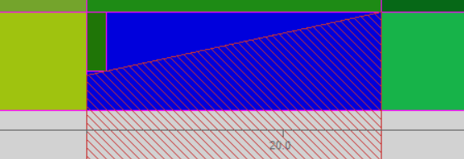
Tips & Tricks: ‘Probdam’
Calculation method probability of flooding.
Example of one damage per compartment (after optimizing damage boundaries:

Slide 140
Tips & Tricks: ‘Probdam’
Calculation method probability of flooding.
As you hopefully understand, the one damage per (sub)compartment does not differ much from the zonal method.

Slide 141
Tips & Tricks: ‘Probdam’
Calculation method probability of flooding.
As you hopefully understand, the one damage per (sub)compartment does not differ much from the zonal method.
The layout is determined automatically.

Slide 142
Tips & Tricks: ‘Probdam’
Calculation method probability of flooding.
As you hopefully understand, the one damage per (sub)compartment does not differ much from the zonal method.
The layout is determined automatically.
Higher accuracy.

Slide 143
Tips & Tricks: ‘Probdam’
Calculation method probability of flooding.
As you hopefully understand, the one damage per (sub)compartment does not differ much from the zonal method.
The layout is determined automatically.
Higher accuracy.
Thus, a higher attained index.

Slide 144
Tips & Tricks: ‘Probdam’
Calculation method probability of flooding.
As you hopefully understand, the one damage per (sub)compartment does not differ much from the zonal method.
The layout is determined automatically.
Higher accuracy.
Thus, a higher attained index.
In general, we use the one damage per compartment method

Slide 145
Tips & Tricks: ‘Probdam’
Calculation method probability of flooding.
What is your experience on accepting of the one damage per (sub)compartment method?

Slide 146
Tips & Tricks: ‘Probdam’
Calculation method probability of flooding.
For your own benefit:
Please don’t just switch to the zonal method if Class Societies don’t understand the mechanism.
With the earlier mentioned explanation, you should be able to convince them it is a valid calculation method.

Slide 147
Tips & Tricks: ‘Probdam’
Calculation method probability of flooding.

Slide 148
Tips & Tricks: ‘Probdam’
Calculation method probability of flooding.
Numerical integration method.

Slide 149
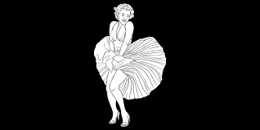
The area of a 2D figure
Suppose we are faced with the daunting task of determining the area of this Marilyn Monroe picture
Then we can choose between (at least) two methods

Slide 150
Method 1960
Simplification and arithmetic

Slide 151
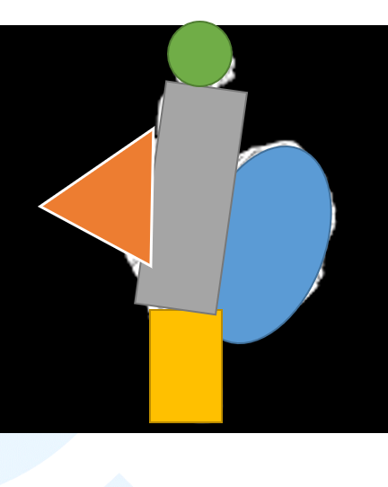
Simplification and arithmetic
Subdivide the figure in five areas (“zones”):
A circle.
A triangle.
A rectangle.
An inclined rectangle.
An ellipse.
Find a handbook with formulas of areas from these elementary shapes.

Slide 152
Simplification and arithmetic
Elaborate detailed rules on mapping these shapes on the figure, e.g.:
The inclination of the torso zone may not be more than 12.3^{O}.
The B/H ratio of the triangle should be between 0.65 and 1.70.
The ellipse and the rectangle may at maximum overlap for 4%.
Tediously write a computer code which scales and locates these shapes over the picture, still matching these mapping rules.
Determine these shape parameters, and compute areas from the equations of the 2nd step.

Slide 153
Method 2006

Slide 154
Method 2006
Count non-black pixels.
N_black_pixel = 0
For row = 1 to number_of_rows
For column = 1 to number_of_columns
If pixel[row,column] is not black then
N_black_pixel = N_black_pixel + 1
Area = N_black_pixel * Bpixel * Hpixel

Slide 155
Numerical integration
Numerical integration = repeated additions
Pros:
Easier to implement.
Faster.
More accurate.
Less arbitrary.
Less equations and prescriptions.
Cons:
?

Slide 156
Fixed damage limits
Fixed damage limits:
Aft
Forward
Penetration from WL (with inclined inner boundary).
Upper.
With one damage per compartment (or zone).
However, what about:

Slide 157
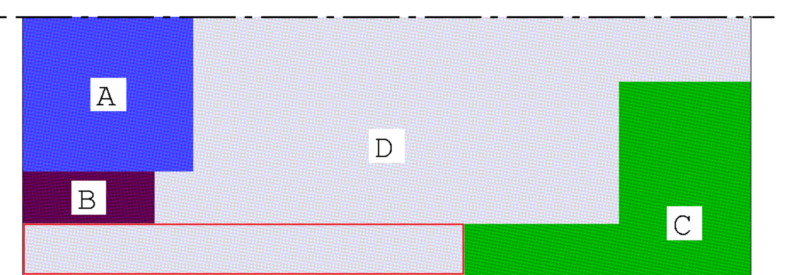
In reality
Presuming a rectangular damage shapes, compartment D can be hit by three distinct damages:
Outside B.

Slide 158
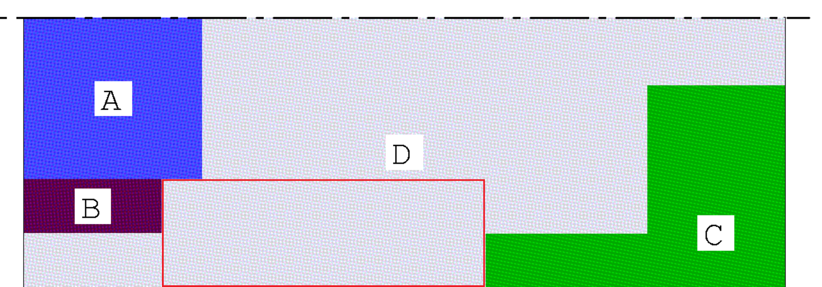
In reality
Presuming a rectangular damage shapes, compartment D can be hit by three distinct damages:
Outside A, just in front of B.

Slide 159
In reality
Presuming a rectangular damage shapes, compartment D can be hit by three distinct damages:
To CL, from the front of A to aft of C.

Slide 160
Conventionally
The conventional (SOLAS) method only allows one of these damages.
Not very realistic, and artificially reducing computed probability of survival.

Slide 161
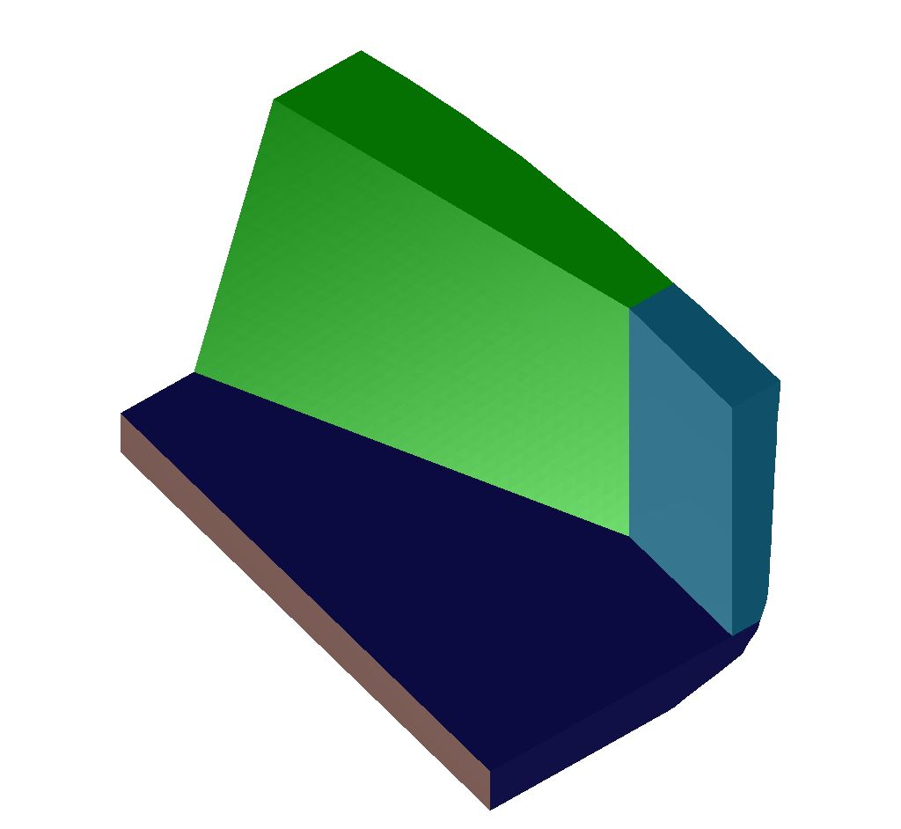
Conventionally
What is here for the green compartment:
Aft boundary
Forward
Penetration from WL?

Slide 162
Solution: numerical integration

Slide 163
Thousands of mini damages
Divide the compartment into thousands of cuboids (“voxels”, in analogy with the pixels of Marilyn Monroe).
Matches the compartment shape accurately.
No presumptions on damage shapes.
More accurate computation.
Matches IMO’s damage statistics fully.

Slide 164
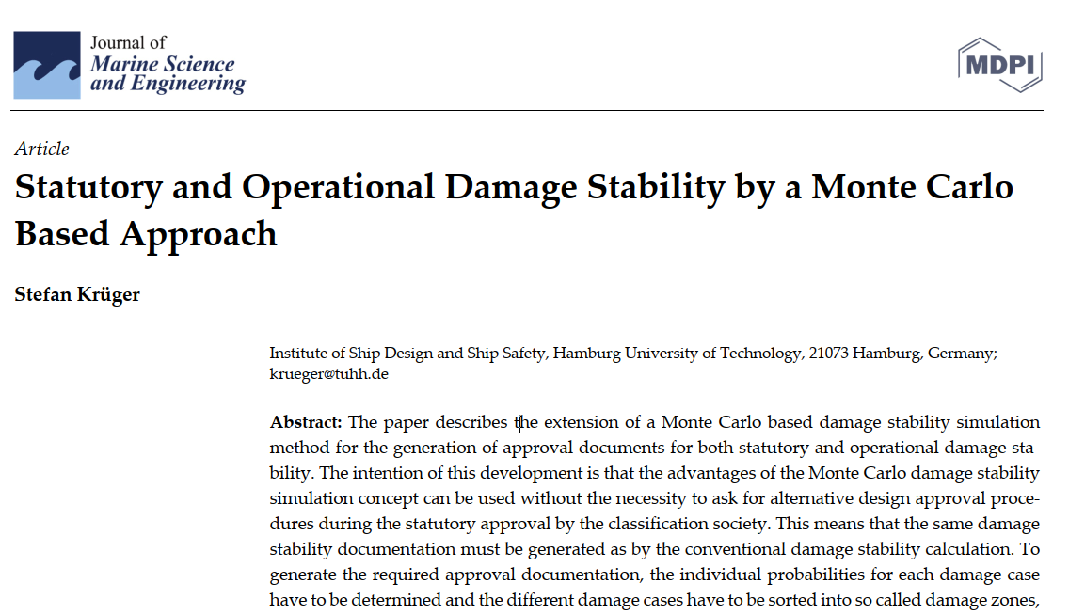
History
Conceived in 2004, presented in 2006 on two conferences.
Included in PIAS since 2005.
Elaborated in writing (SWZ, ISP, see www.sarc.nl/publications/).
Also proposed by others, notably prof. Stefan Krüger (TUHH). He baptized this method “Monte Carlo simulation”.
For a recent overview see doi.org/10.3390/jmse11010016 (2023).

Slide 165
And now?

Slide 166
Status quo
Readily available in PIAS, fully documented.
For a regular subdivision numerical integration yields the same results as conventional zonal-based computation. Which is no surprise.
For more complex (non-regular) subdivision with numerical integration the attained subdivision index (A) will be somewhat higher. Because this method is more accurate and realistic.
At SARC we use this method for quick design studies. While afterwards presenting the results to the classification society with the compartment or zonal method. Accepting reduction in A.

Slide 167
Future?
Some Classification Societies may be inclined to accept this method as alternative arrangement.
For this purpose, at SARC the development of material to show methodological and numerical equivalence has once been converted into a student graduation project. Unfortunately, this student left without finishing the job.
Still lying on the shelf, although SARC will only invest time in collaboration with one or two (potential) users.

Slide 168
The choice
Either:
Choose for predictability, comfortable discussions with the Classification Societies and a somewhat lower attained index. Then stick with the conventional approach.
Or:
Choose for innovation, higher accuracy, less hocus-pocus and a faster computation method. Then contribute to the acceptance of the numerical integration method.

Slide 169
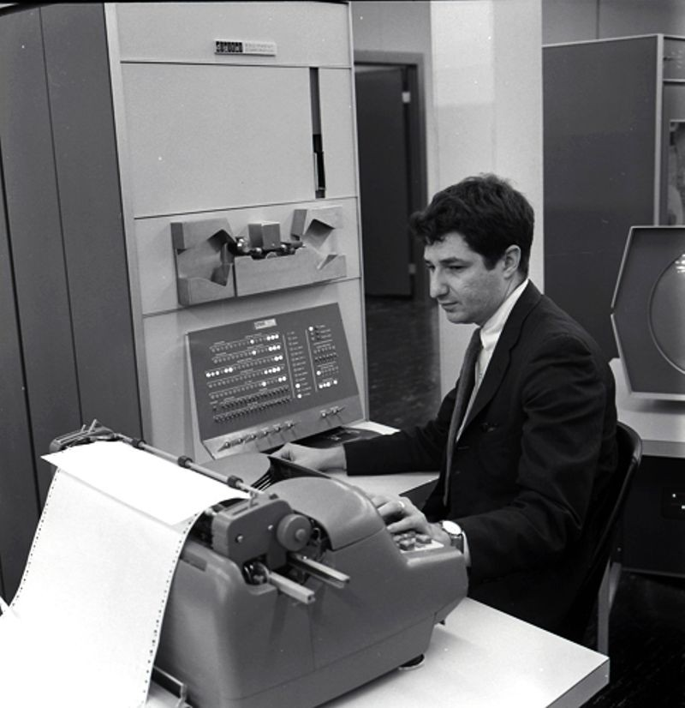
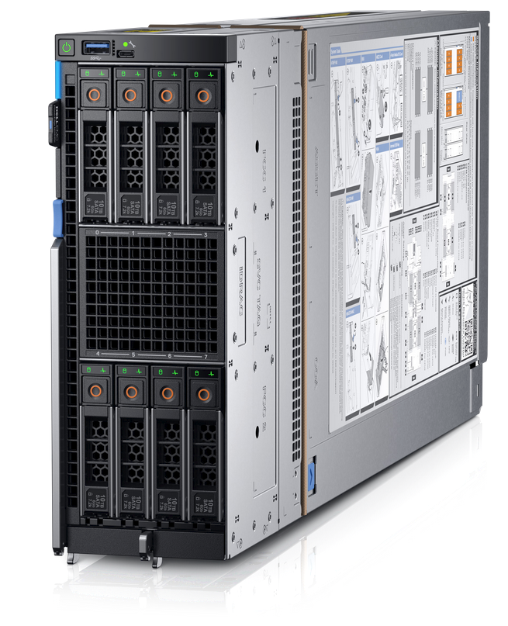
1960 or 2023?

Slide 170
Tips & Tricks: ‘Probdam’
Configurations.

Slide 171
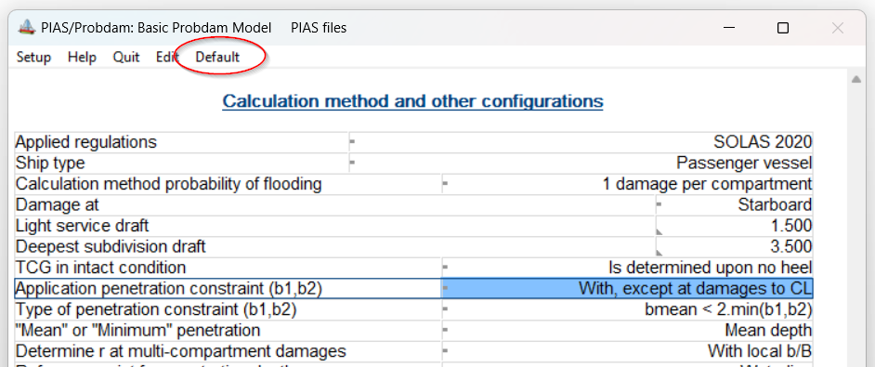
Tips & Tricks: ‘Probdam’
Configurations.
Unless you have reasons to deviate from the default settings, use the default settings which can be set with the button ‘Default’.

Slide 172
Tips & Tricks: ‘Probdam’
Setting: ‘Probability of damage never negative’. Yes, or No?

Slide 173
Tips & Tricks: ‘Probdam’
Setting: ‘Probability of damage never negative’. Yes, or No?
The formulae in the SOLAS, to calculate the probability of a damage, can lead to a negative probability. How to deal with this?

Slide 174
Tips & Tricks: ‘Probdam’
Setting: ‘Probability of damage never negative’. Yes, or No?
Options:
Set to ‘Yes’ (which simply turns every negative probability to zero).
Set to ‘No’ (which can lead to damages with a negative probability) and take no further actions.
Set to ‘No’ and remove the damage cases with non-positive probability of damage.

Slide 175
Tips & Tricks: ‘Probdam’
Setting: ‘Probability of damage never negative’. Yes, or No?
Set to ‘Yes’.

Slide 176
Tips & Tricks: ‘Probdam’
Setting: ‘Probability of damage never negative’. Yes, or No?
Set to ‘Yes’.
This simply turns every negative probability to zero.

Slide 177
Tips & Tricks: ‘Probdam’
Setting: ‘Probability of damage never negative’. Yes, or No?
Set to ‘Yes’.
This simply turns every negative probability to zero.
Questionable weather this mechanism is in line with the SOLAS (Though negative probabilities should not be possible).

Slide 178
Tips & Tricks: ‘Probdam’
Setting: ‘Probability of damage never negative’. Yes, or No?
Set to ‘Yes’.
This simply turns every negative probability to zero.
Questionable weather this mechanism is in line with the SOLAS (Though negative probabilities should not be possible).
Only one calculation needed.

Slide 179
Tips & Tricks: ‘Probdam’
Setting: ‘Probability of damage never negative’. Yes, or No?
Set to ‘Yes’.
This simply turns every negative probability to zero.
Questionable weather this mechanism is in line with the SOLAS (Though negative probabilities should not be possible).
Only one calculation needed.
Higher attained index compared to calculations whith damage cases with non-positive probability of damage.

Slide 180
Tips & Tricks: ‘Probdam’
Setting: ‘Probability of damage never negative’. Yes, or No?
Set to ‘No’ and take no further action.

Slide 181
Tips & Tricks: ‘Probdam’
Setting: ‘Probability of damage never negative’. Yes, or No?
Set to ‘No’ and take no further action.
Damage cases with non-positive probability of damage can (and likely will) occur.

Slide 182
Tips & Tricks: ‘Probdam’
Setting: ‘Probability of damage never negative’. Yes, or No?
Set to ‘No’ and take no further action.
Damage cases with non-positive probability of damage can (and likely will) occur.
According formulae of SOLAS.

Slide 183
Tips & Tricks: ‘Probdam’
Setting: ‘Probability of damage never negative’. Yes, or No?
Set to ‘No’ and take no further action.
Damage cases with non-positive probability of damage can (and likely will) occur.
According formulae of SOLAS.
Only one calculation needed

Slide 184
Tips & Tricks: ‘Probdam’
Setting: ‘Probability of damage never negative’. Yes, or No?
Set to ‘No’ and take no further action.
Damage cases with non-positive probability of damage can (and likely will) occur.
According formulae of SOLAS.
Only one calculation needed
Lower attained index

Slide 185
Tips & Tricks: ‘Probdam’
Setting: ‘Probability of damage never negative’. Yes, or No?
Set to ‘No’, execute the calculation and remove damage cases with a non-positive probability of damage.

Slide 186
Tips & Tricks: ‘Probdam’
Setting: ‘Probability of damage never negative’. Yes, or No?
Set to ‘No’, execute the calculation and remove damage cases with a non-positive probability of damage.
Since one is free to calculate any damage that he/she wants, one may remove the damage cases with a non-positive probability of damage.
Because the probability of damages, also depends on the probability of other damage cases, a re-calculation is necessary.

Slide 187
Tips & Tricks: ‘Probdam’
Setting: ‘Probability of damage never negative’. Yes, or No?
Damage cases with non-positive probability are deleted.
Tip: Use ‘Remove all damage cases with a non-positive probability of damage’.

Slide 188
Tips & Tricks: ‘Probdam’
Setting: ‘Probability of damage never negative’. Yes, or No?
Damage cases with non-positive probability are deleted.
Tip: Use ‘Remove all damage cases with a non-positive probability of damage’.
(Several) re-calculations are necessary to obtain the maximum result.
Tip: Use ‘Re-use unmodified results of former calculations’ for faster re-calculations.

Slide 189
Tips & Tricks: ‘Probdam’
Setting: ‘Probability of damage never negative’. Yes, or No?
Damage cases with non-positive probability are deleted.
Tip: Use ‘Remove all damage cases with a non-positive probability of damage’.
(Several) re-calculations are necessary to obtain the maximum result.
Tip: Use ‘Re-use unmodified results of former calculations’ for faster re-calculations.
According regulations of SOLAS.

Slide 190
Tips & Tricks: ‘Probdam’
Setting: ‘Probability of damage never negative’. Yes, or No?
Damage cases with non-positive probability are deleted.
Tip: Use ‘Remove all damage cases with a non-positive probability of damage’.
(Several) re-calculations are necessary to obtain the maximum result.
Tip: Use ‘Re-use unmodified results of former calculations’ for faster re-calculations.
According regulations of SOLAS.
Higher attained index

Slide 191
Tips & Tricks: ‘Probdam’
Maximum damage length and number of damaged compartments.

Slide 192
Tips & Tricks: ‘Probdam’
Maximum damage length and number of damaged compartments.
Don’t start with exceptional long damage length or high number of damaged compartments.

Slide 193
Tips & Tricks: ‘Probdam’
Maximum damage length and number of damaged compartments.
You can always create additional damage cases later if it turns out that the most-compartment damage cases still contribute to ‘A’.

Slide 194
Tips & Tricks: ‘Probdam’
Drafts, trims and G’M values.

Slide 195
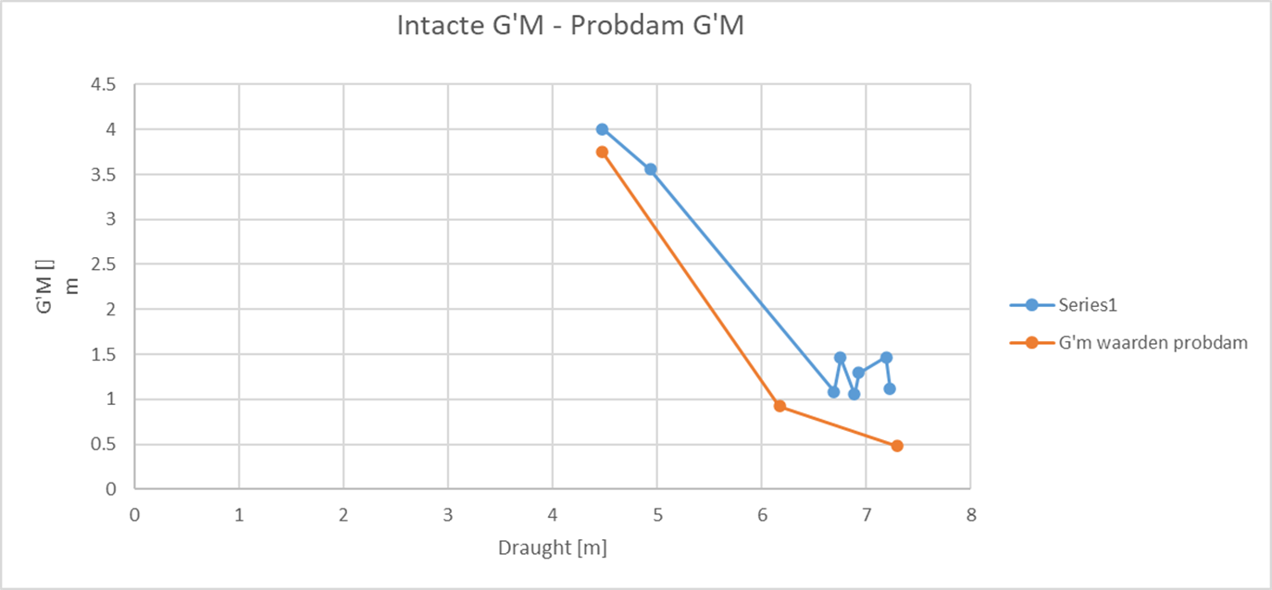
Tips & Tricks: ‘Probdam’
Drafts, trims and G’M values.
Determine useful G’M values.

Slide 196
Tips & Tricks: ‘Probdam’
Drafts, trims and G’M values.
Trim in PIAS is the difference between draft fore and aft between perpendiculars (Lpp). Trim as used in SOLAS is between fore and aft station (Ls).

Slide 197
Tips & Tricks: ‘Probdam’
Drafts, trims and G’M values.
Use function: Determine G’M value so Attained index ‘A’ is equal to the required index ‘R’.

Slide 198
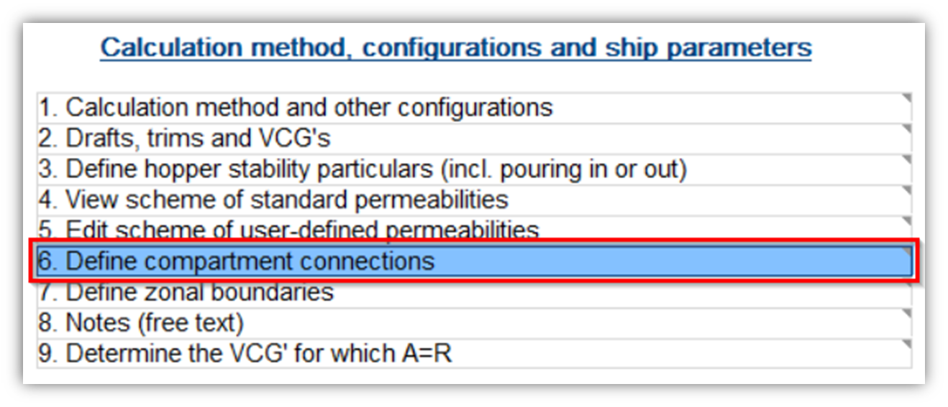
Tips & Tricks: ‘Probdam’
Compartment connections.

Slide 199
Tips & Tricks: ‘Probdam’
Compartment connections.
In PIAS there are three types of compartment connections:
‘Open’.
‘Pipe’ & ‘A-class bulkhead’
The latter only differ in name.

Slide 200
Tips & Tricks: ‘Probdam’
Compartment connections.
‘Open’ connection.
As if there is no resistance in the connection. Progressive flooding is considered to be instantaneous.

Slide 201
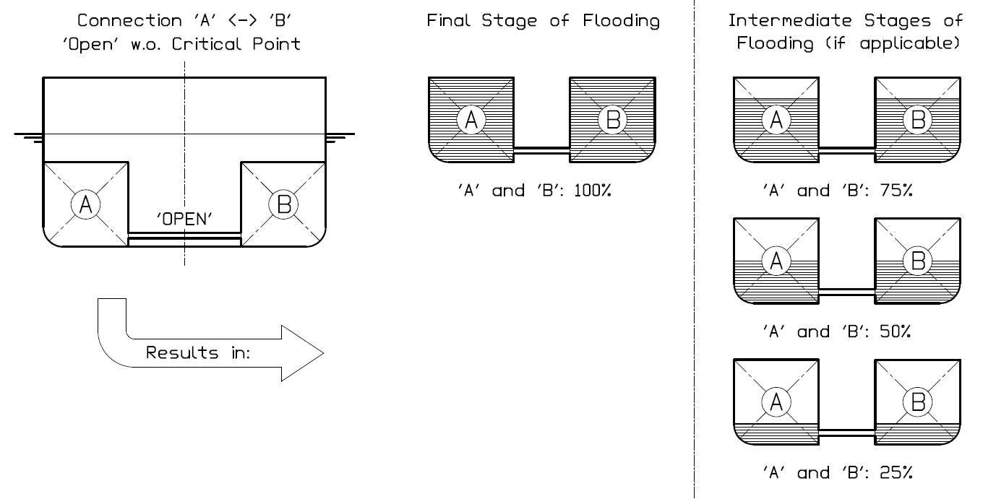
Tips & Tricks: ‘Probdam’

Slide 202
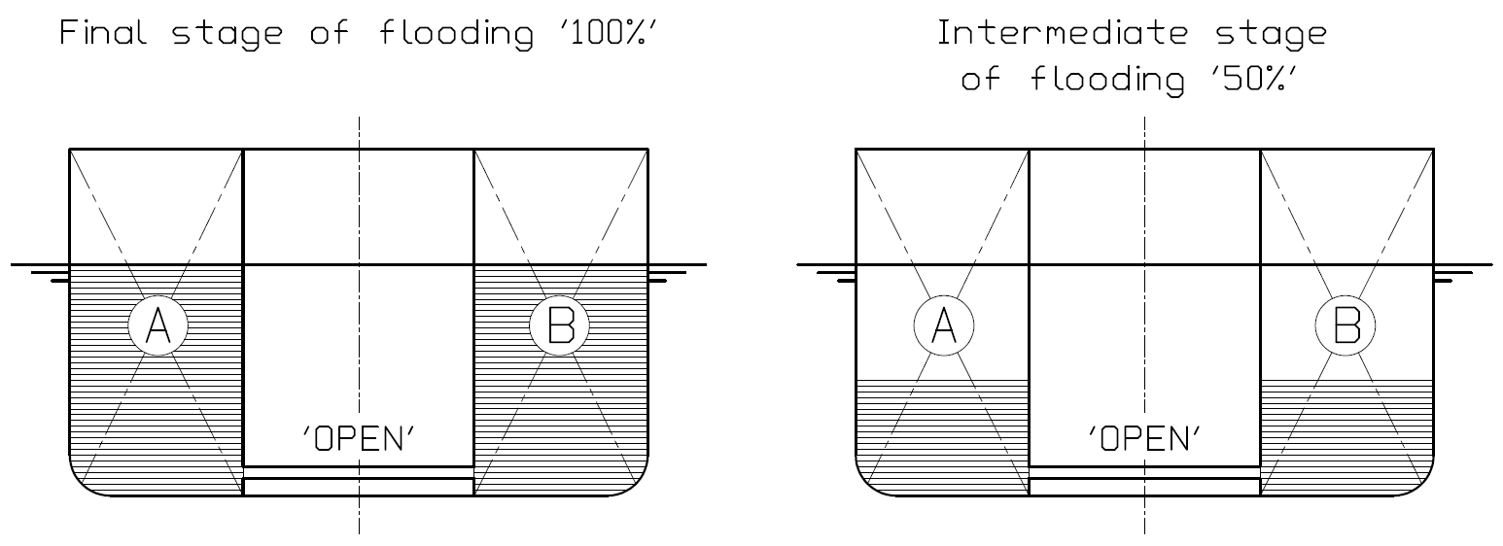
Tips & Tricks: ‘Probdam’
Final ‘100%’ and intermediate stages of flooding.

Slide 203
Tips & Tricks: ‘Probdam’
Compartment connections.
‘Pipe’ and ‘A-class bulkhead’ connection.
Progressive flooding is considered to may take considerable time.
Therefore, an extra intermediate stage of flooding besides the final stage is generated.
Since the minimum value of si for each stage has to be taken, a ‘pipe’ connection is always the ‘worst case scenario’.

Slide 204
Tips & Tricks: ‘Probdam’

Slide 205
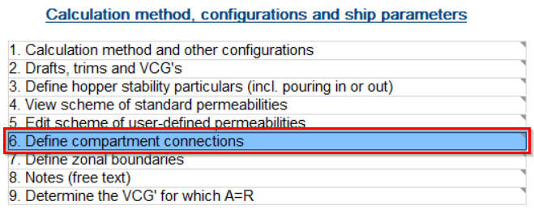
Tips & Tricks: ‘Probdam’
Compartment connections.
How do you set up a compartment connection?

Slide 206
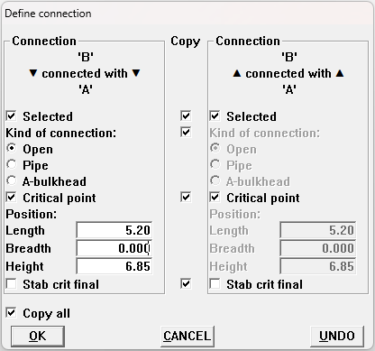
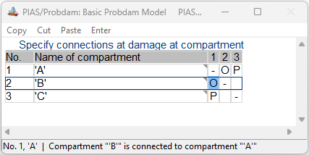
Tips & Tricks: ‘Probdam’
Compartment connections.
Notes:
Open / Pipe
One way or two way connection (copy)
Critical point
Stab crit final

Slide 207
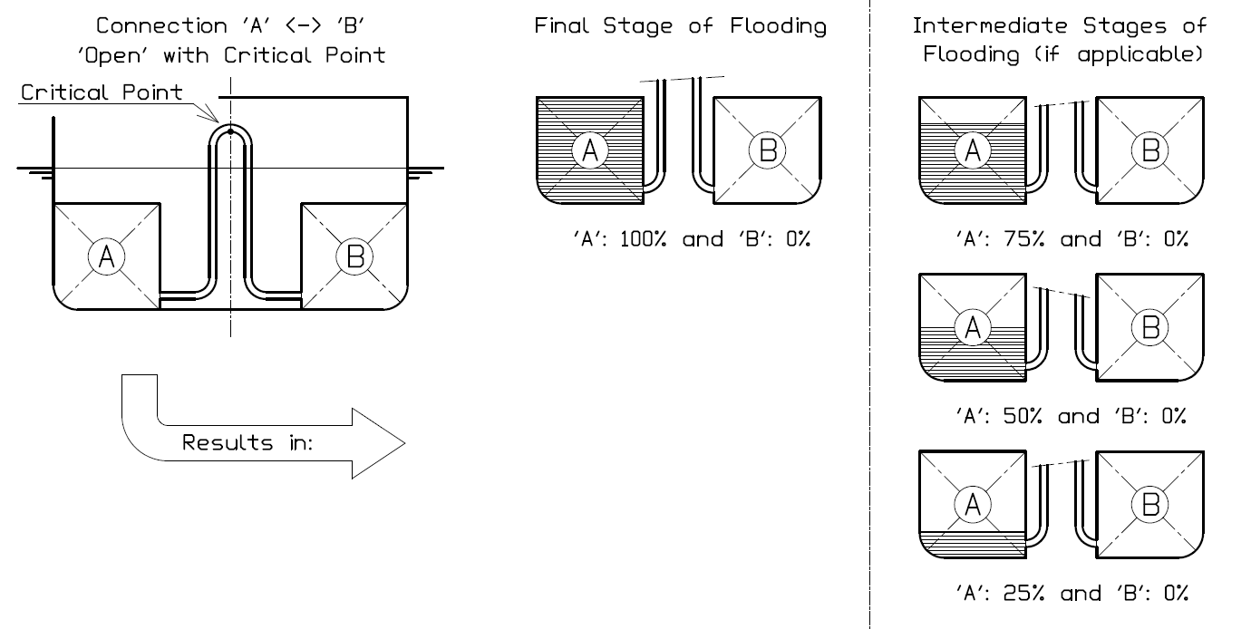
Tips & Tricks: ‘Probdam’

Slide 208
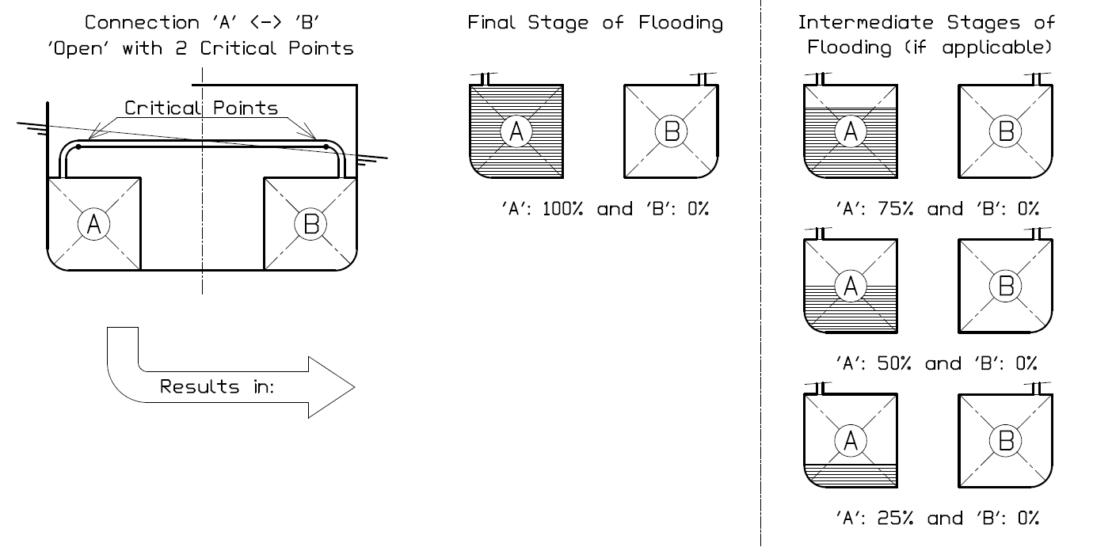
Tips & Tricks: ‘Probdam’

Slide 209
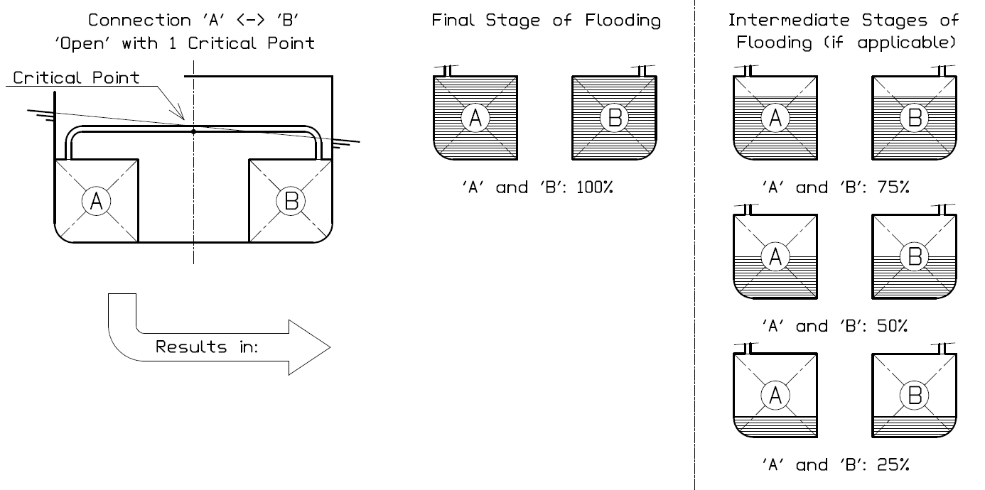
Tips & Tricks: ‘Probdam’

Slide 210
Tips & Tricks: ‘Probdam’
Compartment connections.
Multiple compartment connections.

Slide 211
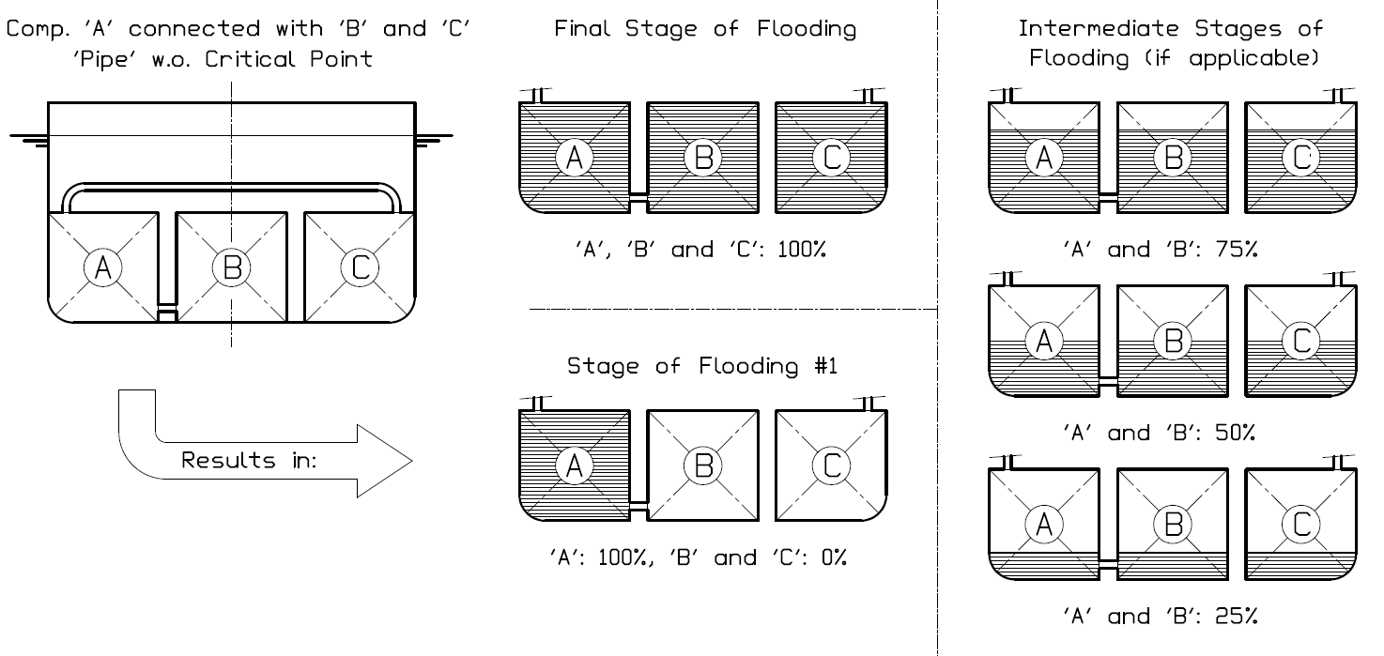
Tips & Tricks: ‘Probdam’

Slide 212
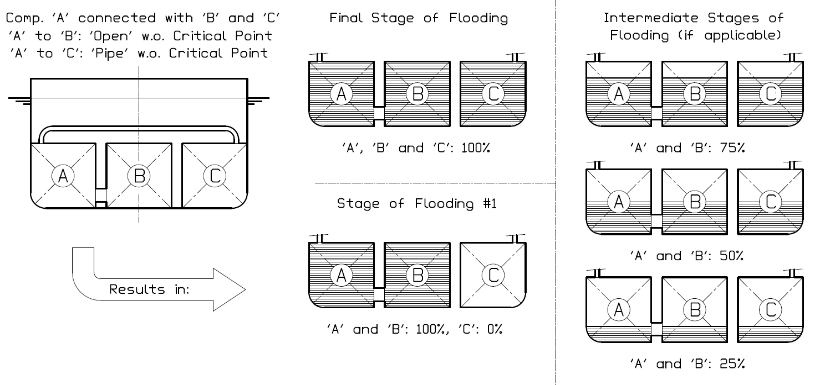
Tips & Tricks: ‘Probdam’

Slide 213
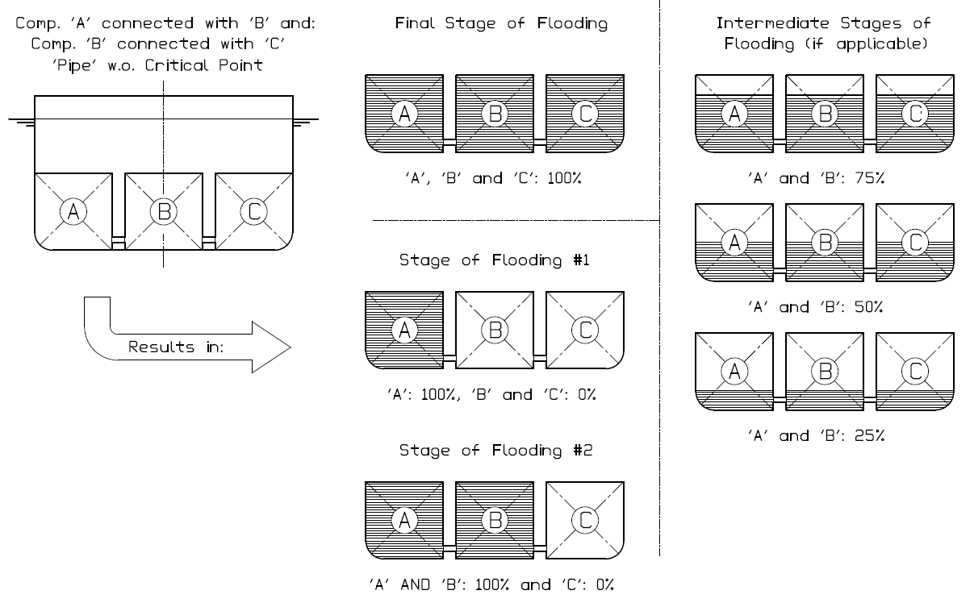
Tips & Tricks: ‘Probdam’

Slide 214
Tips & Tricks: ‘Probdam’
New damage case menu.

Slide 215
Tips & Tricks: ‘Probdam’
New damage case menu.
Here you can select damage cases for which higher subdamages have to be generated.
Here you can select damage cases to be used in ‘Loading’ or ‘Hydrotables’.

Slide 216
Tips & Tricks: ‘Probdam’
End of the topic: Tips & Tricks.
Before we continue with the ‘general’ Q&A section…

Slide 217
Tips & Tricks: ‘Probdam’
End of the topic: Tips & Tricks.
Before we continue with the ‘general’ Q&A section…
Questions regarding the Tips and Tricks?

Slide 218
Q & A.

Slide 219
I would like to thank you for your attention. SARC user day 2023
Workshop Probabilistic Damage Stability with PIAS
Douwe Plukkel

