Slide 1
PIAS tips & tricks
Justin Phaff

Slide 2
Program of this presentation
Useful tips & tricks for daily use of PIAS
Specific tips & tricks for dedicated applications

Slide 3
Layout – Scripts
Computation script
  Settings for calculation of tank data
Output script
  Settings to which data will be shown

Slide 4
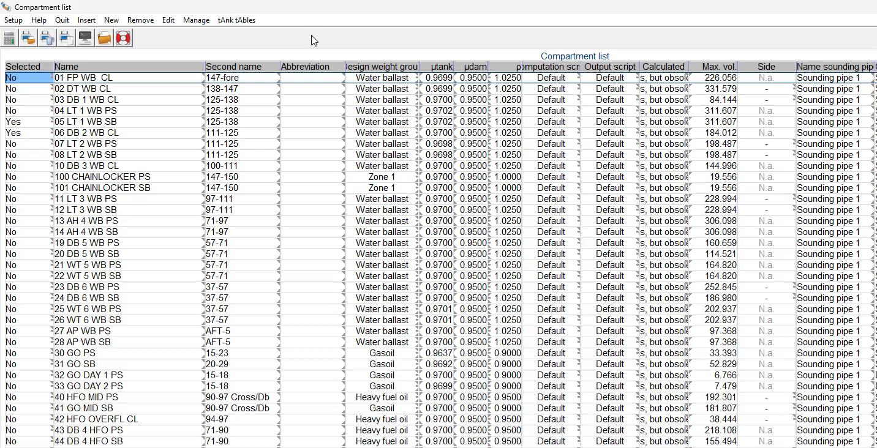
Layout – Scripts

Slide 5
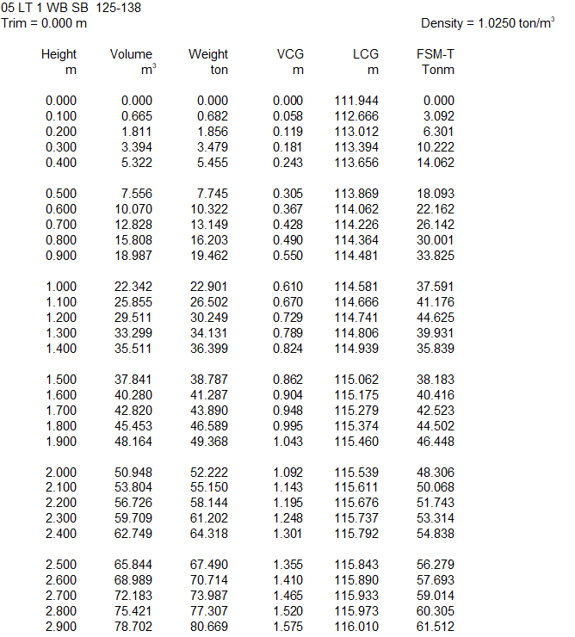
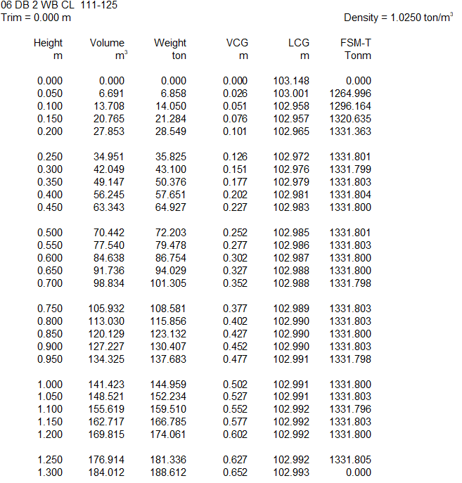
Layout – Scripts
Standard computation script
User-defined computation script

Slide 6
Layout – Watertight layout
Watertight layout:
  contains compartments that are valid for damage stability calculations.
  compartments can be excluded from watertight layout.

Slide 7
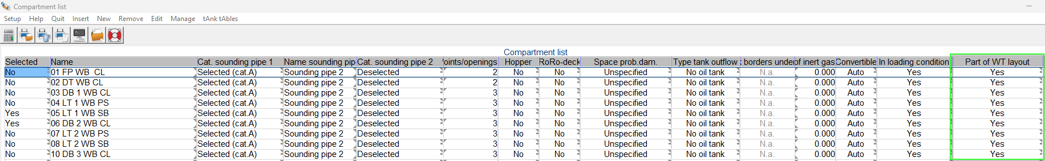
Layout – Watertight layout

Slide 8
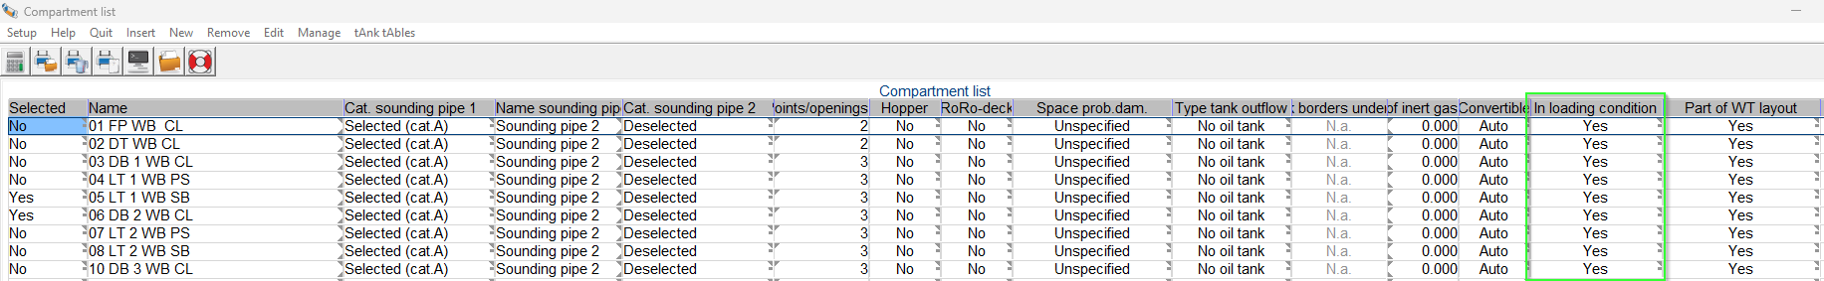
Layout – Including compartments in loading conditions

Slide 9
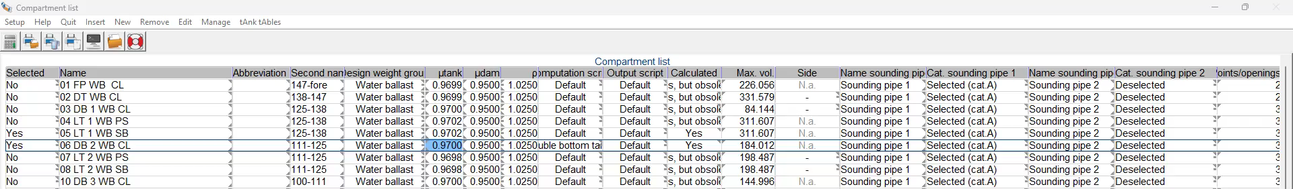
Layout – Shifting columns

Slide 10
Useful tip for daily use of PIAS
Selection of several cells by:
  dragging mouse
  shift & mouse
  using ctrl & mouse

Slide 11
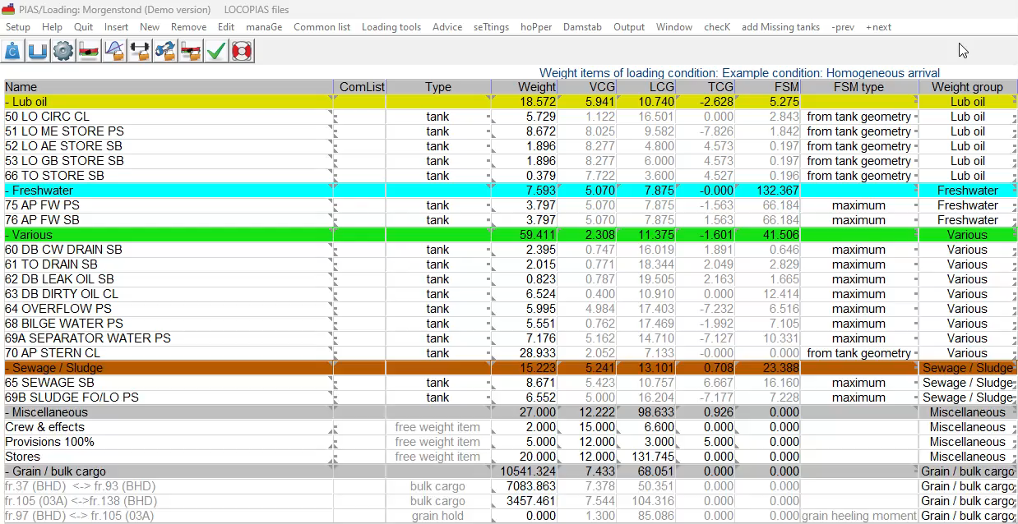
Useful tip for daily use of PIAS

Slide 12
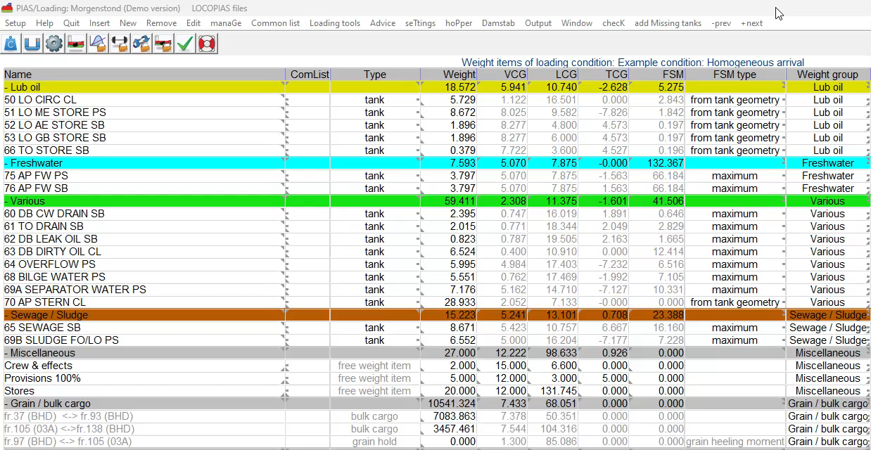
Useful tip for daily use of PIAS

Slide 13
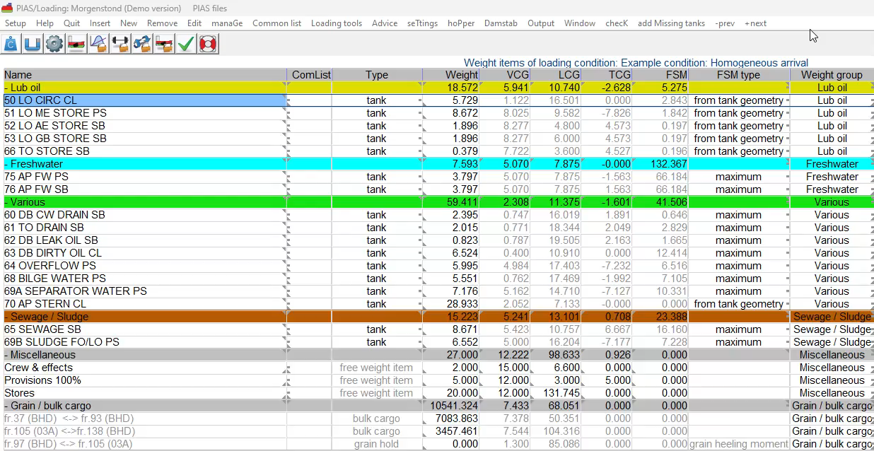
Useful tip for daily use of PIAS

Slide 14
Connection Layout & Loading
How does it work?
  Changes affecting volume and CoG are directly read-in
  Settings independently per loading condition

Slide 15
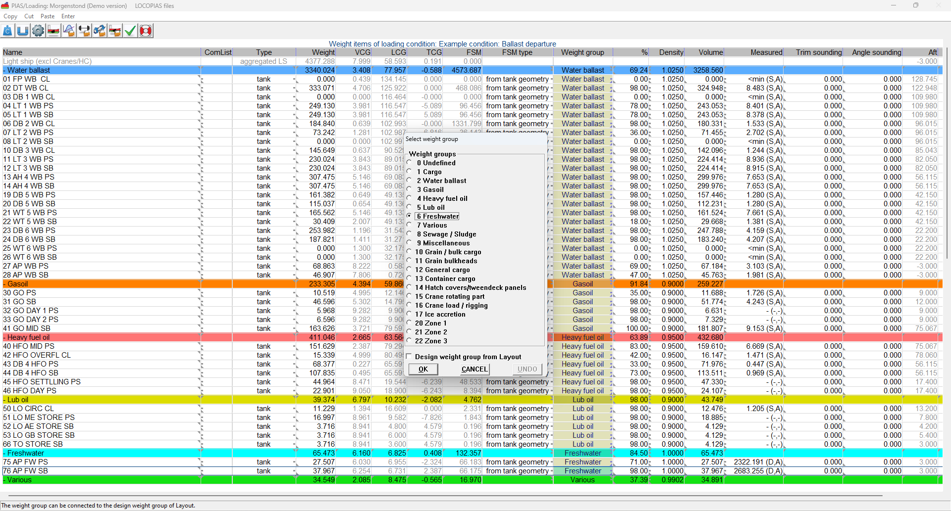
Connection Layout & Loading

Slide 16
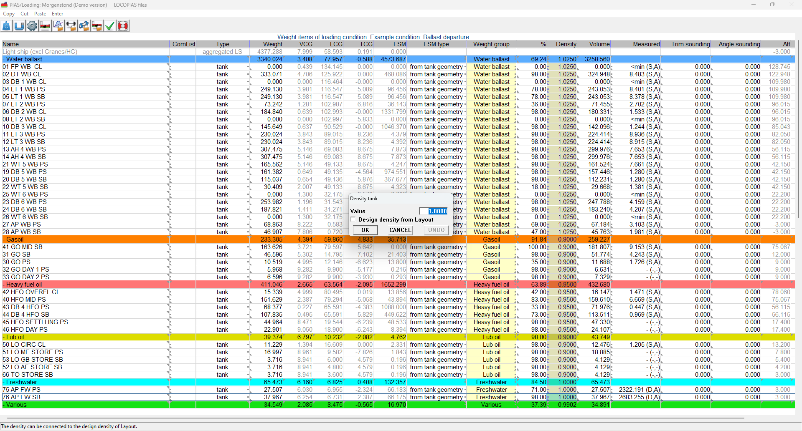
Connection Layout & Loading

Slide 17
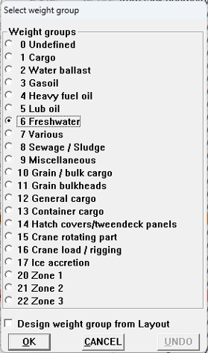
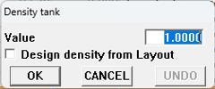
Connecting density tank fillings

Slide 18
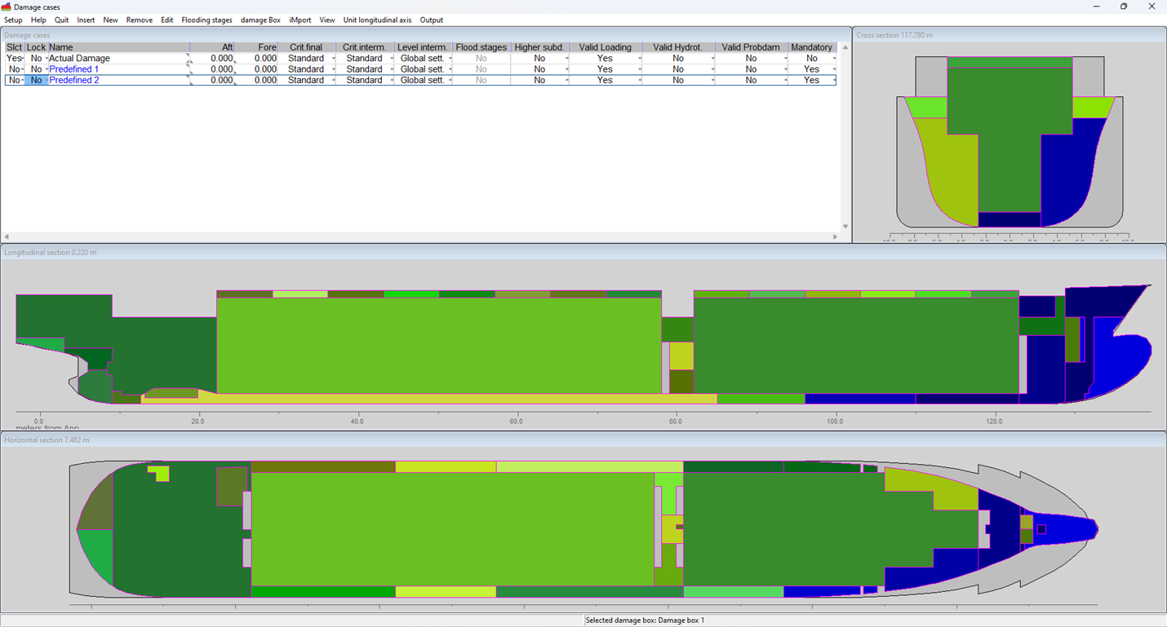
Loading - Damage cases

Slide 19
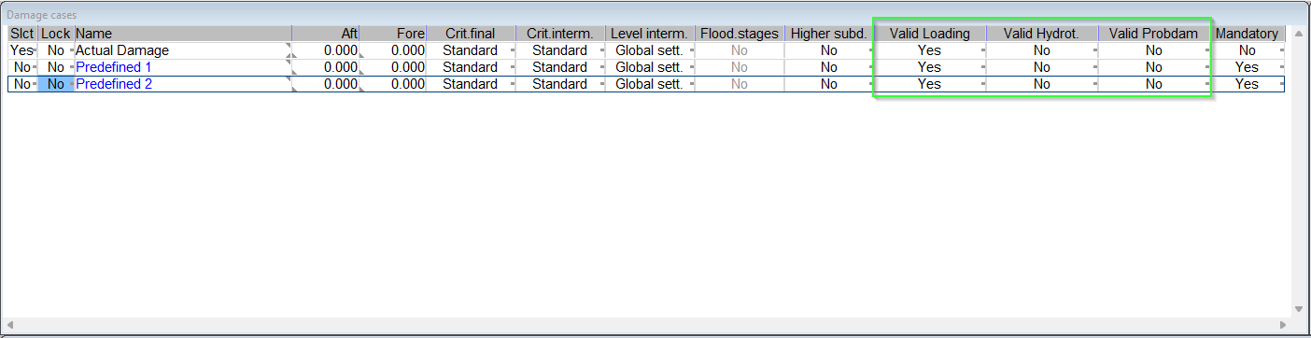
Loading – Damage cases

Slide 20
Output formats
Output can be generated as:
  richtext
  text
  tabbedtext
  image
What does this mean?

Slide 21
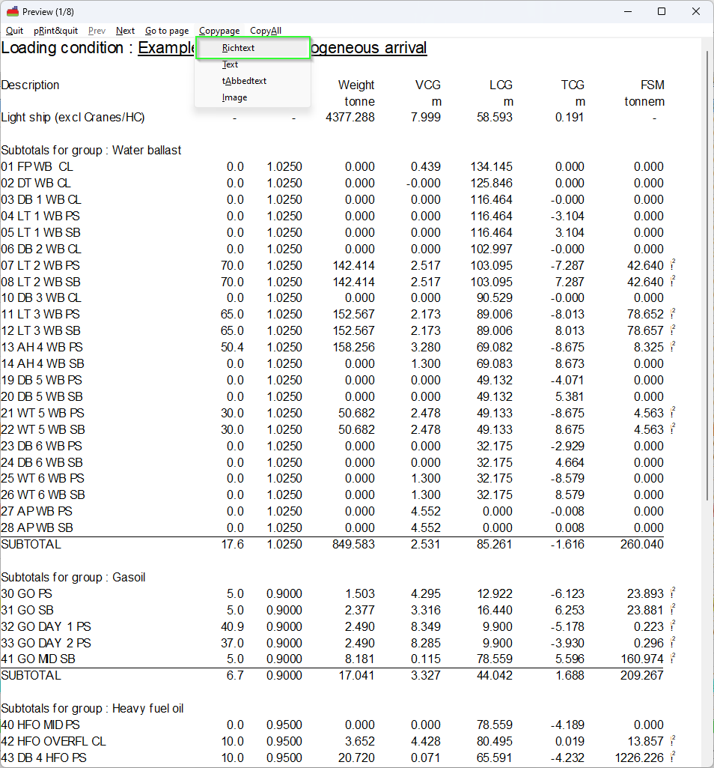
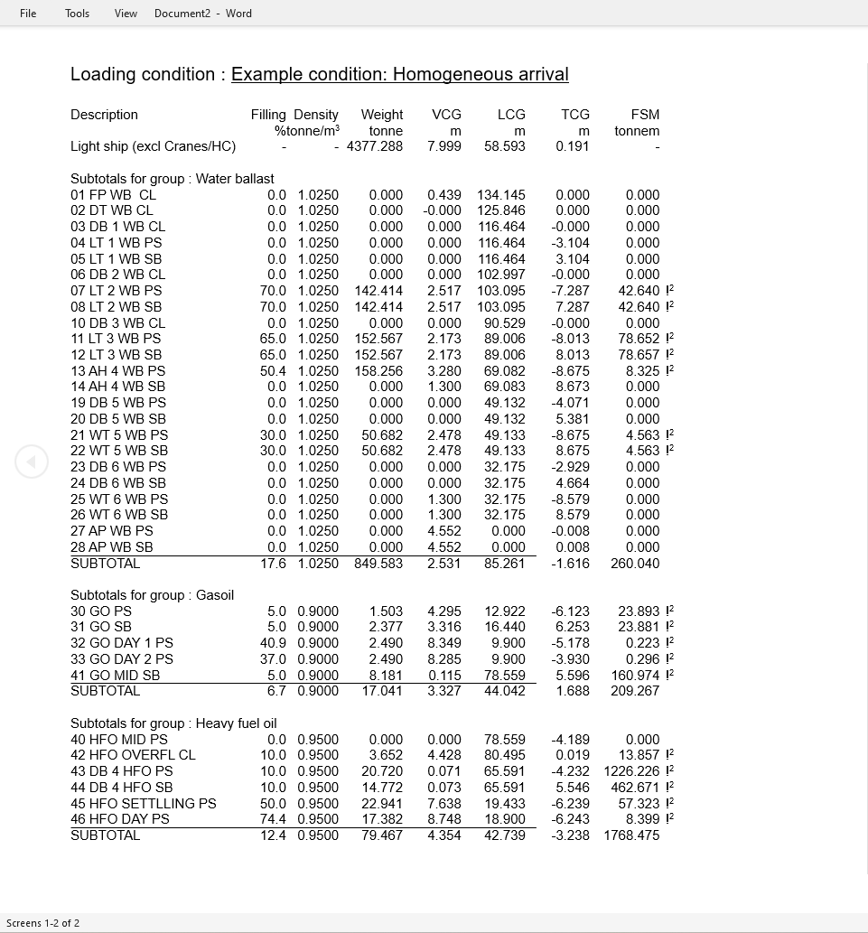
Output as rich text

Slide 22
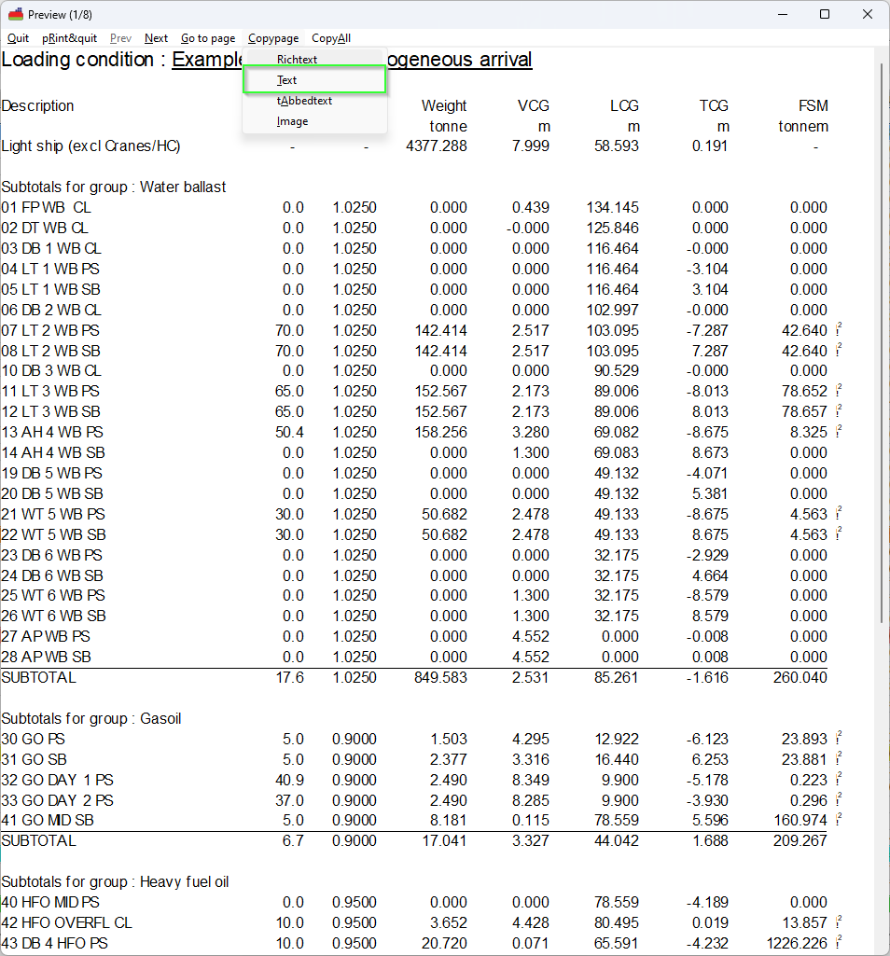
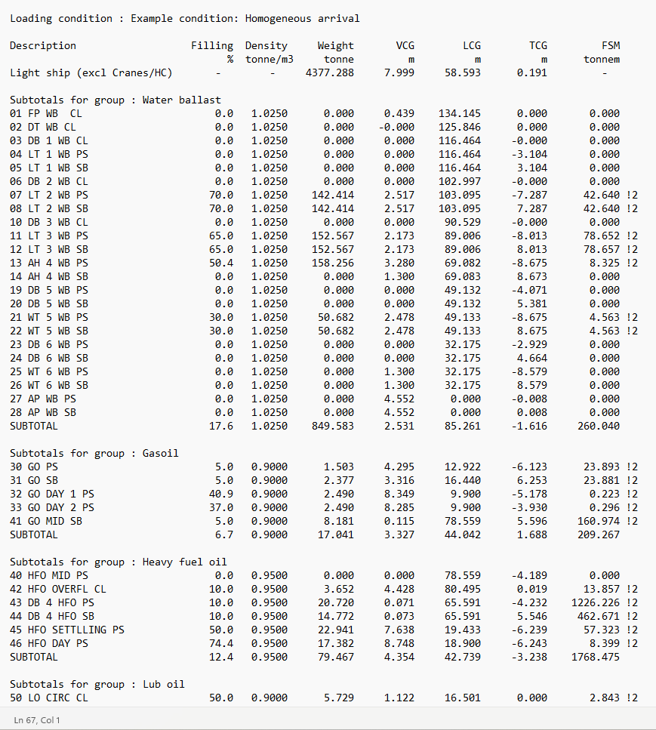
Output as plane text

Slide 23
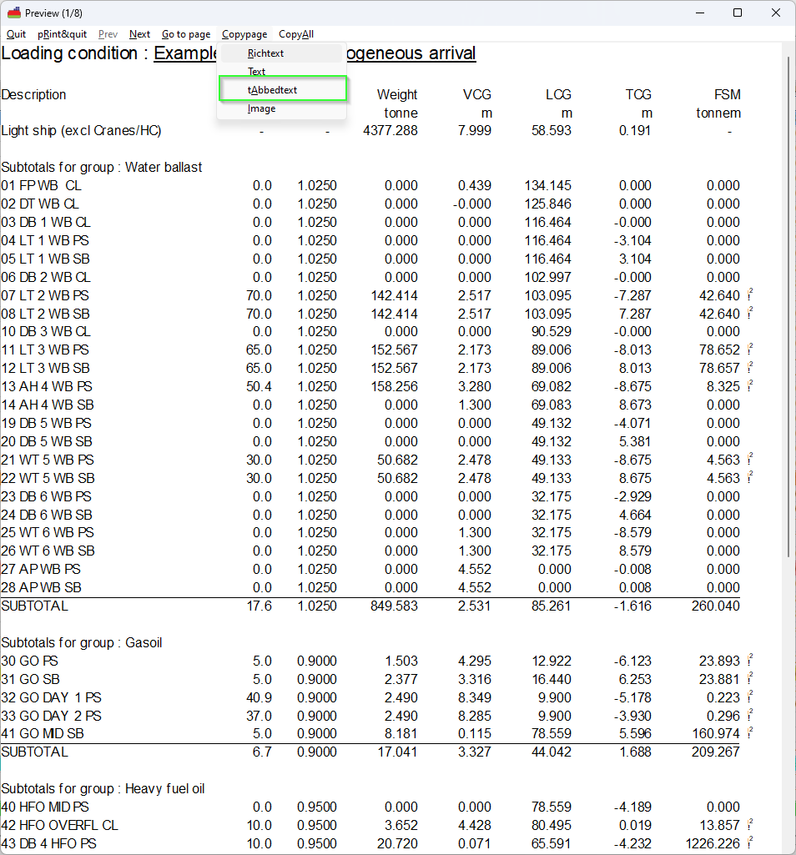
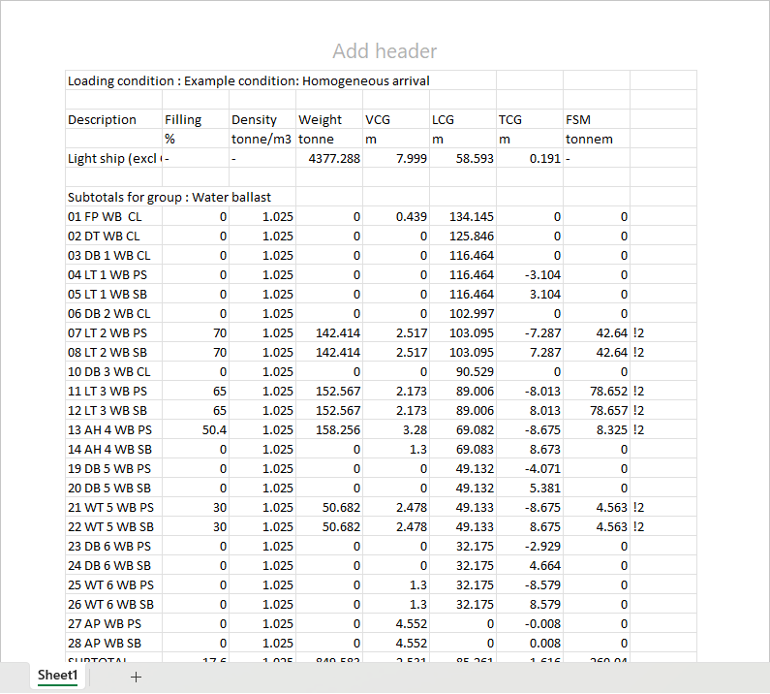
Output as tabbed text

Slide 24
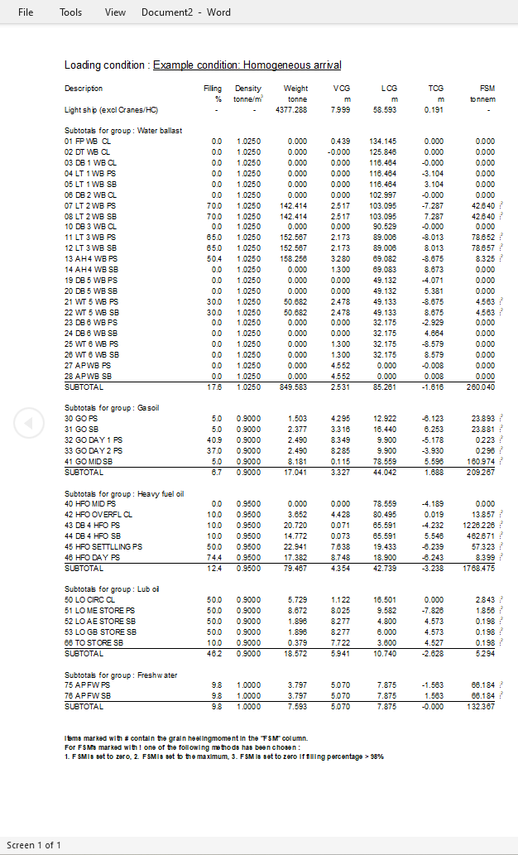

Output as image

Slide 25
Wind moments
Contour can be built up from several sub contours
  Resistance coefficient can be defined individually (box framed constructions)
Wind pressure can be defined per zone
  Wind pressure can differ per zone, defined in height from base

Slide 26
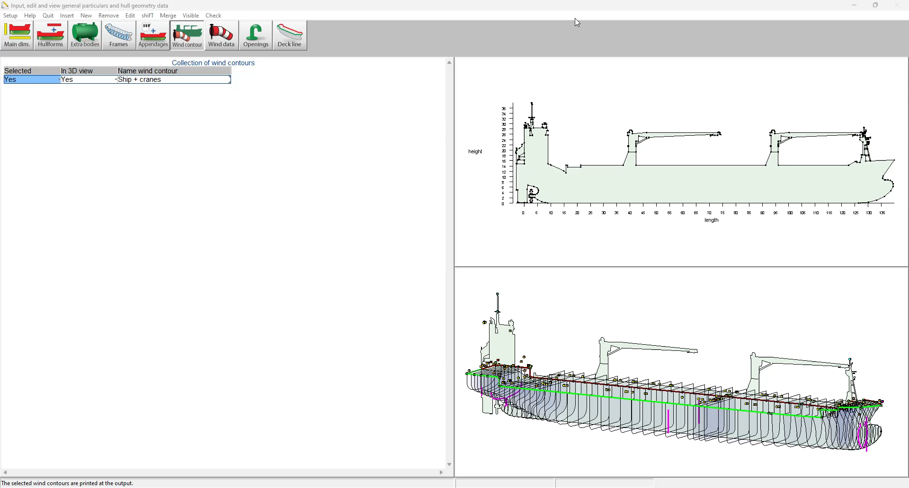
Wind moment – Sub contours

Slide 27
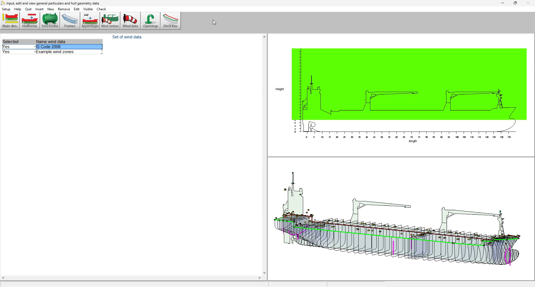
Wind pressures per zone

Slide 28
CodeMeter – License Access Permissions
Per default license coupled to others go to the earliest applicant user
This can be changed as follows:

Slide 29
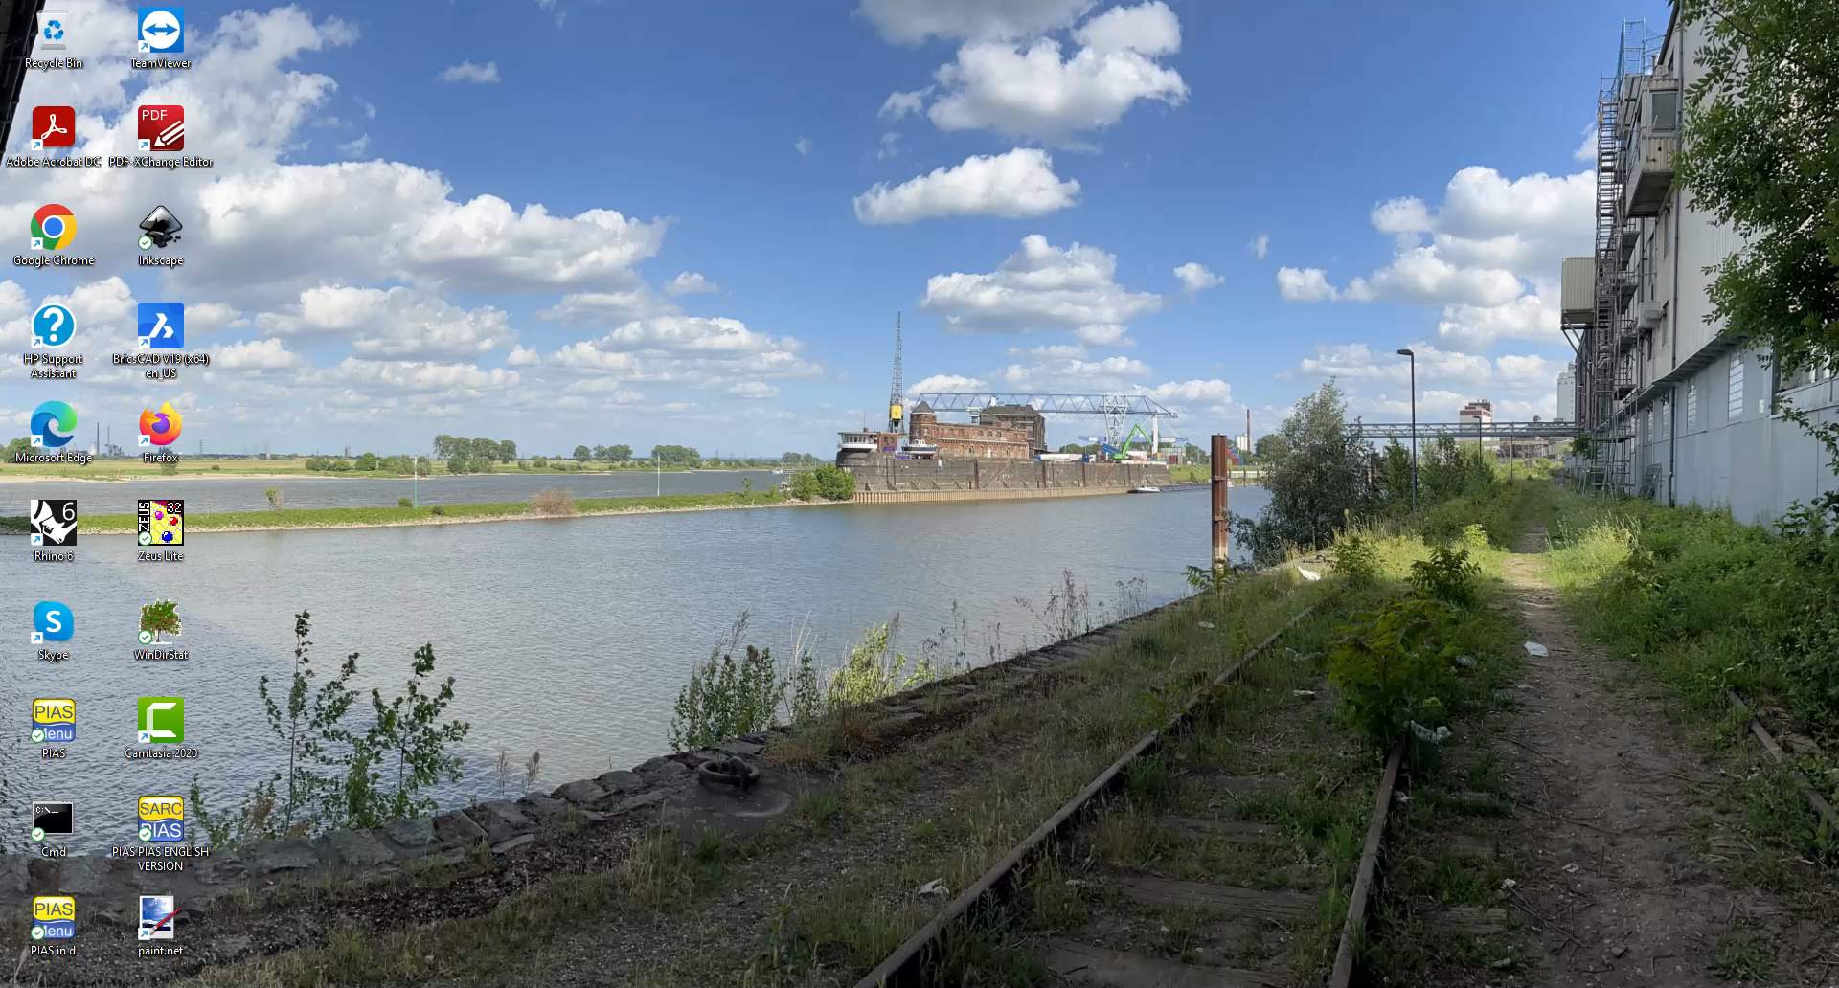
CodeMeter – License Access Permissions

Slide 30
That’s all folks!
Question?

