Slide 1
SARC user day 2023
LOCOPIAS
Abraham de Ronde

Slide 2
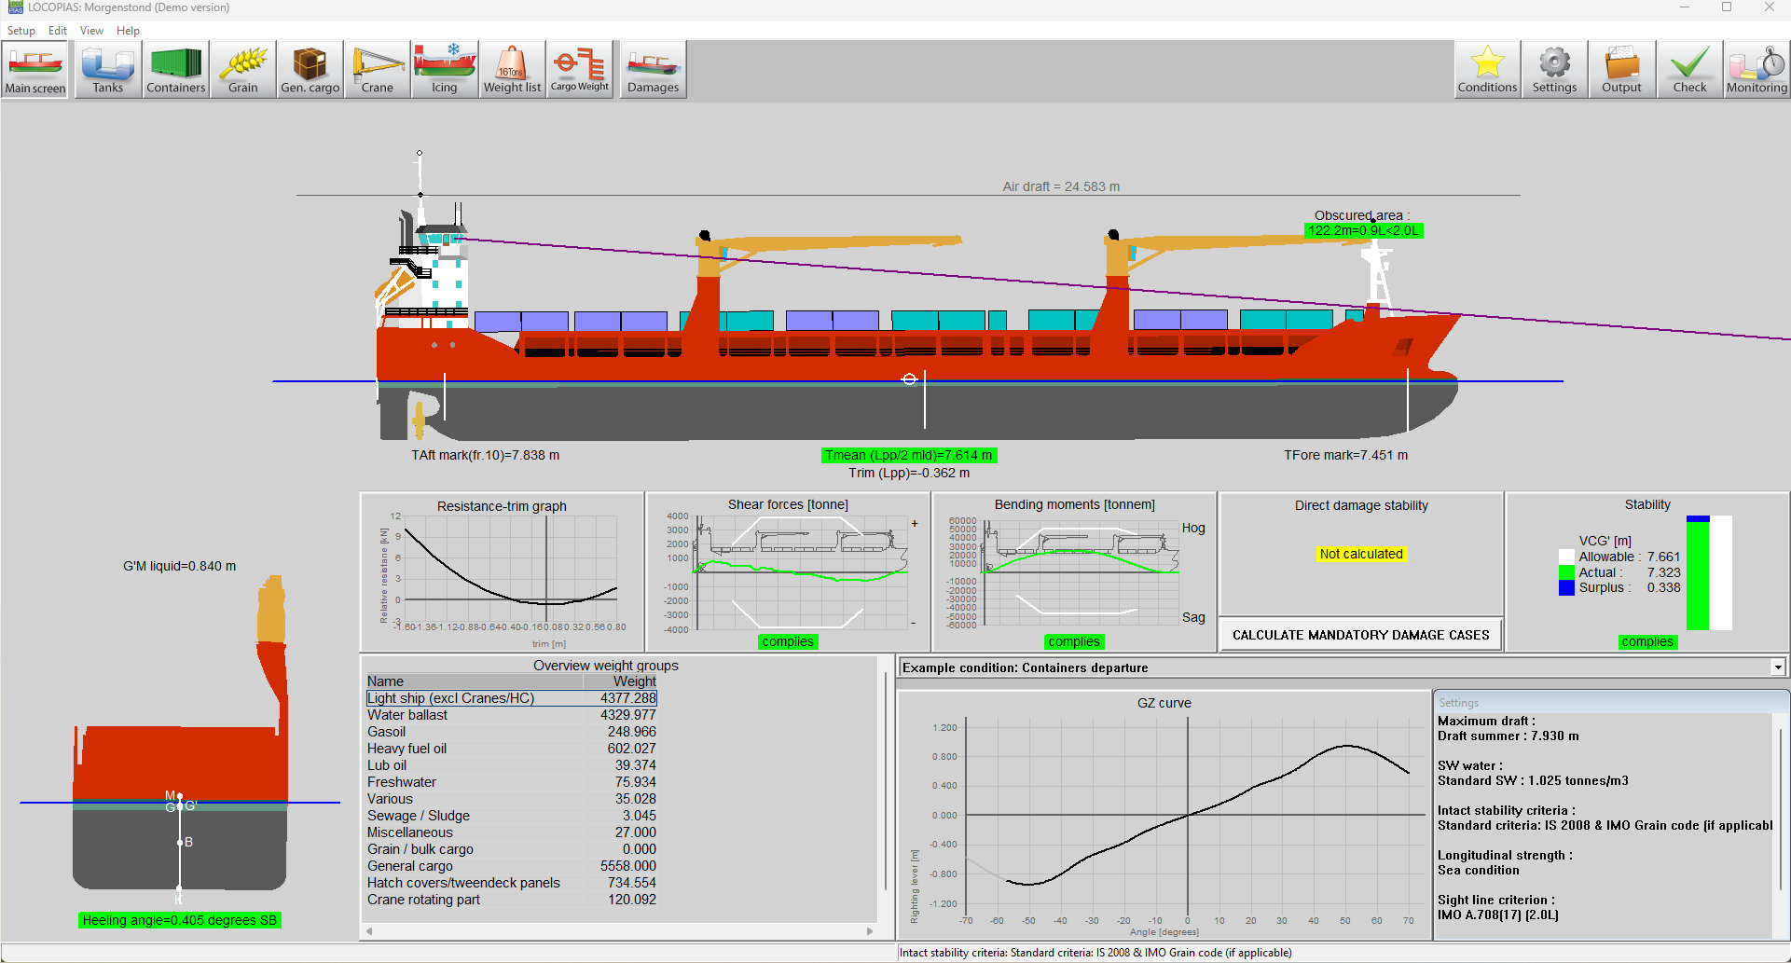
Morgenstond Demo LOCOPIAS

Slide 3
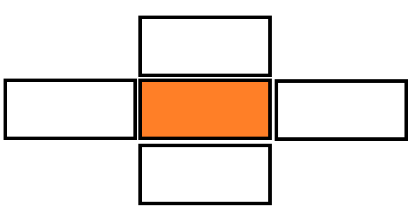
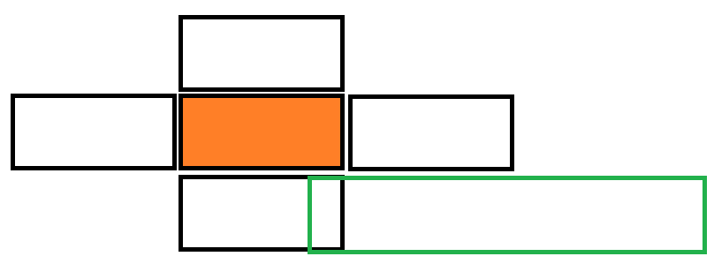
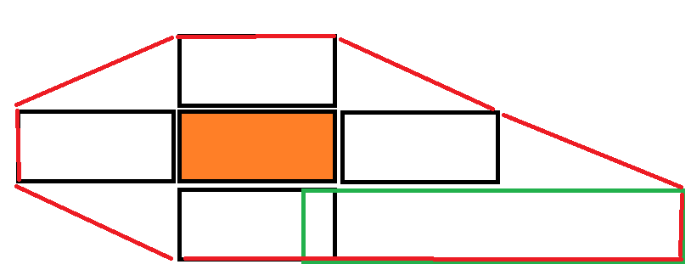
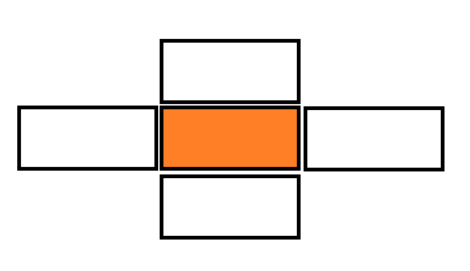
IMDG

Slide 4
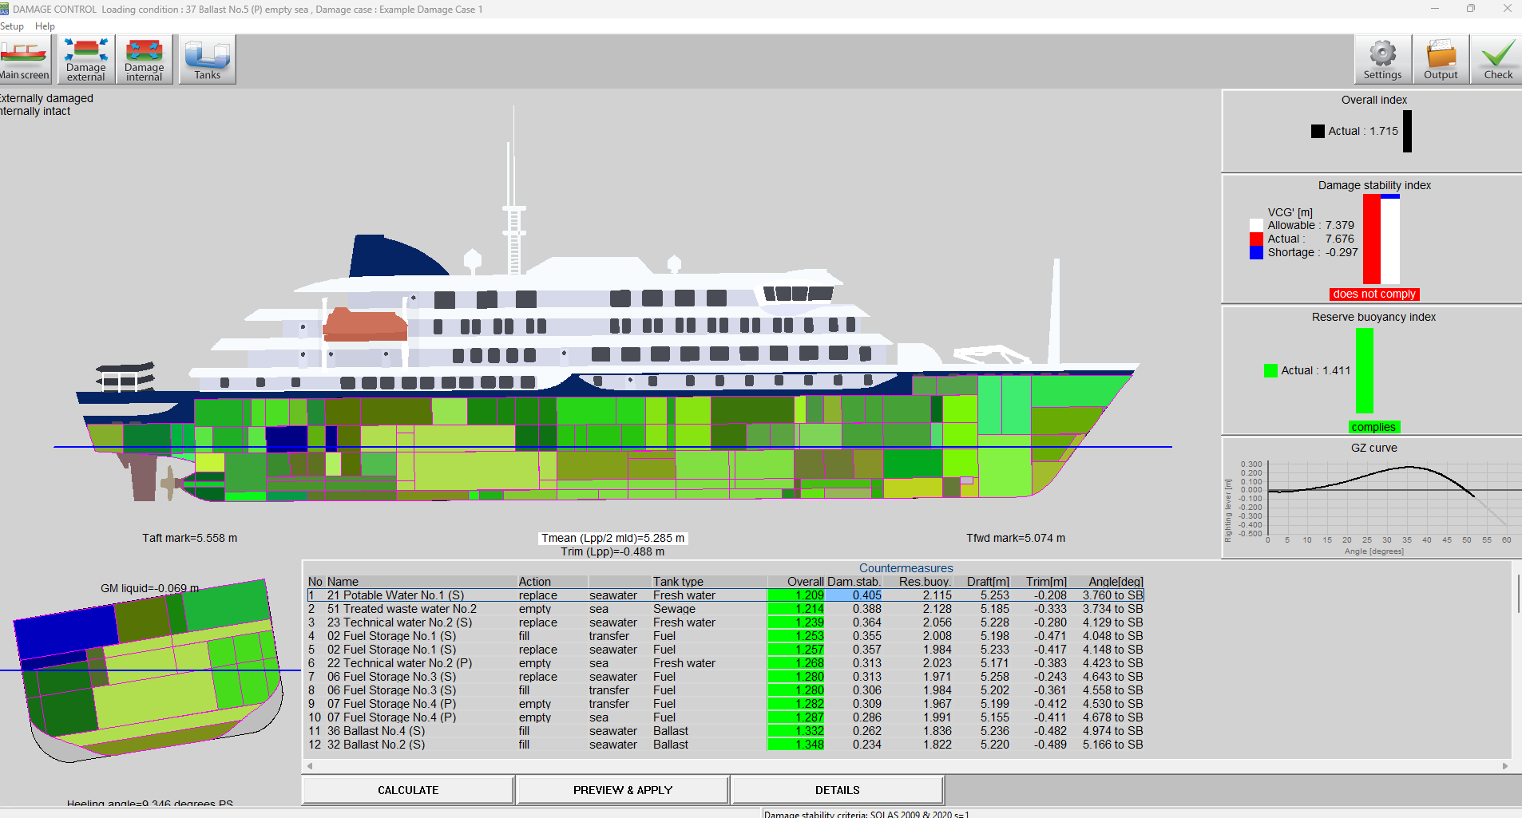
Damage control module

Slide 5
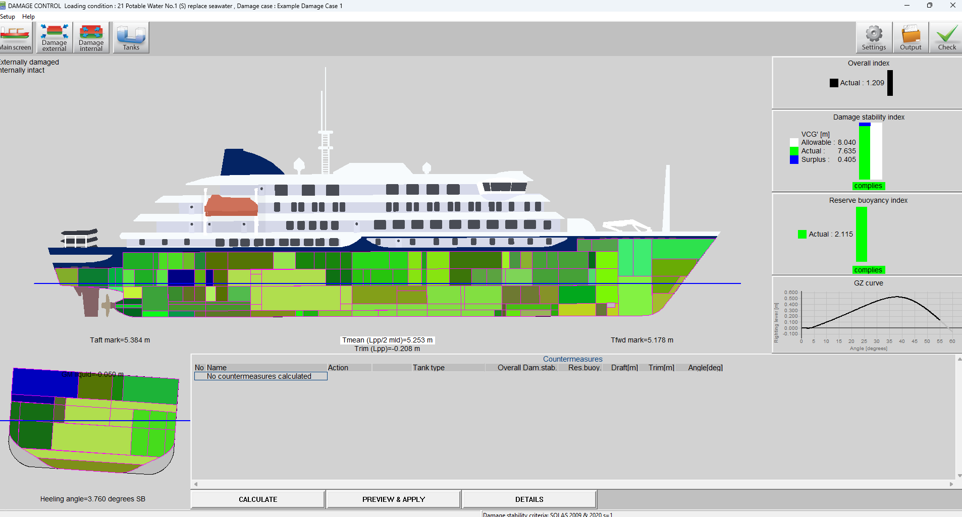
Damage control module

Slide 6
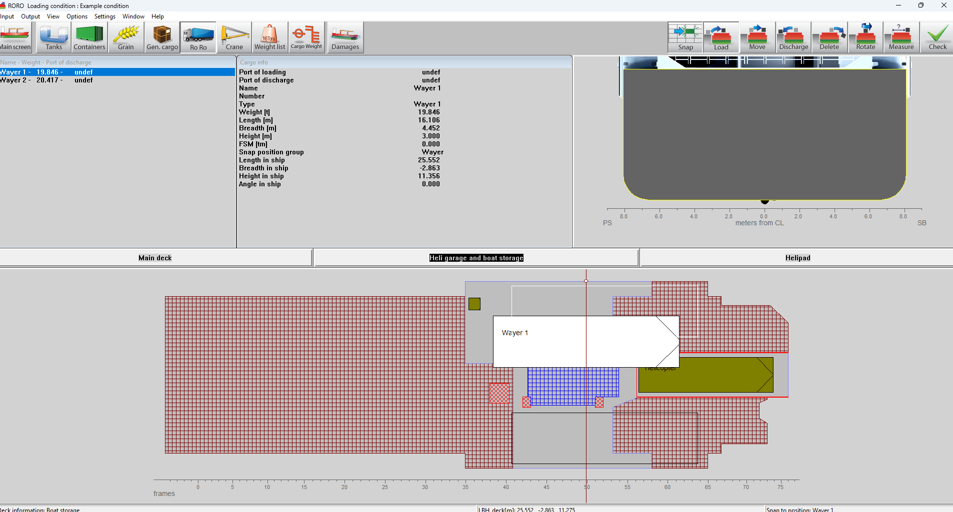
RoRo module
Notes:
Snap positions

Slide 7
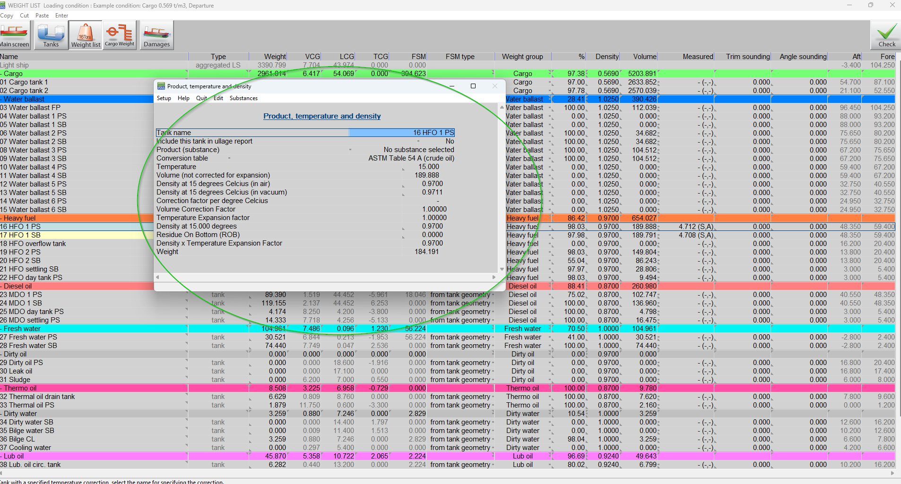
Integrated sounding module
Notes:
Corrections
External tank tables
Etc

Slide 8
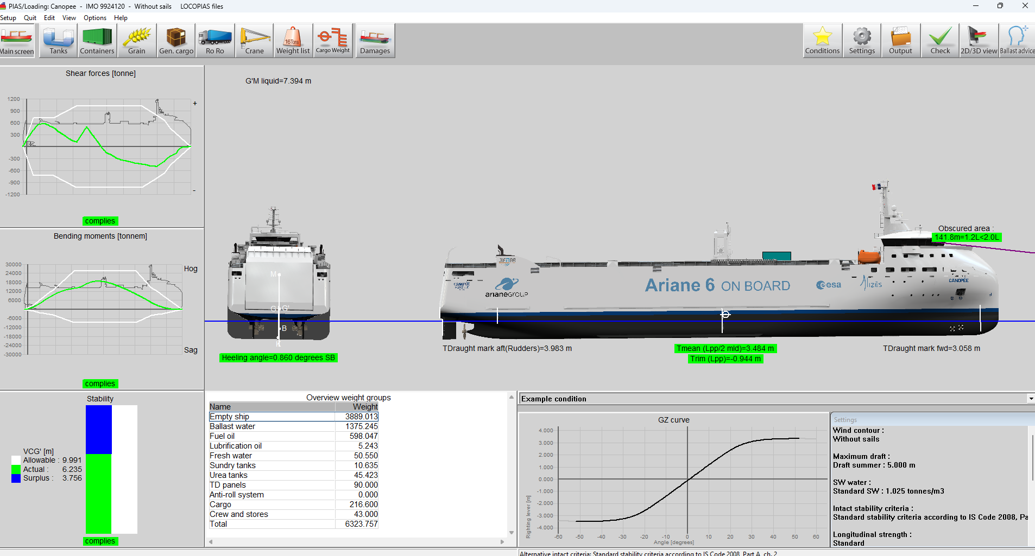
Main GUI
Rendered views

Slide 9
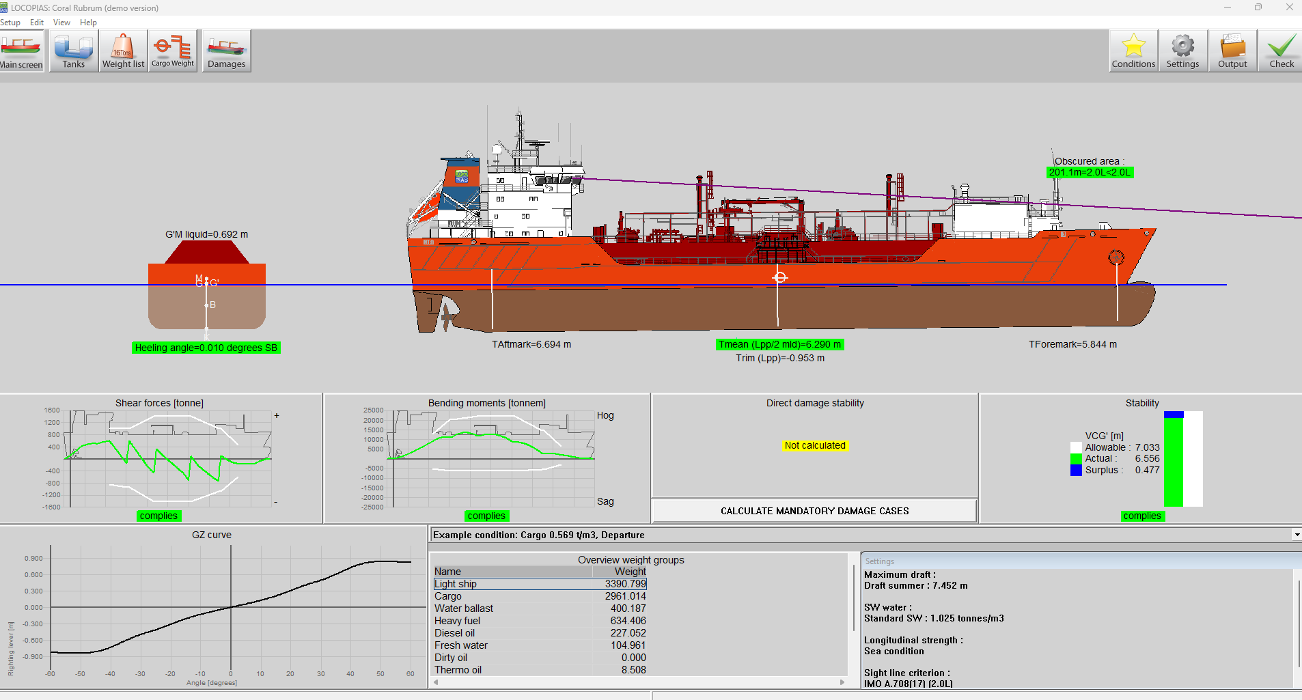
Main GUI
Rendered views

Slide 10
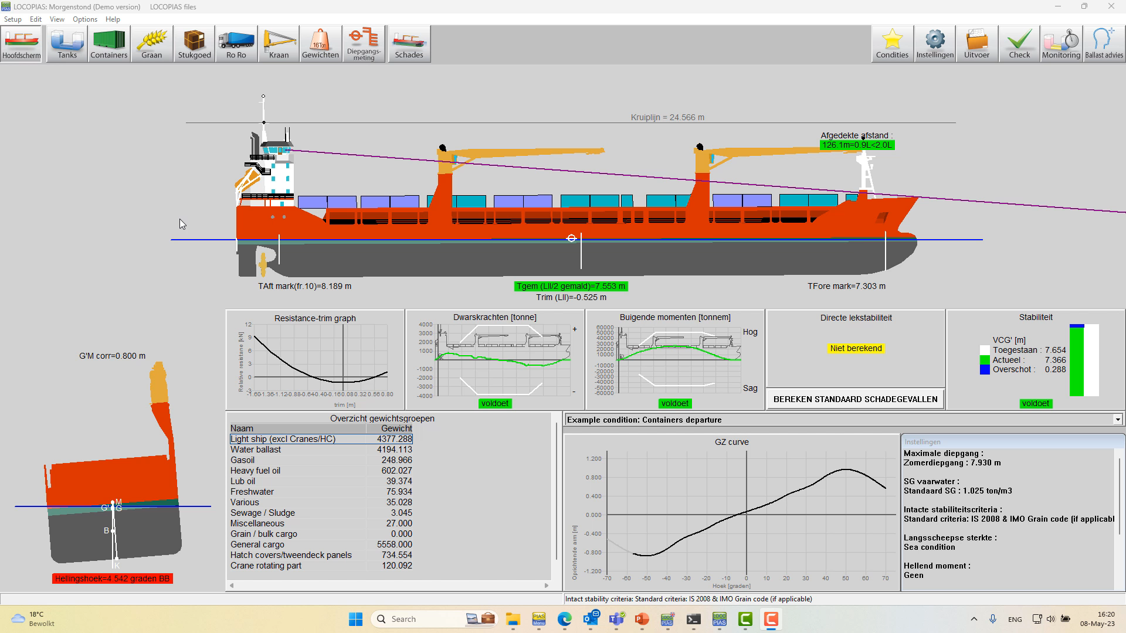
Multiple screen

Slide 11
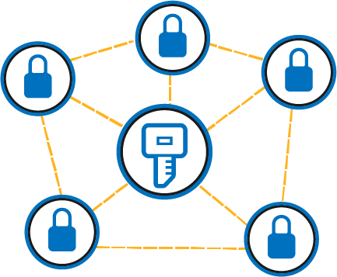
License mechanism
More possibility’s

Slide 12
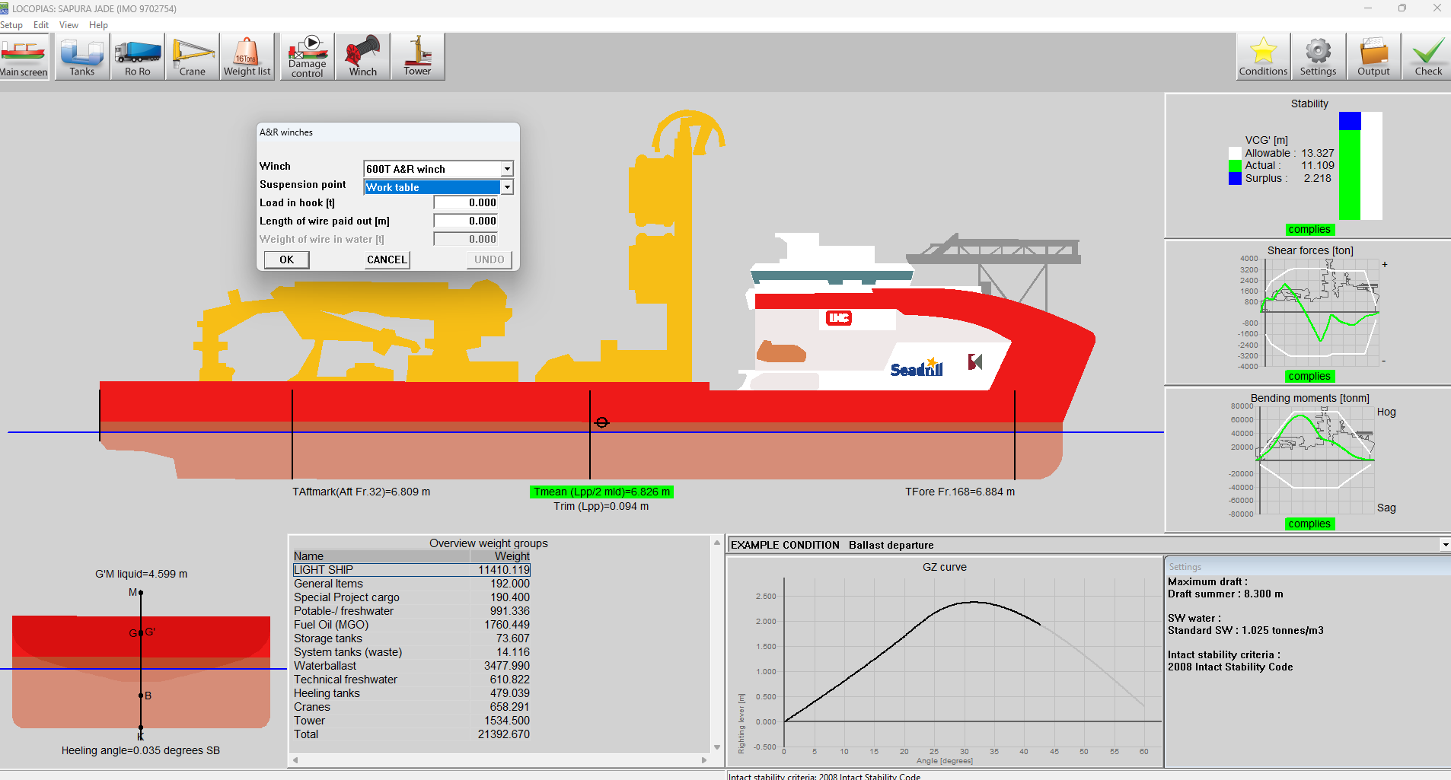
Project specific functions
Three examples
  Sapura cable weight / winch / tower
  Pioneering Spirit strength
  Automatic pallet planning

Slide 13
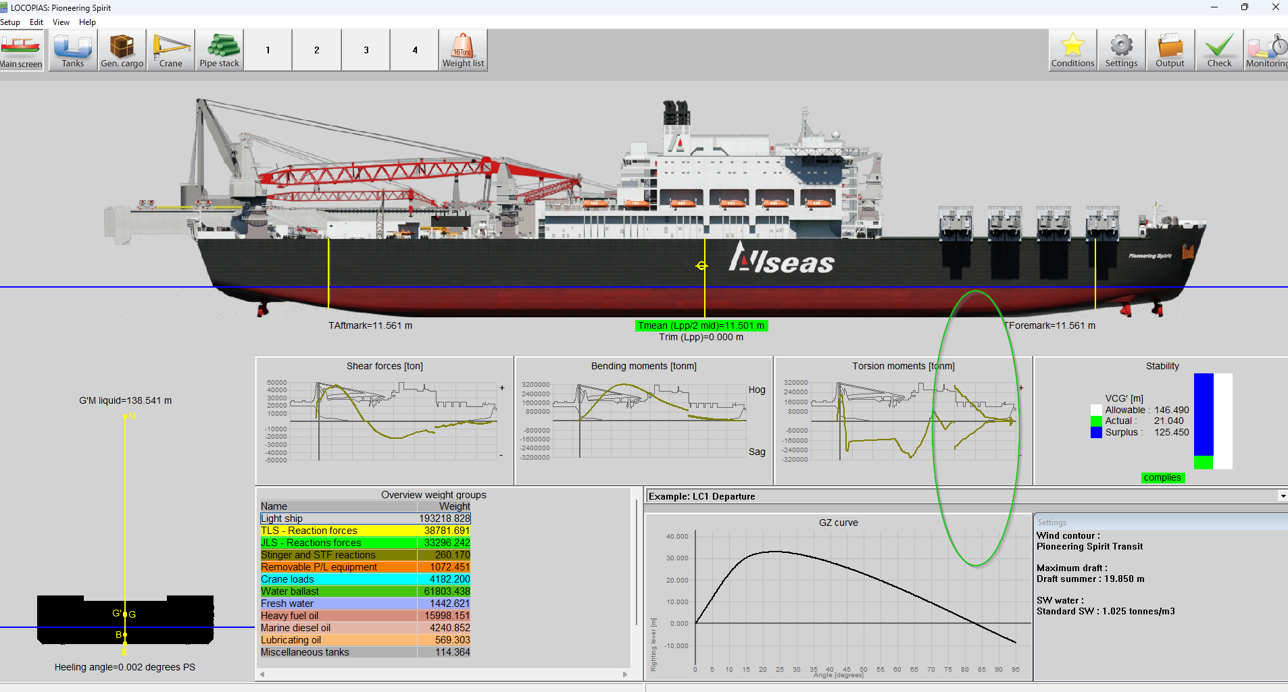
Project specific functions
Three examples
  Sapura cable weight / winch / tower
  Pioneering Spirit strength
  Automatic pallet planning

Slide 14
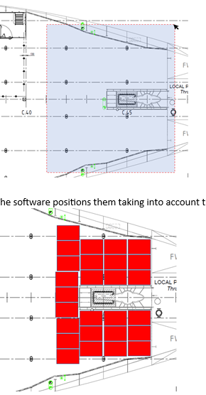
Project specific functions
Three examples
  Sapura cable weight / winch / tower
  Pioneering Spirit strength
  Automatic pallet planning

Slide 15
Interfacing
Tank data reading
Crane (jumbo kinetic)
ST
XML
etc

Slide 16


Tips & Trics
Test conditions
  How to compare
  To understand small differences

Slide 17


Tips & Trics
Meaning of type approval

Slide 18
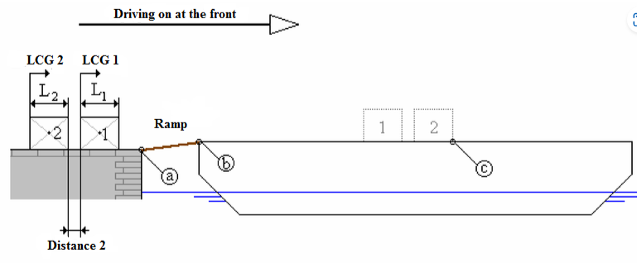
Questions
Victrol:
RoRo operations

Slide 19

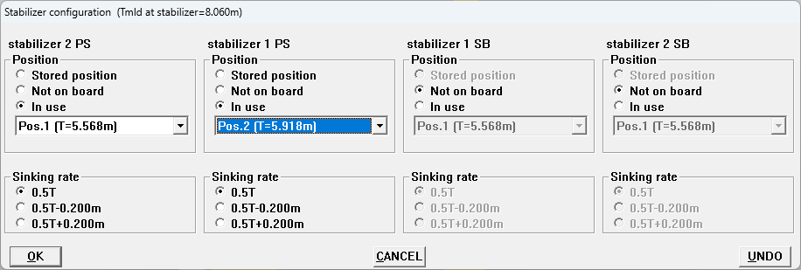
Questions
Biglift
  Multi screen with crane
  Stability pontoons
  Data reading from crane

Slide 20
Questions
Other questions?

