Slide 1
SARC user day 2023
Fairway training
Bart Soede
Notes:
Welcome

Slide 2
Fairway
Why Fairway?
4 Scenarios
Design with developable surfaces
Hydrostatics and transformations
Plate expansions
Import & Export
Tips and tricks
Q & A
Short Break
Demo Fairing
Demo Basic modelling
Q & A (continued)
Notes:
Brief intro to contents.
Feel free to raise questions during presentation!

Slide 3
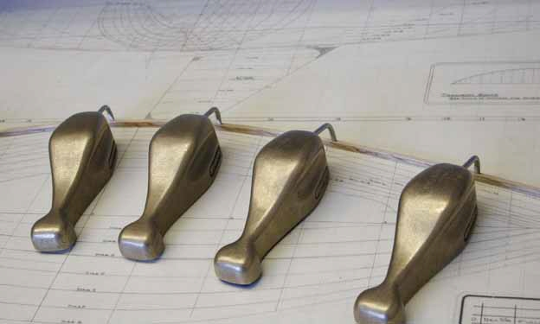
Fairway
Why Fairway?
Less abstract entities
(Spline and ‘ducks’)
Notes:
Many other sofwares use NURBS surfaces (trimmed or not)
Tricks are required for watertightnes and first order continuity.
Manipulation of hull is indirect
Subdivison in patches may be troublesome

Slide 4
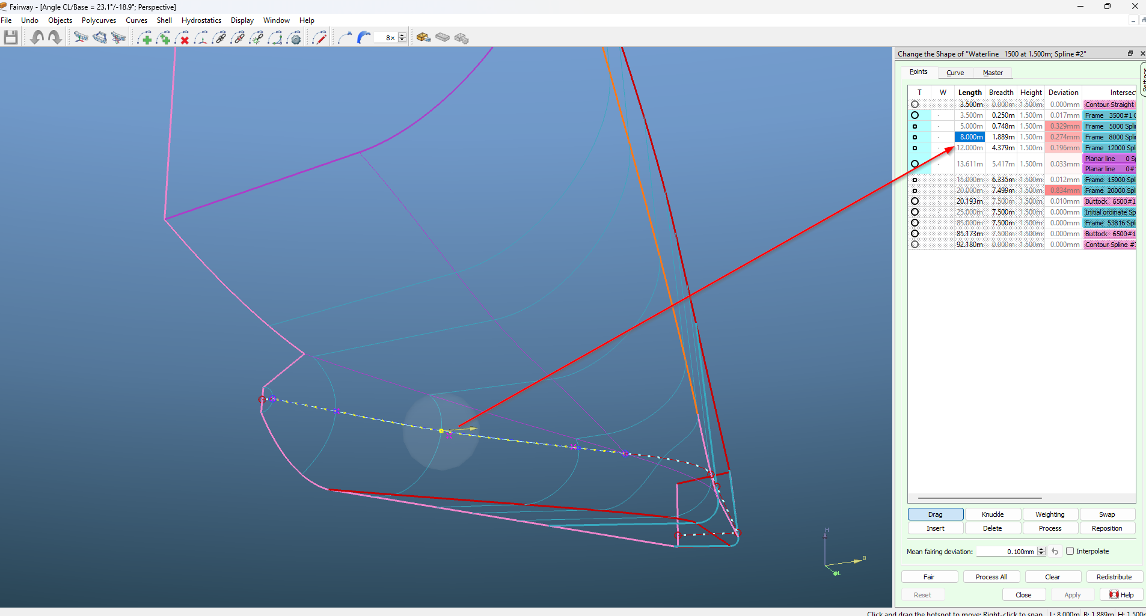
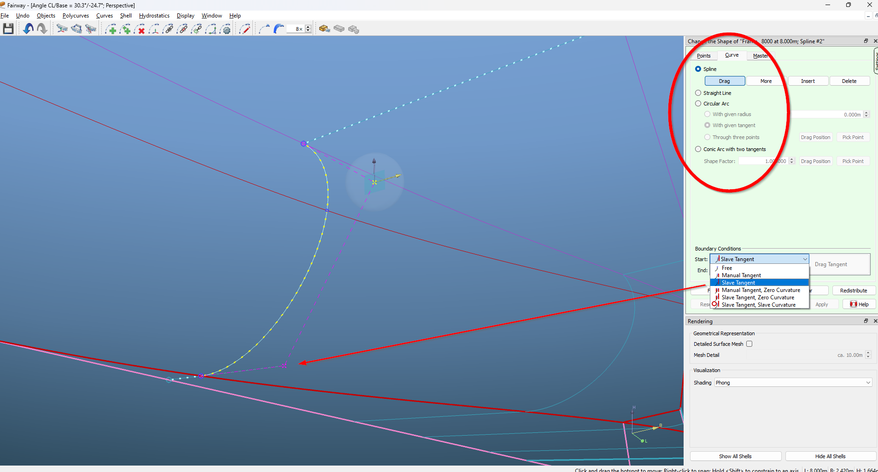
Fairway
Why Fairway?
Less abstract entities
(Spline and ‘ducks’)
Direct control
(coordinates, tangents, linetypes)
Notes:
Fairway compares with drafting on paper, but now without the endless erasing and redrafting.
Even Fairing options compare (to be elaborated on later).

Slide 5
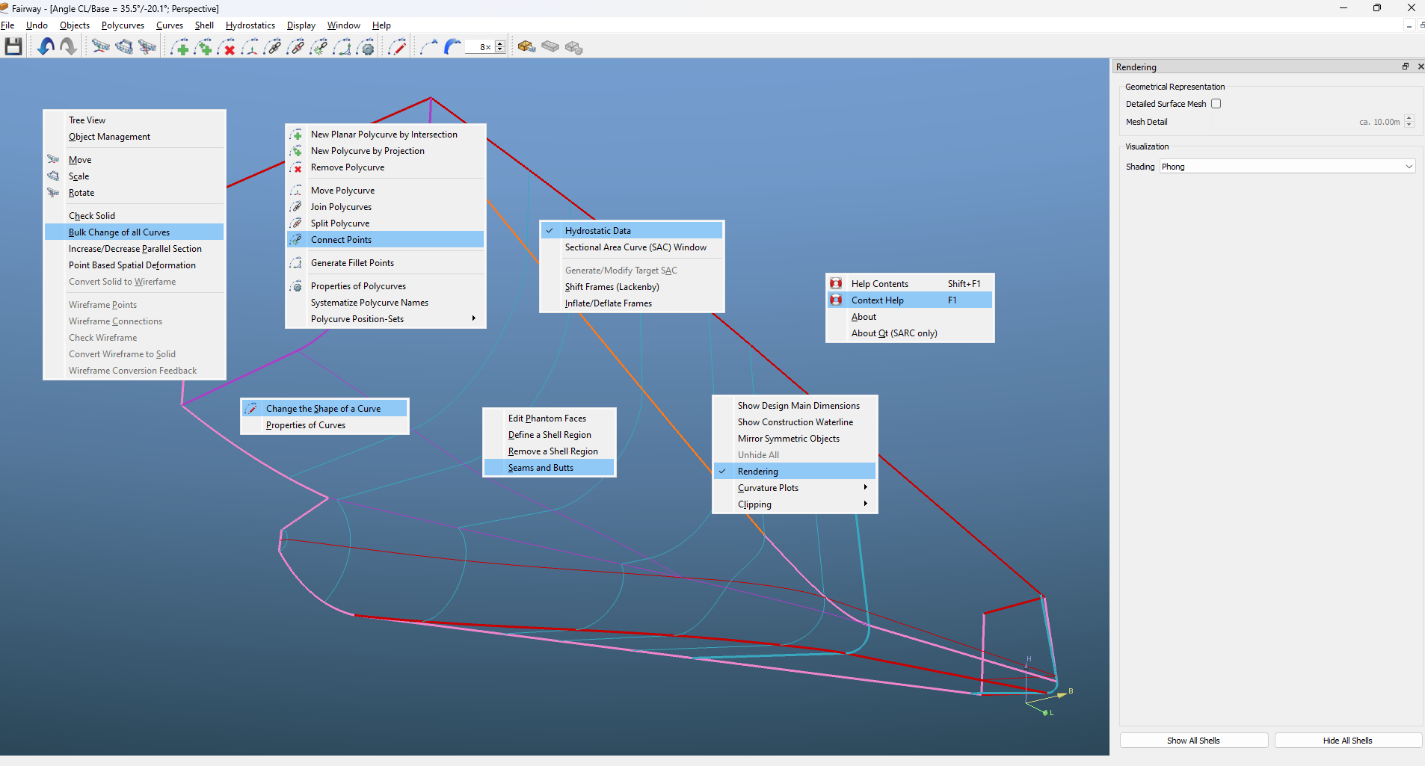
Fairway
Why Fairway?
Less abstract entities
(Spline and ‘ducks’)
Direct control
(coordinates, tangents, linetypes)
‘Toolbox’ approach
(no prescribed working flow)
Notes:
A brief overview of tools in the box

Slide 6
Fairway
Scenario 1: Parent hull used for feasibility study
  Select parent hull (earlier project or SARC library)
  Transformation
  Changing the shape
  Export to some file representation.
Notes:
We have been asked to generate lines plans quickly,
Often similar shapes are available,
Any hull may serve as ‘parent’.

Slide 7
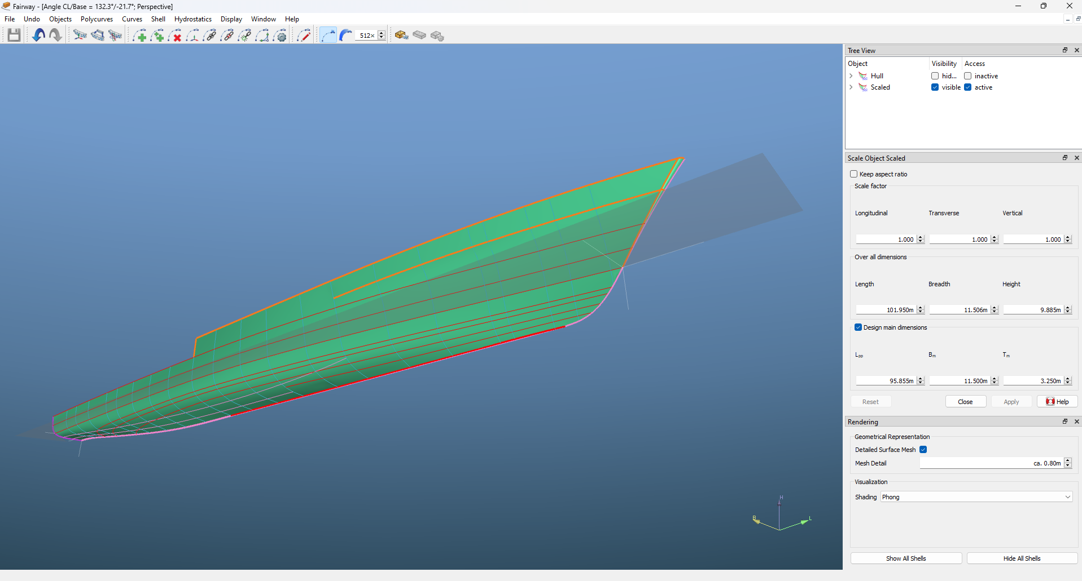
Fairway
Scenario 1
Selected model: GOA
Notes:
We will use a model of a frigate (Available as “Fairway parent hull”)

Slide 8
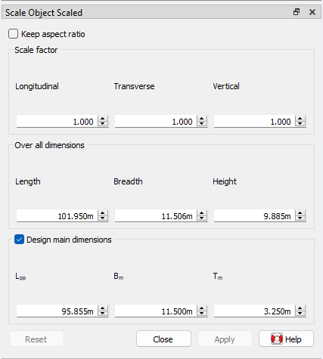
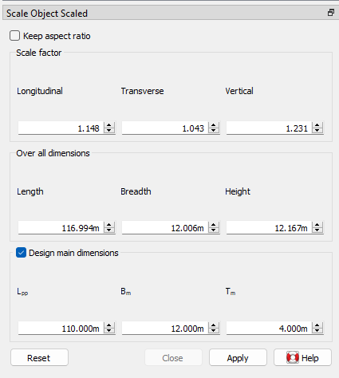
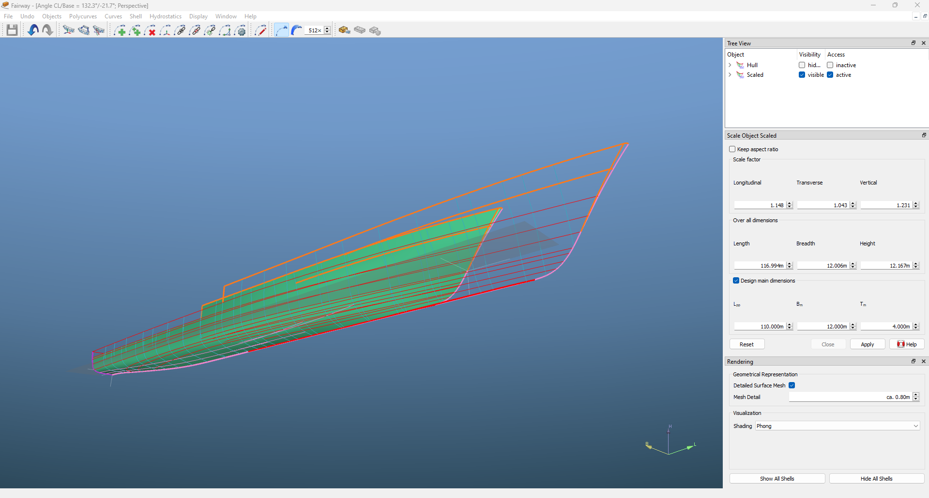
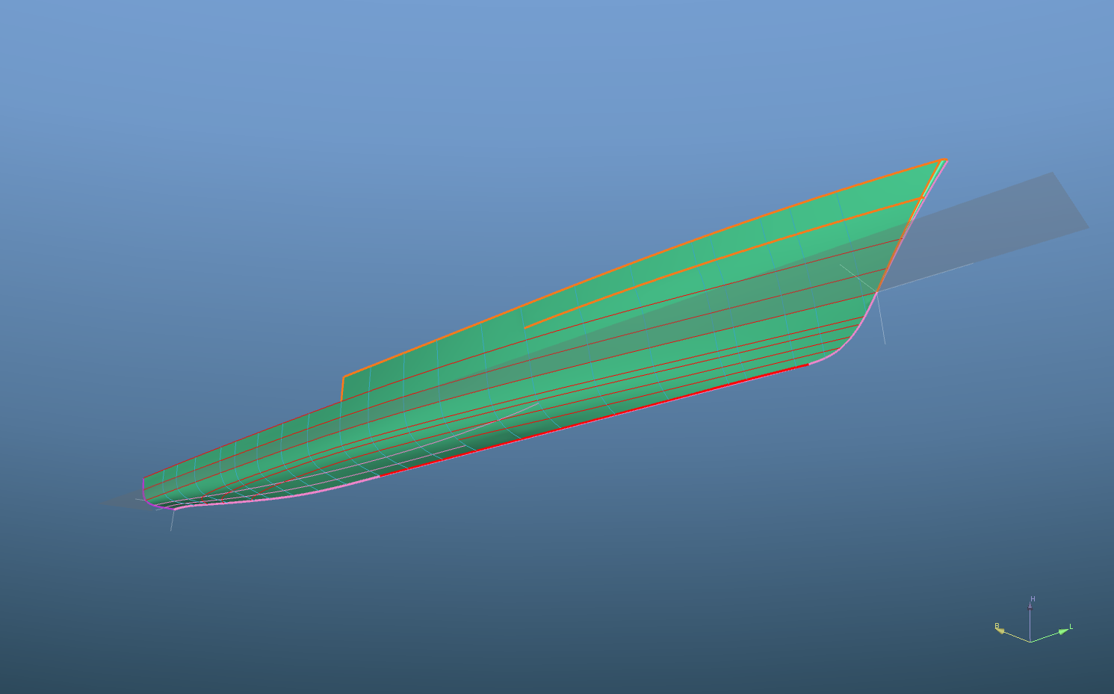

Fairway
Scenario 1: Parent hull used for feasibility study
Selected model: GOA
Scale to new dimensions
Notes:
We will scale this model to the required dimensions
Notice preview on operation

Slide 9
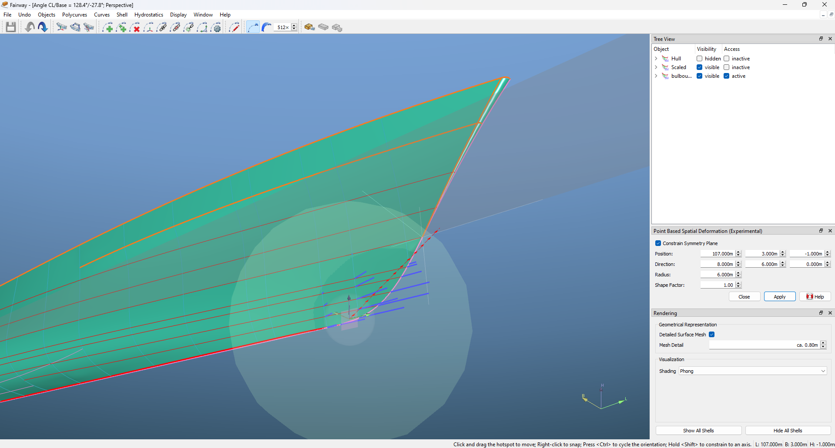
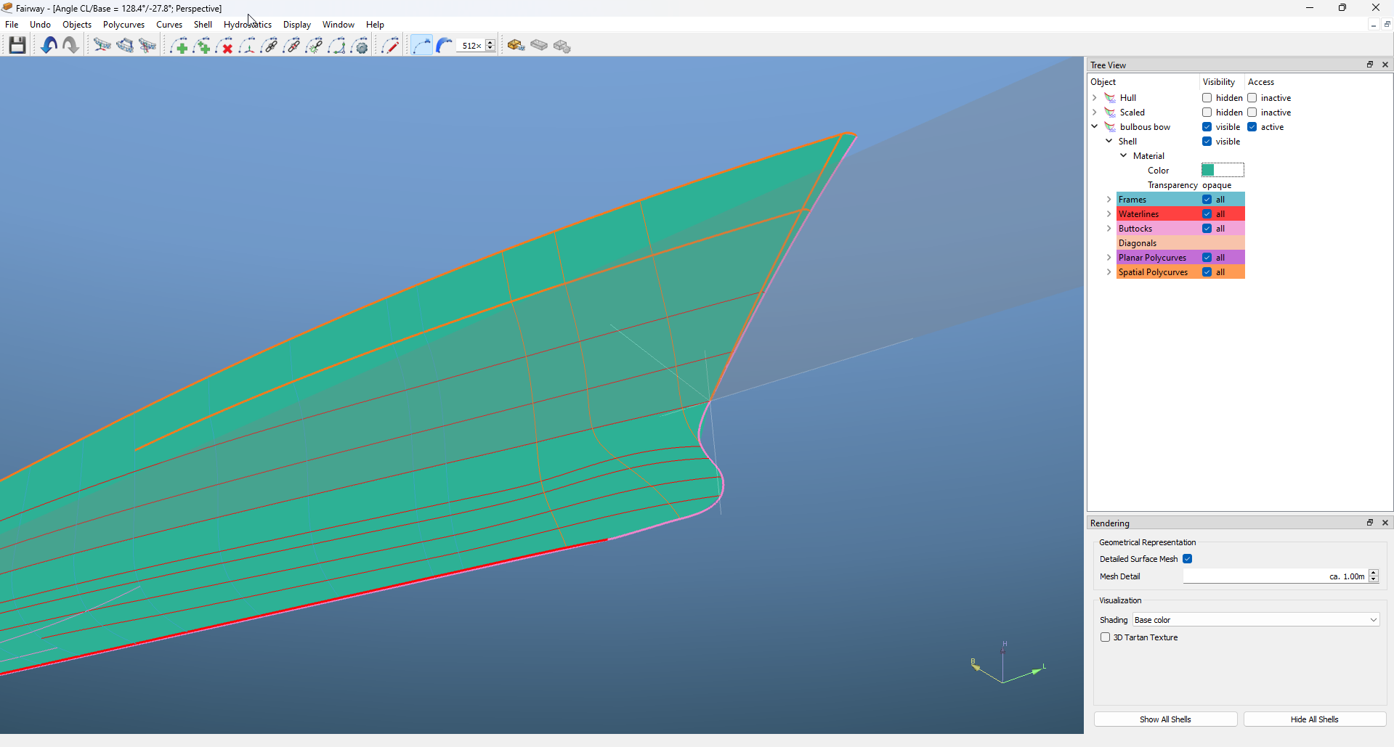
Fairway
Scenario 1: Parent hull used for feasibility study
Selected model: GOA
Scale to new dimensions
Create bulbous bow
(point based spatial deformation)
Notes:
Notice that ‘point based spatial deformation’ is available and may be expanded in the future.

Slide 10
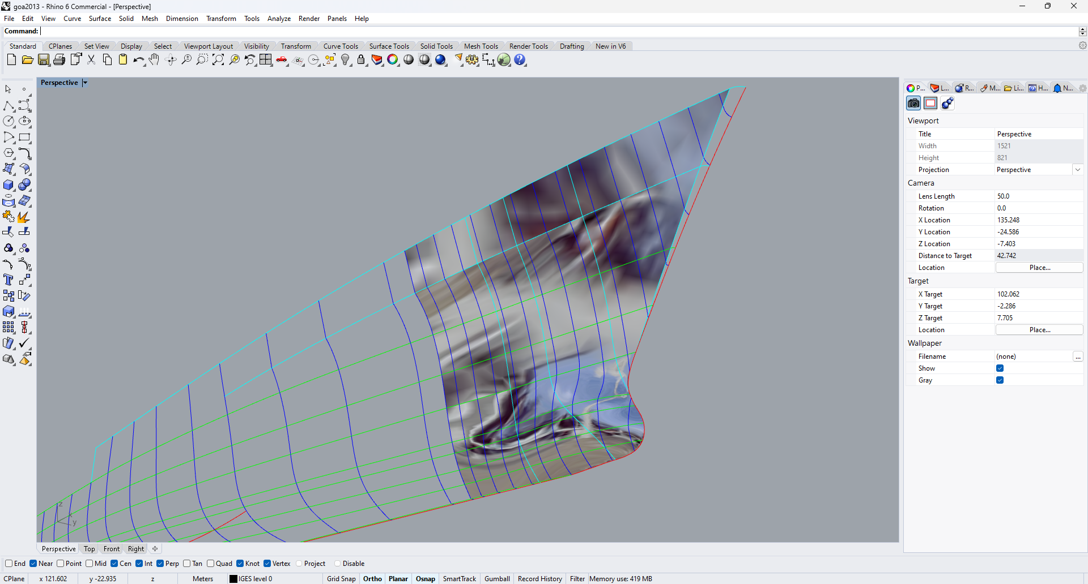
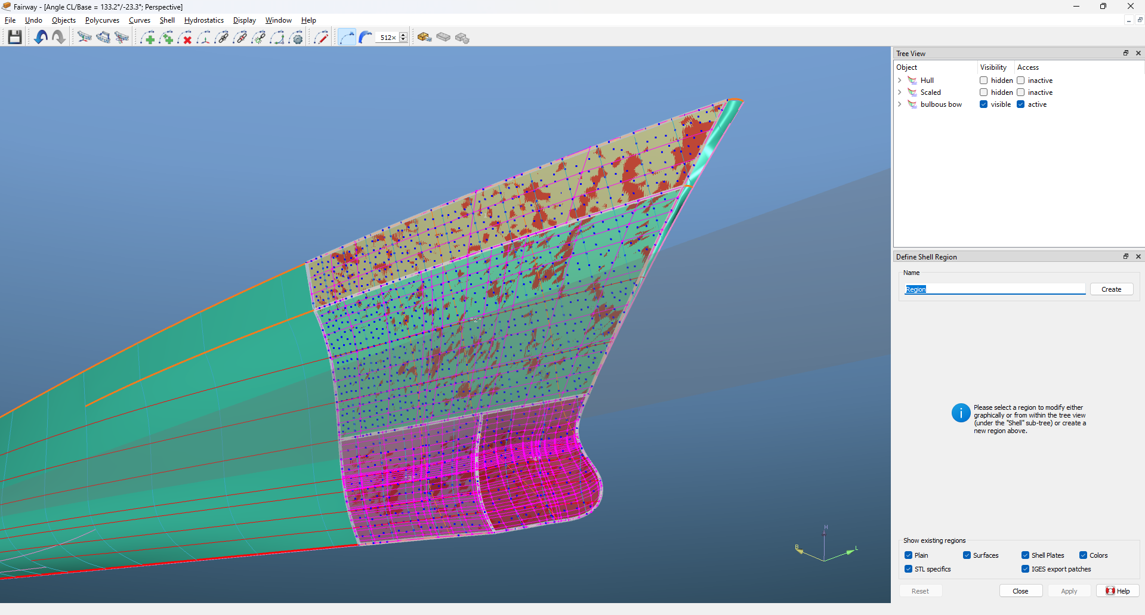
Fairway
Scenario 1: Parent hull used for feasibility study
Selected model: GOA
Scale to new dimensions
Create bulbous bow
(point based spatial deformation)
Write NURBS
(surfaces and / or curves)
Notes:
To write such NURBS surfaces, some settings and definition of areas are required.
This will be elaborated on later.

Slide 11
Fairway
Scenario 2: Using an existing PIAS model
  Import defined frames from PIAS model
  Add relevant curves
  Make the required changes
  Export back to PIAS
Notes:
To model further updates of a design, or to amend an older one (pre-Fairway), it can be convenient to start with a PIAS model.

Slide 12
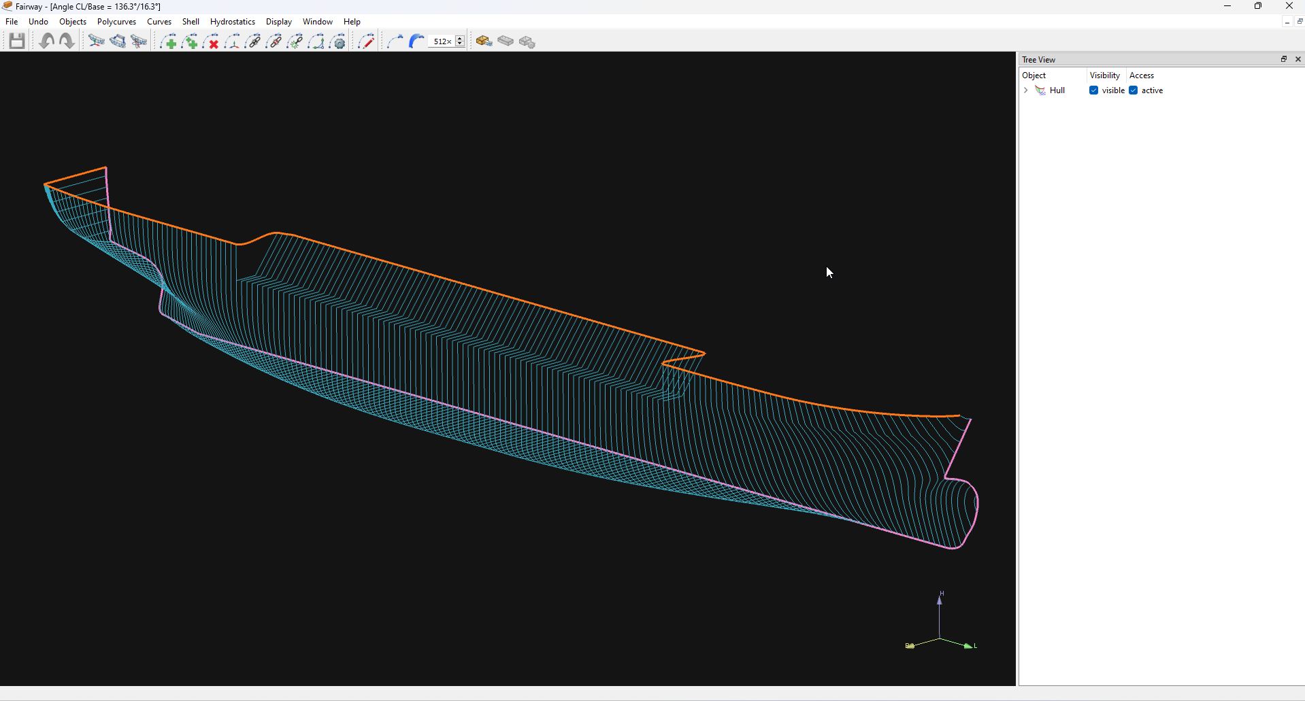
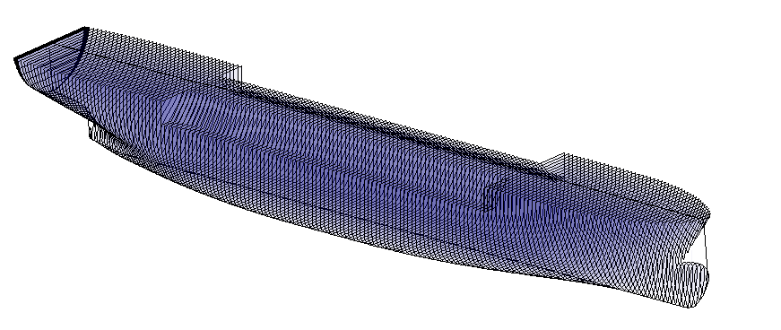
Fairway
Scenario 2: Using an existing PIAS model
Open PIAS model in Fairway
Notes:
A PIAS model of a gas tanker for example.
Say that more room was required under the slanted deck/superstructure:

Slide 13
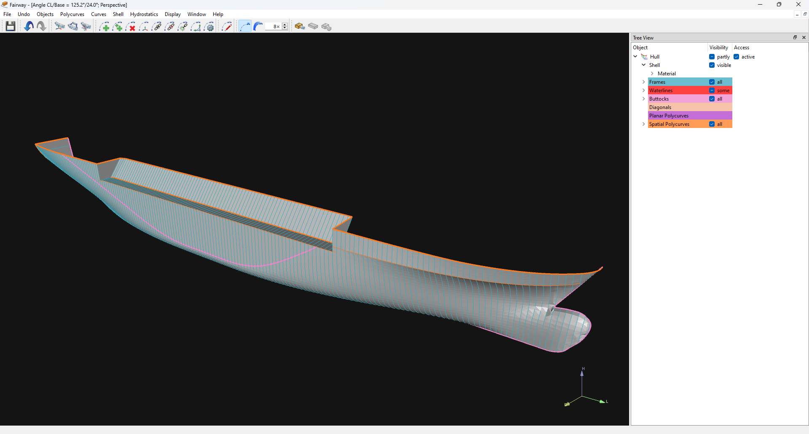
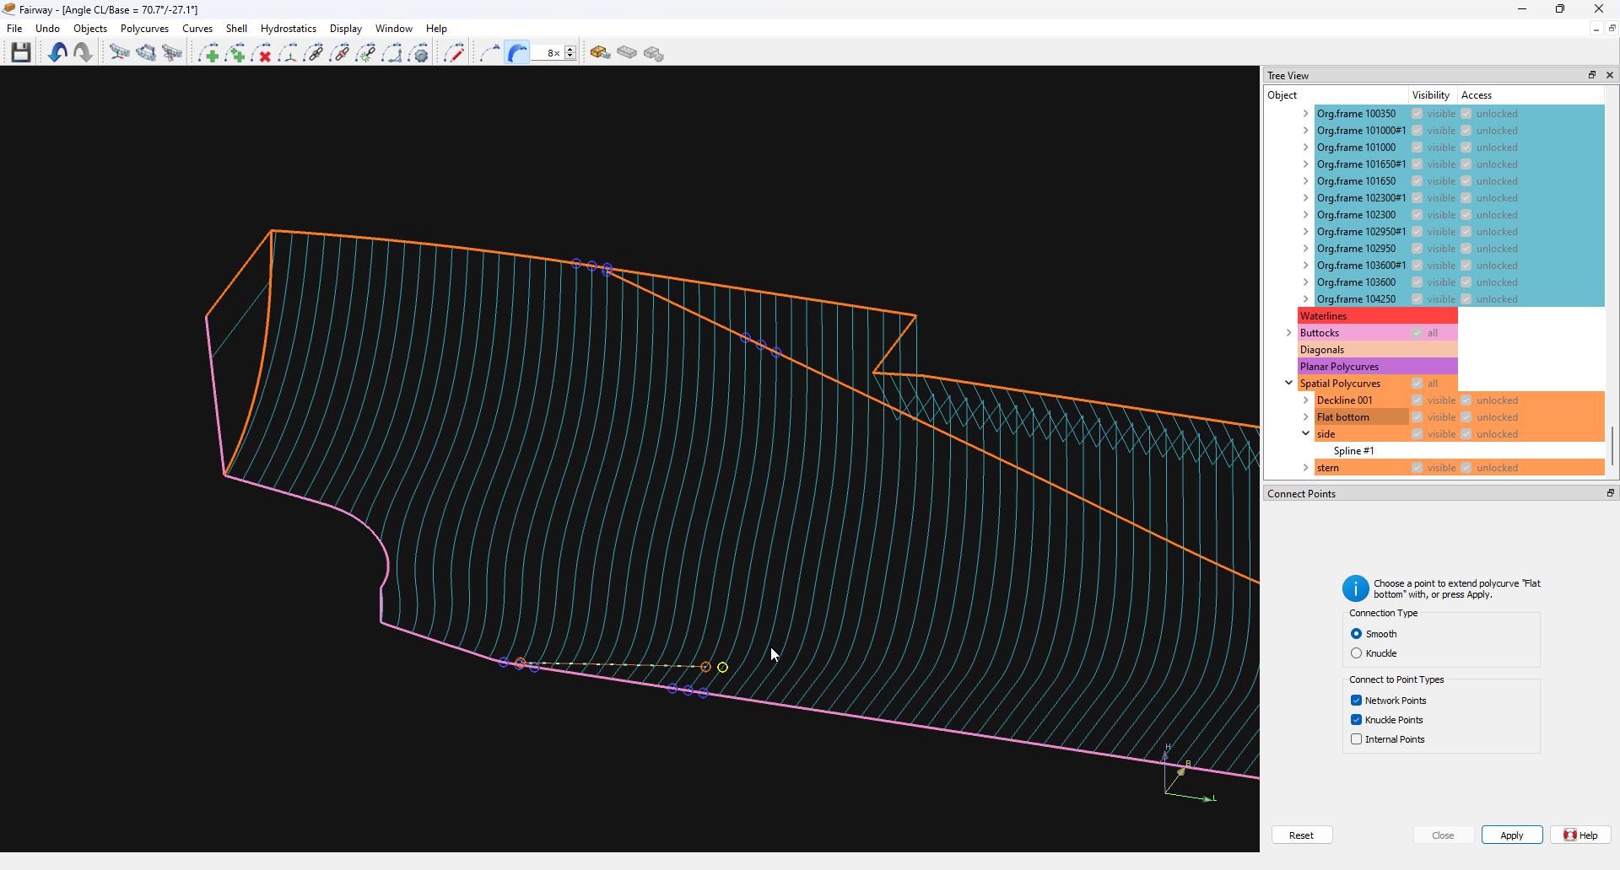
Fairway
Scenario 2: Using an existing PIAS model
Open PIAS model in Fairway
Add curves
Notes:
‘Design curves’ (transom, flat bottom, flat side, deck line, chines) are added and manipulated to allow interpolation of buttocks and waterlines (and enhance graphics).
Use ‘Connect points’ and ‘interpolate polycurve’

Slide 14
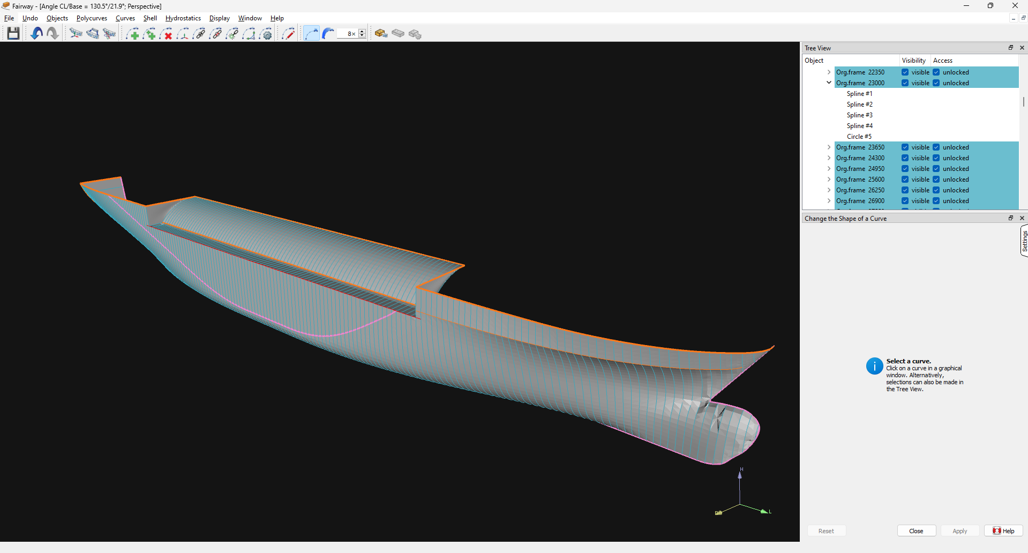
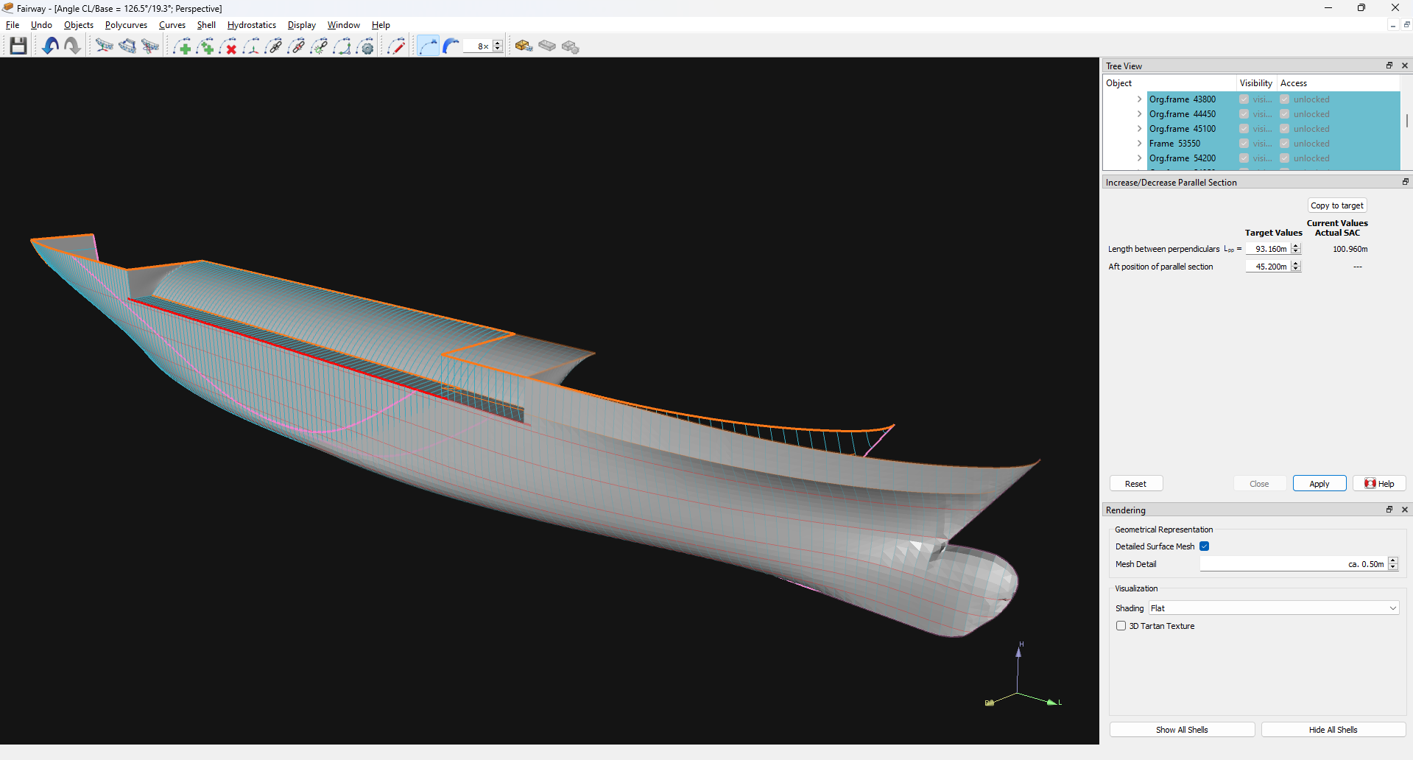
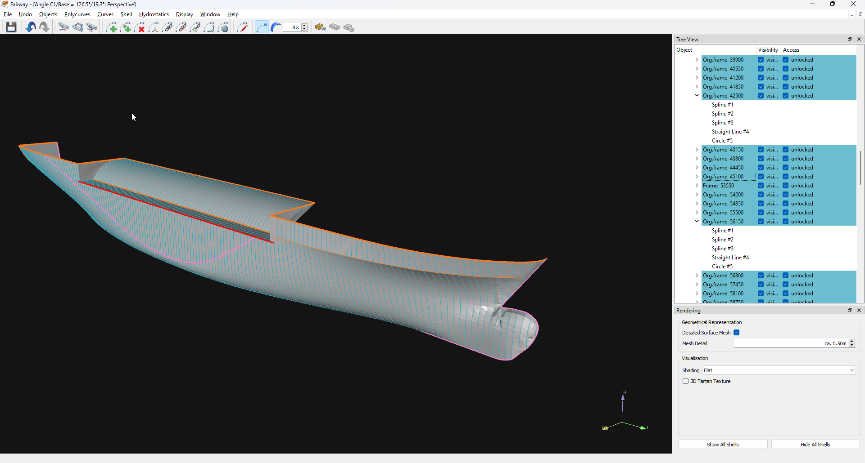
Fairway
Scenario 2: Using an existing PIAS model
Open PIAS model in Fairway
Add curves
Make the required changes
(round deck, shortened)
Notes:
A ‘slave surface’ is defined to modify the deck: all frames in the deck inherit their properties from the selected ‘defining frame’.
The parallel midship section is removed (clear the frames in way of the parallel midship section first).

Slide 15
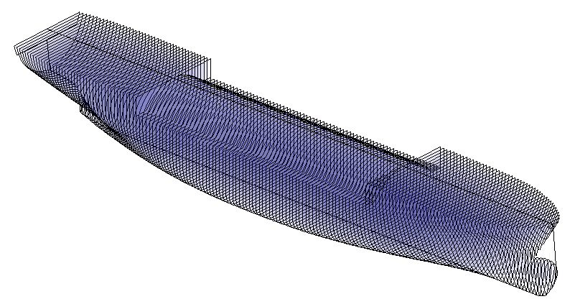
Fairway
Scenario 2: Using an existing PIAS model
Open PIAS model in Fairway
Add curves
Make the required changes
(round deck, shortened)
Export to PIAS again
Notes:
This is a straight forward conversion, but do check the results!
Fairway does not ‘know’ where superstructures will be, and may skipe some ‘double frames, etc.

Slide 16
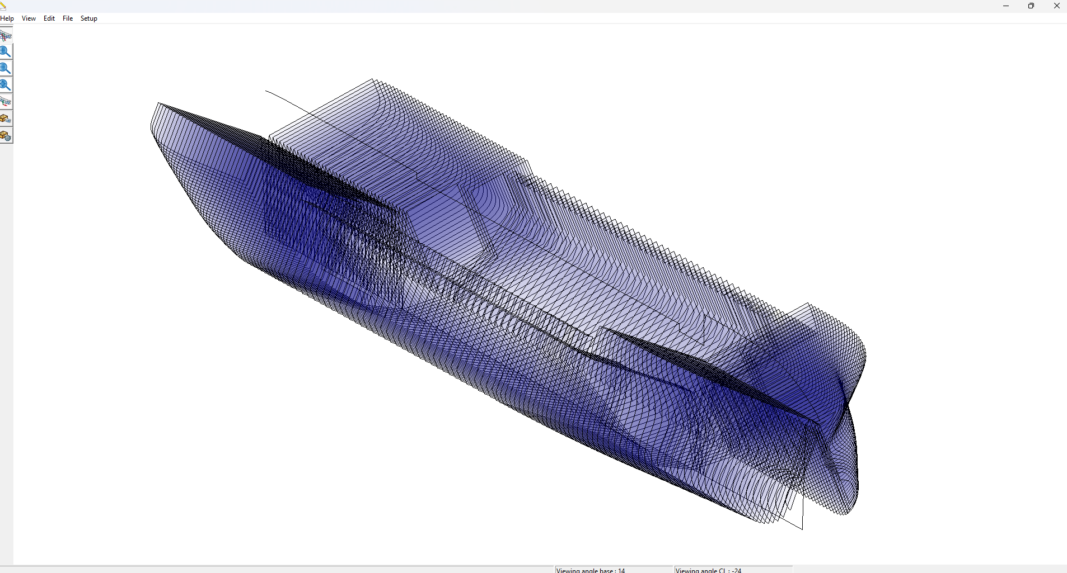
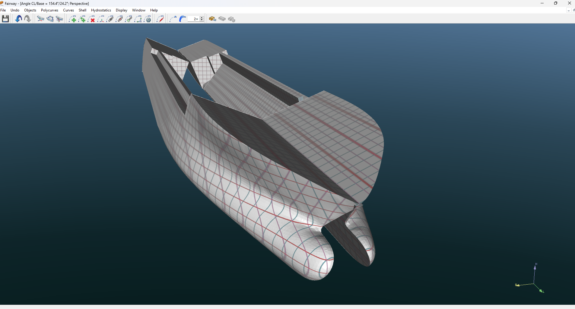
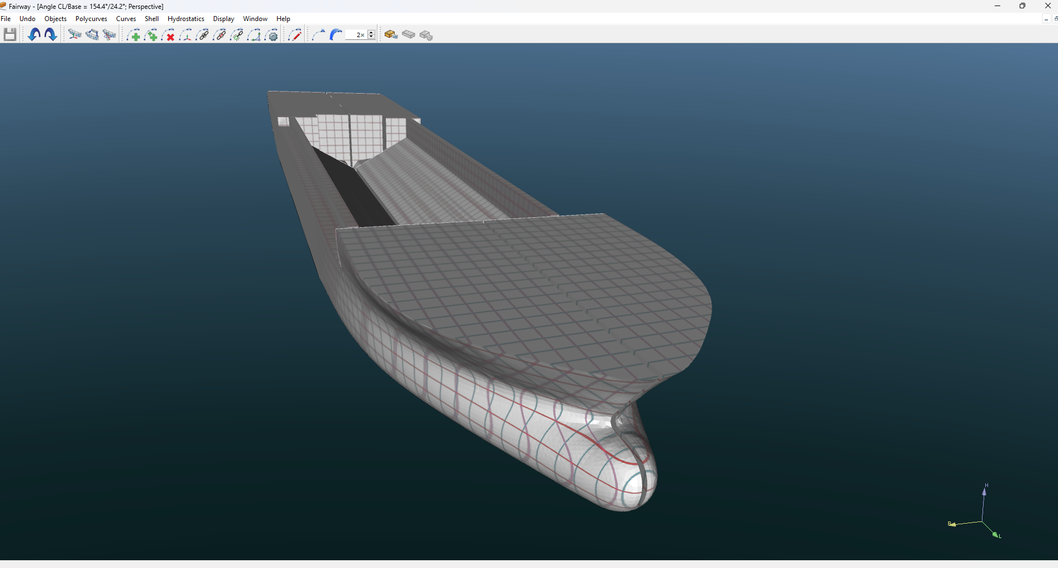
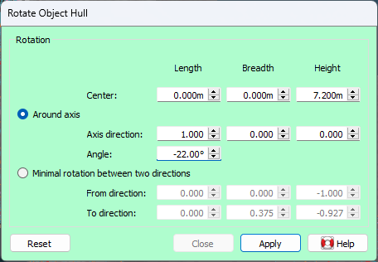
Fairway
Scenario 3: Split condition for a split hopper
Model the vessel in Fairway
Make the model suitable
Rotate the model
Export to PIAS
Notes:
Split hoppers require stability and bending moments calculations in ‘split condition’.
Rotation can be done manipulation of frame coordinates in a spreadsheet, or in Fairway.
Note that the frames should start and end at the same point: during conversion from Fairway to PIAS model, the first and last point of the converted frame will be projected to centre line.

Slide 17
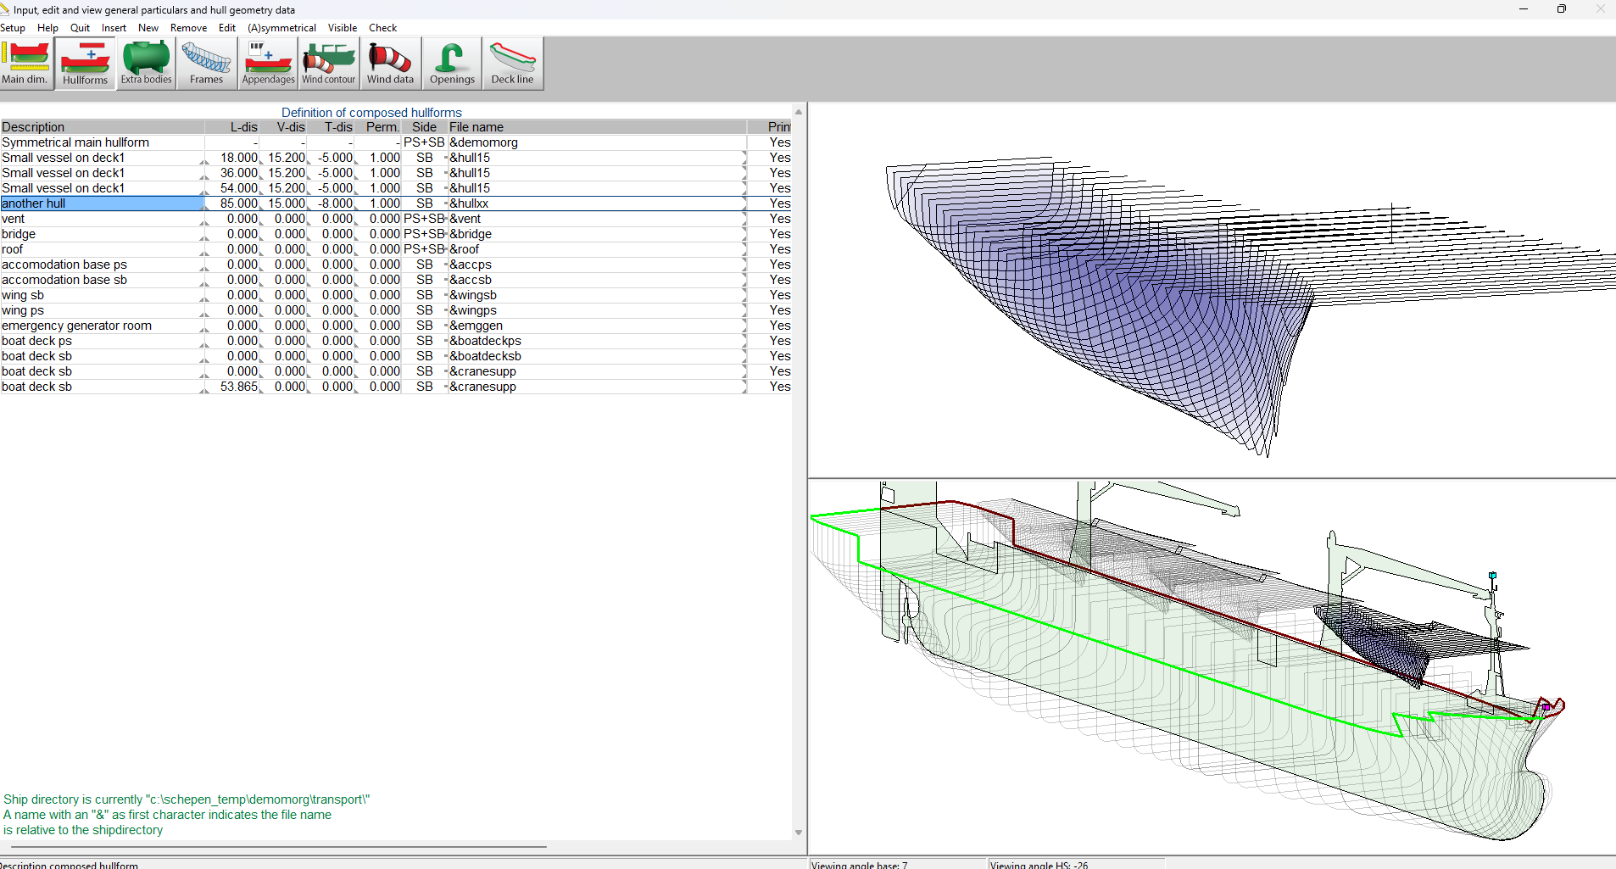
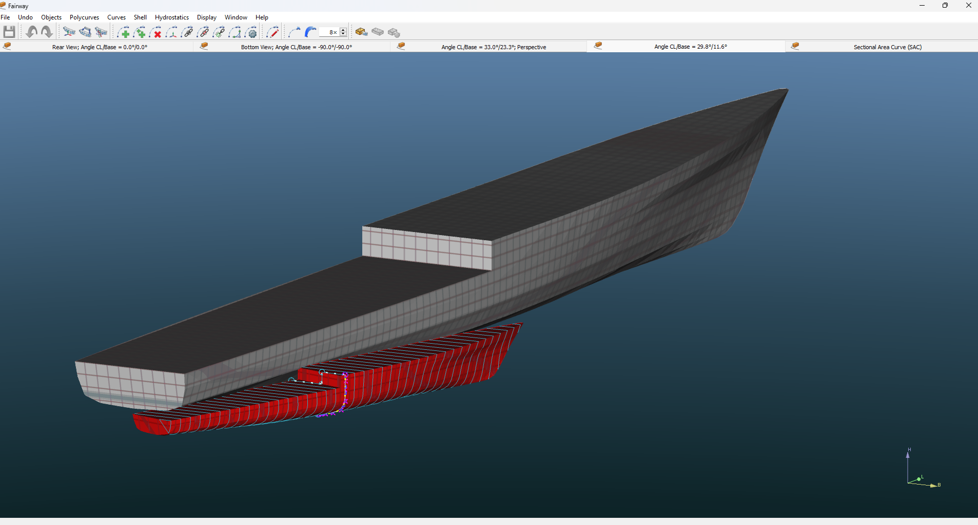
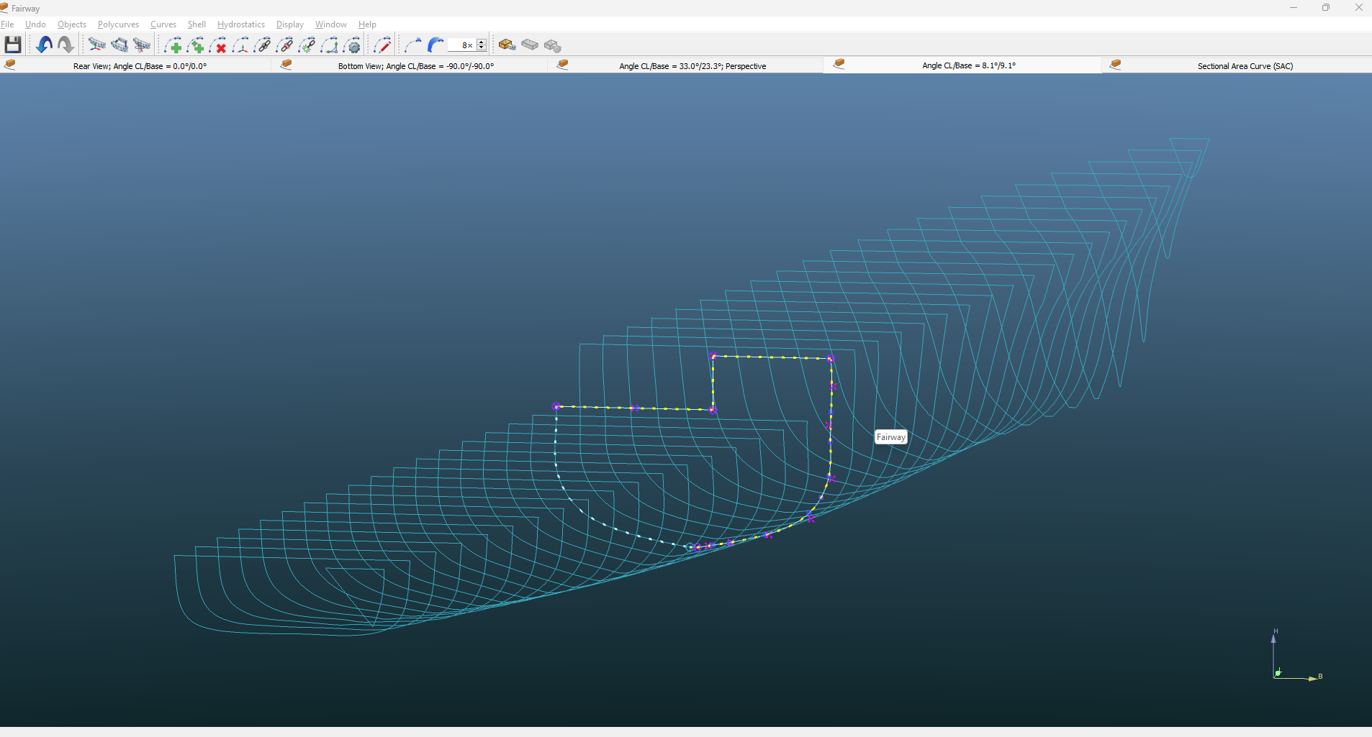
Fairway
Scenario 4: Transport
To load vessels on another
Create a ‘full hull’ model’
(rotated and scaled)
Export to PIAS
Notes:
For a recent demonstration following a client’s request:
Can we place vessels on deck, (off CL & oblique) , but still include the buoyancy?
Yes.
But in PIAS, all buoyant parts are aligned; we need ‘oblique frames’, as depicted.
For the demonstration a model was scaled and rotated,
new frames are interpolated and converted to a PIAS frames model.

Slide 18
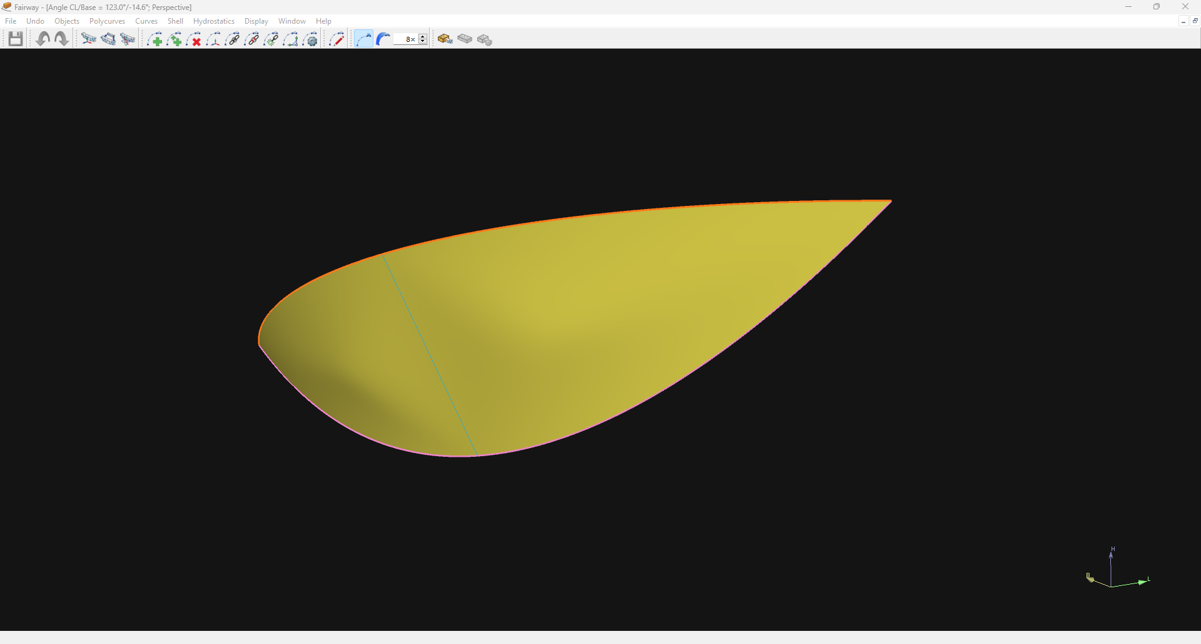
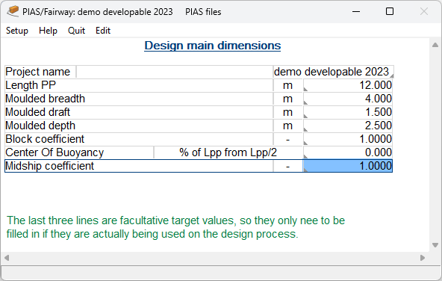
Fairway
Design with developable surfaces
Start: a ‘minimal hull’
Notes:
This is a ‘minimal hull in Fairway. Just a starting point for a new design.

Slide 19
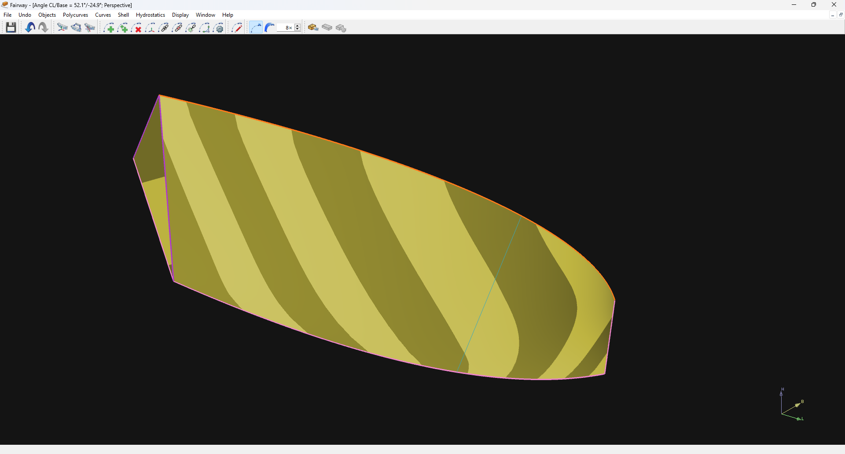
Fairway
Developable surfaces
Start: a ‘minimal hull’
Define bow and transom
Notes:
Add a knuckle in deck and 2 in the centre line
Connect deck and centreline with the transom
Modify transom to a ‘planar curve’

Slide 20
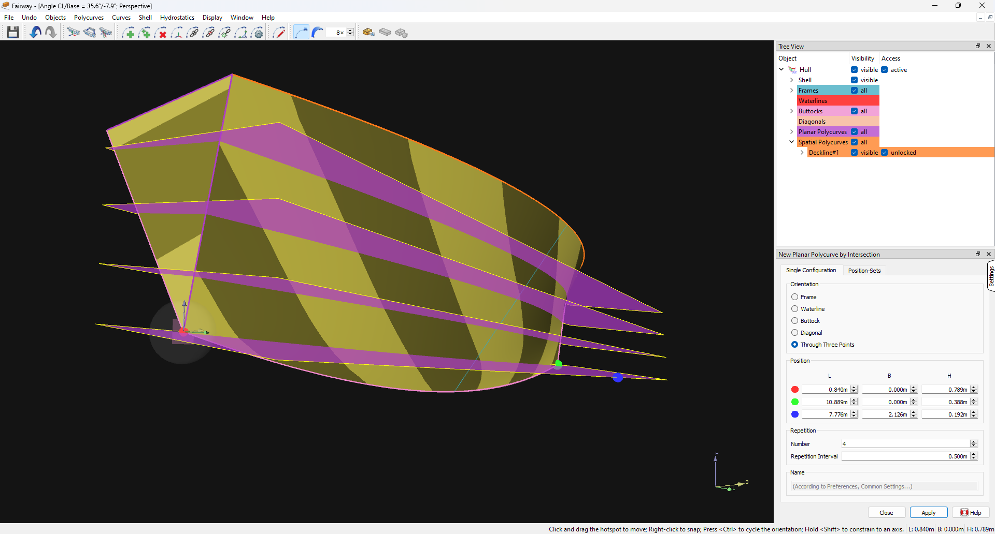
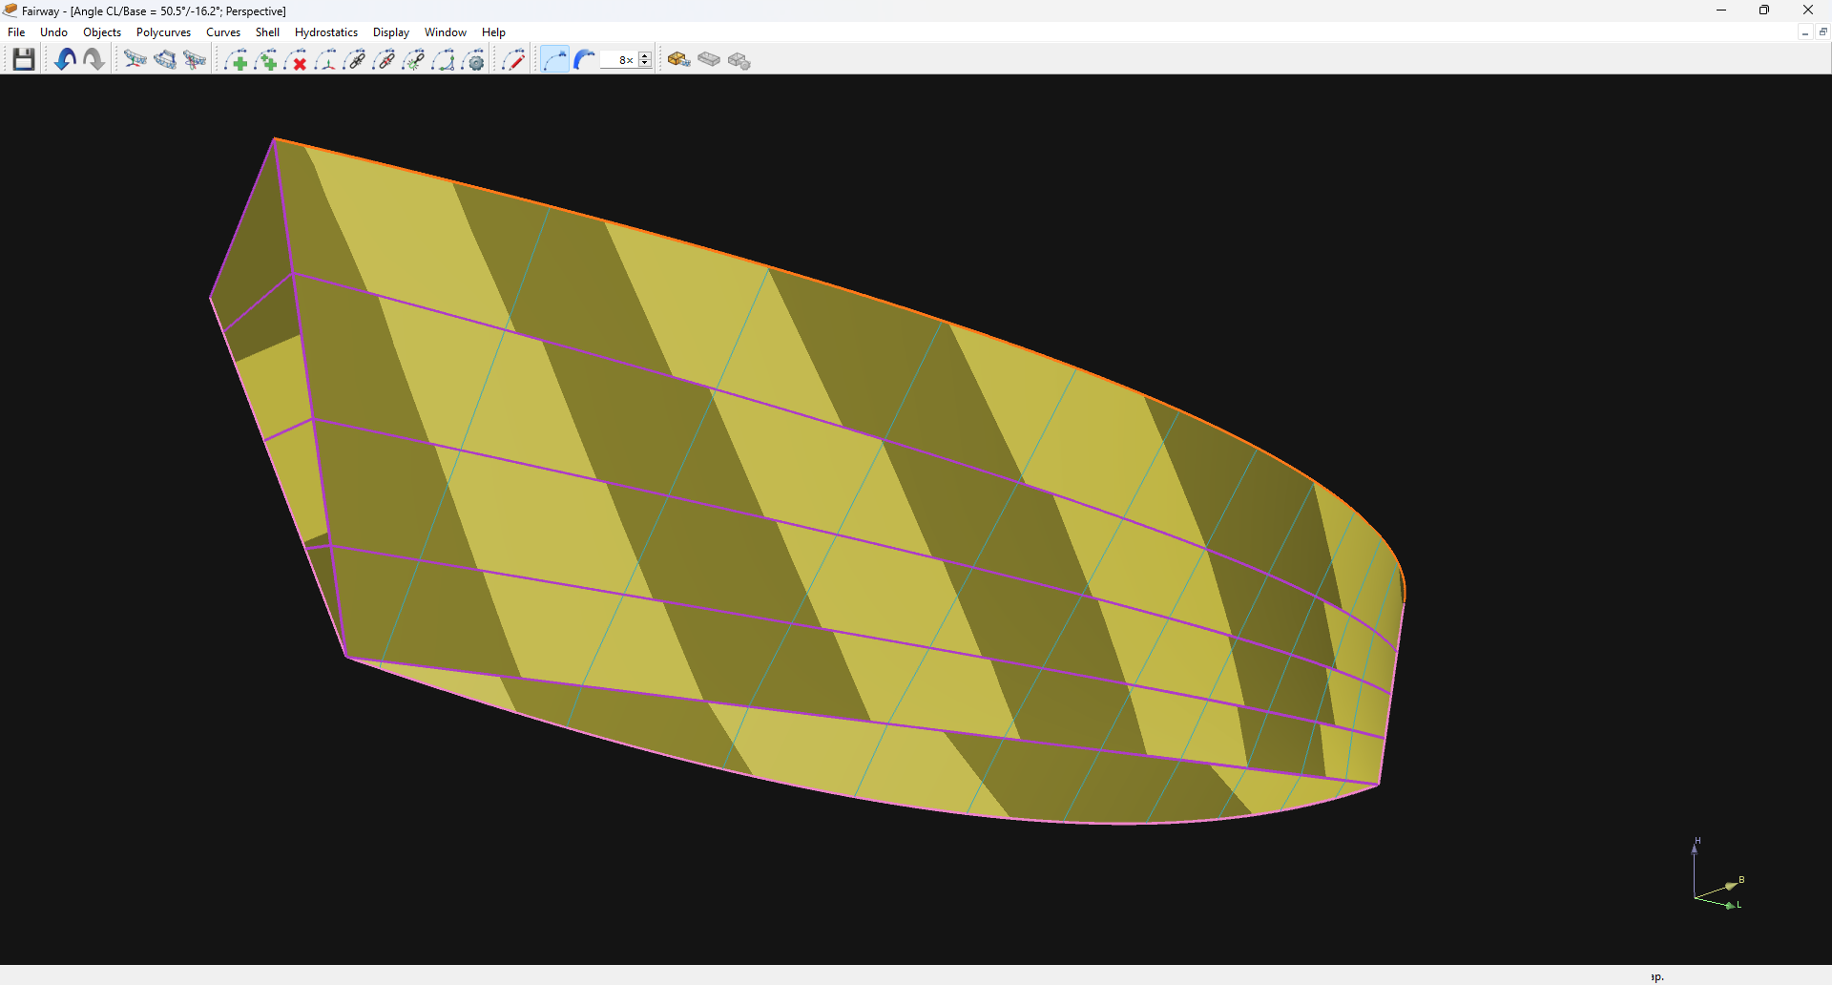
Fairway
Developable surfaces
Start: a ‘minimal hull’
Define bow and transom
Add seams
(planar curves & chines)
Add frames
(to see the shape more clearly)
Notes:
Interpolate some curves (through the knuckles, as an unconnected knuckle is ‘bad’).

Slide 21
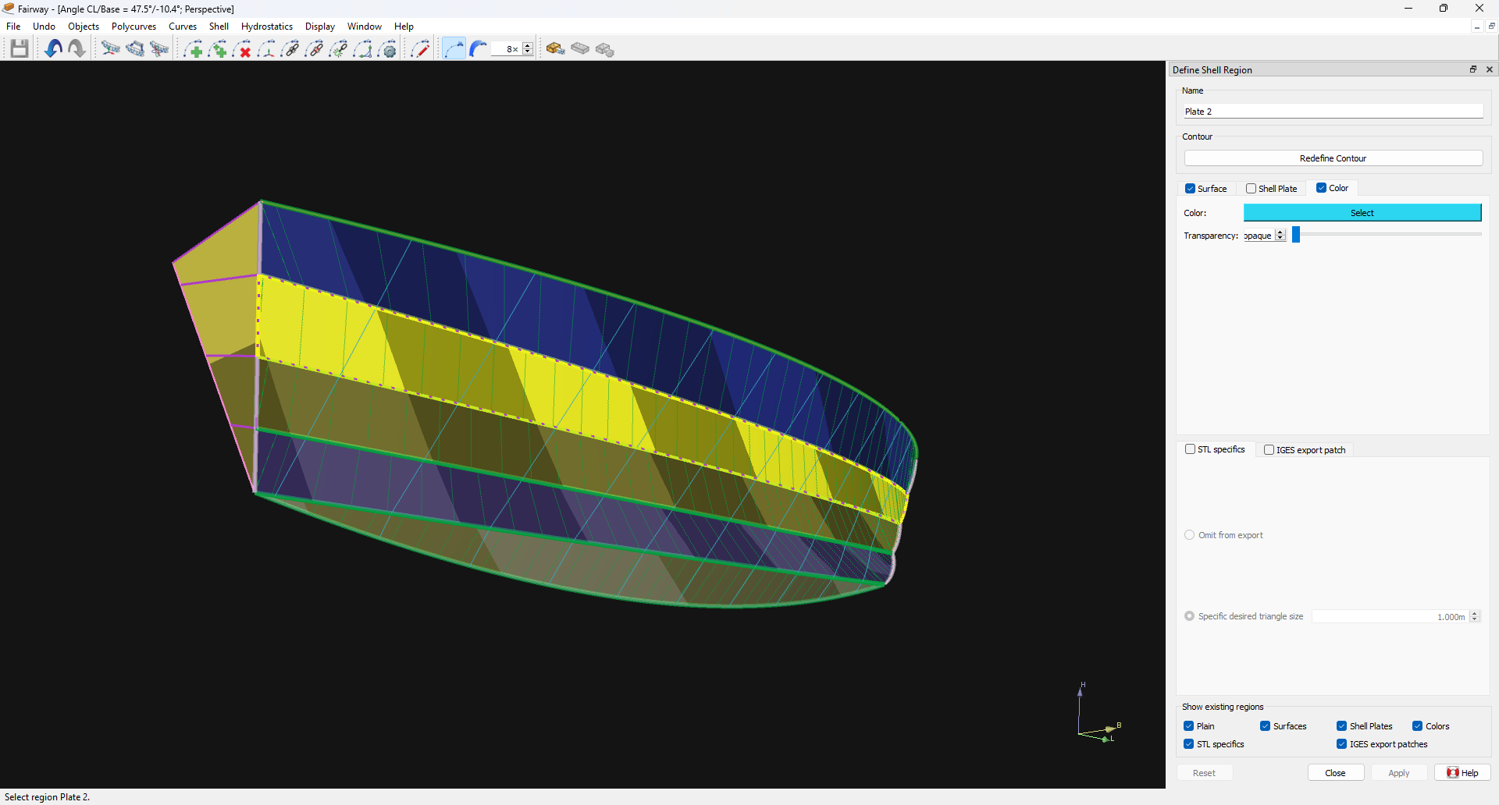
Fairway
Developable surfaces
Start: a ‘minimal hull’
Define bow and transom
Add seams
(planar curves & chines)
Add frames
(to see the shape more clearly)
Define shell regions
Notes:
Define ‘shell regions’ and specify those as ‘developable along 2 chines’
Note that other options are available, but this one allows the most freedom.

Slide 22
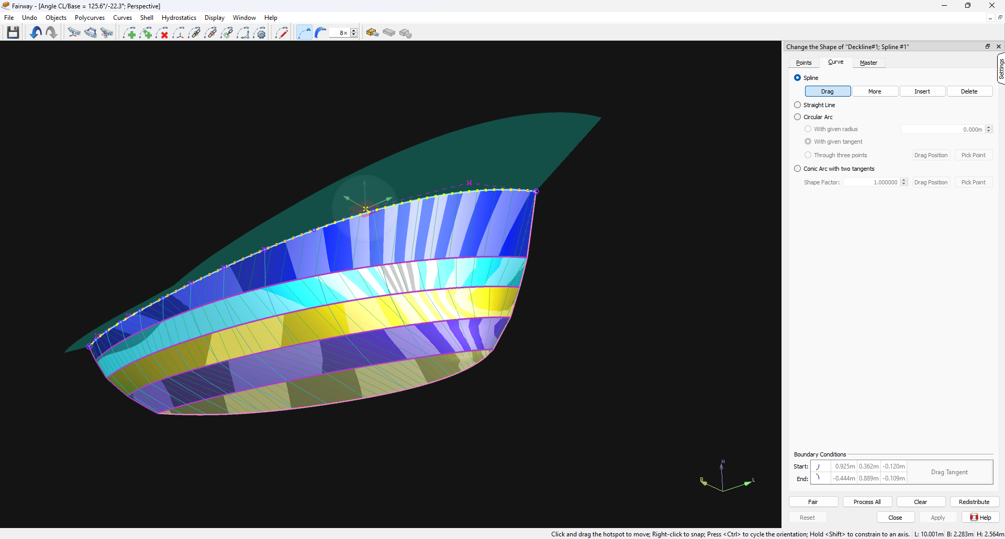
Fairway
Developable surfaces
Start: a ‘minimal hull’
Define bow and transom
Add seams
(planar curves & chines)
Add frames
(to see the shape more clearly)
Define shell regions
Change the boundaries
Notes:
The curves remain in their planes and can be manipulated via their points or vertices.
This example was done in less than 20 minutes (first time, second time should be faster).
See 3d model!

Slide 23
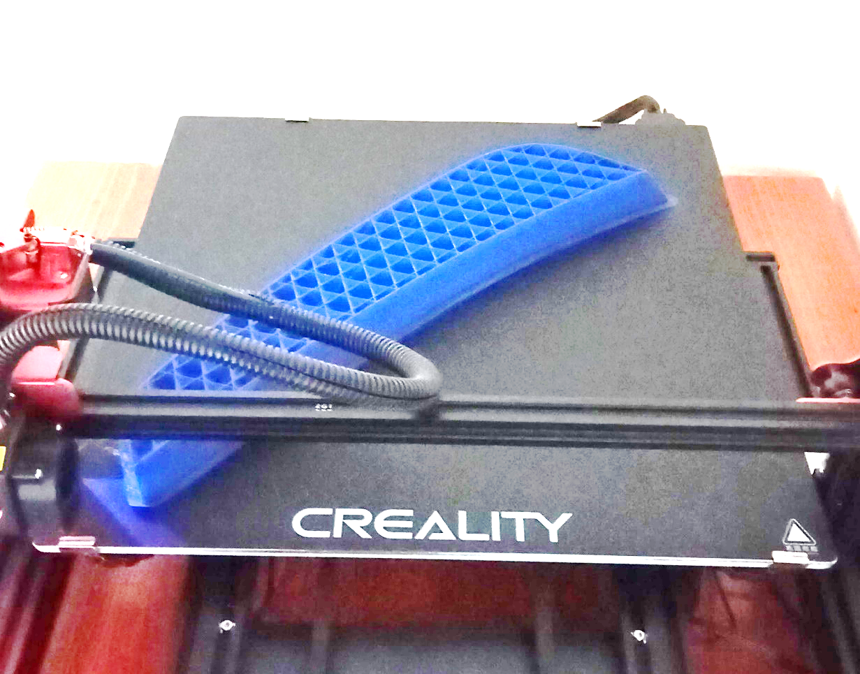
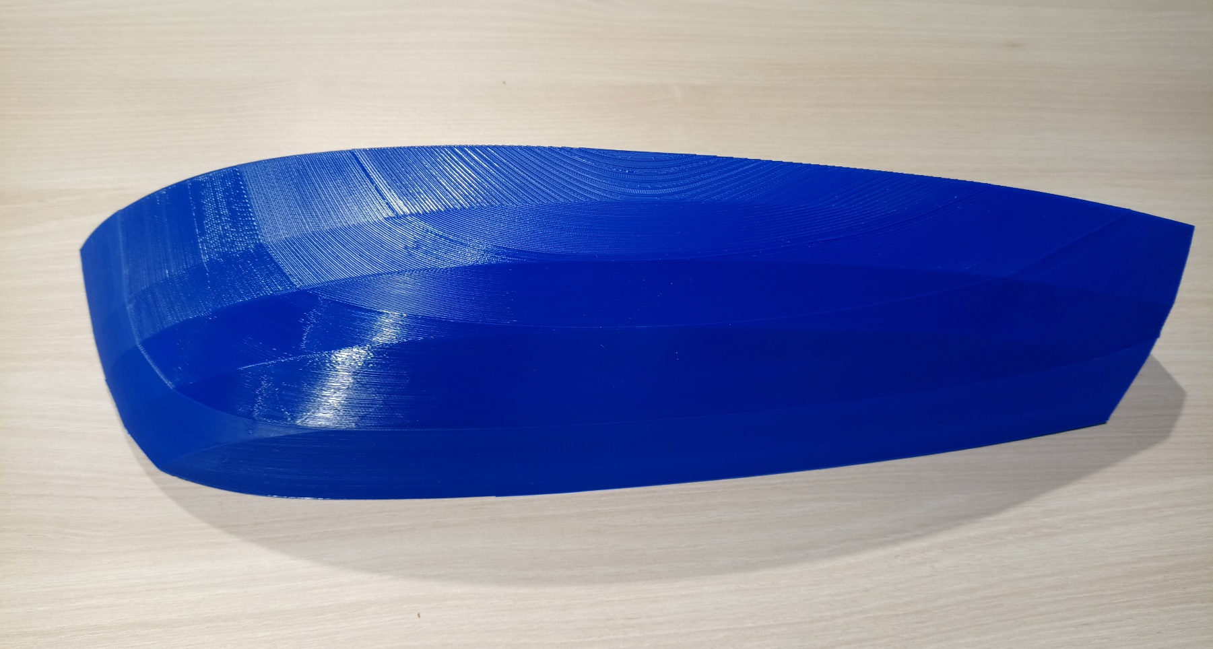
Fairway
Developable surfaces
Start: a ‘minimal hull’
Define bow and transom
Add seams
(planar curves & chines)
Add frames
(to see the shape more clearly)
Define shell regions
Change the boundaries
Showing off the model
Notes:
The 3d model! (Printing took considerably longer than the design).

Slide 24
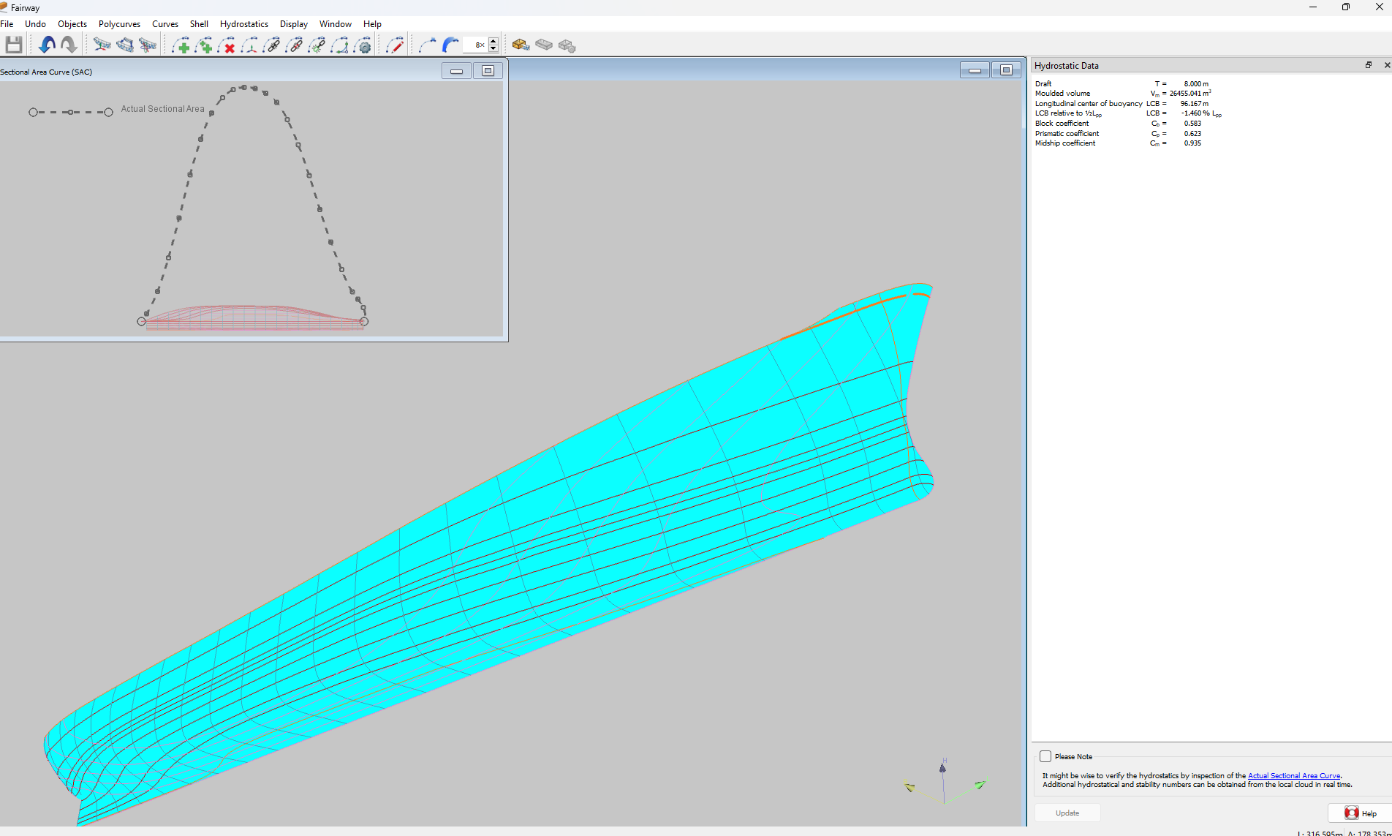
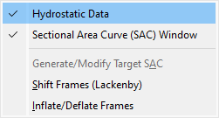
Fairway
Hydrostatics & Transformations
Hydrostatics
Notes:
Hydrostatic date are based on sectional area curve.
Make sure that is correct!

Slide 25
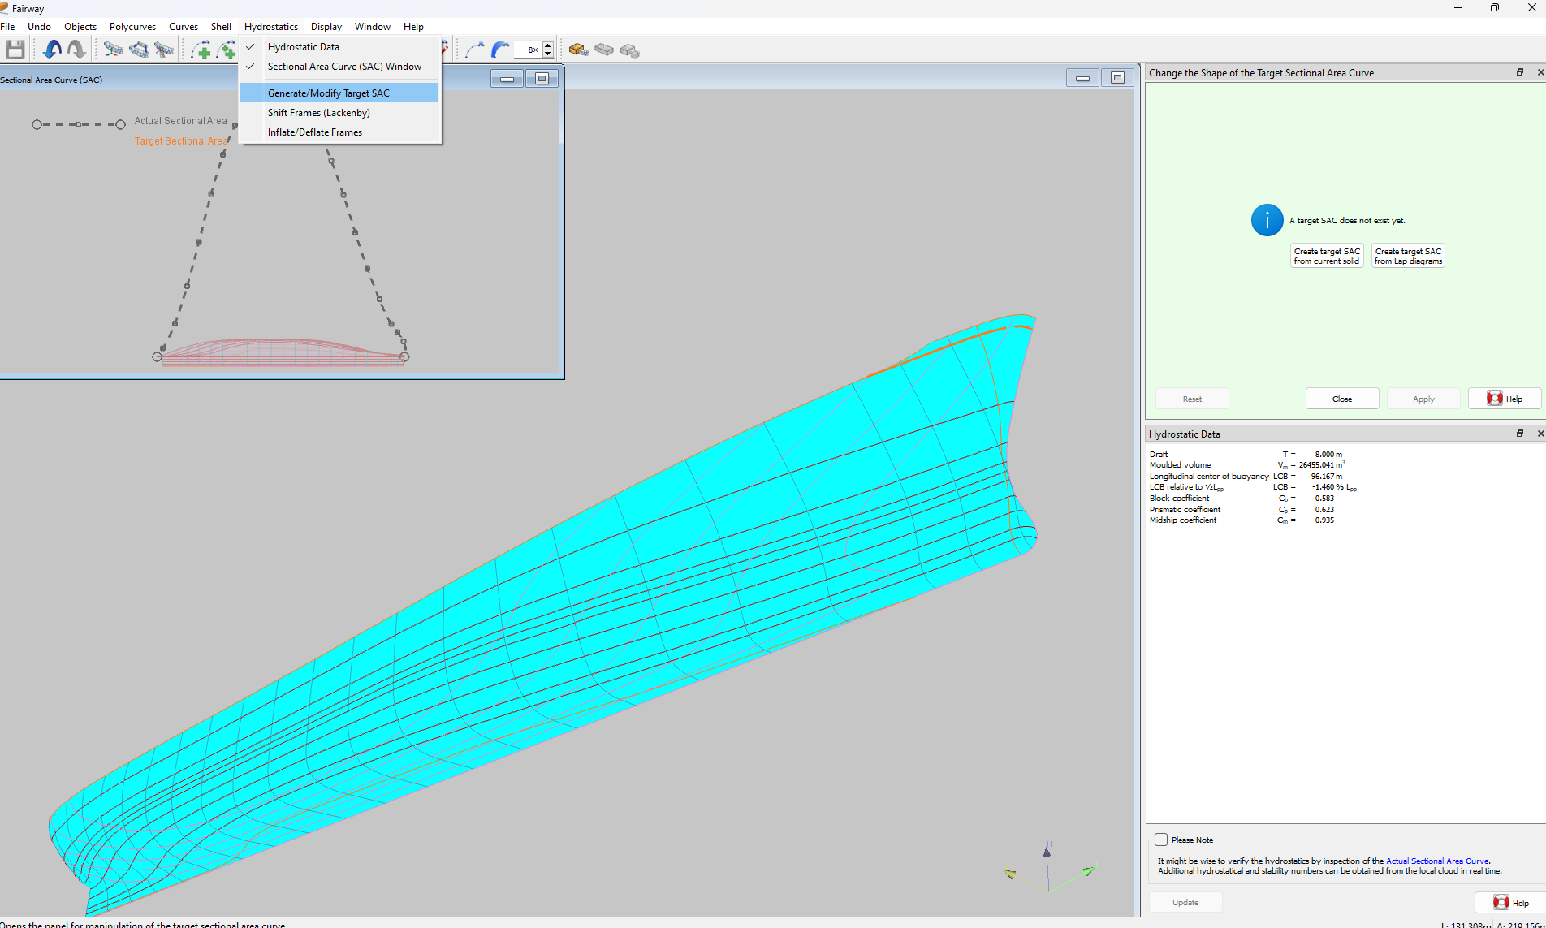
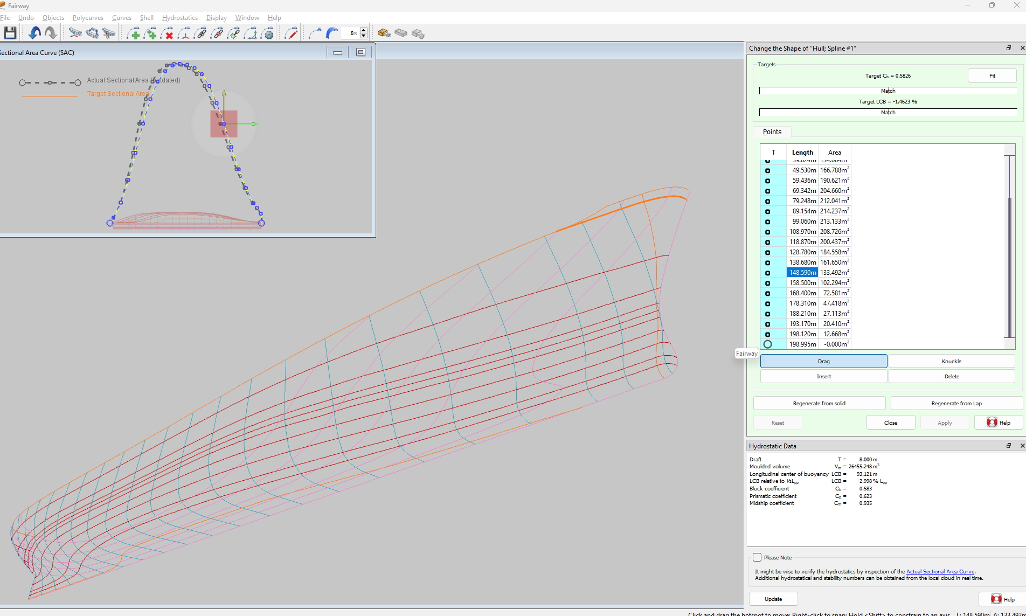
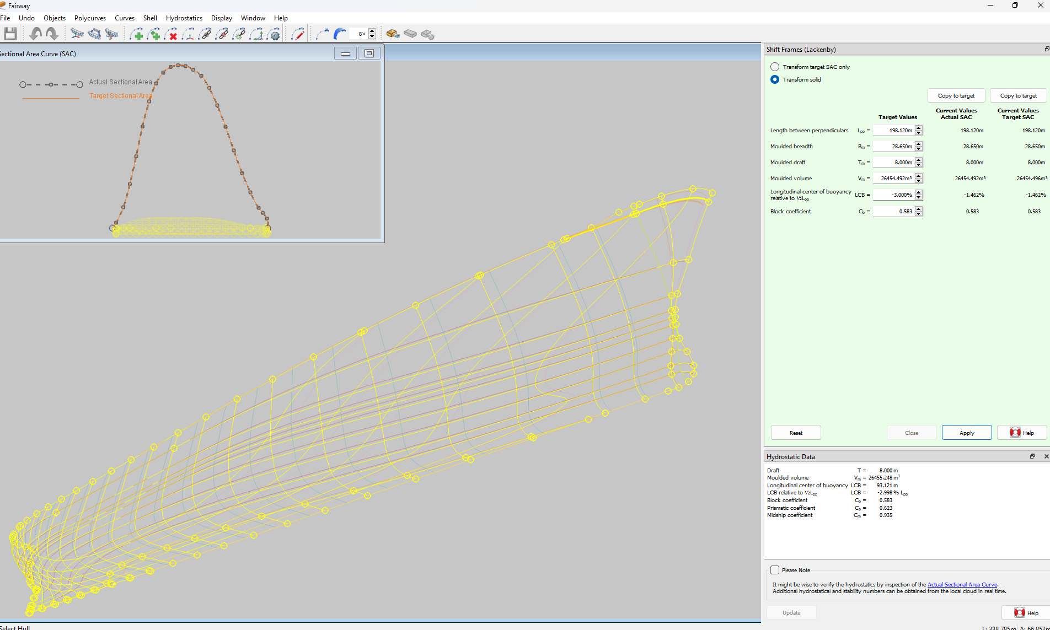
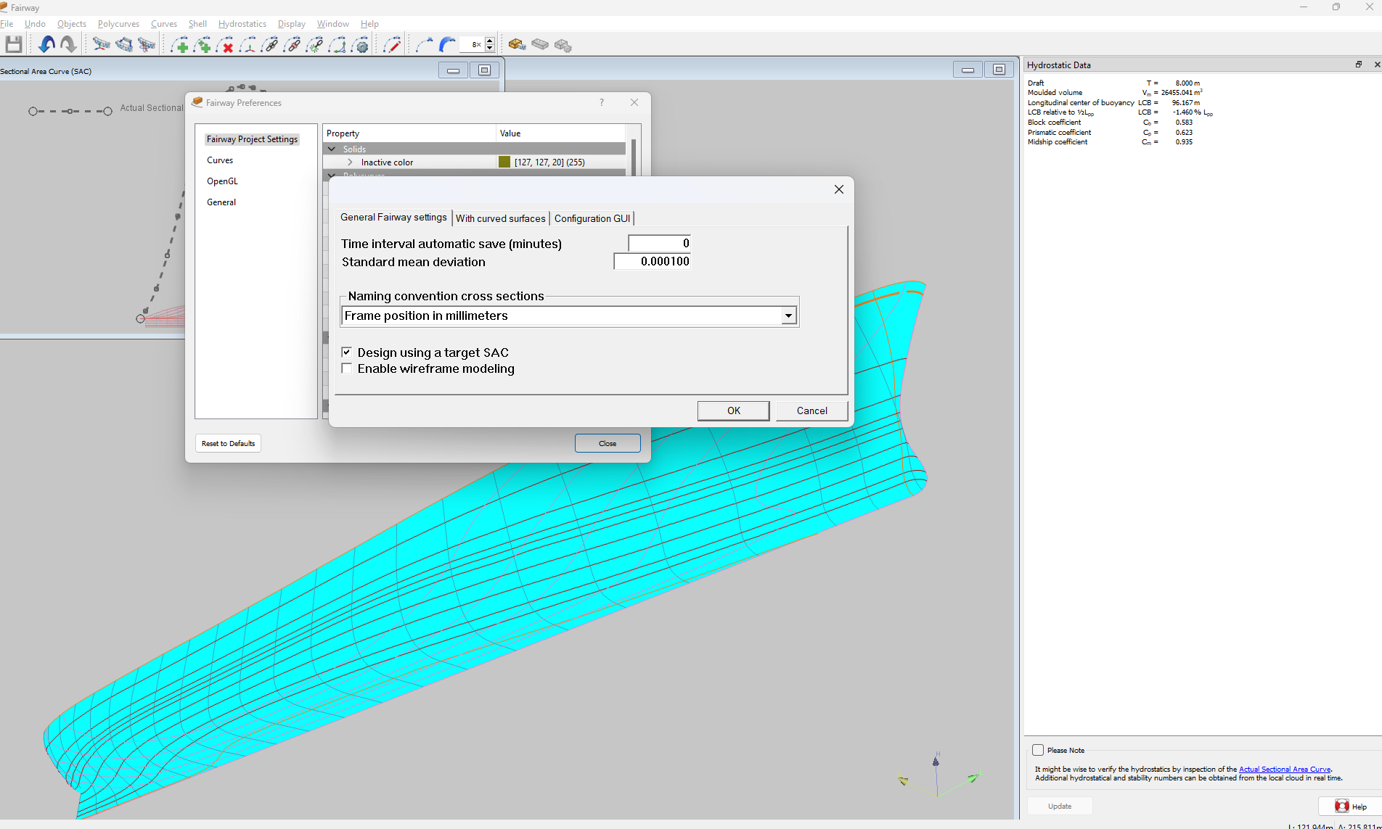

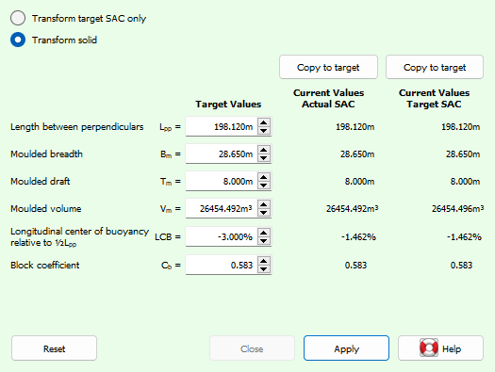
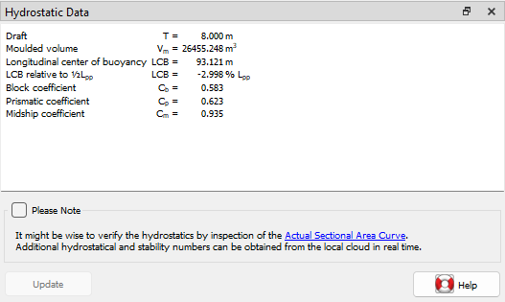
Fairway
Hydrostatics & Transformations
Hydrostatics
Lackenby frame shifting
(switch on first)
Notes:
Generate SAC: copy from current model or via LAP diagrams.
(At SARC we would typically use Frame shifting)
Make the transformation.

Slide 26
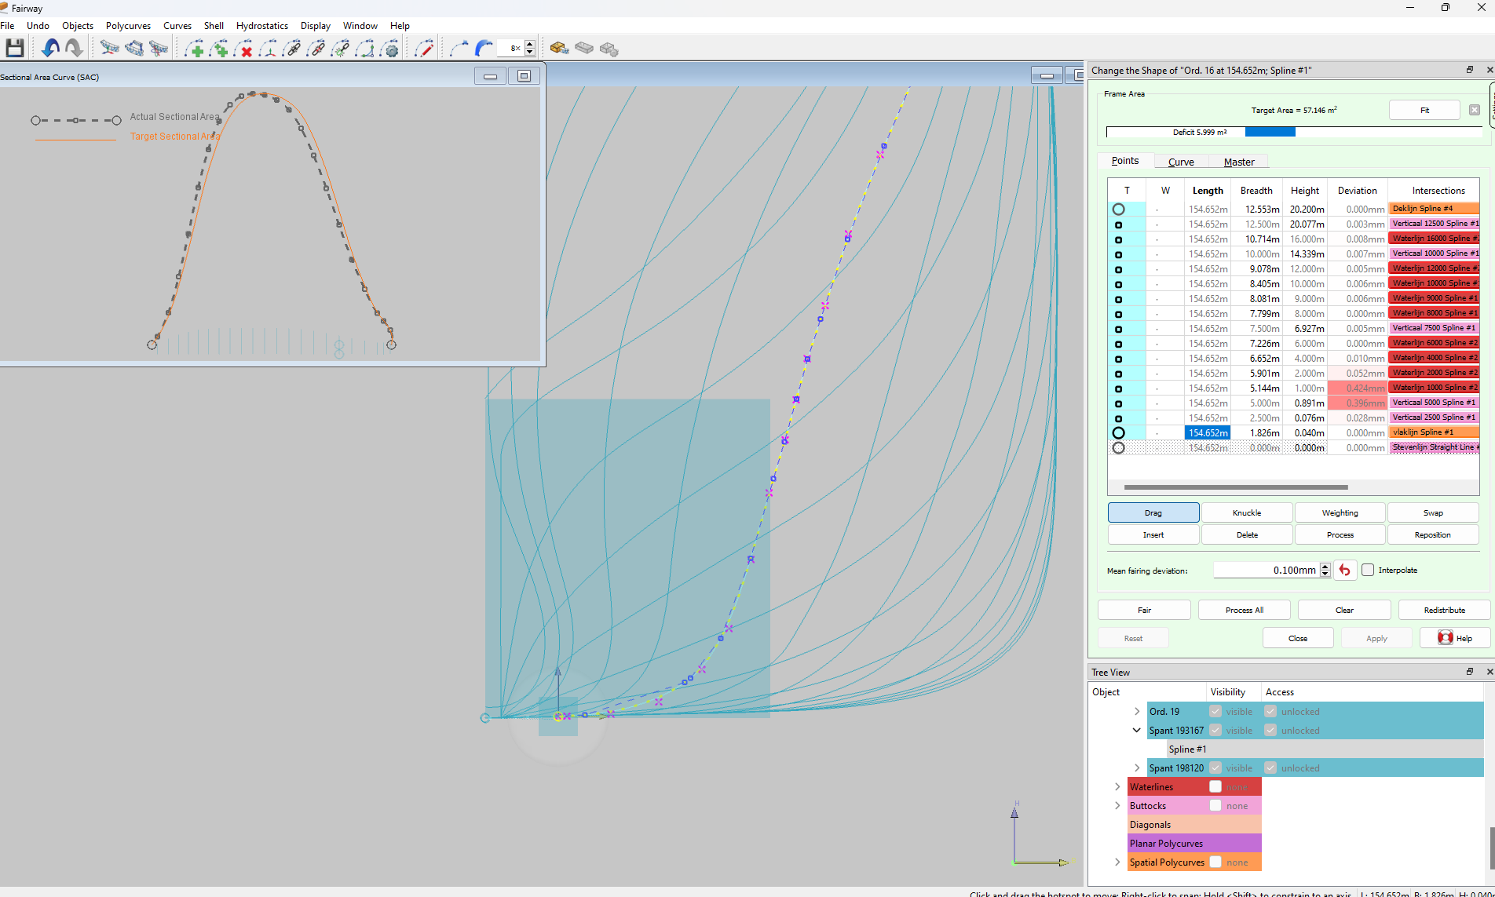
Fairway
Hydrostatics & Transformations
Hydrostatics
Lackenby frame shifting
(switch on first)
Manual frame modification
Notes:
Manual adjustment of frames to SAC area is supported
At early design stages, this may be useful (if working towards designed/generated SAC).

Slide 27
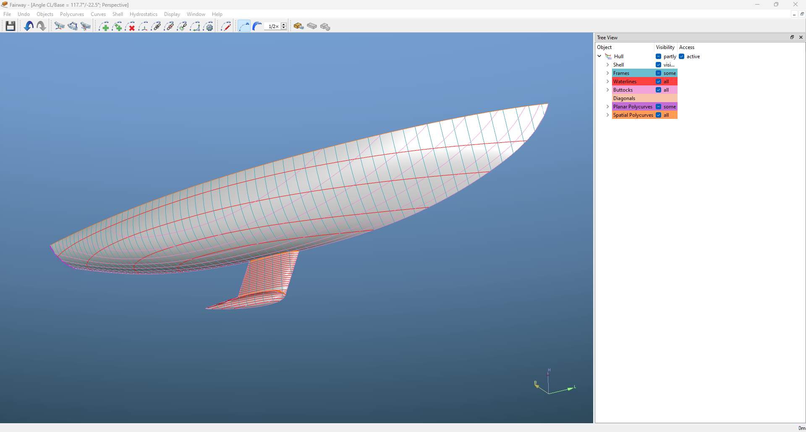
Fairway
Plate expansions
Some hull…
Notes:
A Fairway ‘parent hull’

Slide 28
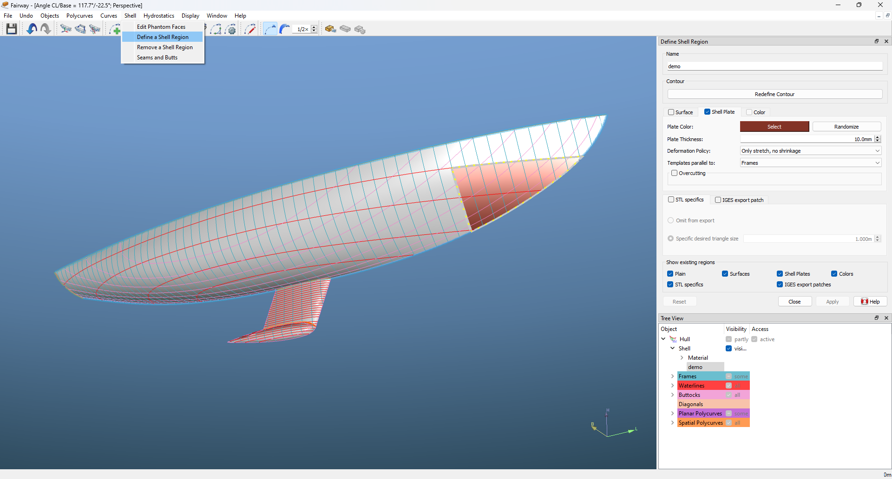
Fairway
Plate expansions
Some hull…
Define ‘Shell regions’
(select boundaries and settings)
Notes:
Define a plate, by simply selecting points on it’s contour.

Slide 29
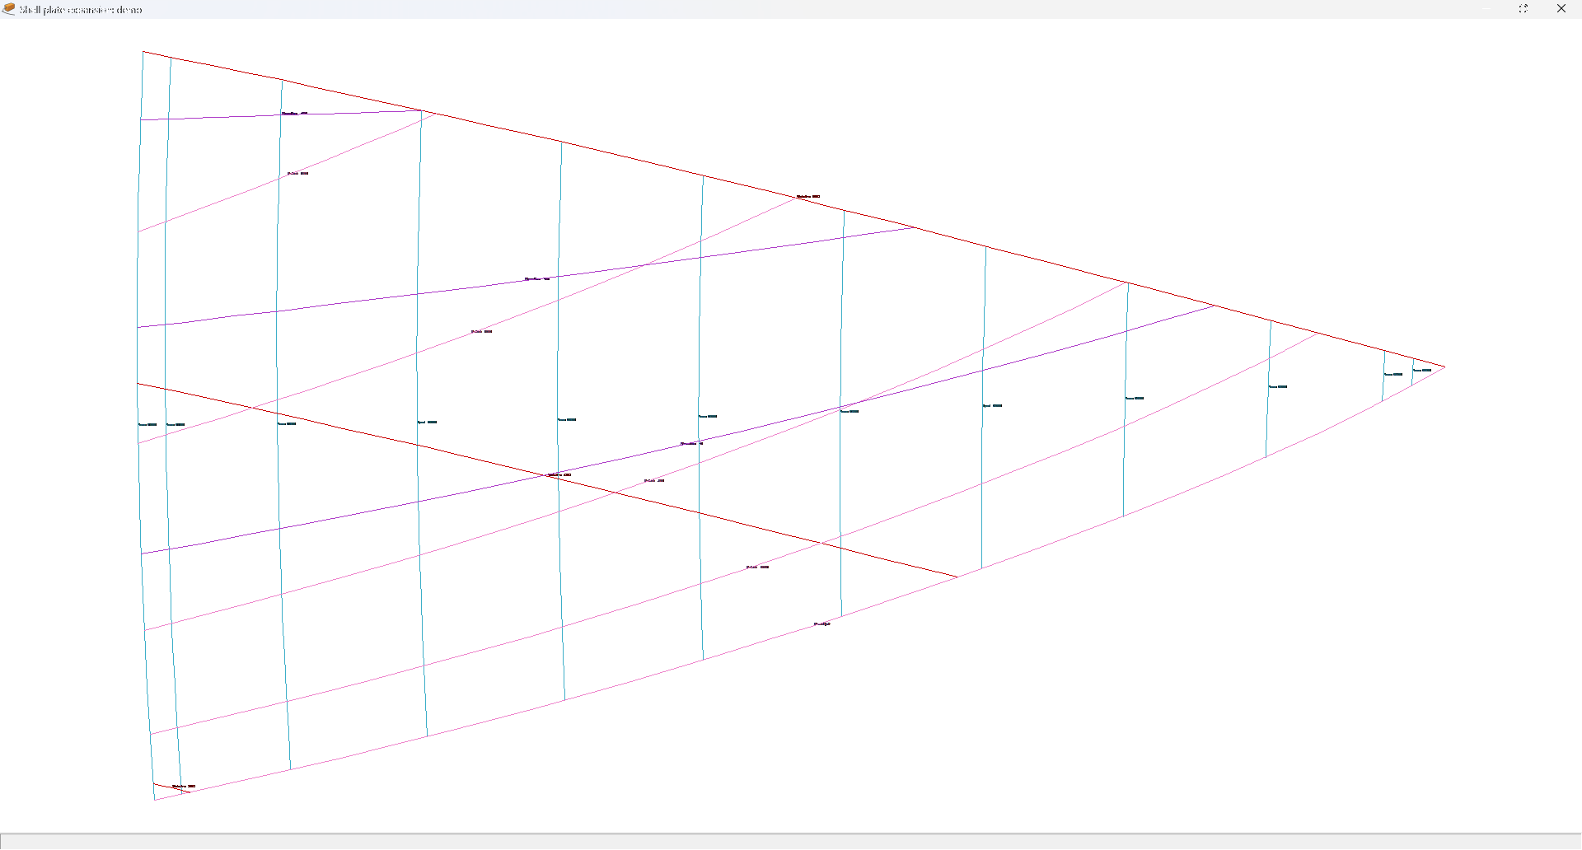
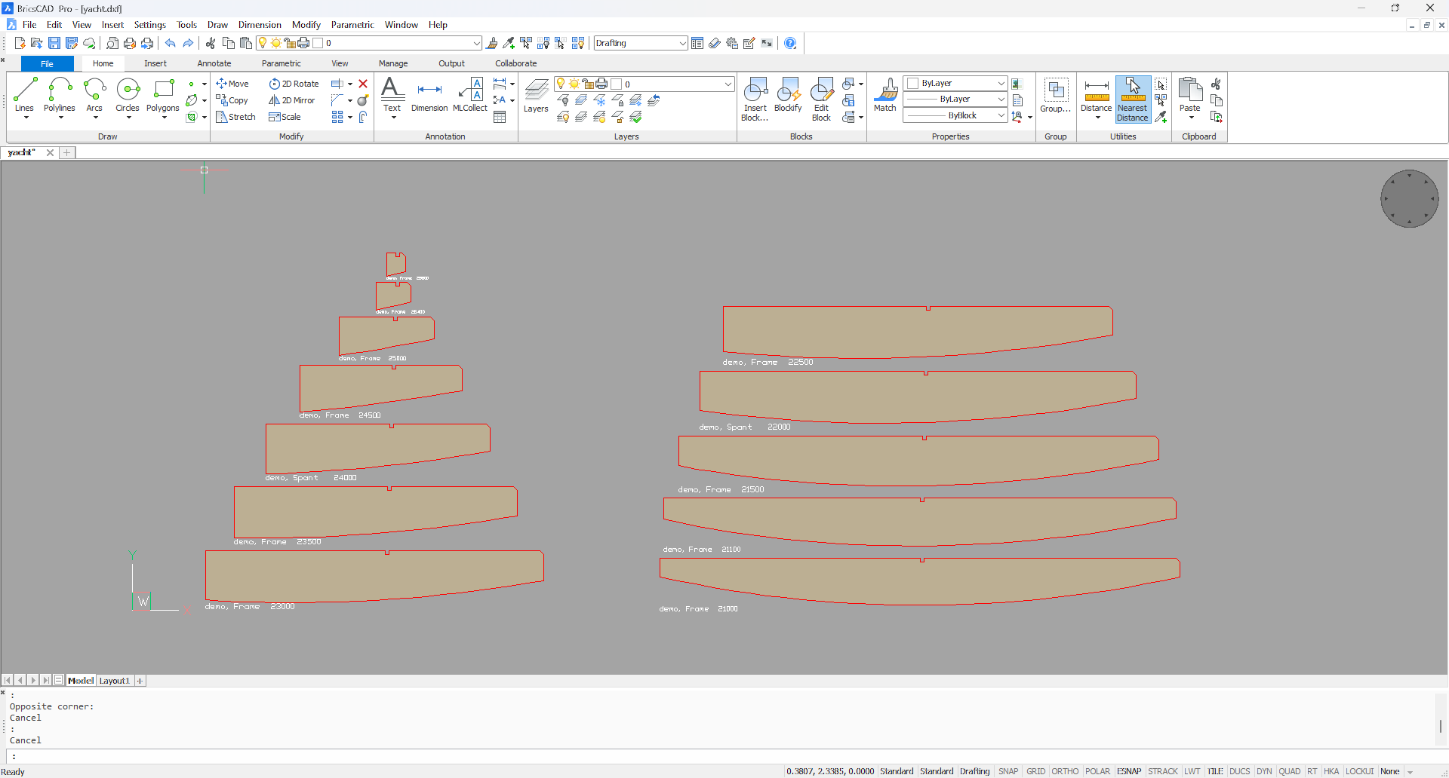
Fairway
Plate expansions
Some hull…
Define ‘Shell regions’
(select boundaries and settings)
Create plate expansions
(and tables and templates)
Notes:
The text menu’s will allow export of the plate expansion, templates and tables

Slide 30

Fairway
Plate expansions
Some hull…
Define ‘Shell regions’
(select boundaries and settings)
Create plate expansions
(and tables and templates)
Or…..
define butts and seams…
Notes:
Designate curves as ‘butts and seams’ and select ‘generate’
Note that plate generated for the keel was removed boundary:
This keel would be solid, rather than built from plates.

Slide 31



Fairway
Plate expansions
Some hull…
Define ‘Shell regions’
(select boundaries and settings)
Create plate expansions
(and tables and templates)
Or…
define butts and seams,
and put Fairway to work.
Notes:
Then, via the tekst menu, all info can be created for all generated plates.

Slide 32
Fairway
Import of models (1)
Question: Can Fairway read:
Rhino 3D Models (*.3dm), Rhino 3D Models Backup (*.3dmbak), Rhino Worksession (*.rws), 3D Studio (*.3ds), 3MF (*.3mf), Adobe Illustrator (*.ai), AutoCAD Drawing (*.dwg), AutoCAD Drawing Exchange (*.dxf), DirectX (*.x), E57 (*.e57), Embroidery (*.dst; *.exp), Encapsulated PostScript (*.eps), GHS Geometry (*.gf; *.gft), GTS (GNU Triangulated Surface) (*.gts), IGES (*.igs; *.iges), LightWave (*.lwo), Microstation (*.dgn), MotionBuilder (*.fbx), NextEngine Scan (*.scn), OBJ (*.obj), Geomview OFF (.off), OpenInventor (.iv), Portable Document Format (*.pdf), PLY (*.ply), Points (*.asc; *.csv; *.txt; *.xyz; *.cgo_ascii; *.cgo_asci; *.pts), Raw Triangles (*.raw), Recon M (*.m), Scalable Vector Graphics (.svg), SketchUp (*.skp), Slice (*.slc), SOLIDWORKS (*.sldprt; *.sldasm), STEP (*.stp; .*step), STL (Stereolithography) (*.stl), VDA (*.vda), VRML (*.vrml; *.wrl), WAMIT (*.gdf), ZCorp (*.zpr) ?
Answer: Only the highlighted ones (depending on content)
In most cases files can be converted via Rhino or other generic CAD software to suitable IGES or DXF files
And of course: PIAS models.
Notes:
The list of file types is from Rhino’s Help; there may be (many) more.

Slide 33
Fairway
Import of models (1)
Question: Why only IGES and DXF and why depending on content?
Answer:
IGES and DXF are the most used and suitable
These are open formats, with virtually unlimited number of entity types.
Better/faster/cheaper to convert some items than to implement all.
Notes:
To many file formats to implement, and to little use for most of them anyway.

Slide 34
Fairway
Import of models (1)
Question: Why is import from IGES or DXF not straight forward?
Answer (part 1):
The entire data structure of Fairway is more complex (superior, even) than the commonly used NURBS surfaces, NURBS curves or polylines.
Every curve in the model may only be defined once (contrary to matching boundaries of NURBS surfaces).
In Fairway, the user manipulates curves: the ‘gaps’ between curves are filled automatically.
See manual
Notes:
Self-explanatory text

Slide 35
Fairway
Import of models (1)
Question: Why is import from IGES or DXF not straight forward?
Answer (part 2):
A lot more is explained in the manual:
  https://www.sarc.nl/images/manuals/pias/htmlEN/fwy_wireframes.html#fwy_IGES_import
  https://www.sarc.nl/images/manuals/pias/htmlEN/fwy_wireframes.html#fwy_DXF_import
The conversion must (typically) create a solid from a wireframe. If that were easy, any CAD software could do it. More info is found in the manual:
  https://www.sarc.nl/images/manuals/pias/htmlEN/fwy_wireframes.html#fwy_wireframes_brief_introduction
Notes:
Reference to manual

Slide 36



Fairway
Import of models (2)
Start with IGES model
(Ah, Houston, we've had a problem)
Notes:
Select the file, with some settings

Slide 37




Fairway
Import of models (2)
Start with IGES model
(Ah, Houston, we've had a problem)
Fix the problem(s)
Notes:
Remove the ‘offending’ curves
Recreate these curves with ‘connect points’

Slide 38


Fairway
Import of models (2)
Start with IGES model
(Ah, Houston, we've had a problem)
Fix the problem(s)
Generate ‘Connections’
(automatically, with settings)
Notes:
Generate all (other) connections automatically (with settings).

Slide 39



Fairway
Import of models (2)
Start with IGES model
(Ah, Houston, we've had a problem)
Fix the problem(s)
Generate ‘Connections’
(automatically, with settings)
Check & correct wireframe
Notes:
A conversion can only suceed for a correct wireframe

Slide 40







Fairway
Import of models (2)
Start with IGES model
(Ah, Houston, we've had a problem)
Fix the problem(s)
Generate ‘Connections’
(automatically, with settings)
Check & correct wireframe
Generate solid model &
fix issues until done
Notes:
Issues may still occur (say a connection is not found).
Check connections and 2-connectivity
Other errors are typically result of 2-connectivity or incorrect connections (to many/to few).

Slide 41

Fairway
Import of models (3)
Typical problems:
‘Non watertight models’
(Naked edges)
Notes:
You may expect some issues here

Slide 42


Fairway
Import of models (3)
Typical problems:
‘Non watertight models’
(Naked edges)
Overcomplete models
(Overlapping curves and/or surfaces)
Notes:
Double curves are automatically deleted, but the fewer the occur, the higher the success rate!
Double surfaces should not occur because of that.

Slide 43

Fairway
Import of models (3)
Typical problems:
‘Non watertight models’
(Naked edges)
Overcomplete models
(Overlapping curves and/or surfaces)
Overly detailed models
(will simply take ‘forever’)
Notes:
KISS (Keep It Stupid Simple)

Slide 44


Fairway
Export of models
Fairway legacy export
(NURBS patches to Rhino via IGES)
Notes:
The (not so good) old days

Slide 45



Fairway
Export of models (DTC)
Fairway legacy export
(NURBS patches to Rhino via IGES)
LEANURBS
(Lowest Effective Amount of NURBS)
Notes:
LEANURBS Rather a neat trick, actually!
Surfaces are ‘watertight’ !

Slide 46


Fairway
Export of models (DTC)
Fairway legacy export
(NURBS patches to Rhino via IGES)
LEANURBS
(Lowest Effective Amount of NURBS)
But HOW?
(Coons patch + offset perpendicular to it)
Notes:
Simple surface (Coons patch) gives 4 sided patch
Perpendicular offset to actual Fairway surface

Slide 47

Fairway
Export of models (DTC)
Fairway legacy export
(NURBS patches to Rhino via IGES)
LEANURBS
(Lowest Effective Amount of NURBS).
But HOW?
(Coons patch + offset perpendicular to it)
Other export formats:
Notes:
Disused formats not shown (for obvious reasuns)

Slide 48
Fairway
Tips
On modeling:
Less is more
First things first
Beware of discontinuities
Use the many features
See the demo’s
Other
R.T.F.M. (Read The (user)Friendly Manual)
Practice
We offer training
Save regularly
Notes:
Any Questions till now?

Slide 49

Fairway
Q & A?
Notes:
Any Questions till now?

