Slide 1
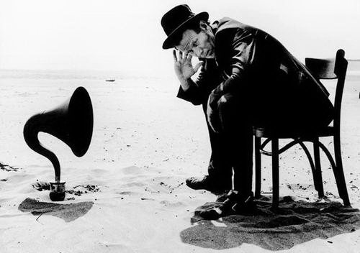
Tell me
An summary of the May 24 COMPIT presentation
Herbert Koelman

Slide 2
On the acceptance of innovations
In the childhood of SARC.
Adulthood.
Looking back.
Future?

Slide 3
1. The childhood of SARC (the eighties)

Slide 4
Childhood
Replacing manual labour.
From 1000 hours for a complex dam.stab. analysis to 100 (in those days).
Smooth market reception.
Hull form generation module only 60x12 meter!
Because PIAS did essentially the usual and familiar work.
Adding ever more computational tasks (deadweight scale, probabilistic damage, IMO grain code, hopper stability).

Slide 5
2. Adulthood (1995 – now)

Slide 6
Conventional developments
More functions.
More features.
More output formats and options.
More support (e.g. integrated manual, instruction movies).
Conventional developments are registered in a ticketing system. From which 2.500 are closed, and 500 still open.
So, we may conclude that essentially this development is more or less finished.
Essentially.

Slide 7
Advanced developments
Software collaboration, integration and interfacing.
The balance between computational accuracy and computation time.
Enhanced representations or algorithms, aimed at improving the effectiveness and efficiency of the program.
The fruits of novel technologies, such as fast optimization, machine learning and AI.

Slide 8
Examples of advanced developments
As discussed today:
Fairway.
LEANURBS.
Interconnectedness between compartments, bulkheads and decks (in Layout).
Numerical integration in prob.damstab.
Multithreading.
Constraint management as design aid.
Ballast optimization in LOCOPIAS.

Slide 9
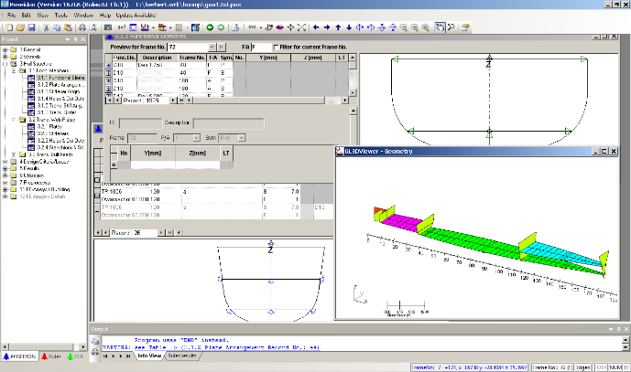
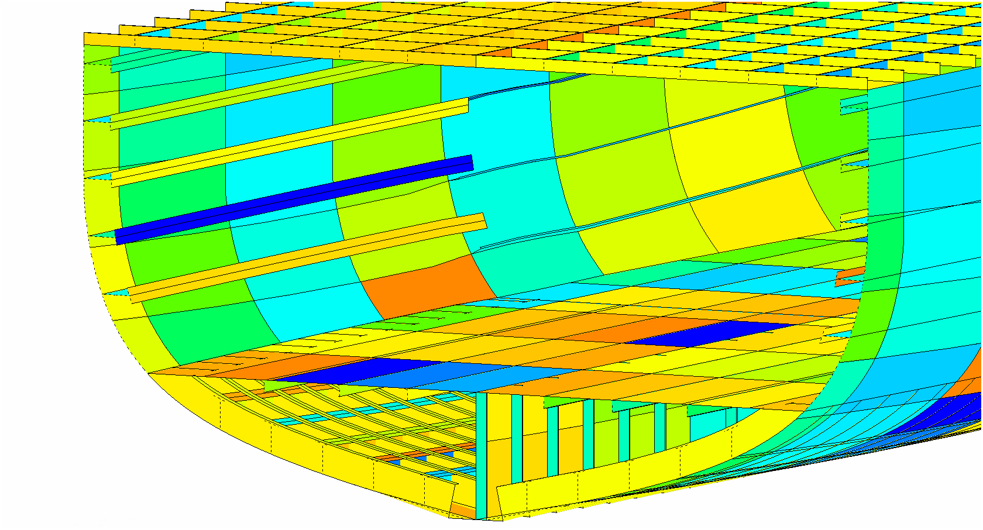
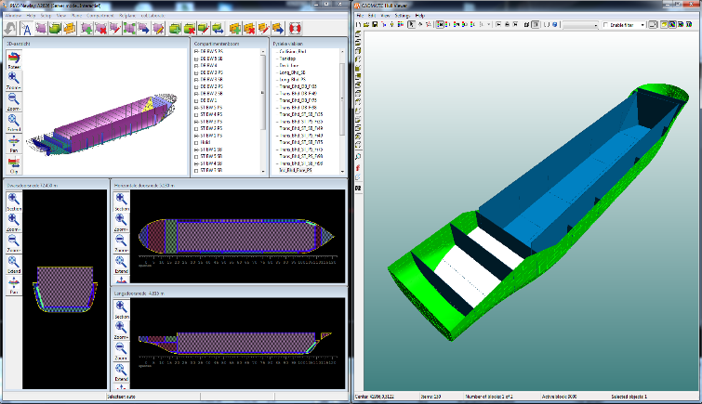
Examples of advanced developments
Other:
Container optimization in LOCOPIAS.
CADMATIC – PIAS interface.
Interface with DNV Poseidon.

Slide 10
Reception of these advanced developments
Not particularly warm.
Sales ratio compared to conventional PIAS modules 5-15%.
Why?

Slide 11
3. Looking back

Slide 12
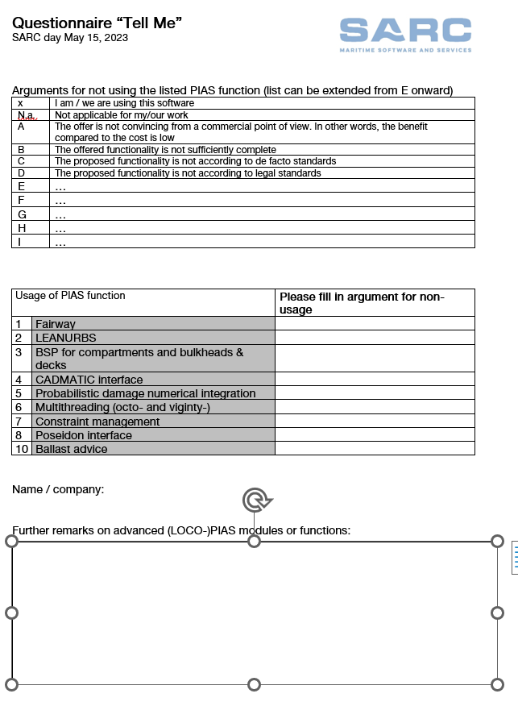
Why?
In the Compit paper I announced to ask you, today.
So, if applicable, please fill in the questionnaire.
Where you can provide arguments for not using mentioned advanced software modules.

Slide 13
My estimations
The offer is not convincing from a commercial point of view. In other words, the benefit compared to the cost is low.
The offered functionality is not sufficiently complete.
The proposed functionality is not according to de facto standards.
The proposed functionality is not according to legal standards.
In the paper I made some comments on these arguments.
Comment on container loading optimization (around 2005):
Manually: a day.
With the LOCOPIAS optimization program: 15 minutes.
Insufficient; requirement 5 minutes.

Slide 14
Status quo
Is the market happy now? Is there no real need for advanced software?
Could be. In the 80s we witnessed a productivity gain of a factor ten.
And now by an estimated 1.5, 2 or 3.
Although it is not only on acceleration of existing processes. Today everybody is expecting salvation by Big Data, AI and machine learning. See the national Maritime Master Plan.

Slide 15
Considerations 1
Provisional considerations and conclusions:
Norms and standards can stimulate or prevent innovations. Please realize that sticking for too long to an outdated standard leads to stagnation.
SARC will pursue to better quantify costs/benefits. Example: Layout battle.
A ship designer is not a software developer. Nevertheless, some knowledge of software backgrounds can be of assistance for users. NHL Stenden provides a course in this area, Advanced Engineering Tools for ShipX.

Slide 16
Considerations 2
In case of software with a pilot nature, SARC will emphasize that the included functionality is only a preview, and not the final set. And that the software will grow during its usage.
On the other hand, potential users are asked to realize that software will only be actually finalized on basis of proven user interest.

Slide 17
Considerations 3
Users are asked to accept that the days of productivity gains of 100s % are over. But the risks of buying newer software are also much lower. After all, in the early 1980s, one bought a software package with a price of an average car from a one-man startup. And now one buys the innovative add-on modules for the price of an electric bicycle.

Slide 18
4. Future

Slide 19
Conclusion
Awaiting the response on the survey we will proceed with the development of novel software tools, because, until shown otherwise, it is still our belief that this will serve the maritime industry.
Presented by Herbert Koelman.

Slide 20
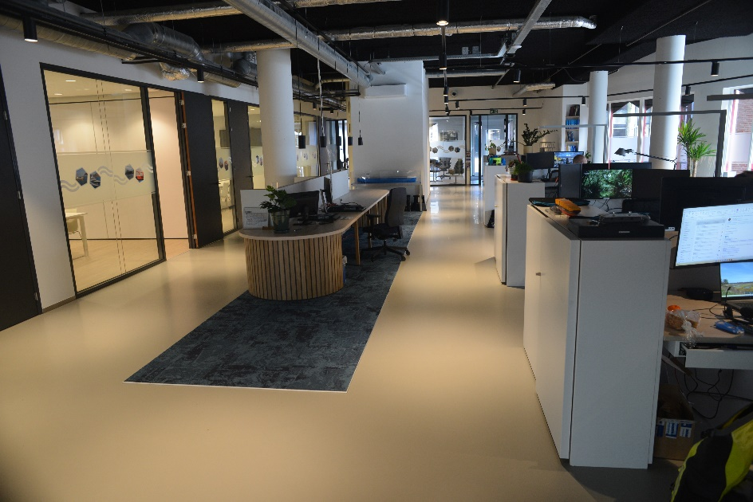
Postscript

