Slide 1
Recent developments in PIAS
Mark Visser
Naval Architect
Notes:
Next 20-30 mins present RDIP
During this PR discuss following topics

Slide 2
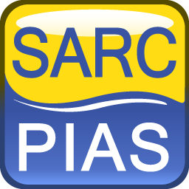
Subjects
Introduction
Restructuring software design
Output languages
Layout
Revised inclination test module
PS & SB
Octo-threading & AVX
Some ‘smaller’ modifications worth mentioning
New license mechanism CODEMETER
Obtain and install PIAS updates

Slide 3
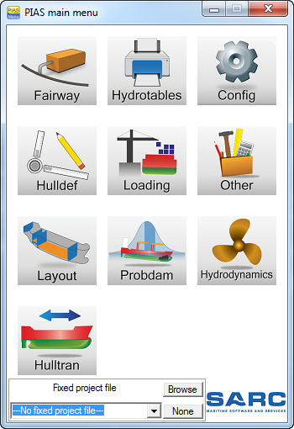
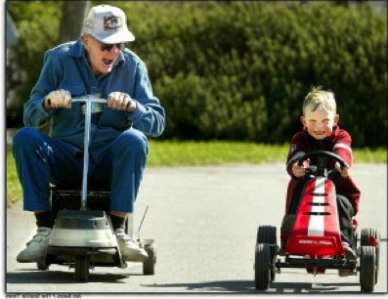
Restructuring software design
Notes:
I prepared this slide, the old PIAS menu VS the new/young menu, because it very well reflects 1 of the major changes of a large scale renewal of our PIAS software, which started in 2011 and has been released in 2016, last year.
The original PIAS was subdivided in many distinct modules, each for a specific task, such as hydrostatics, bonjean, cross curves damage stability etc.
Relevant modules were combined and restructured and with results in a new PIAS structure which consists of a more concentrated set of modules, as refelected by the new main menu you see here.

Slide 4
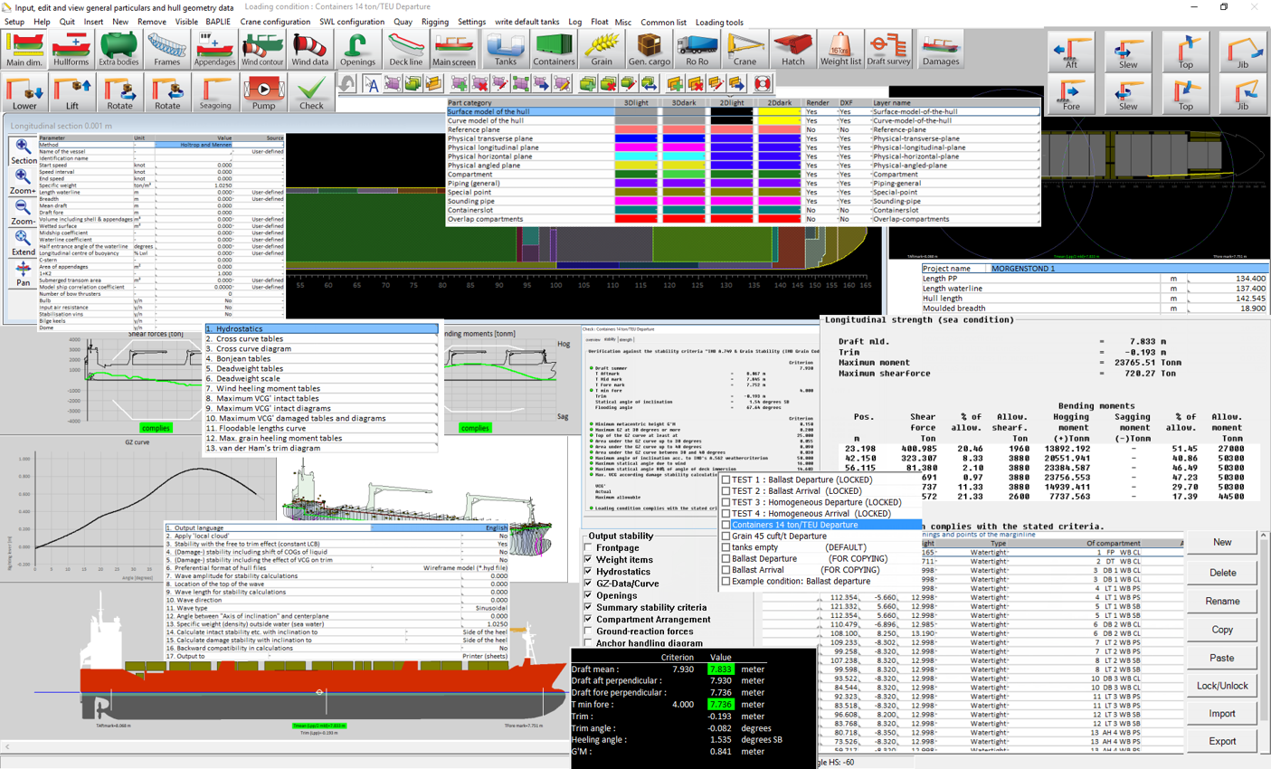
Why Modules?
Notes:
why modules anyway, why not 1 interface, 1 single point of contact between user and software. The Answer is Simple, PIAS contains so many features, functions and computation settings, it would be physically impossible to present all on 1 monitor, and secondly this will be very confusing for the user. So up to a certain level a modular structure is desirable

Slide 5
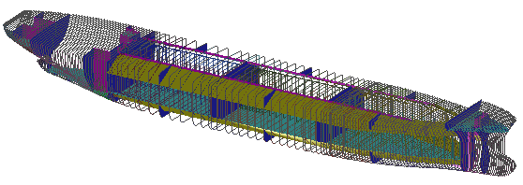
single data model with well arranged modules
Collaboration of modules
Commit
update
Commit
update
update
Commit
Notes:
A drawback of modular design is the collaboration between distinct modules. In PIAS we solved this by a design where all ship data are shared locally (so on 1 PC) between modules. We baptized this “PIAS local cloud“ and it will be available later this year.
This Local cloud permanently synchronizes data in the background, modules commit changes and update the required project data without specific user interaction required. So the cloud makes it possible to work with multiple modules simultaneously on 1 PC. So for example, a modification in hull form is directly visible in the hydrostatics of a loading condition.
In this way we combine a single data model, with well arranged modules that are focused on the main task.

Slide 6
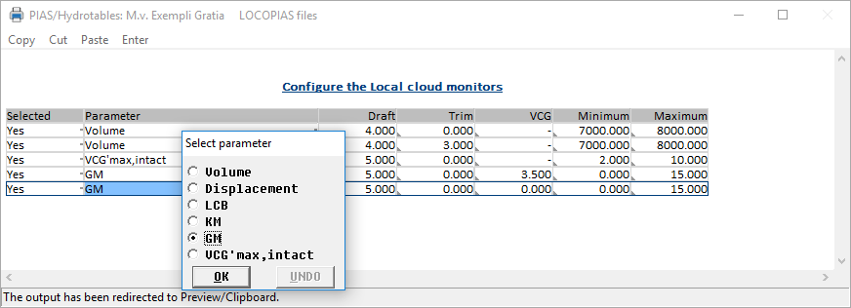
Cloud monitors
Notes:
Furthermore hydrotables is able to eavesdrop on the cloud. You can configure several cloud monitors, as shown. On activation, these monitors will appear on screen as shown below. So it is f.e possible to work on the hull in fairway and directly see the corresponding volume or other relevant values in the monitors.

Slide 7
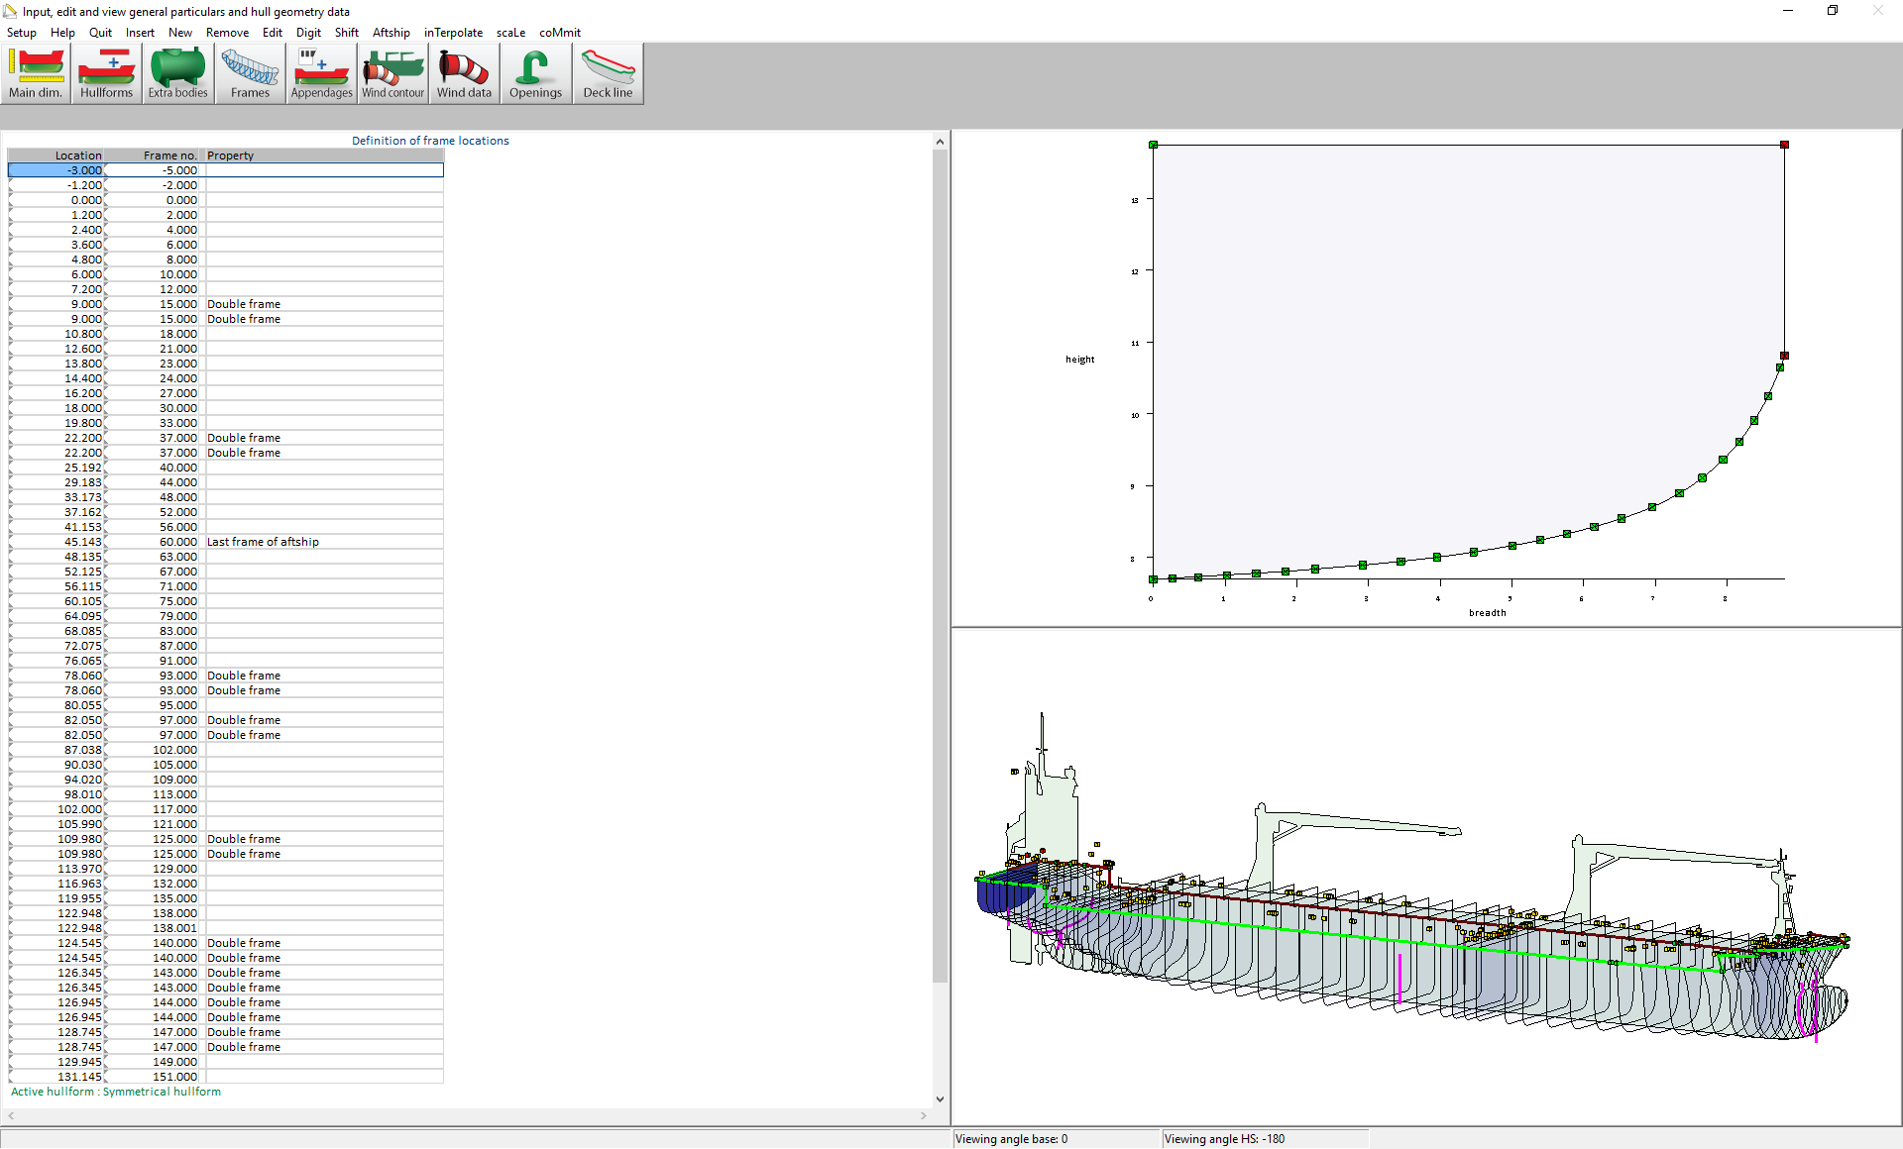
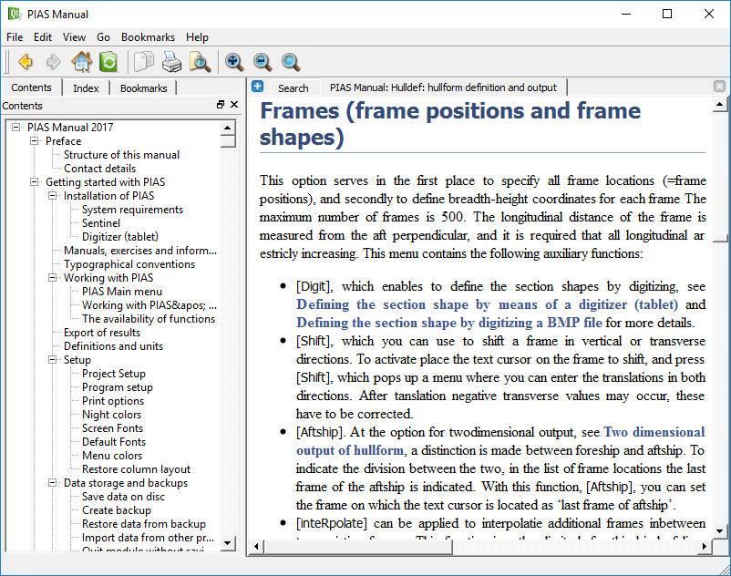
Context sensitive help
www.sarc.nl/downloads
Notes:
Besides this structural reform, we have used this opportunity to make more use of dedicated graphical user interfaces to give the user where possible, a direct feedback on his input data. Furthermore a lot of time and effort is spend on the user manual. The PIAS manual is now integrated in the software as a context sensitive help reader If you are in a particular menu and hit the F1 button, the reader will open showing the corresponding section of the manual. The manual is also available on the internet through our website in HTML or PDF format.

Slide 8
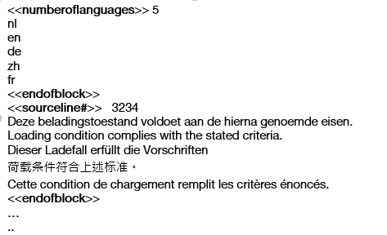
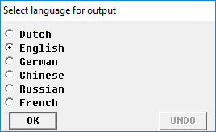
PIAS output languages
PIAS available in Dutch and English
Supported output in Dutch English and German
Output text included in separate text files.
You are free to add languages ☺
Notes:
From the early days this manual, but also PIAS has been available in Dutch and English.
Supported output has been quite some time Dutch, English and German for the most commonly used modules. For many modules also other languages are available, such as German, Chinese or Russian, but these are not actively supported by SARC.
All output text are included in separate files. These are Unicode text files and can be modified with a unicode text editor, which are freely available on the internet. In cooperation with SARC, each PIAS user is in principle free to add languages using these files. The exact procedure is described in the manual.

Slide 9
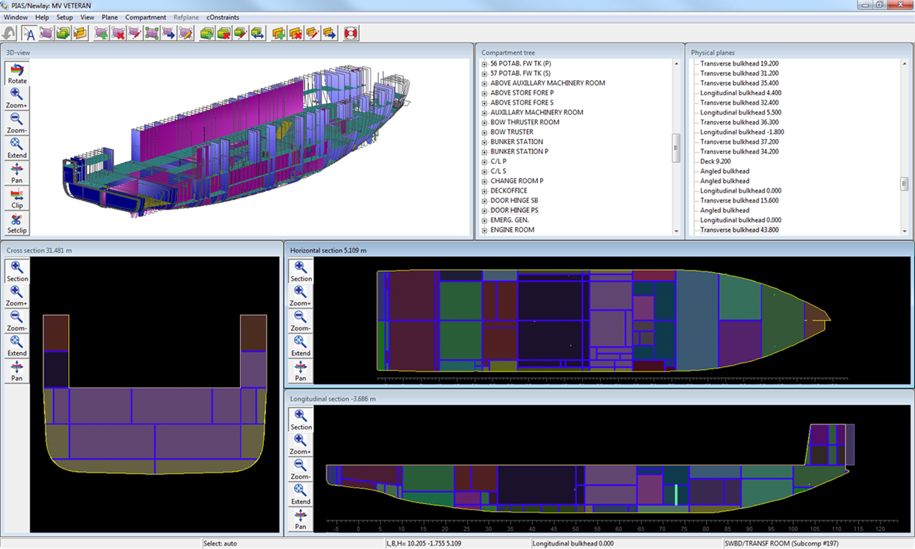
Layout
New method of definition
Subdivision plan
Conversion of file format
Notes:
Layout is the new PIAS module for the definition of internal geometry of the ship, and as such replaces the original Compart module of PIAS. I would like to bring the following 3 issues to your attention. Bullets

Slide 10
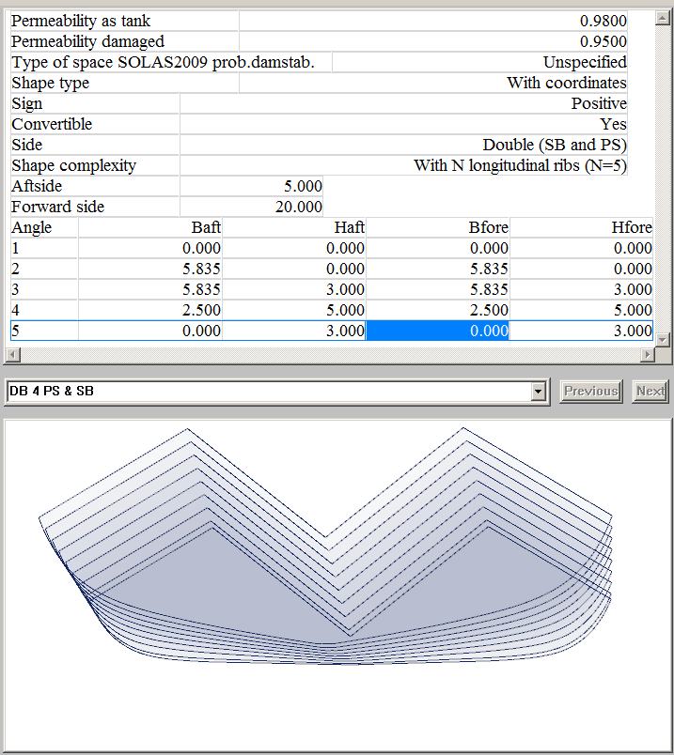
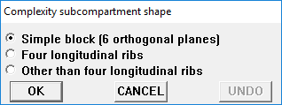
Individual compartment definition
Notes:
In Compart (and this method is still available in Layout), definition of compartments is done by entering the limiting boundaries of a space by coordinates, such as front-side, aft side, underside top etc.
With Layout this method is extended or by defining an arbitrary number of longitudinal ribs which allows more complex geometry.

Slide 11
Layout definition with planes
Insert tanktop 1.2m
Rename compartments in the GUI
Insert bulkheads frame 15, 37 and 138
Select extend of the deck
30 sec
Notes:
A completely new method is to define the internal geometry by defining planes, such as bulkheads, decks or other arbitrary planes, which automatically divide the space into separate compartments.
This 30sec movie shows how this works in basic.
Show automatically generated compartments
Show intermediate window, possible to change contour and extend of the plane to insert.
In this way the complete internal geometry can be defined.

Slide 12
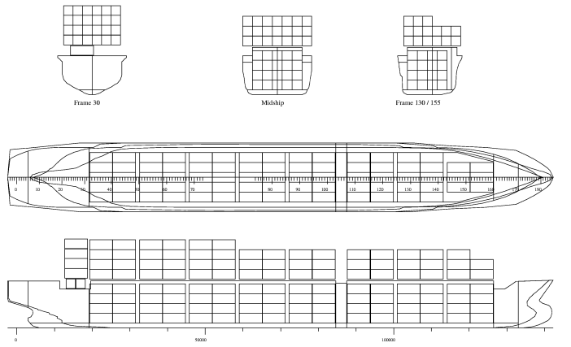
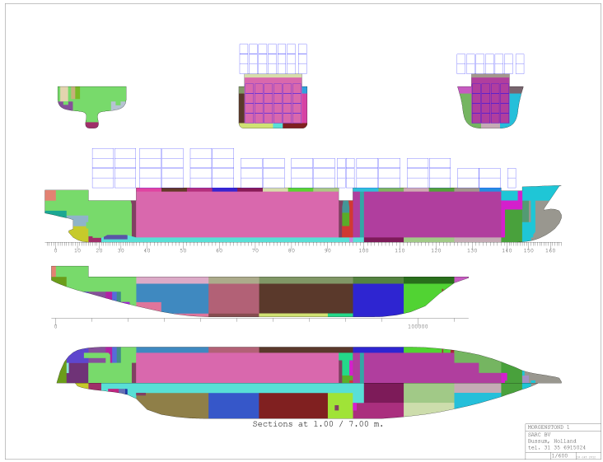
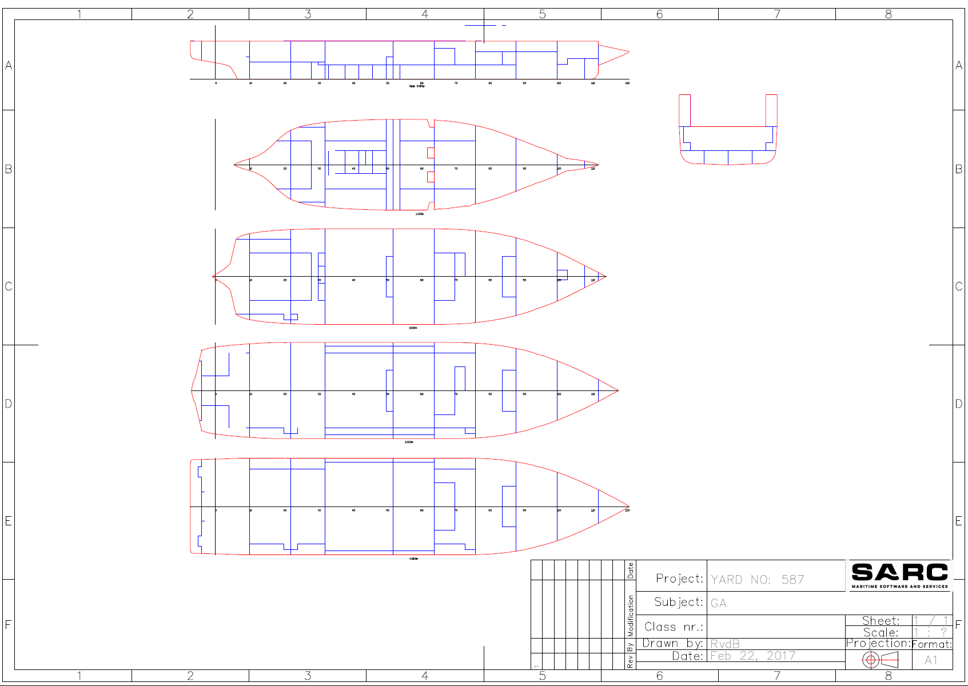
Layout subdivision plan
Notes:
With Layout a 2D subdivision plan can be generated based on the defined internal geometry. Some examples are shown here. Such a subdivision plan contains the complete information of the internal geometry, and can be used as schematic general arrangement plan, tank plan or safety plan.

Slide 13
Layout conversion
New features are added
Storage format different from original compart
Other modules make use of the internal geometry
Each time Layout is used, a conversion is done to the compart format.
Important to be aware of
Unimportant as compartment module will be omitted later this year
Notes:
Layout is a recent development. As new features and functionality are (and still being) added (for example longer compartment names and use of multiple sounding pipes)
In layout the storage format is different than that of compart.
However many other modules make use of the compartment definition (for example the module for definition of loading conditions).
Therefore each time the Layout module is used a conversion is performed to the storage format of the original compart so it can be used by other modules.
Very important to be aware of as some functionality already in layout, is not used in other modules of PIAS,
but for the rest very unimportant as the compart module will be omitted later this year as all modules make direct use of the data structure of Layout.

Slide 14
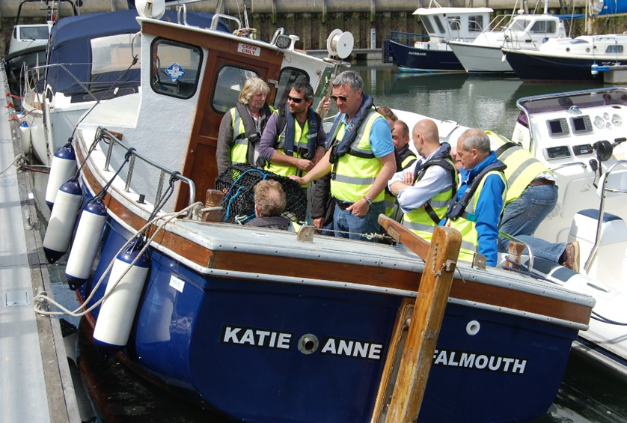
Revised inclination test module
Tanks as test weight.
Integration with PIAS’ tank definitions.
Drafts can now also be given on (pre-defined) draft marks.
Alternative determination of final G’M.
Better-arranged lists of weights to add, remove or relocate.
More flexible way of defining movements of test weights.
Enhanced output.
Notes:
The design of the original version of PIAS’ inclination test module, was drawn up around 1988. In the course of the years, quite some changes and extensions have been made to the program, but the basic structure has roughly remained the same. Comments and desires of many users and ourselves have been collected over the years, and have recently been used in the implementation of a completely new module, which has replaced the present one in December 2016. Some enhancements are:
Integrated support for the use of ballast water as test weight.
Integration with PIAS’ tank definitions, so just giving ullage or sounding will suffice to retrieve volume and CoG.
Drafts can now also be given on (pre-defined) draft marks
As alternative to the determination of final G’M as average of all measurements, a least squares method can now be applied.
Better-arranged and separate lists of weights to add, remove or relocate.
More flexible way of defining movements of test weights.
Enhanced output,

Slide 15
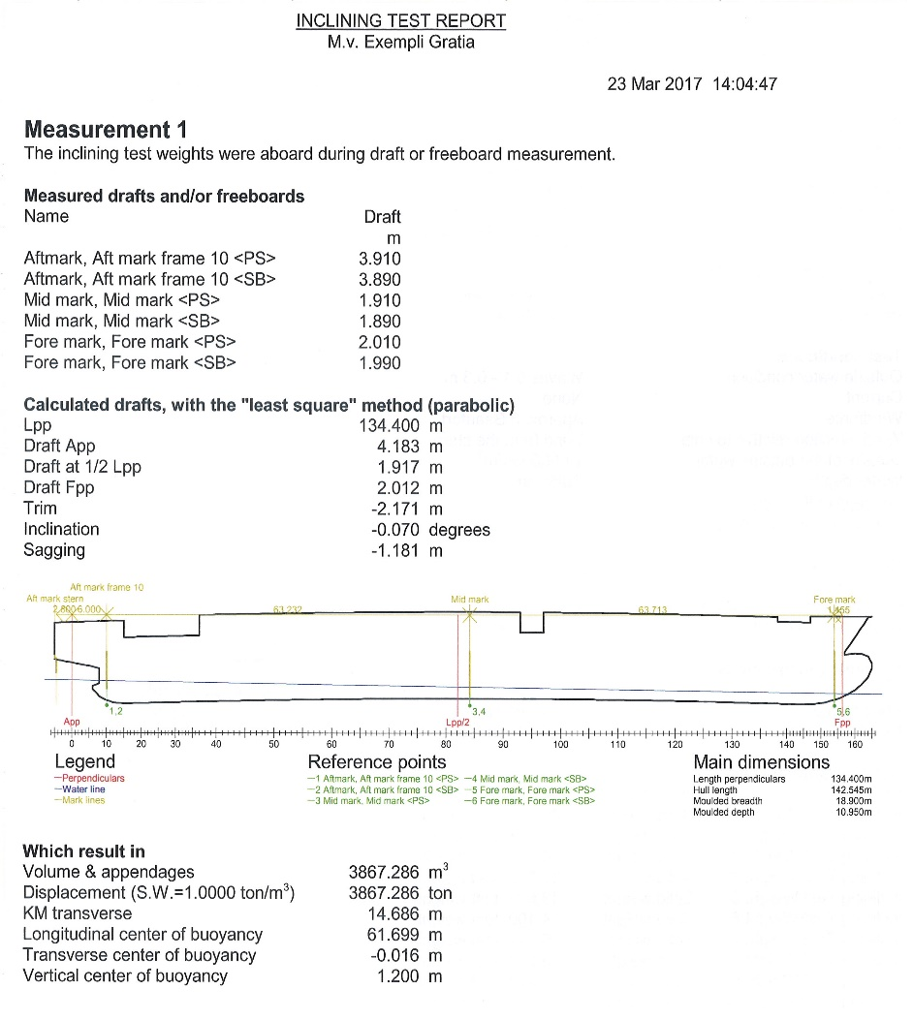
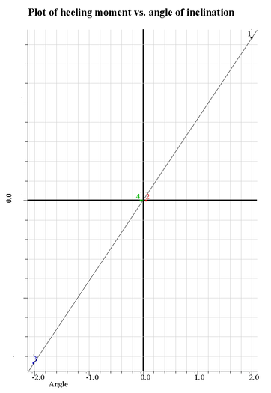
Enhanced output
Notes:
This slide shows the enhanced output of the inclining test module. Which now includes depiction of the ship’s deflection, sketches with positions of test weights and a graph of heeling moment vs. inclination.

Slide 16
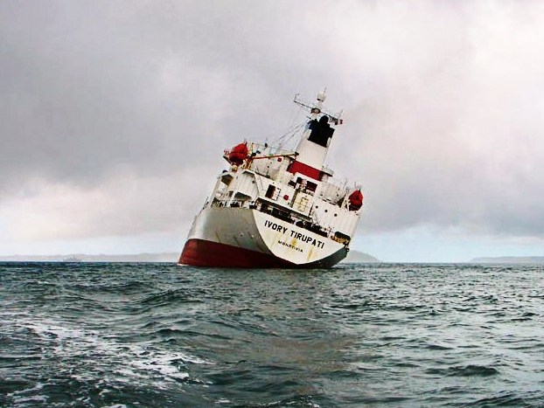
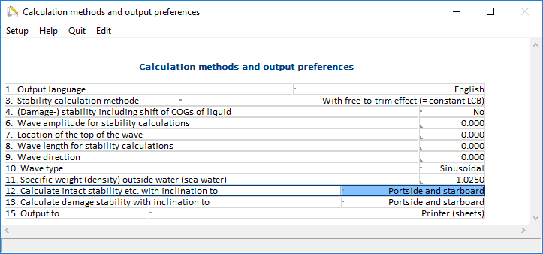
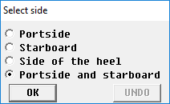
Calculation setting Angle of inclination to…?
For stability related calculations angles of inclination can be defined.
To which side?
So far options; PS, SB and automatic
Recently added PS and SB.
Notes:
For stability-related calculations, angles of inclination can be given That leaves the question of which side (PS, SB or both) these angles should be applied. So far we had the options: Portside.Starbord & automatic
With automatic, the side of the worst stability is estimated as follows: if the statical angle of inclination (the heel) is to PS, then the calculation is made to PS, otherwise to SB. We renamed this setting to “side of heel”
Recently we have added the calculation setting, “Portside and starboard.” With this setting there is no assumption on the “worst side”, instead the stability will be calculated to PS as well as SB.

Slide 17
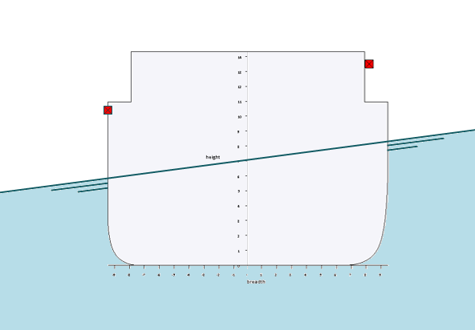
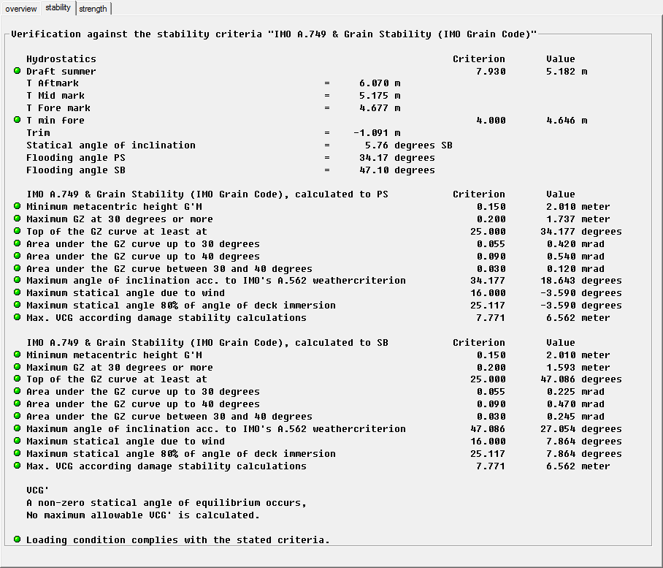
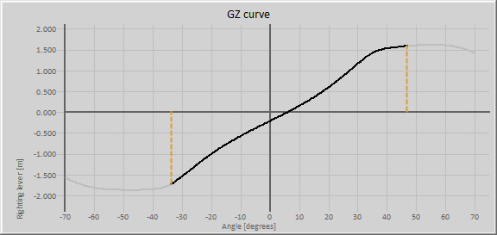
PS & SB
Rethink the applicable choice
Notes:
The third option is the default, but that does not mean that the user should not rethink the applicable choice for the vessel under consideration. In this example, a ship with asymmetrical openings on PS and SB, the statical angle is to SB, but the opening to PS is submerged earlier, so with setting side of heel, calculation would have been performed to SB, but for stability the worst side is to PS.
In any case, one must realize that the more asymmetrical the ship is (in terms of hull, openings or compartments) the less accurate the first three options can be. Obviously, the fourth option will require more computations, and hence more calculation time.

Slide 18
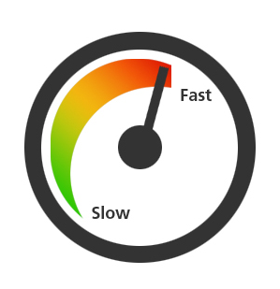
OCTOTHREADING
It seems Moore's Law (1965) comes to an halt
Alternative use of multiple processors / cores
To use these you need processes that can run parallel
In theory unlimited, but in practice set to max 8
Notes:
SARC puts a lot of effort in optimizing performance of calculations in PIAS, especially now that it seems that Moores law, introduced in 1965, (that the speed of computers doubles every 2 years due to a double number of electronic components on a single chip) has come to an halt. Simply because we cannot produce smaller transistors, the main component of processors. As an alternative computers have more and more been equipped with multiple processors or cores.
It is important to understand that just adding more processors does not automatically make them being used. Reason is that only tasks that can run parallel are suitable for multithreading. This means on application level we have to identify the computational intensive tasks and see if we can modify it to run this task, or parts of it, parallel.
In theory the number of cores could be higher, but with initialization of each separate thread some overtime is involved. Therefore in practice the maximum number of concurrent threads has been set to 8, hence the name Octo-threading.

Slide 19
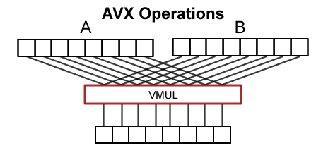
AVX Advanced Vector eXtensions
PC’s with scalar CPU
16 numbers
8 multiplications
8 cycles
Modern processors (INTEL/ AMD) 16 numbers
1 multiplications
1 cycle
Notes:
While developing Octo-threading we also implemented another technique to enhance the speed of our calculations.
Earlier PC’s were equipped with scalar CPU’s. These CPUs can process 1 operation per cycle. A cycle is the shortest interval in which an elementary operation can take place in a processor. Modern intel and AMD processors facilitate AVX operations or Advanced vector Extensions for floating point (decimal numbers) operations, which are relative time consuming. .
Using AVX can in some cases be very rewarding in terms of computational speed
AVX in theory is explained on this slide. We have to multiply 16 values. On a scalar CPU this means 8 multiplications which take 8 cycles. With AVX we present the processor with 2 vectors of 8 numbers, so 16 in total. Which, due to the AVX extension, require 1 multiplication, in 1 single cycle. In this particular case using AVX would be theoretically 8 times faster. While implementing Octothreading we used AVX where possible. Again it Is important to realize you don’t get it for free by just using the AVX processor, on application level , in the module it must be implemented at suitable locations in the source code.

Slide 20
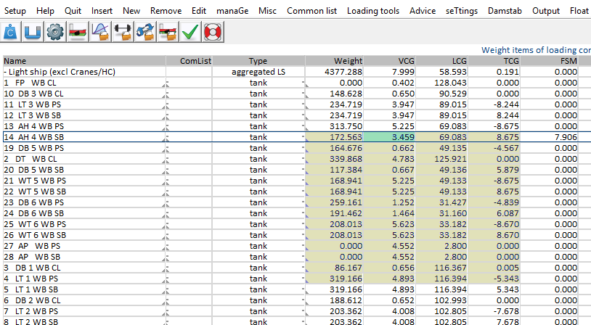
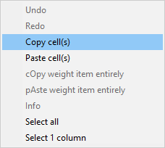
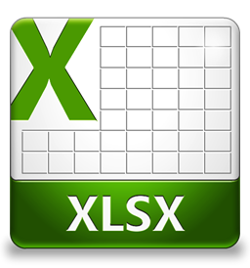
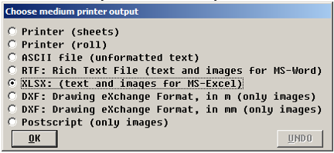
Some smaller modifications
Implementation of Copy/Paste Undo in cells of menus
PIAS will no longer operate on XP
Output to EXCEL
Notes:
Copy/paste undo, column resize
In all PIAS menus you can now make multiple cell selection and copy and paste directly to and from the windows clipboard. This makes it also possible to copy from or to external programs like excel spreadsheet directly
No XP support
PIAS internal libraries have been enhanced in order to benefit from facilities of more recent versions of MS-Windows. This implies that PIAS / LOCOPIAS will no longer operate on Windows XP.
Output to EXCEL
PIAS already had the output to printer, text file, RTF (to read in Word), DXF and Postscript. Output to XLSX (excel spreadsheet) have recently been added to this list. I specifically like to mention this option, as we did not make this for a hobby, but it was specifically asked for by a customer who expressed serious interest in this option. The option is now available for over a year but has never been ordered, not even by the mentioned customer. For SARC this illustrates it is sometimes difficult to decide what and what not to add to our software, but it certainly helps if customers clearly indicate what they do or do not want

Slide 21
Software protection
Single user (stand alone dongle)
1 (PIAS)
UNTIL 2016 - Sentinel
Multi user (Network dongle 10)
8 (PIAS)
2 (Unused)
0
0
0
0
0
0
LIMITATIONS
Type of lock predefined (max. number concurrent users)
Table can only be programmed in SARC office
Limited table only allows to increase/decrease complete PIAS package → +/- 1
license table
Notes:
As you know, our PIAS software has been protected against unauthorized use by means of a hardware lock of brand sentinel.
We are still using and supporting the sentinel, however due to increasing number of licenses at our customers, increasing requests for trail versions also from foreign countries, and desire for more flexible use of PIAS software we ran more and more against its limitations.
The way the sentinel works is very basic. It contains a table with license counters. Each time PIAS is started it uses 1 license. The maximum number of counters is 8 and the total sum of licenses is predefined by the type of lock SARC supplies. The counters can only be programmed on forehand in the office of SARC, so if the number of licenses needs to be changed the sentinel must be exchanged for another. Basically this limited table only allows to increase (or decrease) the license for a complete PIAS package at once.

Slide 22
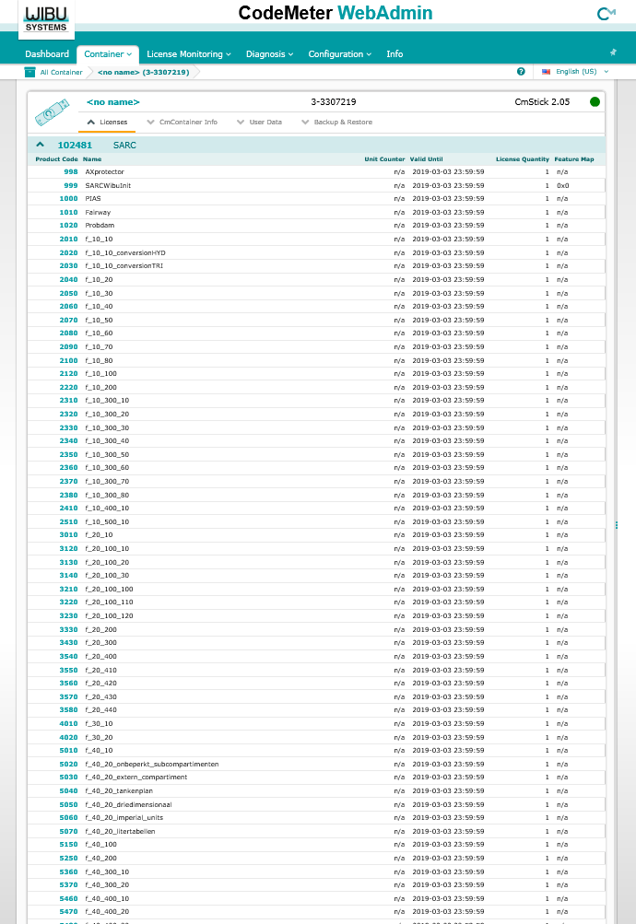
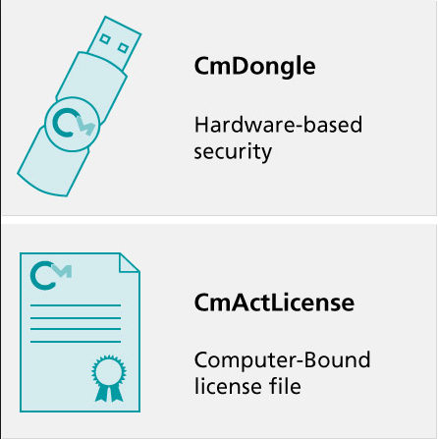
New license mechanism
Unlimited license table
Due to the unlimited table, it is now possible to increase or decrease license per module or even per functionality individually.
Notes:
For this reasons we have been looking for a more flexible solution, and in the past years we have implemented a new license mechanism, called Codemeter by Wibu Systems, a German Based international company, which offers far more flexibility.
The codemeter container comes in two variants. It can be a sentinel-like stick or a computer-bond software license file called Cm-Act license. The container can hold an unlimited table in which we can set an unlimited number for the number of licenses of a specific module, but even for a specific function within a module. PIAS, checks the table if a license is available to start a module or use a specific function. Due to this unlimited table, it is now possible to increase or decrease license per module or even per functionality individually.

Slide 23
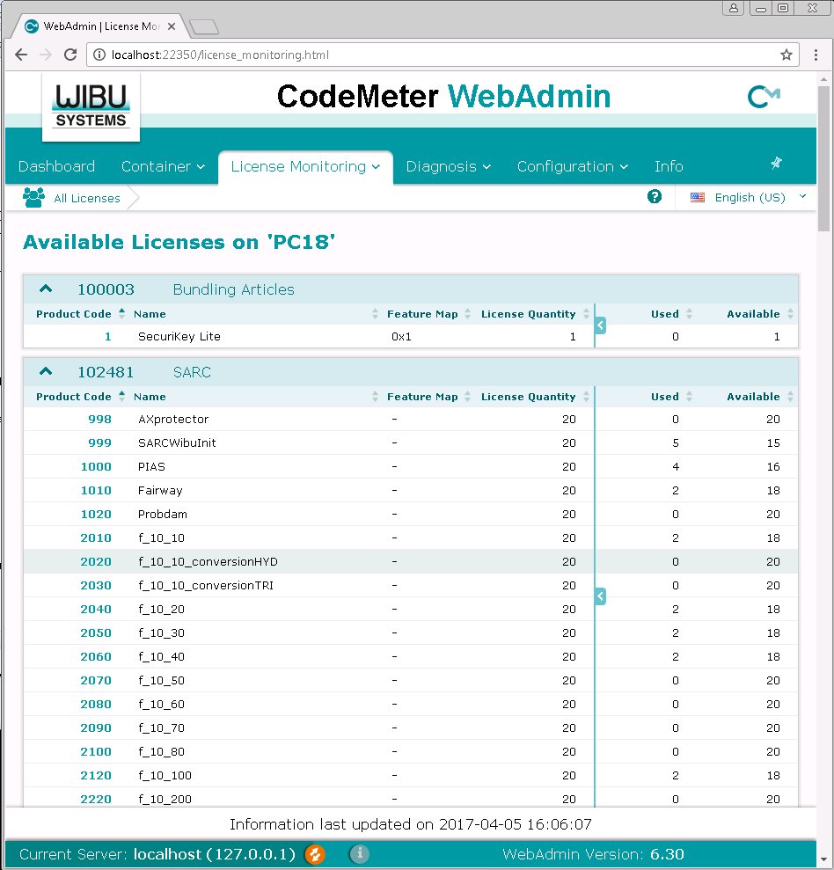
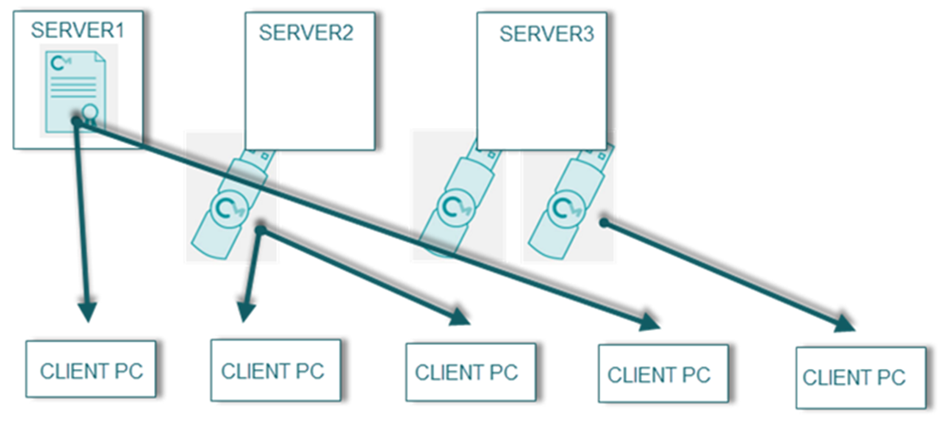
Codemeter
Combined use of CM-stick and CM-ACT
Sticks are hot-swappable
Remote programming
WebAdmin and integration with SLM systems
Notes:
We have implemented combined use of stick and Cmact licenses. This allows to have 1 or more Cmact licenses in the office in combination with sticks, containing 1 or more license. If required the stick can be taken to location. This will decrease the number of licenses in the office at that moment. The sticks are hot swappable, this means that if the license was occupied at the time it was taken out, PIAS will automatically search for an alternative available license on the network. Once returned to the office and plugged in, the license is again available on the network.
Both the stick as well as the CmAct license are remotely programmable by exchanging a request vs update file between SARC and the user. So it is no longer necessary to send physical locks in the event of a change in PIAS package.
The Codemeter webadmin gives a clear overview of the available and used licenses using the webbrowser, but codemeter also allows for easy integration with third party software license management systems like for example OPENLM

Slide 24
WWW Additional / Temporary Activation 24/7
Notes:
This is whats implemented so far. We are by far not using all technical posibilities with codemeter in PIAS at this moment. For example codemeter offers the possibility to activate additional or temporary licenses through a web portal, 24/7 but also the possibility of temporary use (rent) or other forms of pay per use.

Slide 25
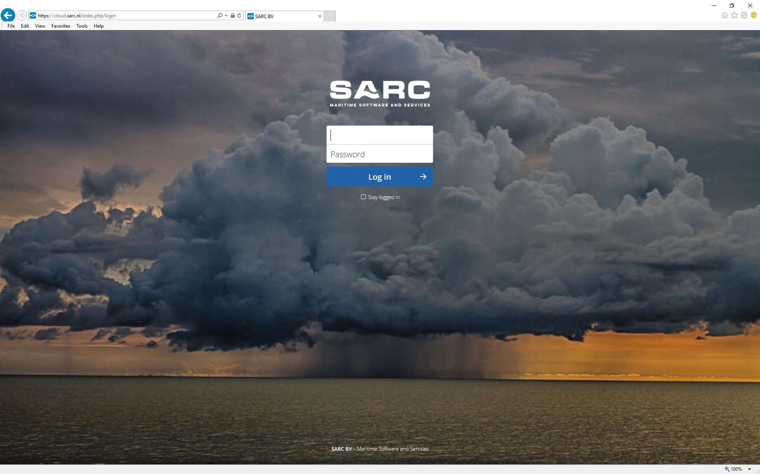
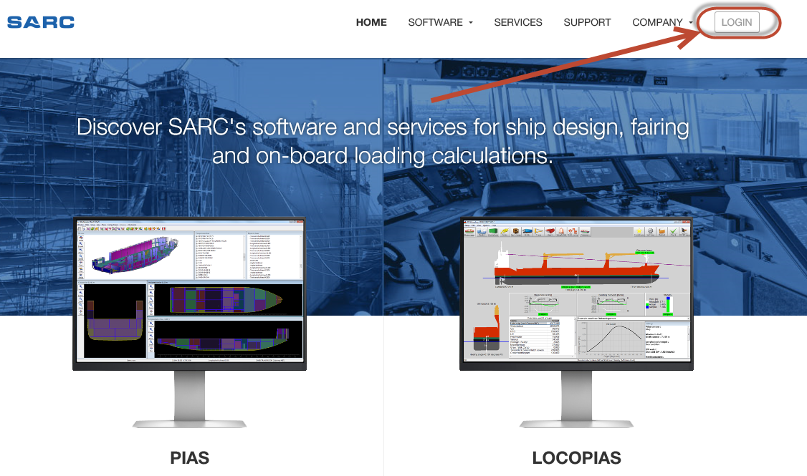
SARC CLOUD
https://cloud.sarc.nl
Notes:
For a long time you could download your PIAS updates through FTP. FTP is not considered one of the safest file transfer protocols and furthermore, in many companies FTP access is disabled by network policies.
We have been looking for alternatives for some time and noticed there is a trend to store and share data in the Cloud.
Offering easy access by web browser.
Companies like dropbox and wetransfer offer cloud based storage services. But this raises the question, where is my data stored, under which law. Furthermore with over 1000 Locopias versions and almost 200 PIAS users a significant upload time would be involved for every update we make.
We have found a solution in the form of an open source cloud service which allows to host the cloud locally. So all data is stored on our servers in our office in Bussum. We call it the SARC Cloud and it can be reached on the following address or through a link on our website. We use this SARC cloud to distribute the versions of PIAS and LOCOPIAS to the users, but also to exchange or share data.
There is also a desktop client available and even a version for android or iPhone. Furthermore you can customize setting so you will be informed of new updates by email.

Slide 26
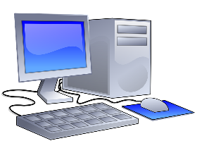
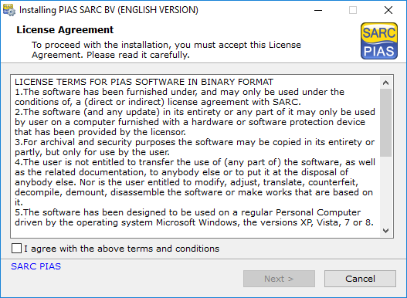
PIAS DISTRIBUTION MECHANISM
CENTRAL LOCATION ON NETWORK
A
B
C
D
Notes:
Once you have downloaded your PIAS version installation file, the installation process itself is relative simple and straight forward. Especially for single user licenses. However for installation in a situation with a network license and multiple workstations it can be quite a job. You cannot uninstall or overwrite a previous version if it is in use by a someone. But you also do not want to skip this person, as it is not advised to work with different versions of PIAS within one company for a longer time.
We have enhanced the PIAS-menu with an automated distribution mechanism to make this job easier. This slide is an animation to demonstrate how it works.
This is the SARC Cloud, where the update is available. This is the guy responsible to download and distribute the update in the company. This is a central location on the network of the company, and here on the right, you see 4 users, abcd. B&C already have the latest version of PIAS represented by the small? Orange dot.
Start animation. Guy downloads the update and installs it on the central network location. A bit unrealistic but for this presentation abcd start their PIAS menu simultaneously, which check if a newer version is available in the central location on the network. For A&D a new update is available, The updated version is copied to their local PIAS folder from which they work with PIAS. In this way the distribution over the users in a company is an automated process.

Slide 27
Discussed subjects
Introduction
Restructuring software design
Output languages
Layout
Revised inclination test module
PS & SB
Octo-threading & AVX
Some ‘smaller’ modifications worth mentioning
New license mechanism CODEMETER
Obtain and install PIAS updates
Notes:
This concludes my presentation of recent developments in PIAS.
Questions?

