Slide 1
My aim is true
On present and future developments
Herbert Koelman

Slide 2
Subjects
Present developments in PIAS
Development strategy
Customer developments
Quo Vadis; a mid-term outlook in CASD

Slide 3
Present developments in PIAS

Slide 4
Integrated pipe lines
Purpose and use
Damage stability calculations
Data sharing with CAD/CAE systems (e.g. CADMATIC)
In LOCOPIAS: time to capsize analysis
Integrated into the “Layout” internal geometry module

Slide 5
Data structure inspired on the ISO-15926 standard
Equipment (engine, tanks etc.)
Piping systems (administrative, e.g. “ballast” or “sounding”)
Piping network (system of connected pipes)
Piping segment (one branch of a network)
Piping connection (joint, opening, equipment)
Piping component (valve, reducer, check valve)

Slide 6
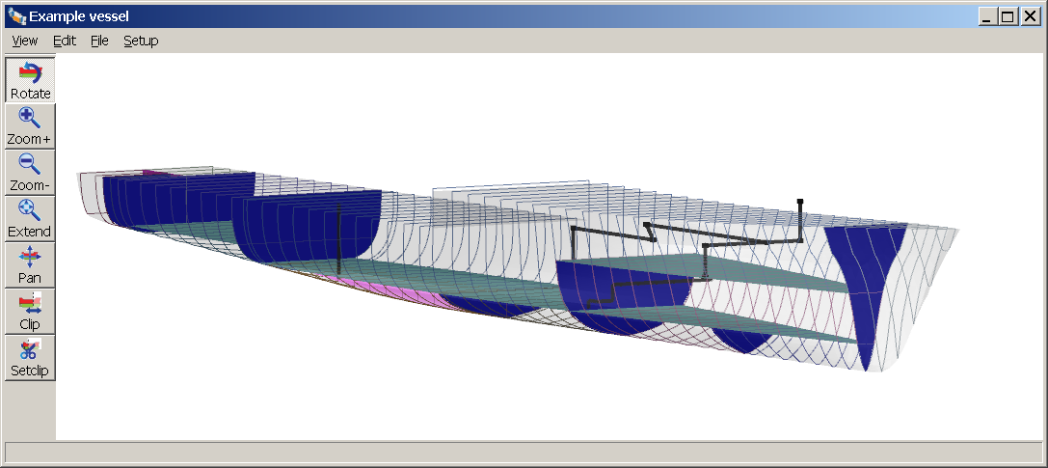
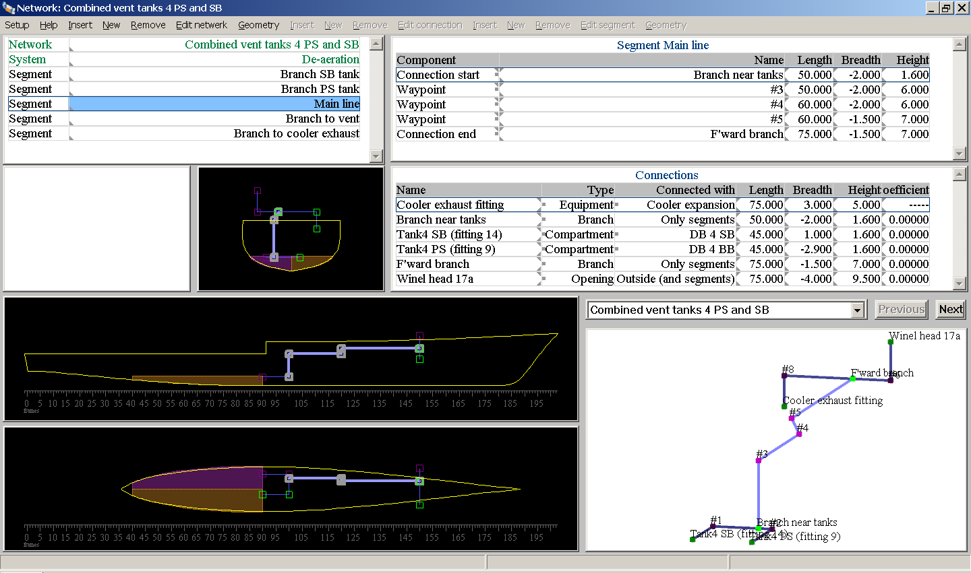
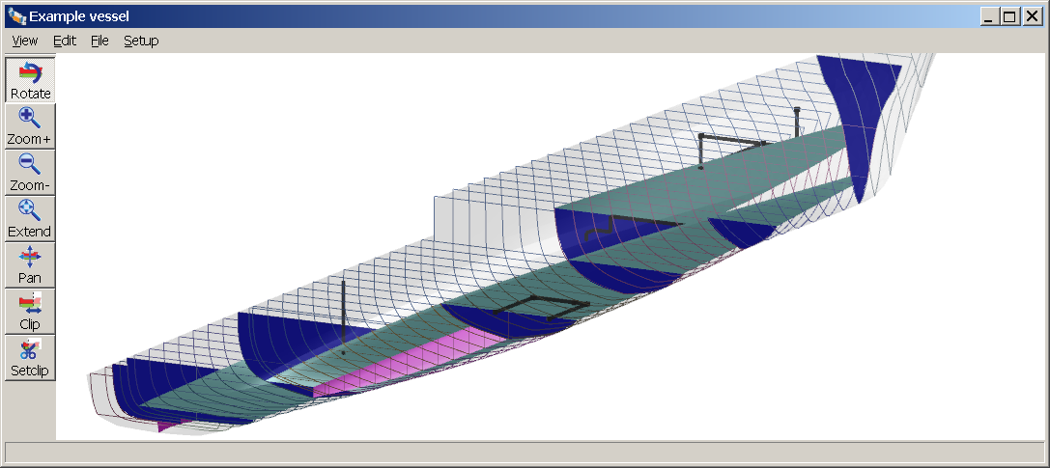
GUI in “Layout”

Slide 7
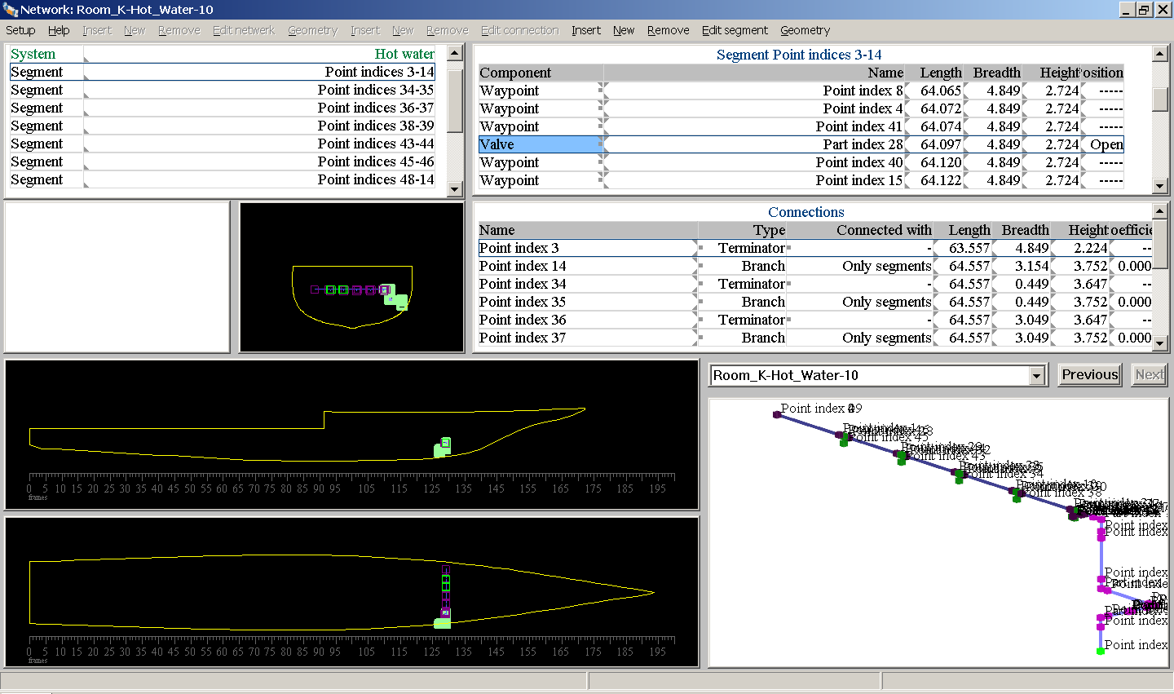
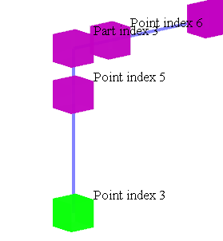
Import from XML (CADMATIC)

Slide 8
Role in PIAS
Will replace “compartment connections” in damage stability.
Incorporated in flooding case generation (which will then include flooding through damaged pipes).
Can be used in damage case generation (more damages in prob. dam. stab.).
Fire resistant bulkheads modelled with pressure relief valve.
But first switch from “Compart” to “Layout” models in “Loading” and “Probdam”.

Slide 9
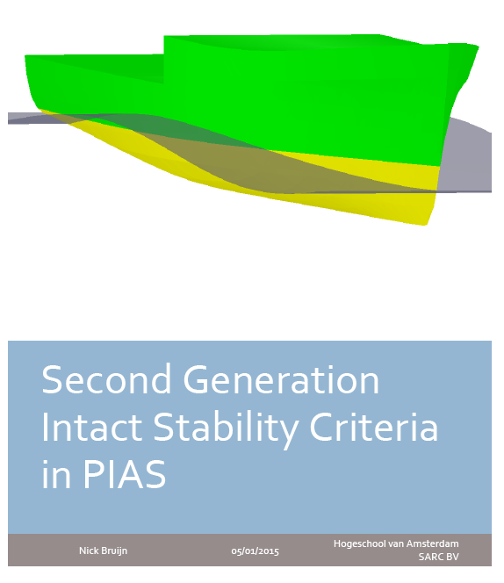
2nd generation stability criteria
Conclusion
Can be automated in PIAS
Will be automated in PIAS, scheduled for 2017.

Slide 10
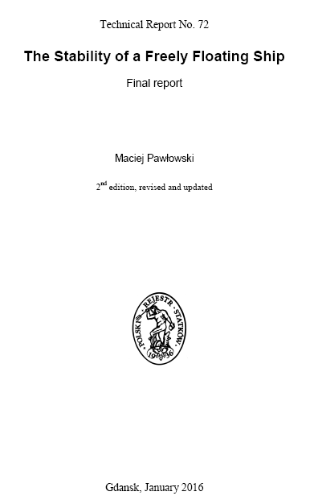
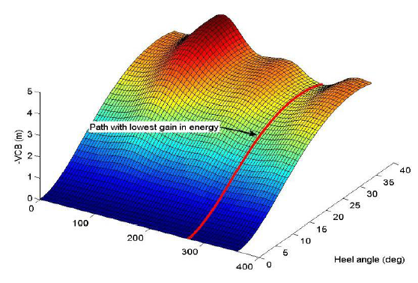
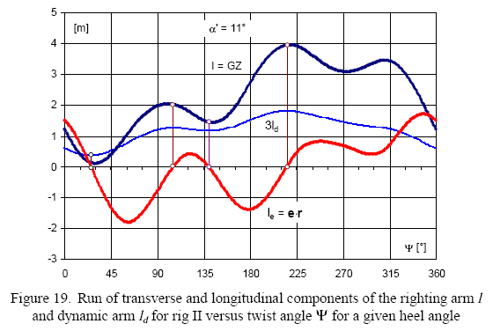
Weakest axis stability
Not predominantly transverse.
Has always been feasible to implement. And ordered recently.
Scheduled for April 2017.

Slide 11
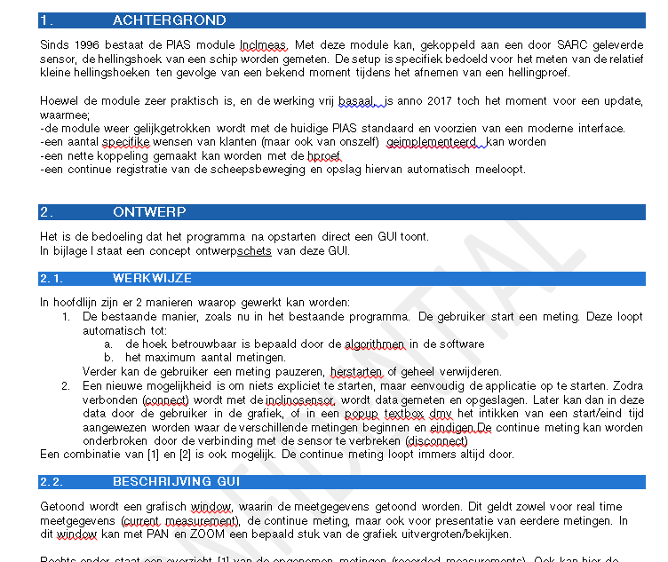
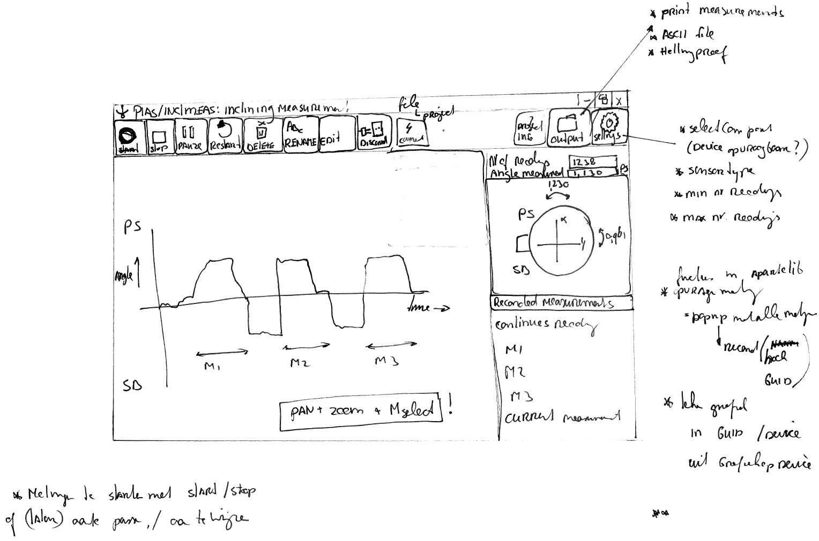
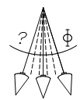
Inclmeas

Slide 12
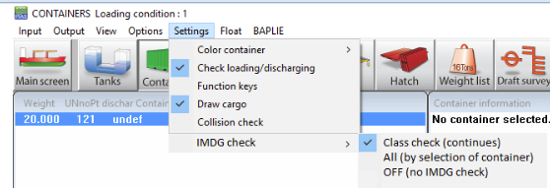
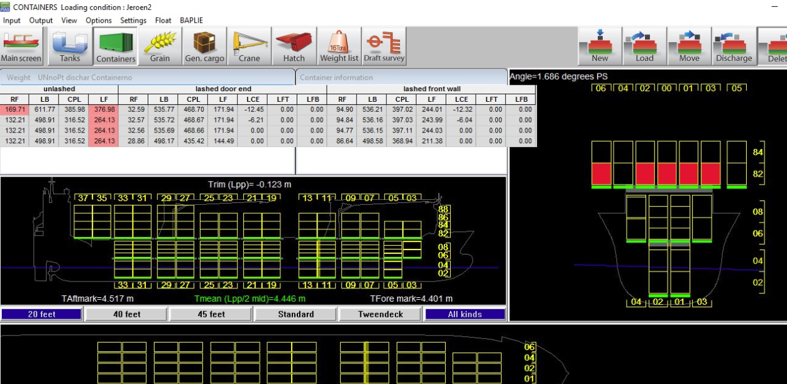
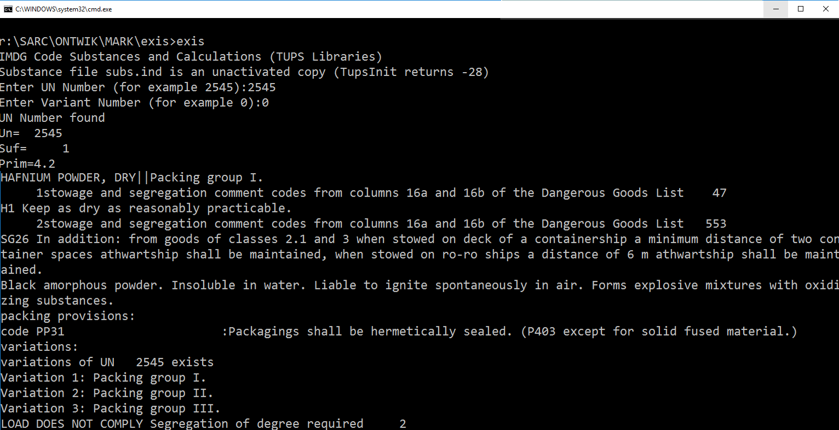
LOCOPIAS extensions
Dangerous goods (IMDG)
Lashing
Integration of HOPper STABility
Support for a longer journey (which glue multiple loading conditions)

Slide 13
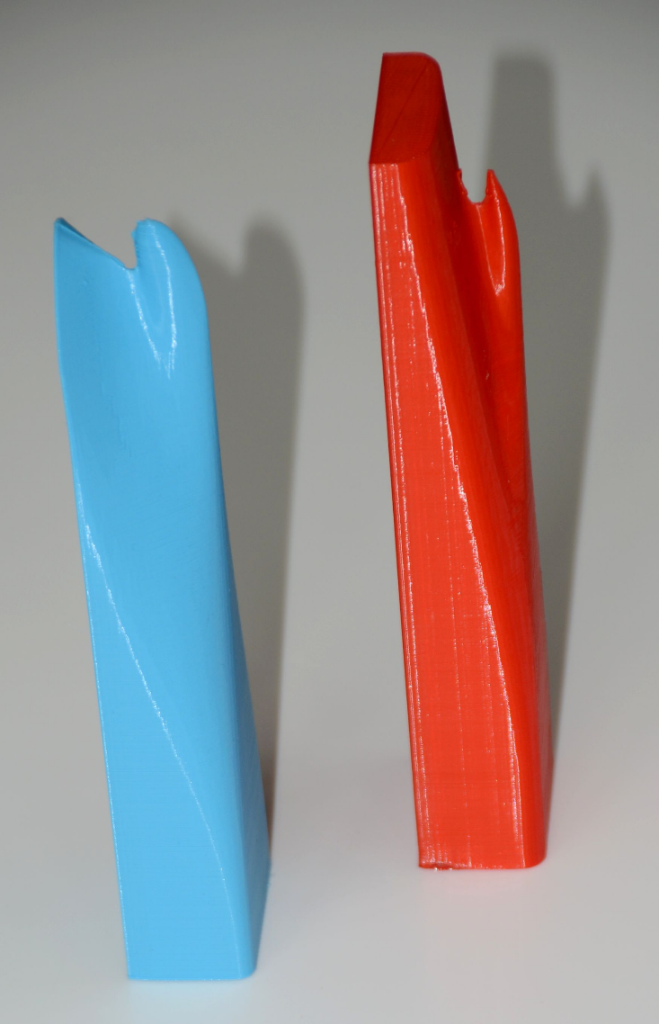
Fairway to CFD (to Fairway)
Experimenting with OpenFoam.
Hull shape export from Fairway to STL, with T for triangle. This format allows all shapes, and is watertight (no gaps).
Import and meshing in OpenFoam.
CFD in openFoam.

Slide 14
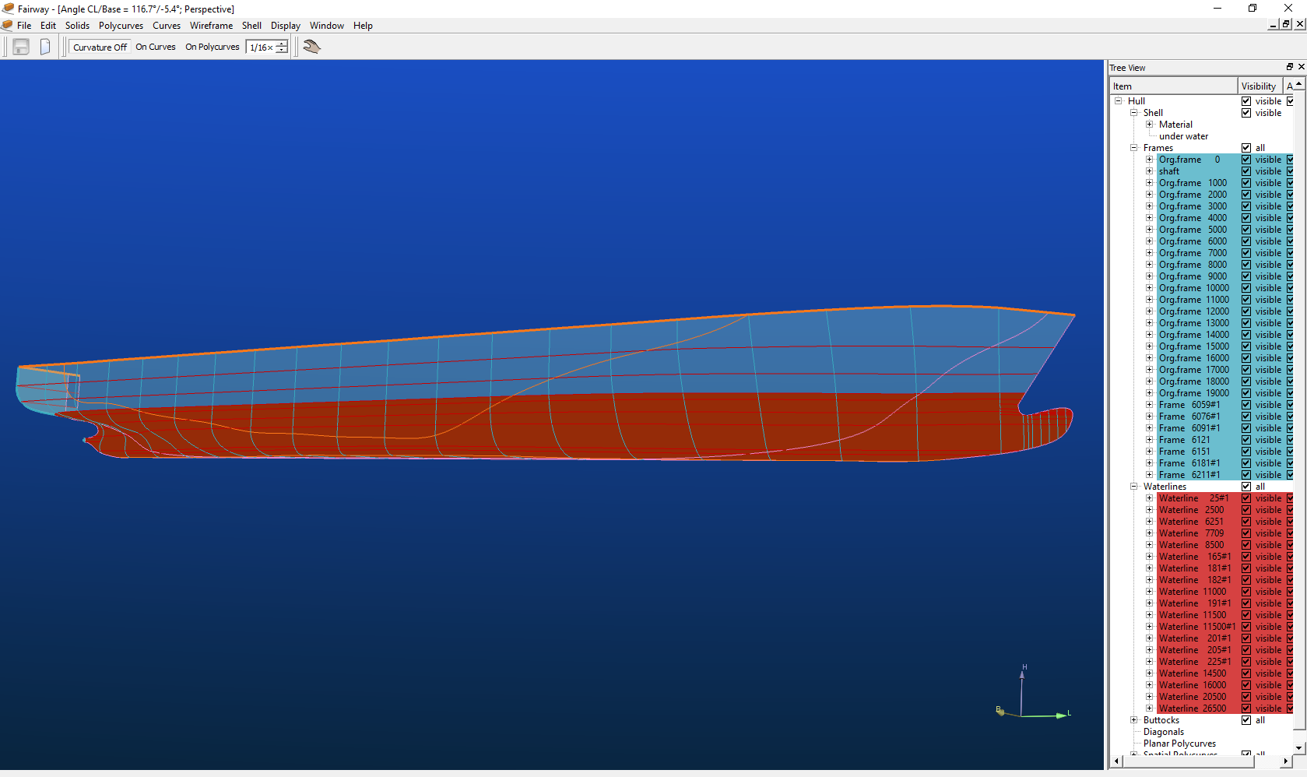
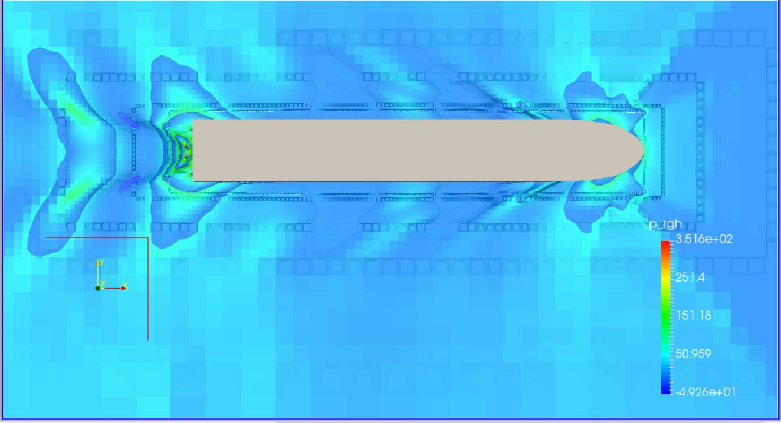
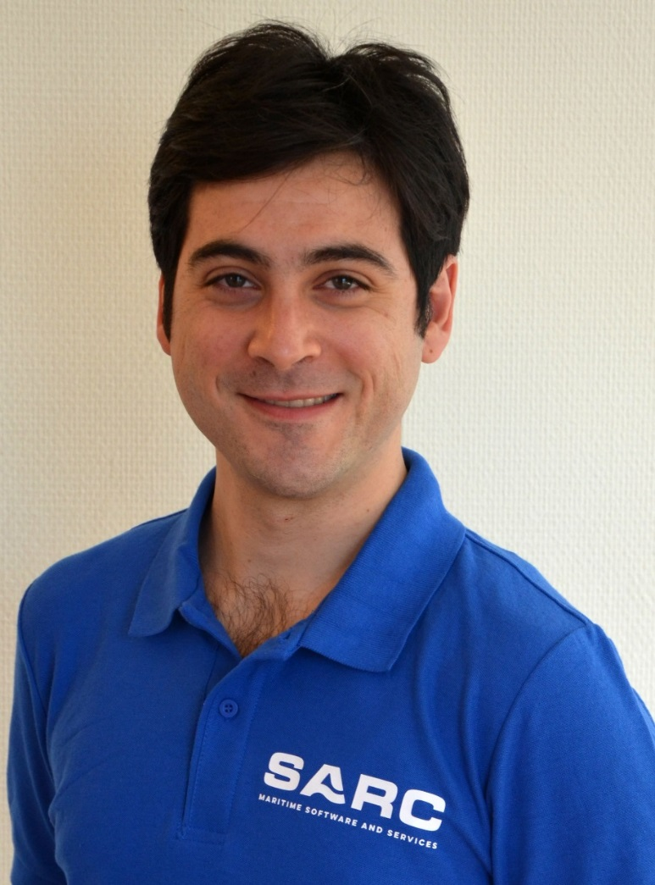
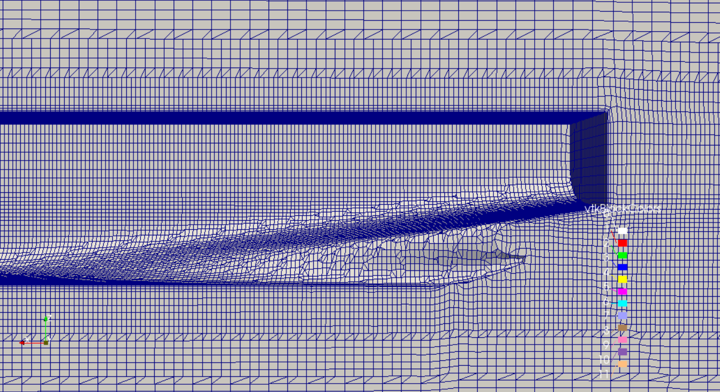
Preliminary results
Structured procedure.
Results back to Fairway?
Computation farmed out at many-core cloud servers.
For our use in services.
As framework to PIAS users.

Slide 15
Development strategy

Slide 16
How do we decide on developments?
By estimating present and future requirements of the users.
Applying, but limited by, state-of-the-art mathematical and technical tools.
Fed by user demands.
To-do list is flexible.
Shall I reflect on development plans of previous SARC user day? No.

Slide 17
User input
Wish list of users valuated and evaluated:
Already on to-do list
Added to to-do list
Declined
Quoted
Demands of a generic nature are specifically welcome.
However.... We are the guards of uniformity.

Slide 18
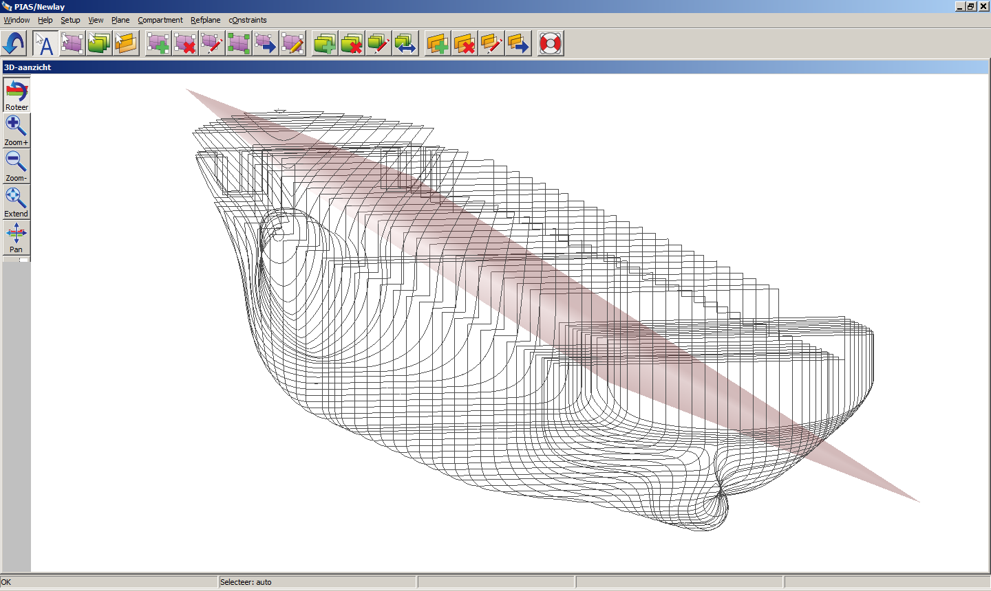
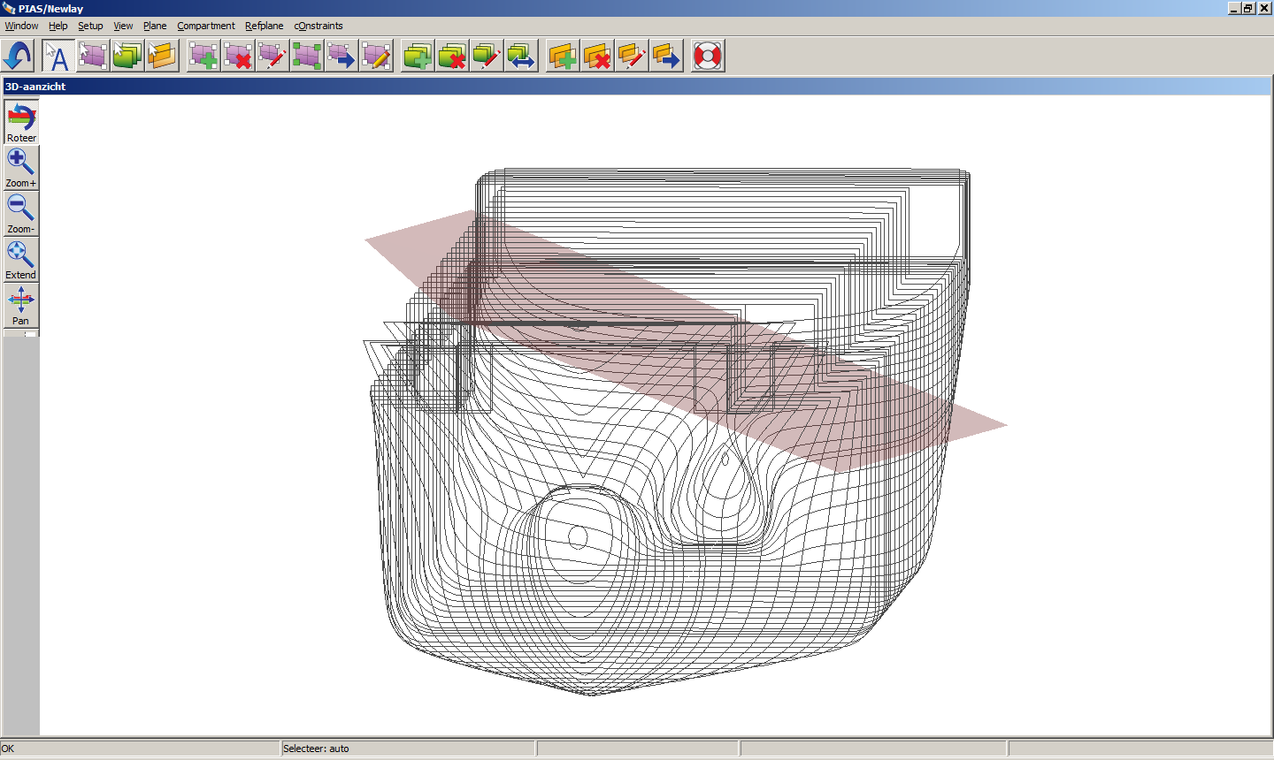
A matter of choices and dilemmas
Recent revision of inclining test module was too flexible, and appeared to invoke confusion. On user-demand some flexibility was removed.
Idea and proposal for V-line surface plots in prob.dam.stab. Contribution in development costs.

Slide 19
Customer developments

Slide 20
Are occasionally a bit amazing
Hyperbolically: linesplan drawn manually, faxed, scanned to BMP, digitized in PIAS, exported to Excel, converted to DXF, imported in Autocad.
V-line surface: NWT coordinates from PIAS, to Excel, imported into Rhino, post-processed and visualized.

Slide 21
…but customer developments are paramount for collaborative tools
XML output from Loading to be used in customizable stability summary generator.
Dutch Navy: design system GCD²: Rhino, Quaestor & QPIAS. 2010, presently under review.
Waiting for news from the Bussum development front does not suffice anymore.

Slide 22
Quo Vadis; a mid-term outlook in CASD

Slide 23
2013 Compit presentation
https://prezi.com/4z9y-ovvn6nf/?utm_campaign=share&utm_medium=copy&rc=ex0share

Slide 24
The end of the design spiral
Pr
In order to be user-friendly CAD tools should facility chaos

Slide 25
Empiral strikes back!
Top ships, Erik Rotteveel, TU-Delft
Resistance & propulsion IWW (shallow water!)

Slide 26
Scenarios
Less focus on computer programs as such.
More emphasis on methodological user-friendliness.
Focus on methodology stimulates interoperability.
Gloomy scenario: MS-Windows will remain the prevailing platform for office applications.
Tablets / handhelds / apps?

Slide 27
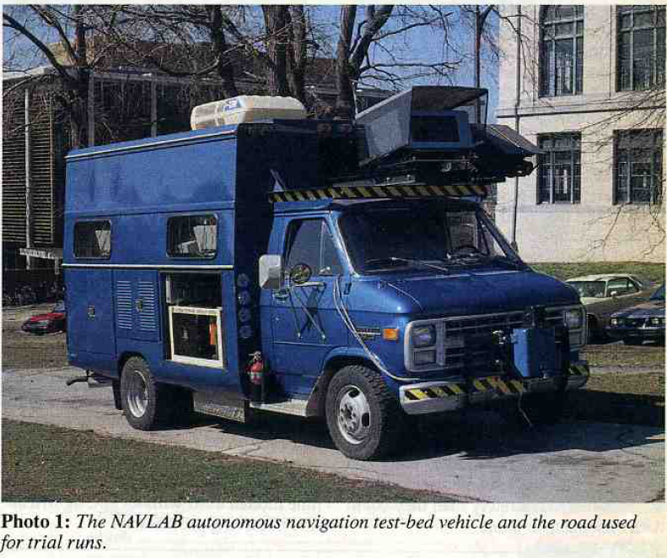
Winding down
Collaborative ship design.
Artificial intelligence & machine learning.
Might change the way we work drastically. But that will require a massive amount of examples.
Is already some decades old (Delft 1980s).
At present consider application on prob.dam.stab. (expert estimation of Attained subdivision index).

