Slide 1
NOVELTIES IN LOCOPIAS
Douwe Plukkel

Slide 2
Introduction
LOCOPIAS is LOading COmputer software based on PIAS.
Direct calculations, Type 3 (acc. IACS L5)
Calculation of actual C.O.G. of liquids
Modular software

Slide 3
From the first LOCOPIAS in 1994, we have now
equipped over a 1.000 vessels with LOCOPIAS

Slide 4
Within these 1000 vessels, a wide variety of type of vessels is included.

Slide 5
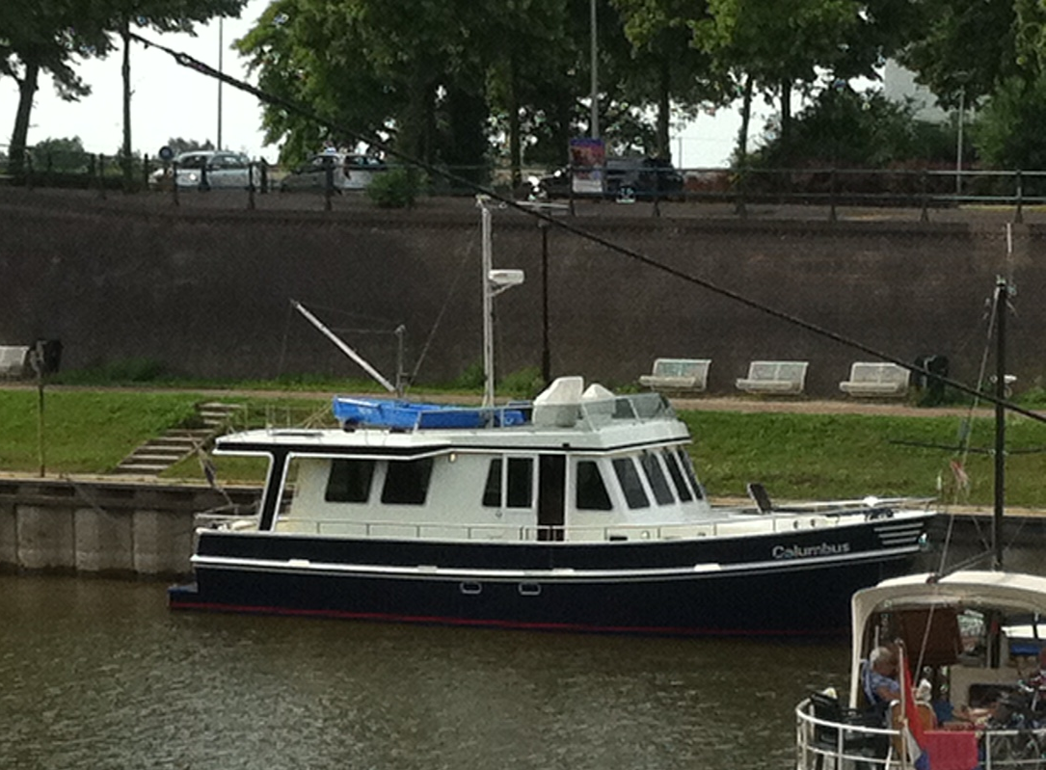
Ranging from small…

Slide 6
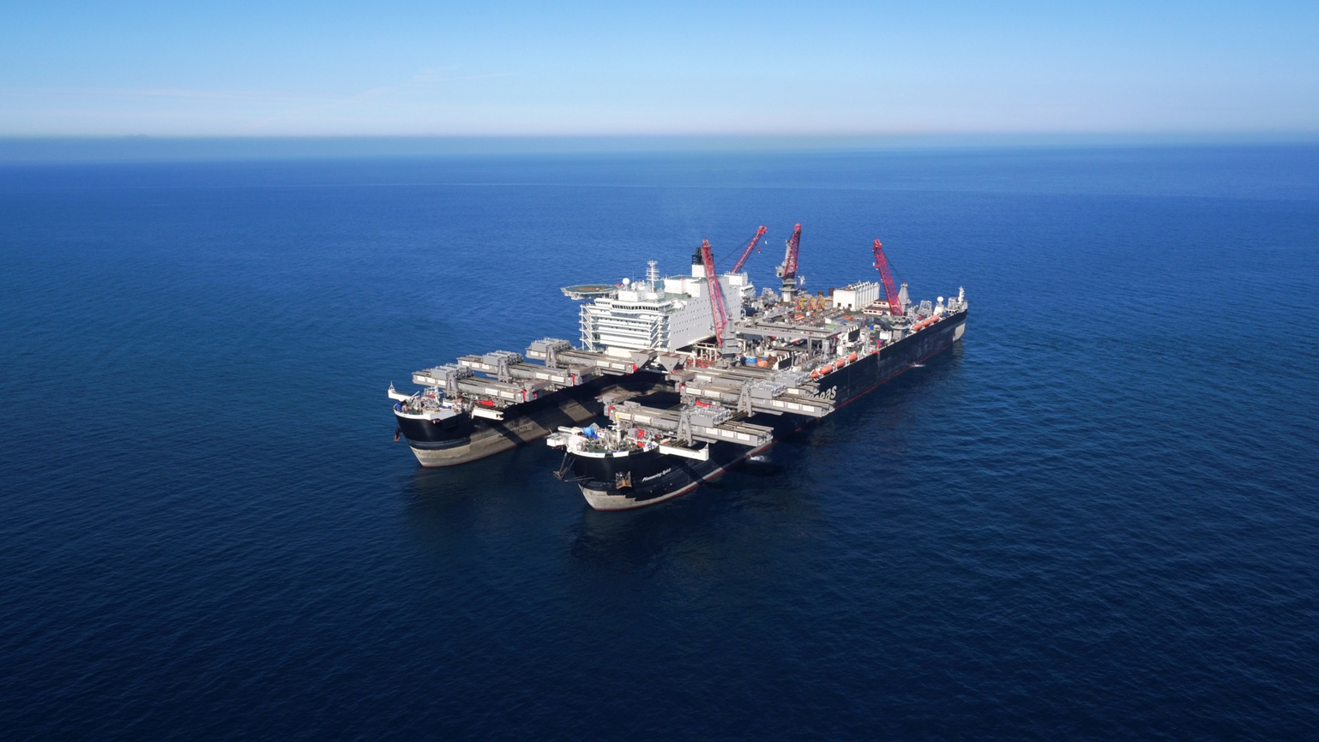
...to large.

Slide 7
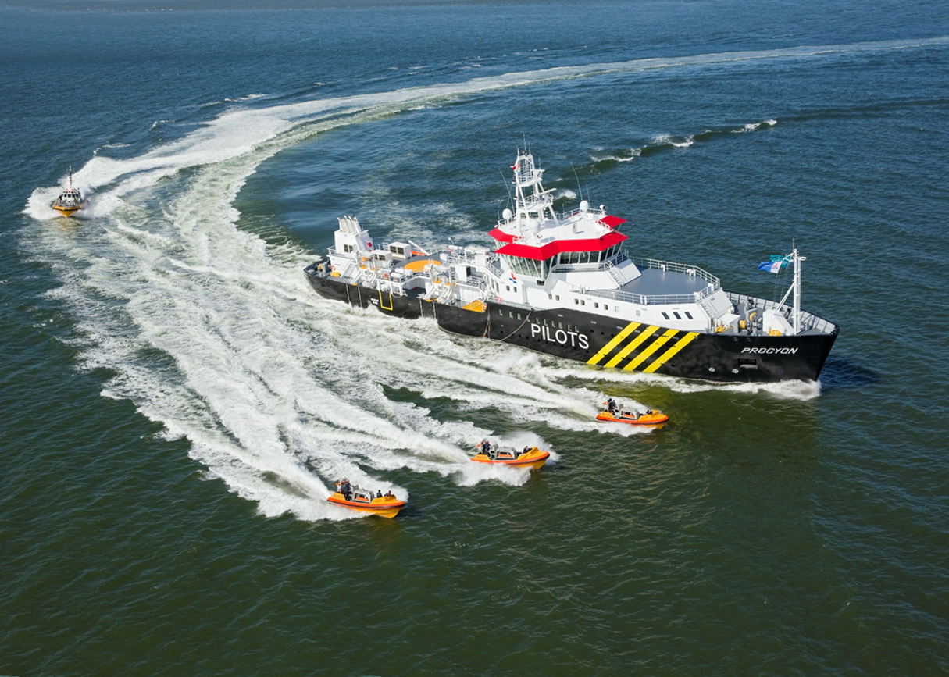
Some examples..

Slide 8
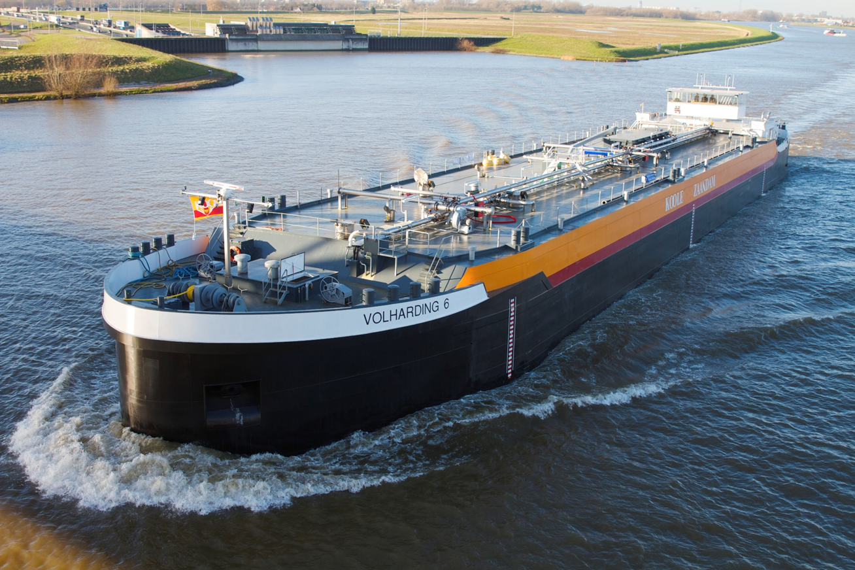

Slide 9
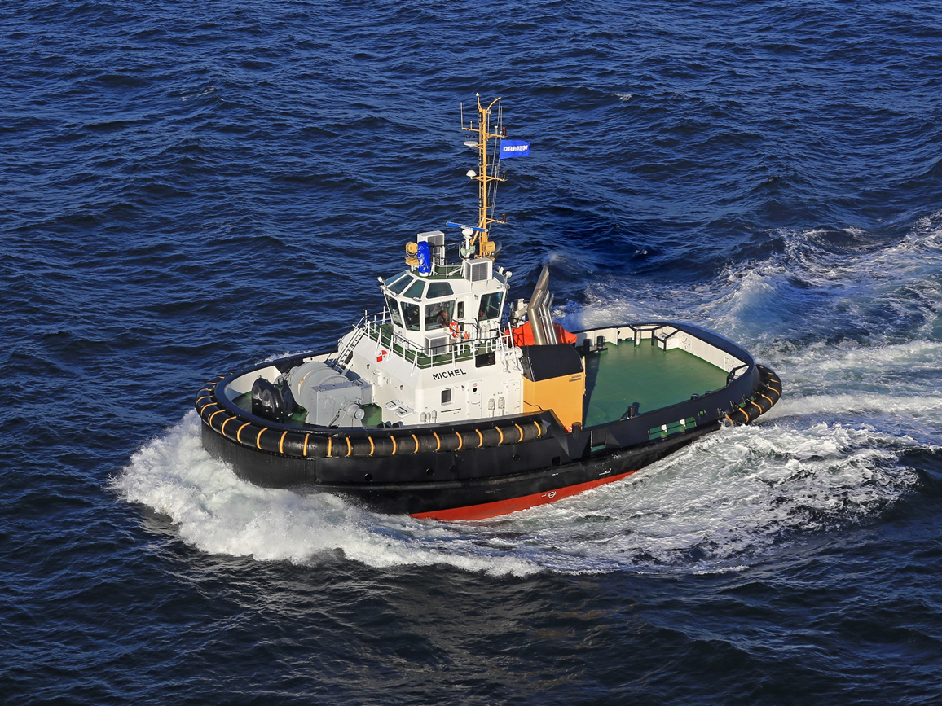

Slide 10
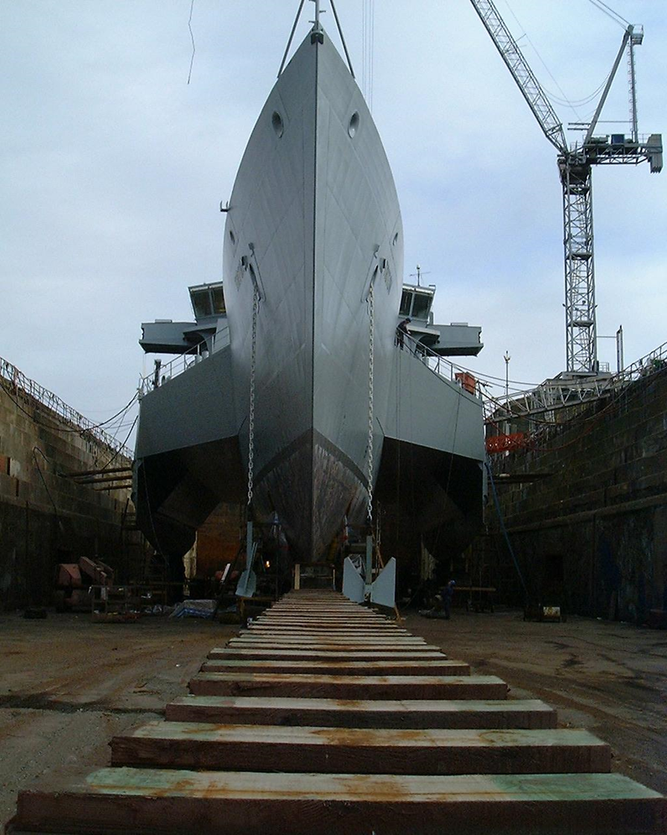

Slide 12
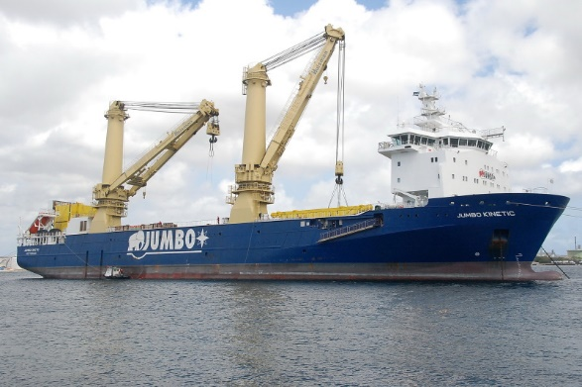

Slide 13
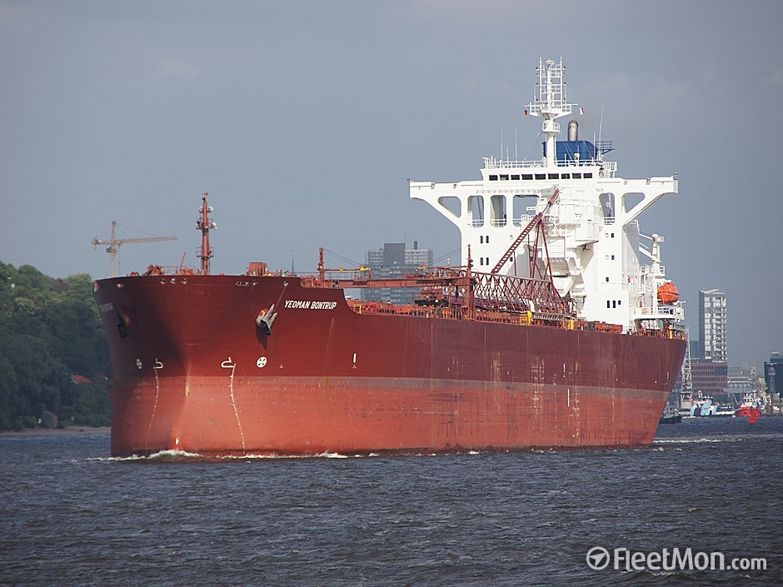

Slide 14
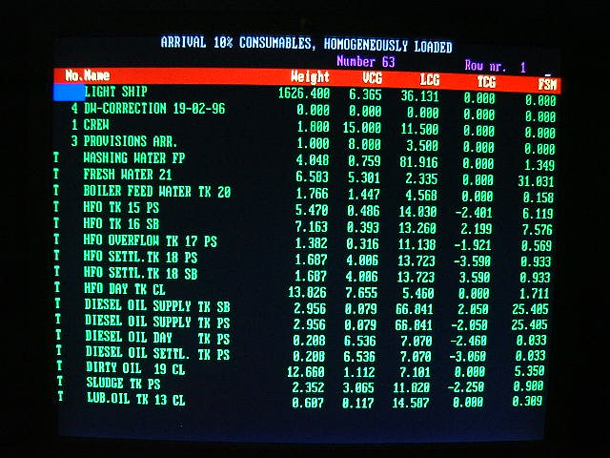
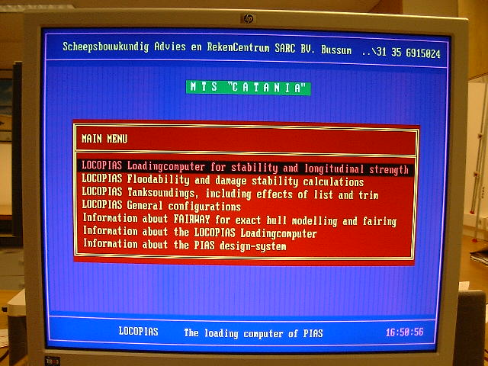
In all these years…

Slide 15
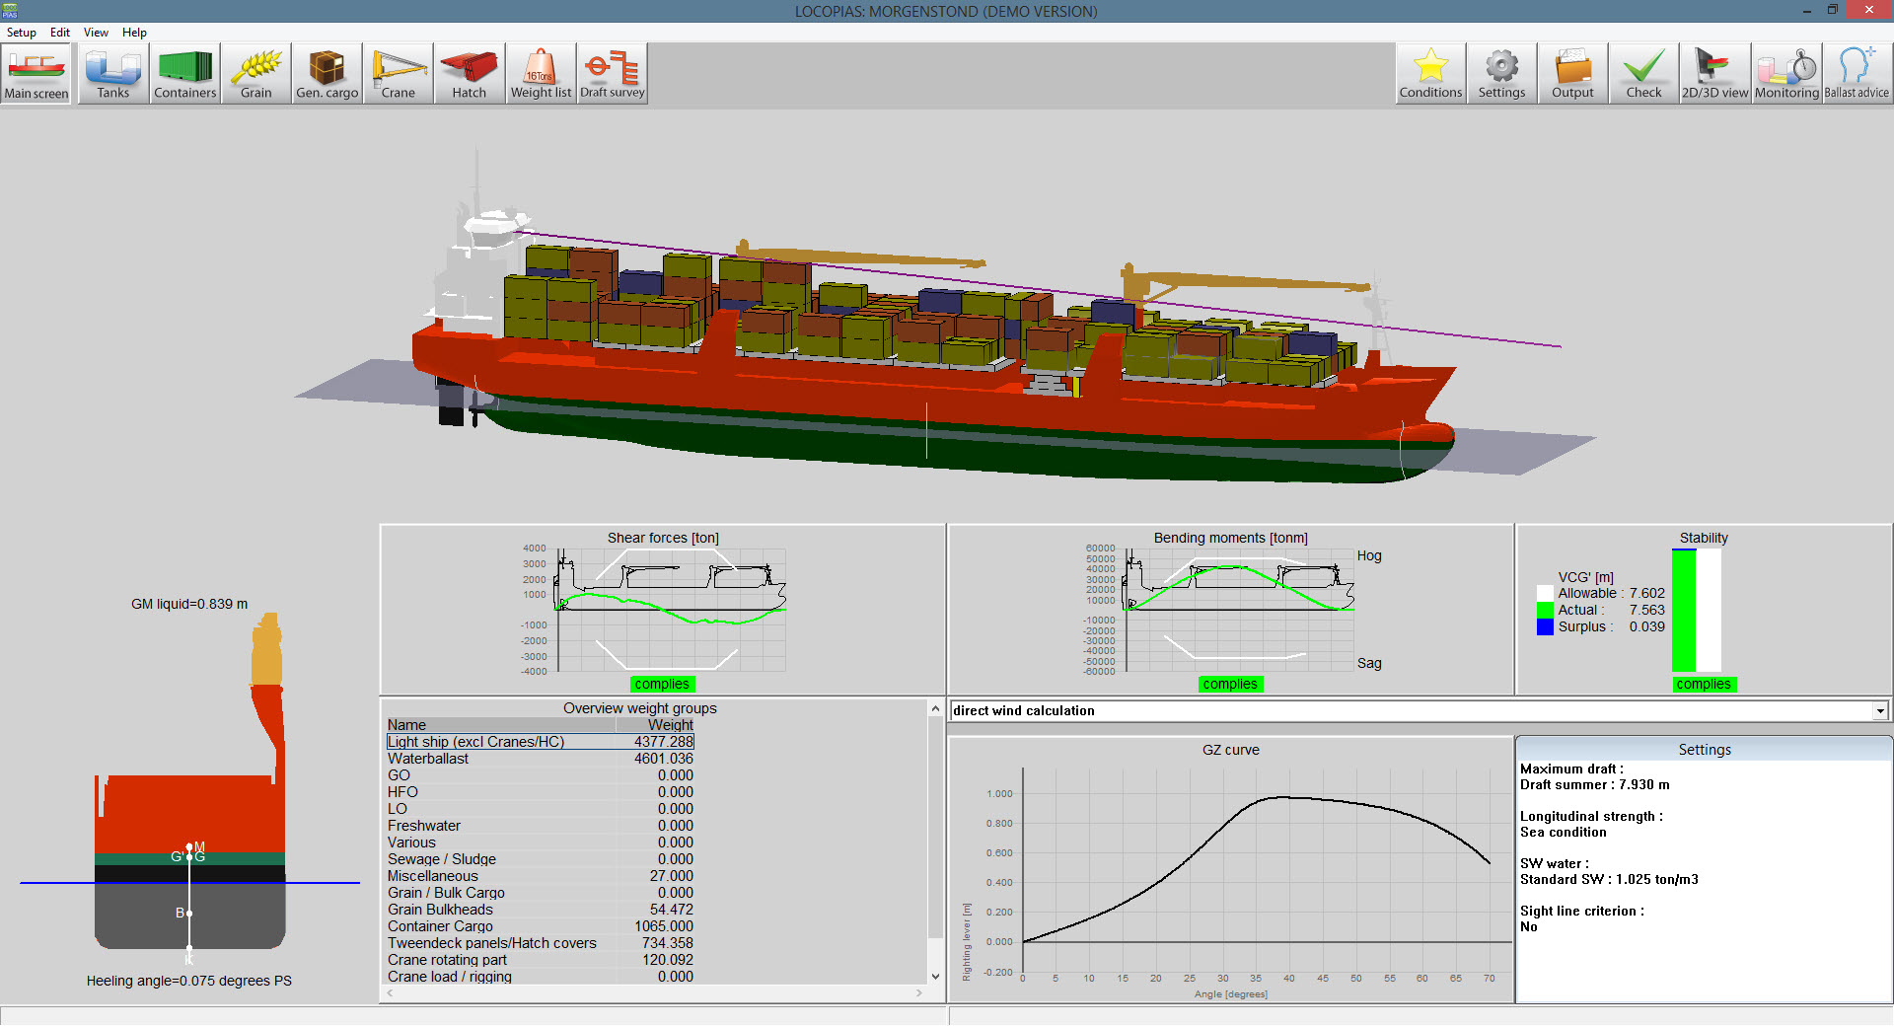
…things have changed

Slide 16
Recent developments
Counter measures
Anchor handling forces
Loss of crane load
Stabilizers
Ballast advise
Line of sight
Direct wind calculation with deck cargo
Icing

Slide 17
Counter measures
With this module counter measures are being calculated in case of damage. Initially developed for the Royal Navy, this module would also be very practical to be used for civilian vessels.

Slide 18
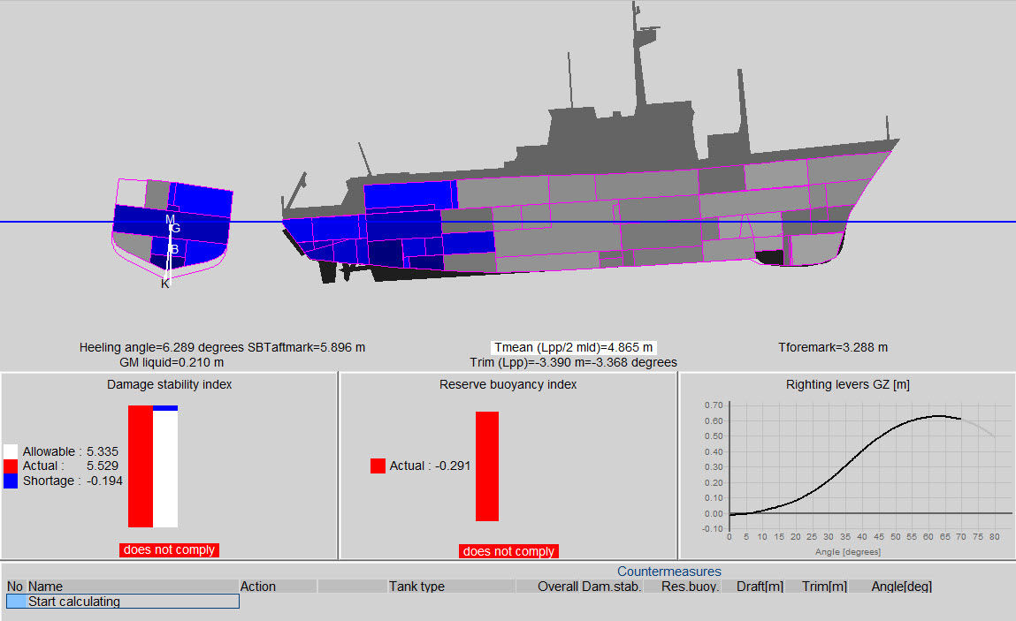

Slide 20
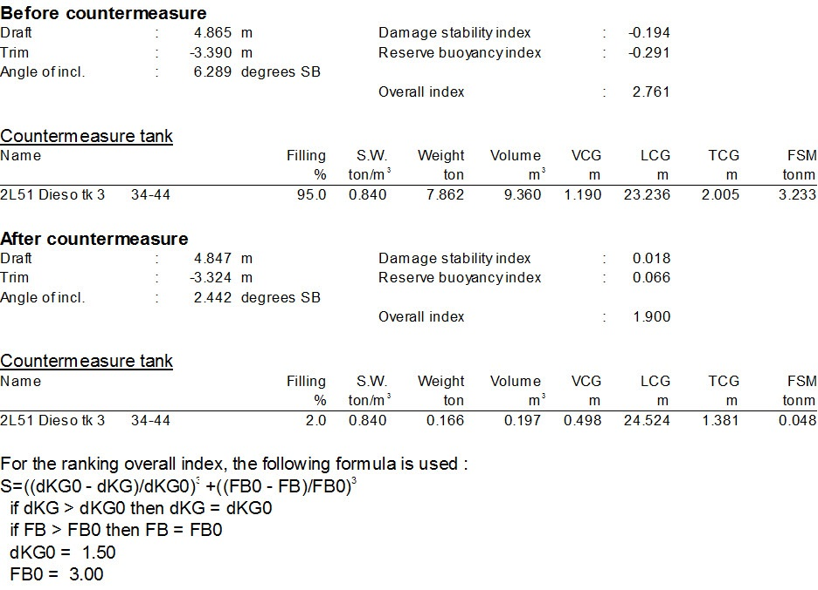

Slide 21
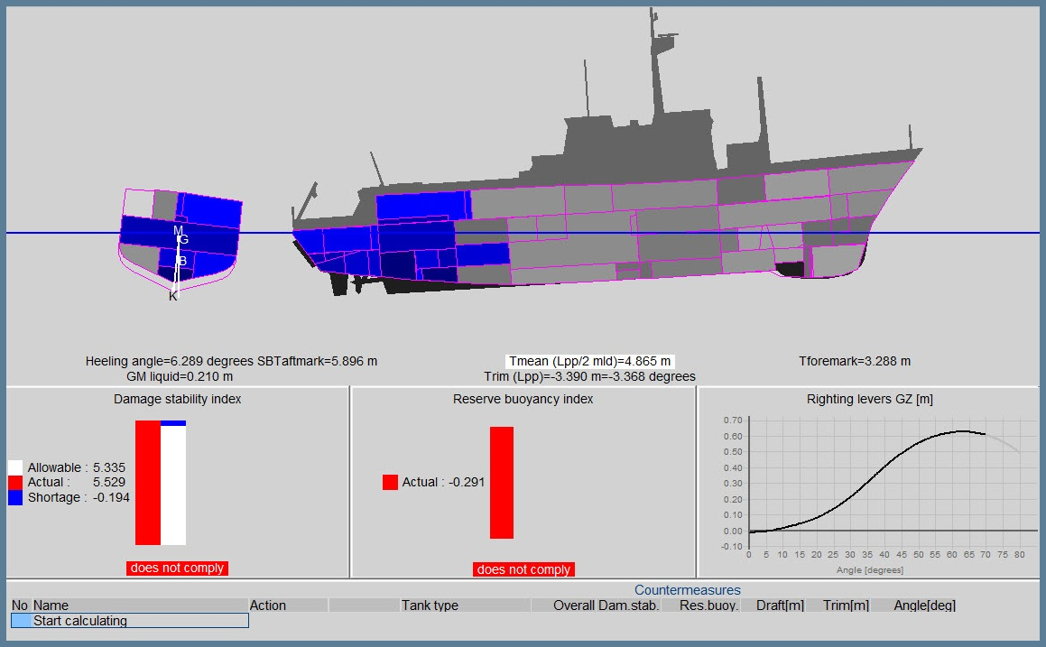
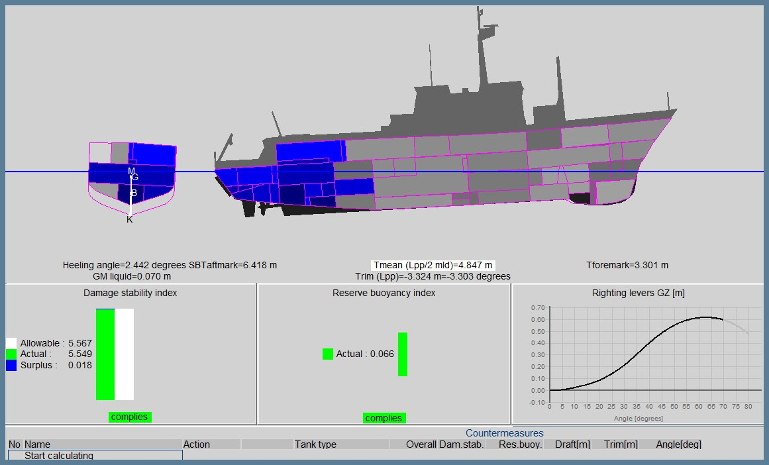

Slide 22
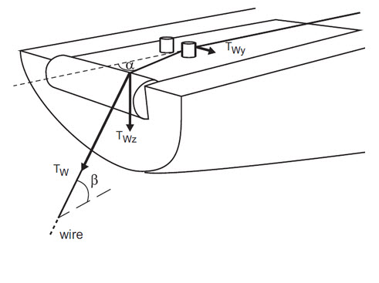
Anchor handling forces
Calculating the maximum allowable anchor chain forces according the regulations of:
Norwegian Maritime
Directorate 2007
Bureau Veritas 2014

Slide 23
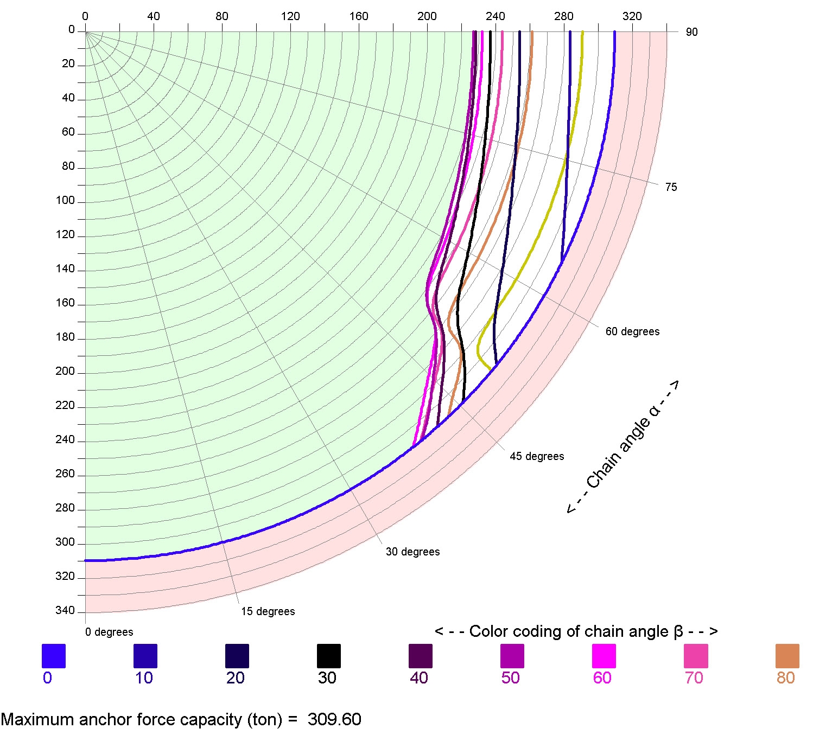

Slide 24
Loss of Crane Load

Slide 25
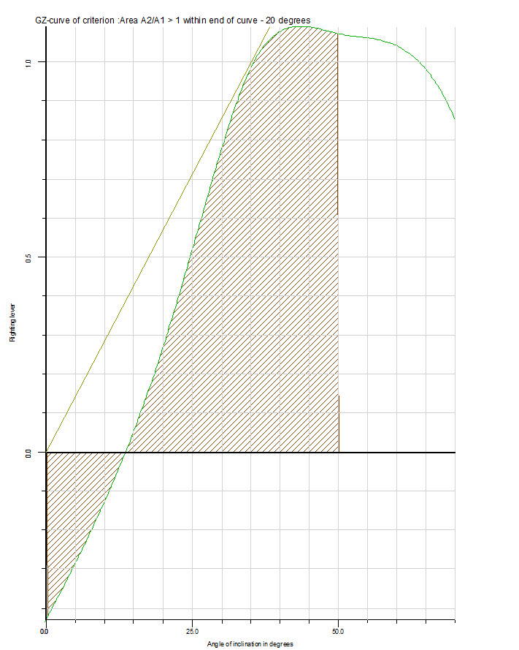
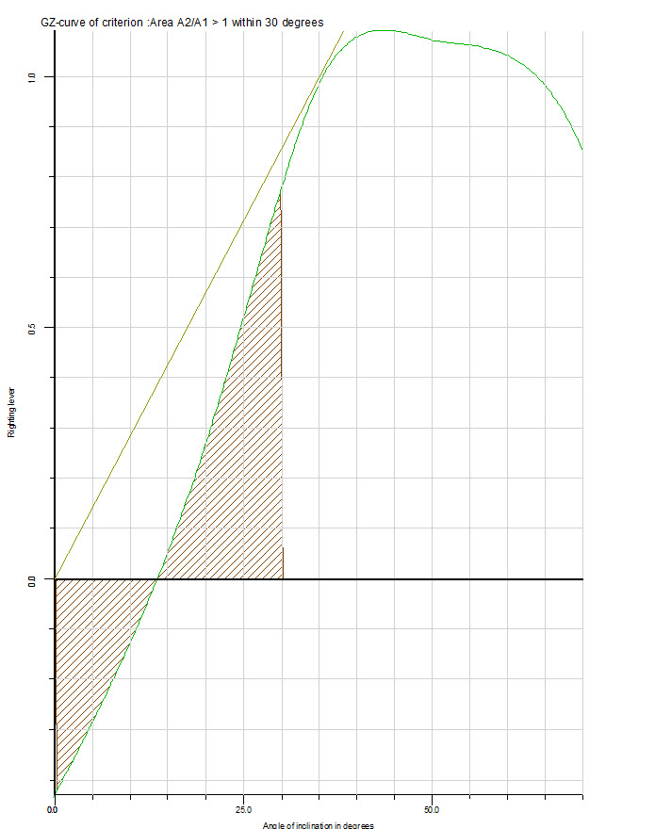

Slide 26
Stabilizers

Slide 27
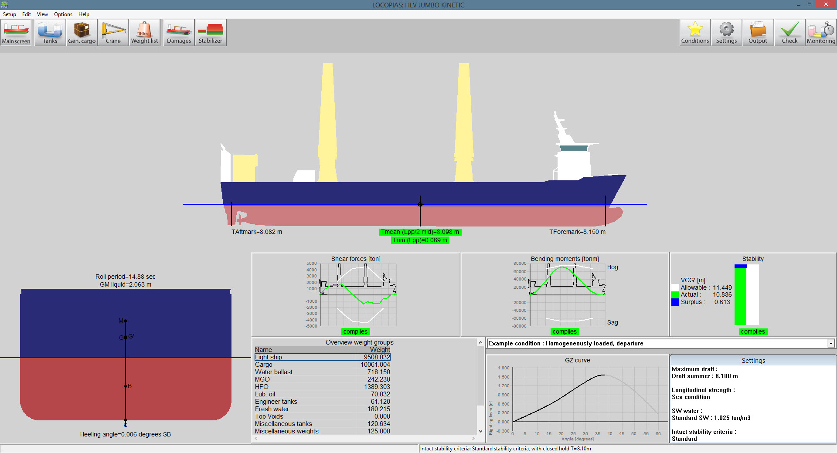

Slide 29
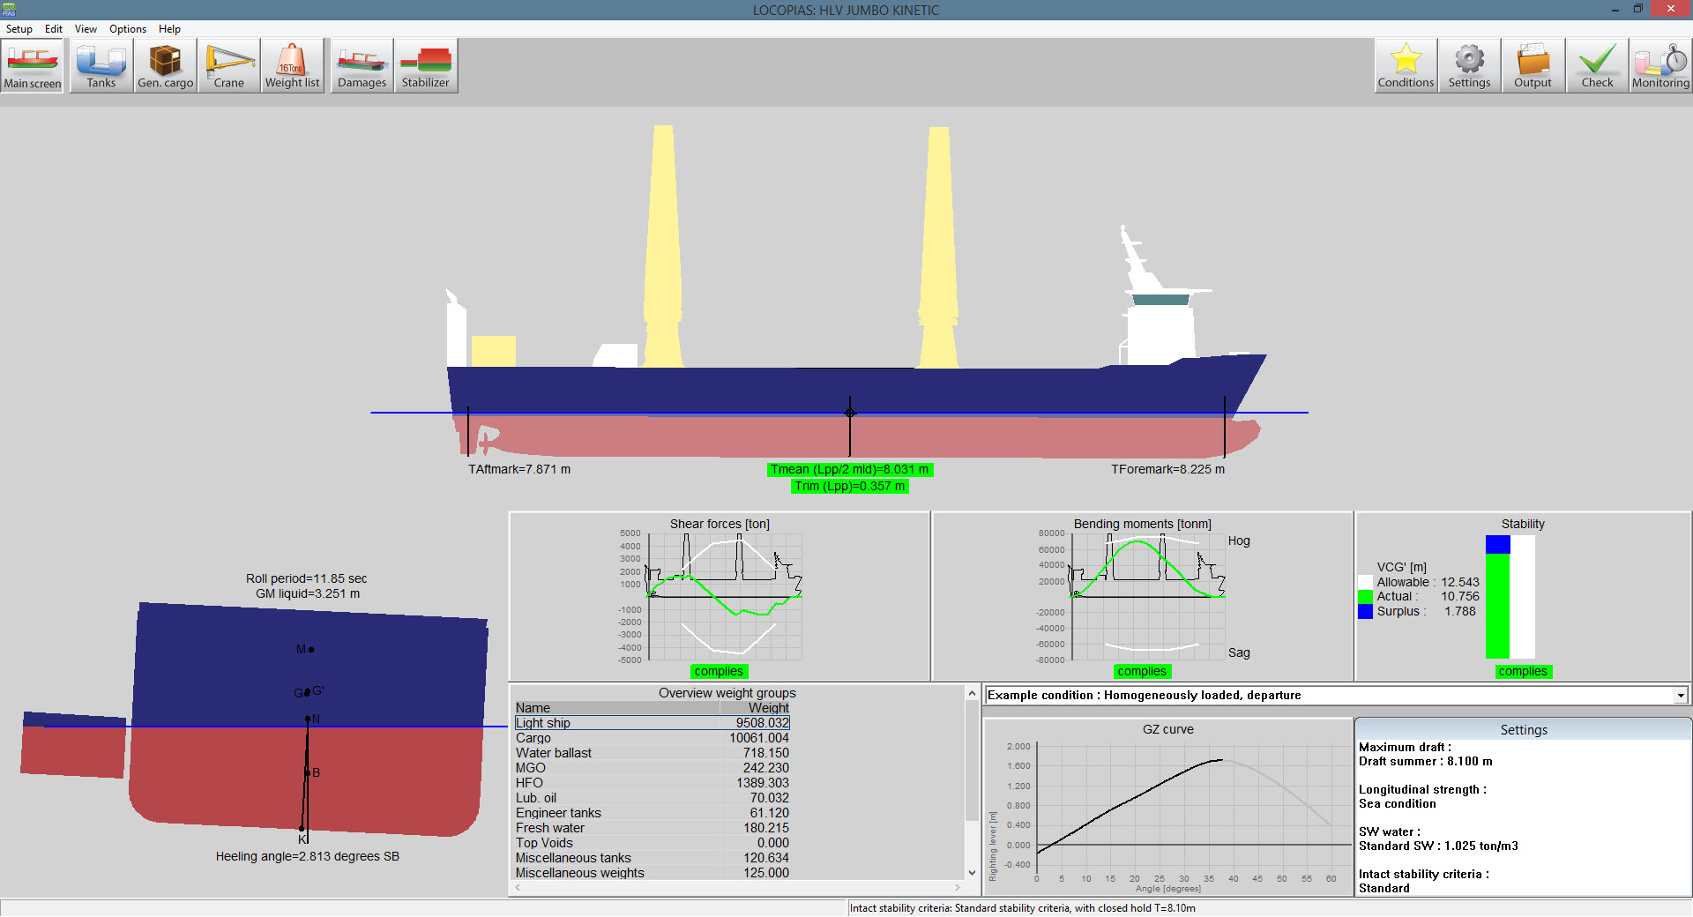

Slide 30
Ballast Advice

Slide 31
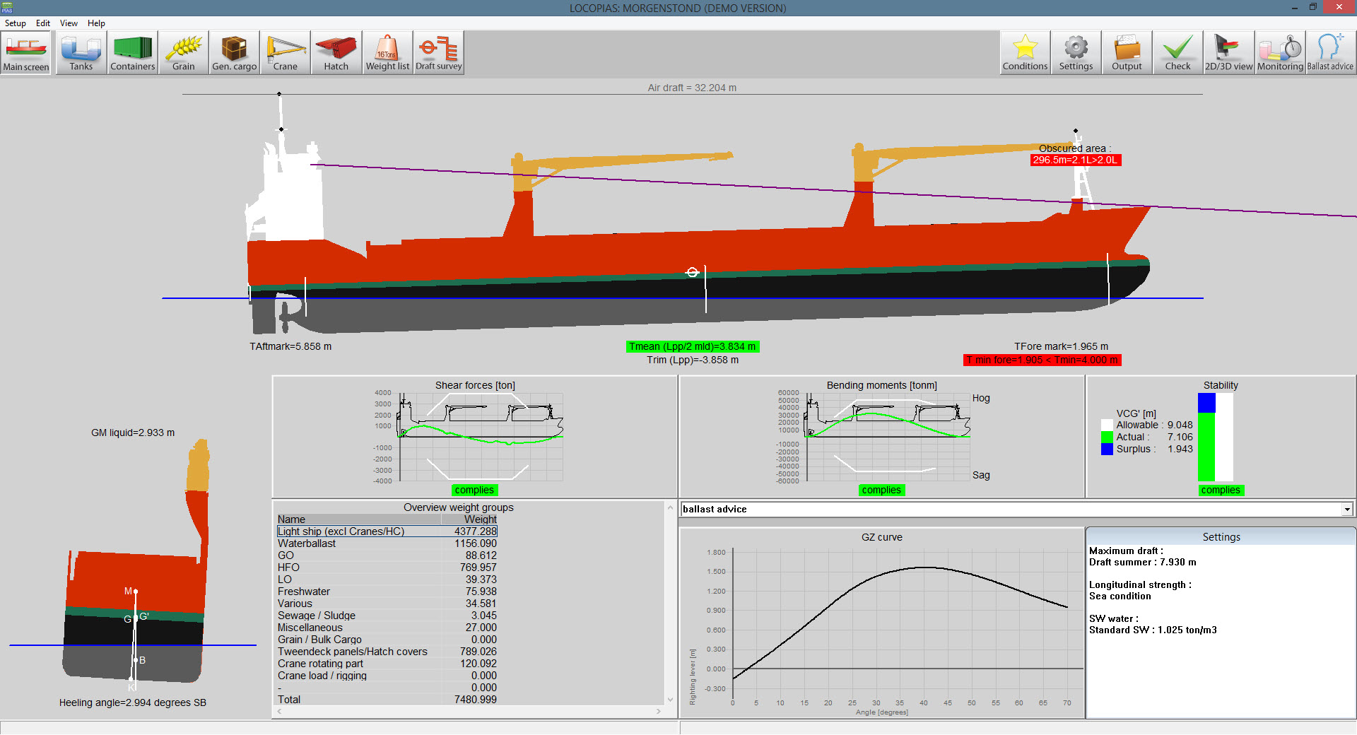

Slide 32
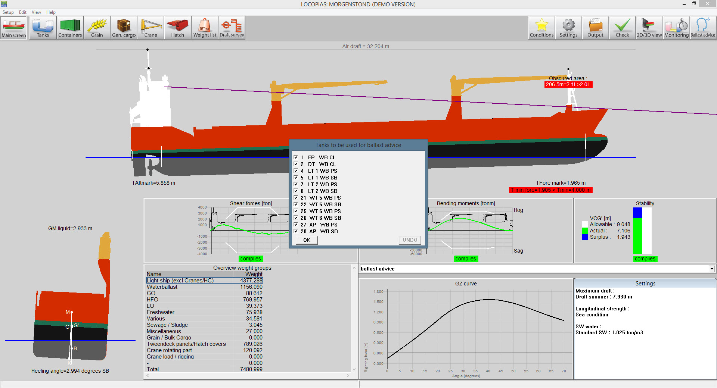
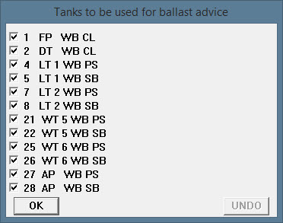

Slide 33
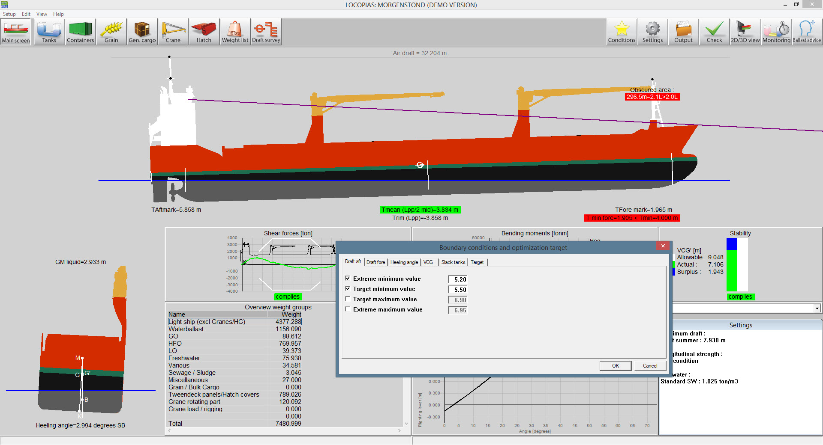
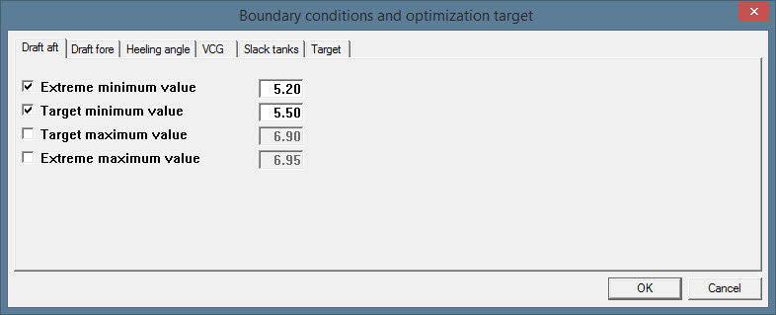

Slide 34
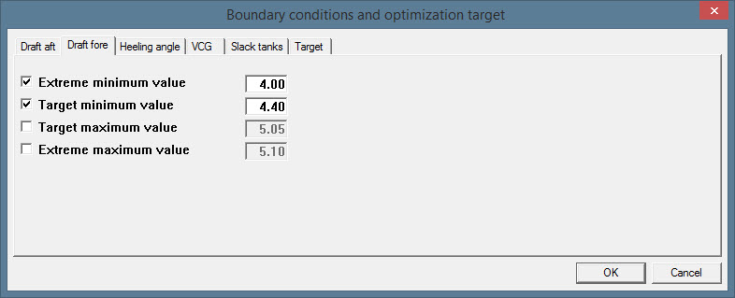

Slide 35
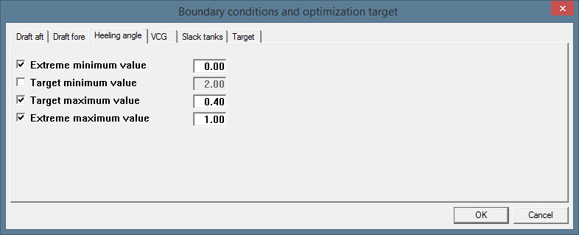

Slide 36
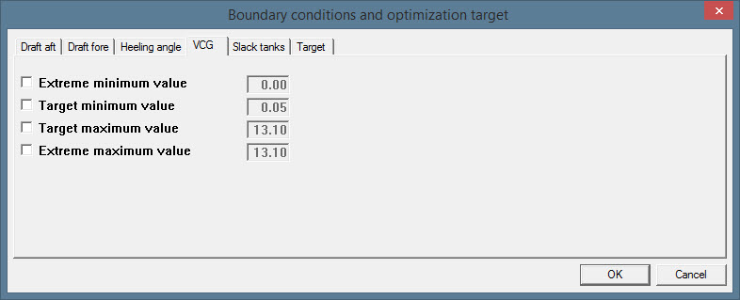

Slide 37
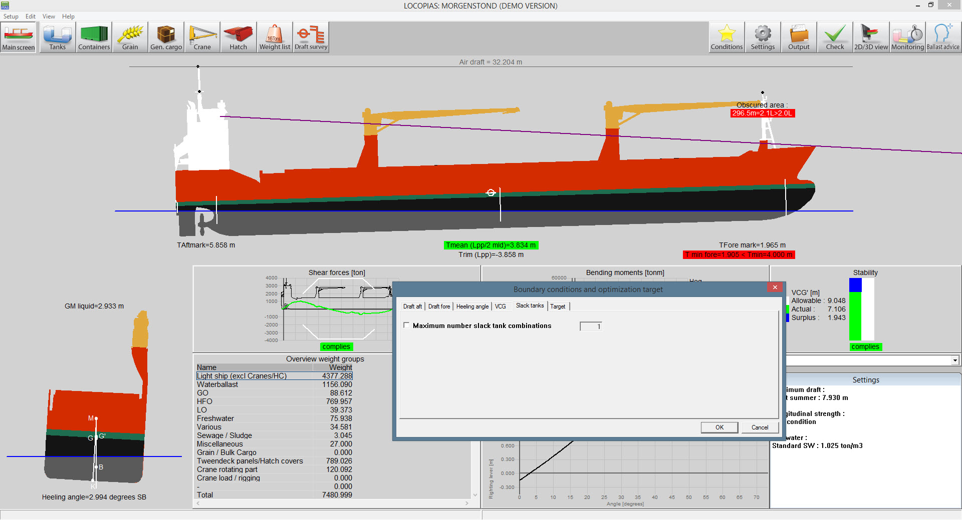
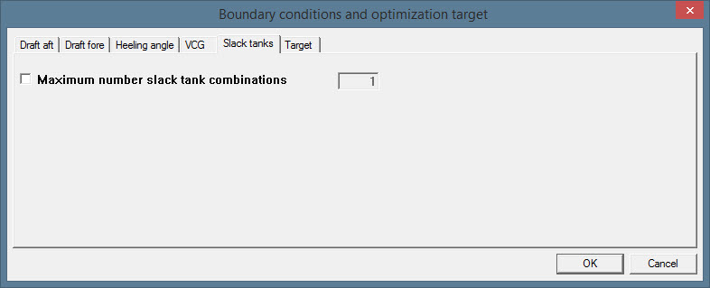

Slide 38
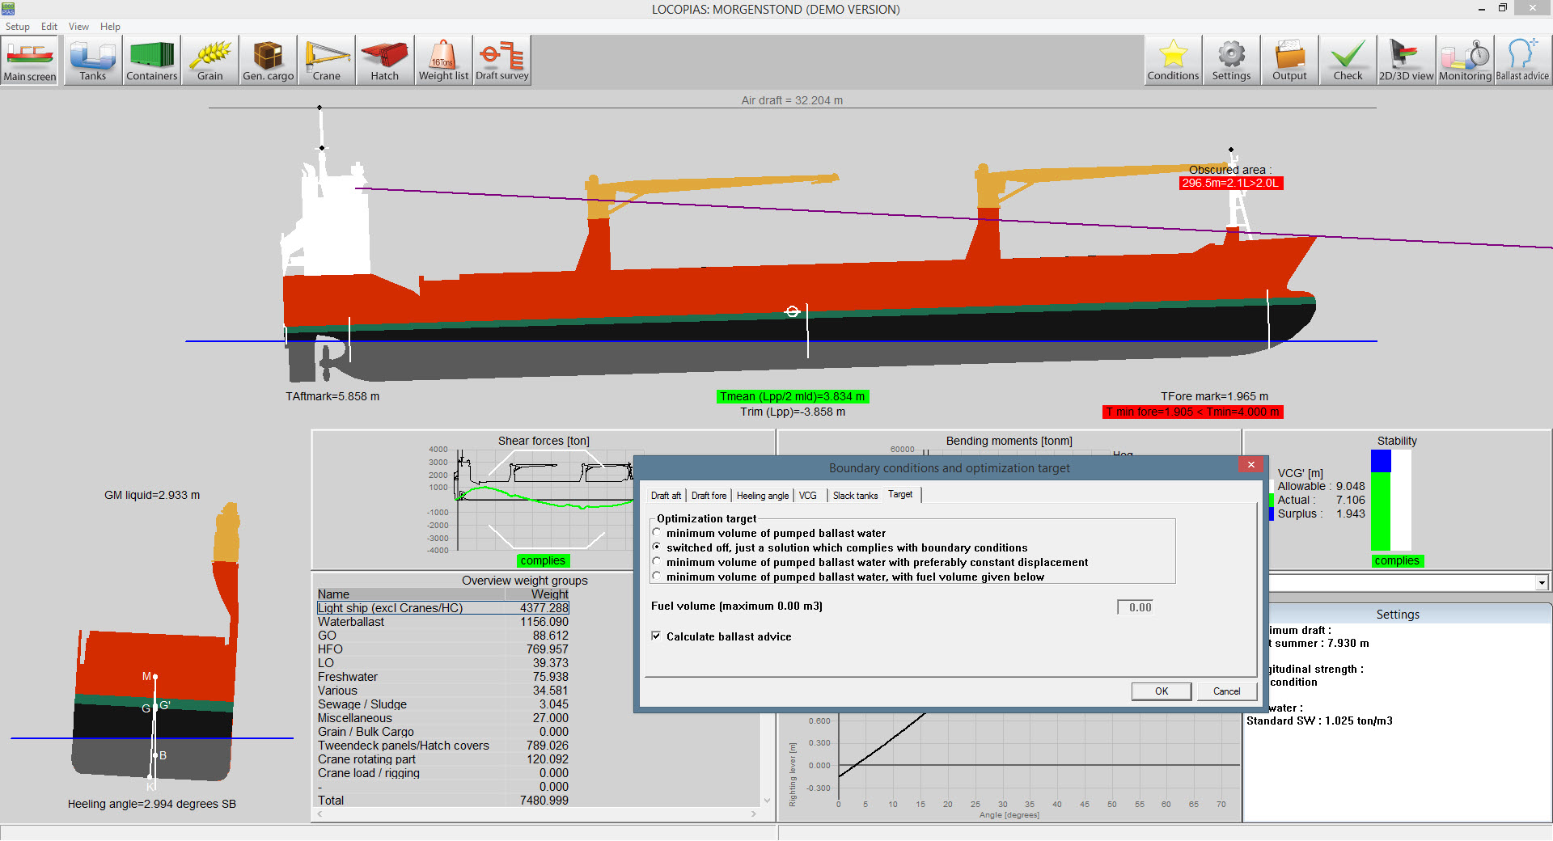
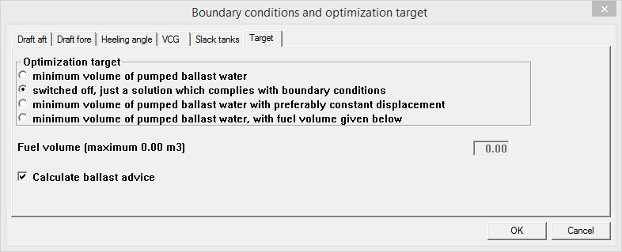

Slide 39
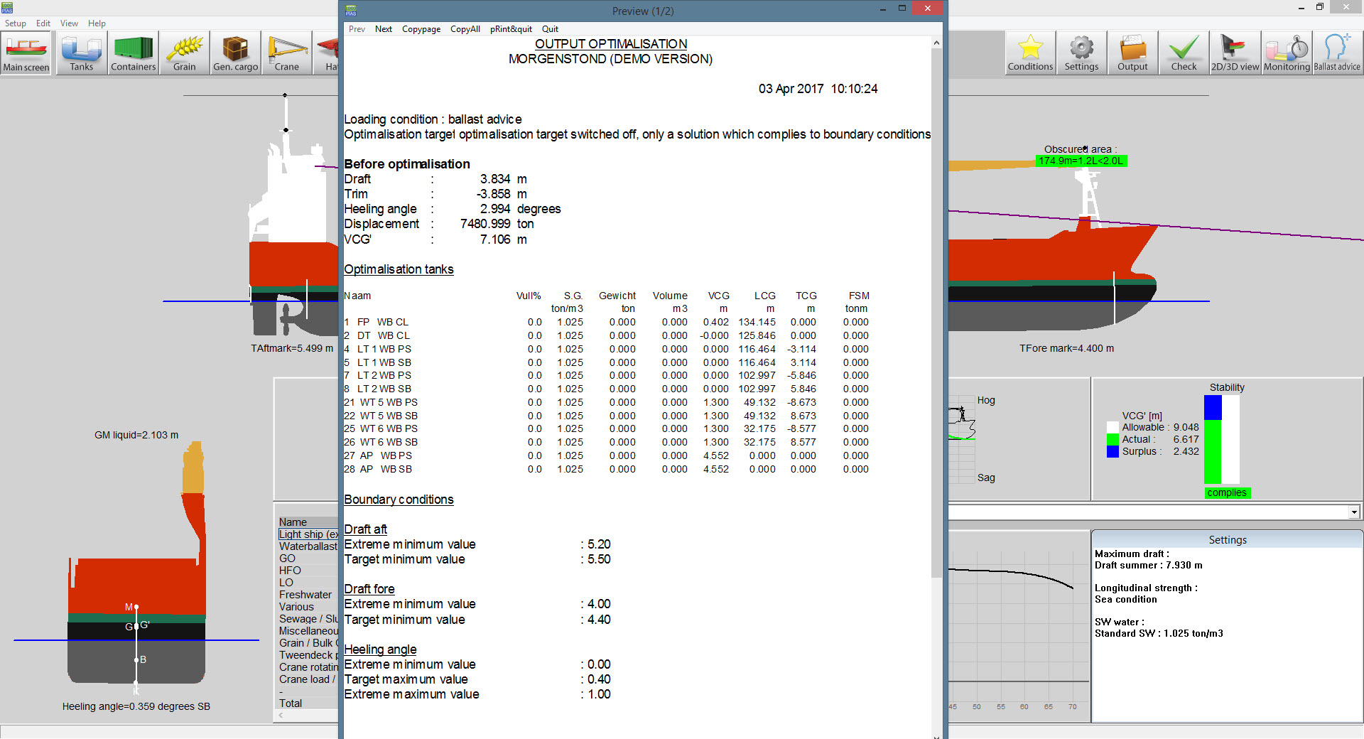

Slide 40
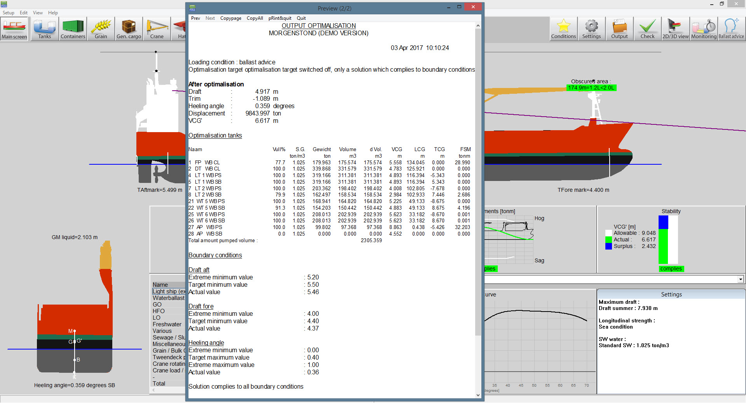

Slide 42
Line of sight
The line of sight is determined for the actual draft and trim of the vessel.
Deck cargo will be taken into account determining the obscured area.
Sight line criteria, IMO A.708 and Panama Canal, can be added

Slide 43
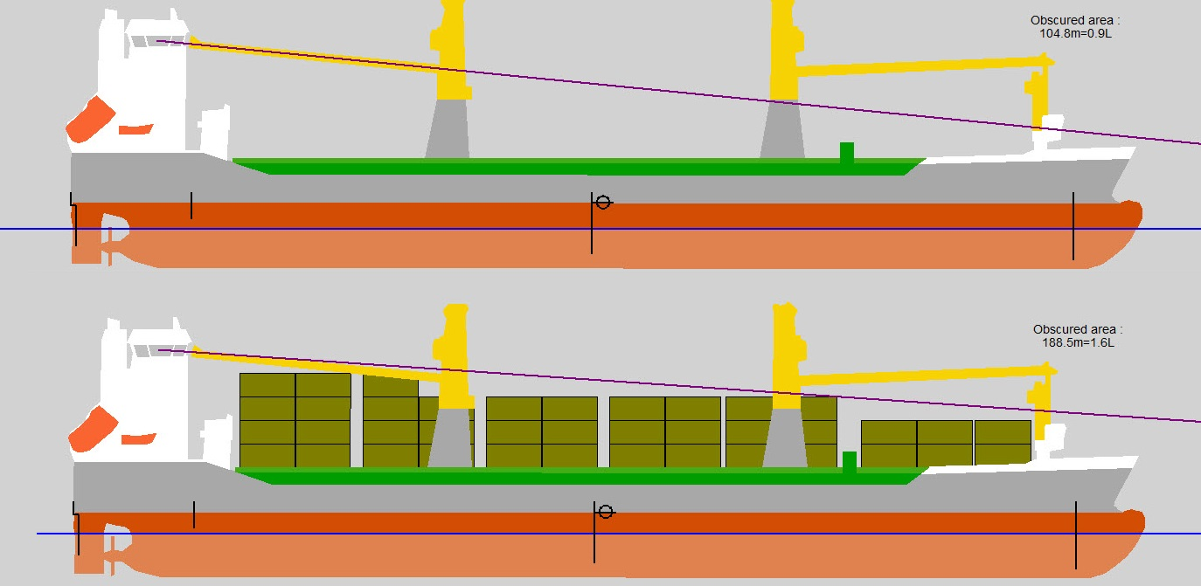

Slide 44
Direct Wind calculation with Deck Cargo
Deck cargo generated with the container and/or general cargo module will be included in the lateral area used for the wind calculation

Slide 45
Icing

Slide 46
Icing

Slide 47
End (of my part of this presentation)

