Slide 1
Fairway
A waterfall of novel functions and features
Notes:
As most of you know, Fairway is one of the cornerstones in our company, it is the tool that we use for defining the geometry of ship hulls; Fairway can do more than that, but that’s what it’s primarily for.
As a start, I’d like to take a minute and introduce Fairway to those of you who aren’t using Fairway yet, so you’ll be able to make sense of this presentation.

Slide 2
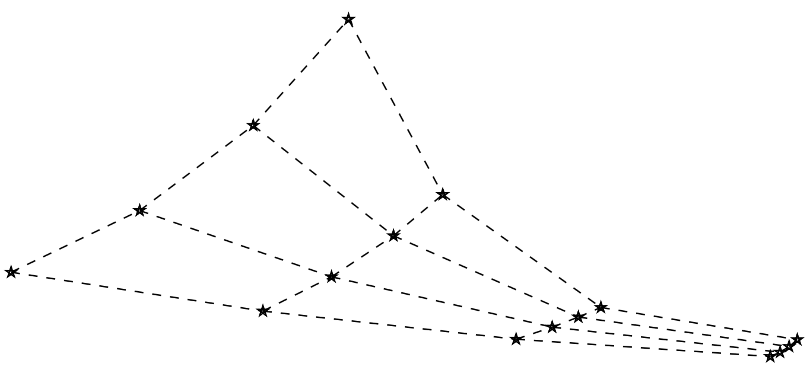
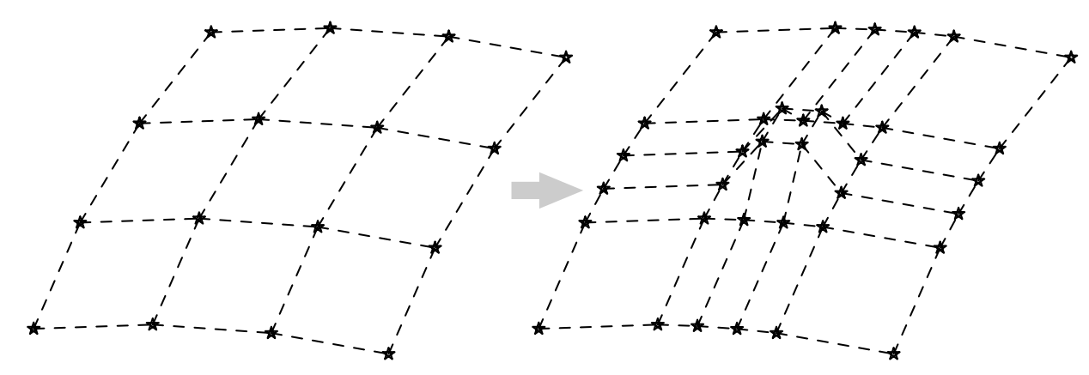
Why Fairway?
What’s wrong with […]?
NURBS surface patches
What’s wrong with NURBS patches?
Notes:
-
I’ll answer the question “Why would I want to use Fairway over Rhino, SolidWorks or AutoCAD?” (or whatever mechanical CAD system you have) and also “Why didn’t you implement Fairway as a plugin to an existing system?”
-
Traditional mechanical CAD systems are based on non-uniform rational B-spline surface patches, which is also the data format of geometry exchange formats such as IGES and DXF.
-
What do NURBS patches look like?
-
1. Always four-sided, have four corners.
-
2. Data definition is always a regular network of control points.

Slide 3
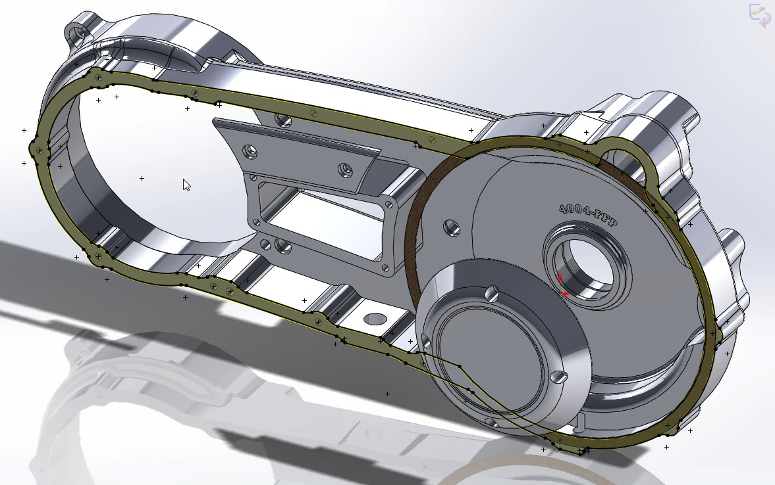
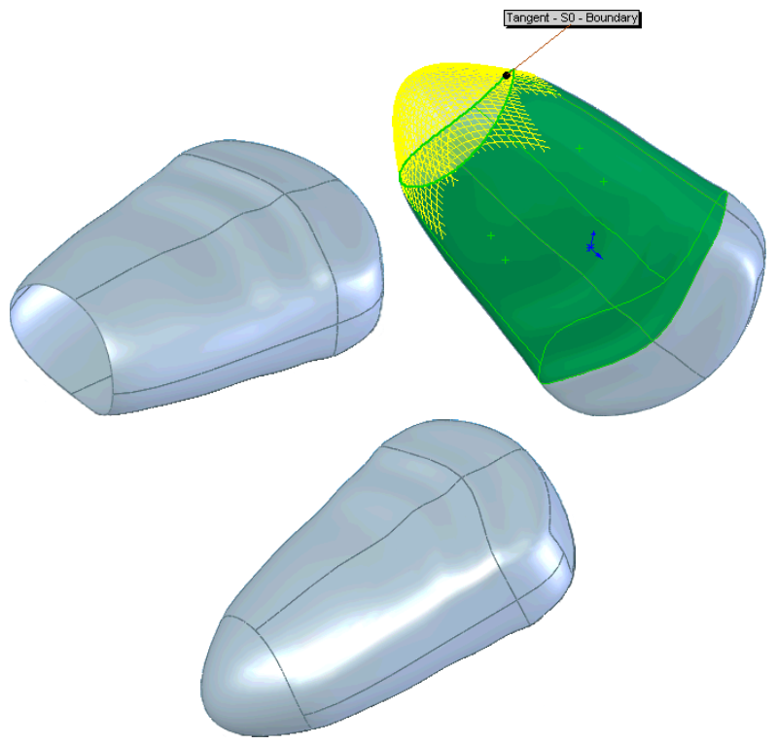
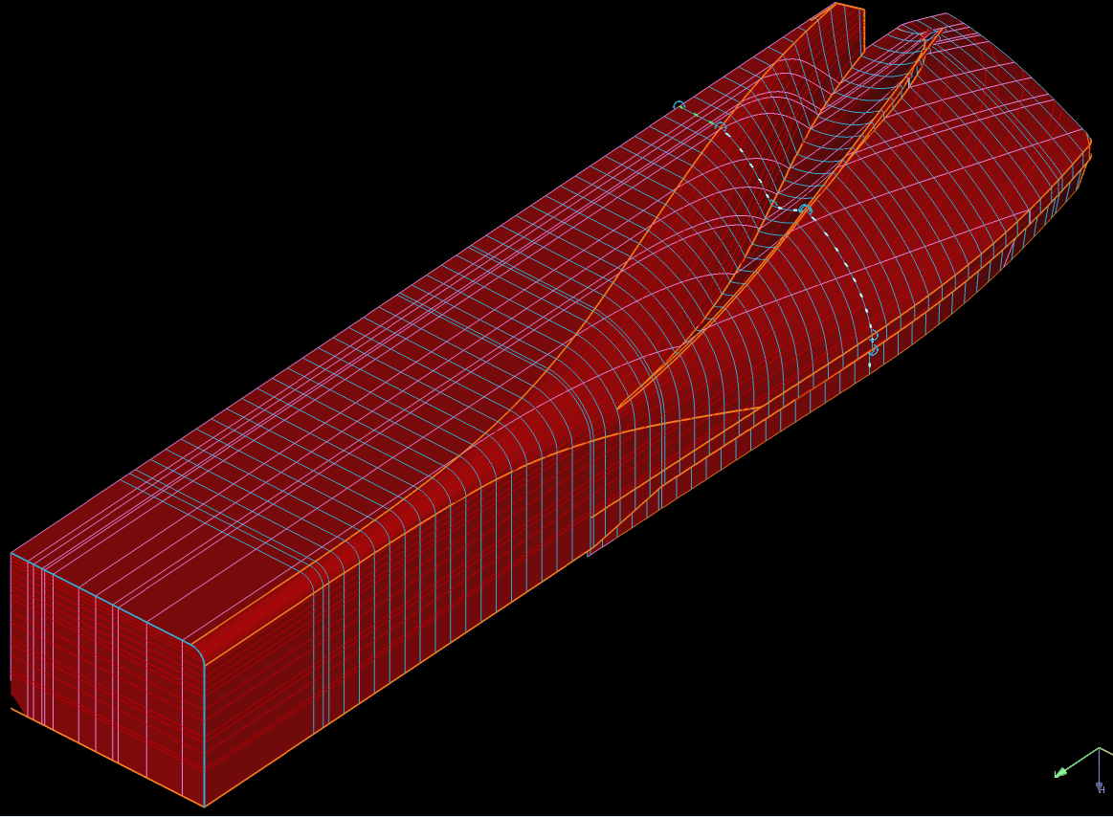
Notes:
NURBS patches are good for most applications in mechanical CAD: extrusions, sweeps, surfaces of revolution, fillets, chamfers, and cut-outs are all very well supported.
-
They are not so good for free-form shapes, but are usually good enough in applications where you can accept to be dictated by the method at certain levels: like in appliances that just need to look appealing, but their exact geometry is not important.
-
For the design of free-form shapes with exact geometric requirements, such as ships and automobiles, NURBS surfaces just don’t cut it.

Slide 4
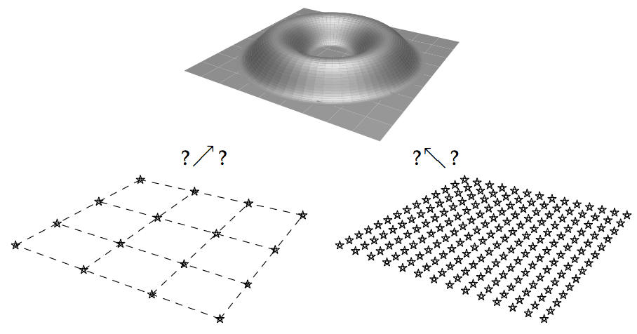
?
Covering a ship hull with four-sided regions = puzzle
Continuity across patches
Distribution of control points
Notes:
Why don’t they? I could fill an hour long presentation explaining in what ways NURBS surfaces are inappropriate for the job, but it boils down to these three challenges:
-
Covering a ship hull with four-sided regions without too much singularities and degenerate corners is a puzzle.
-
Obtaining continuity across patches is achallenge...
-
… as is the distribution of control points (both regarding alignment with surface features, as well as the appropriate density).

Slide 5
Covering a ship hull with four-sided regions = puzzle
Continuity across patches
Distribution of control points
Notes:
Some people ague that you can eliminate challenges 1 and 2 by using a single NURBS patch.

Slide 6
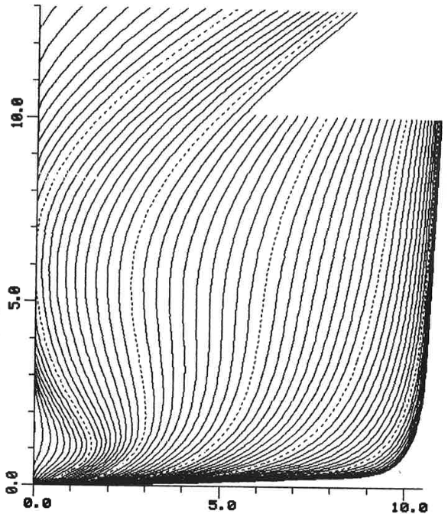
Single NURBS patch
1985
1997
Notes:
-
So did we in 1985. We actually had a PIAS module for hull form generation based on the principle of a single NURBS patch for several years. The limitations were clear and it is this experience that has sparked the development of Fairway.
-
When Fairway matured in 1997 we were happy to be able to ditch the NURBS surface approach altogether.
Now, you may be about to raise your hand and point out: “You said automobiles. The automotive industry seems to manage quite well using NURBS surfaces”.

Slide 7
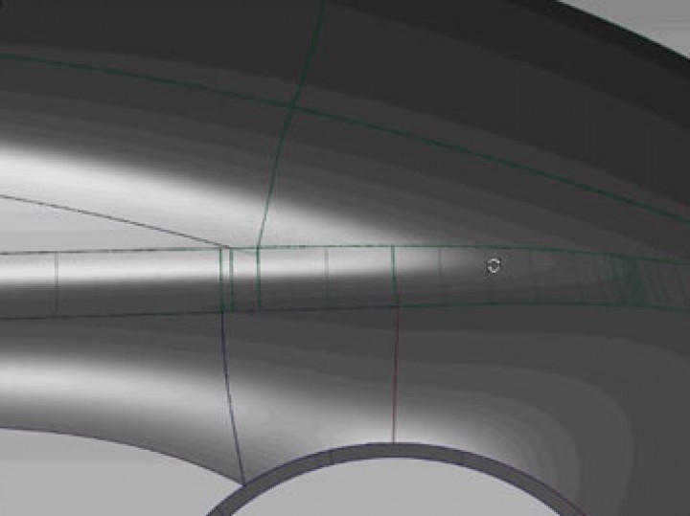
NURBS in automotive industry
Notes:
Yes so it seems, but really, the bodywork of a car is not designed using NURBS surfaces:
-
it typically is still sculpted by hand in clay, and subsequently scanned and painstakingly reverse-engineered into NURBS surfaces.
-
Because the development cycle of a car is measured in years and the production volume is measured in hundreds of thousands of units, the automotive industry can afford the investment it takes (in man-hours) to mould a patch set into something of sufficient quality.
In our industry, to the contrary, we need something workable within the first weeks of design.
Then, if you’re lucky, you may have another week or two for hydrodynamic optimisations, and maybe another week for production fairing.
At the same time the production volume is probably just one unit.

Slide 8
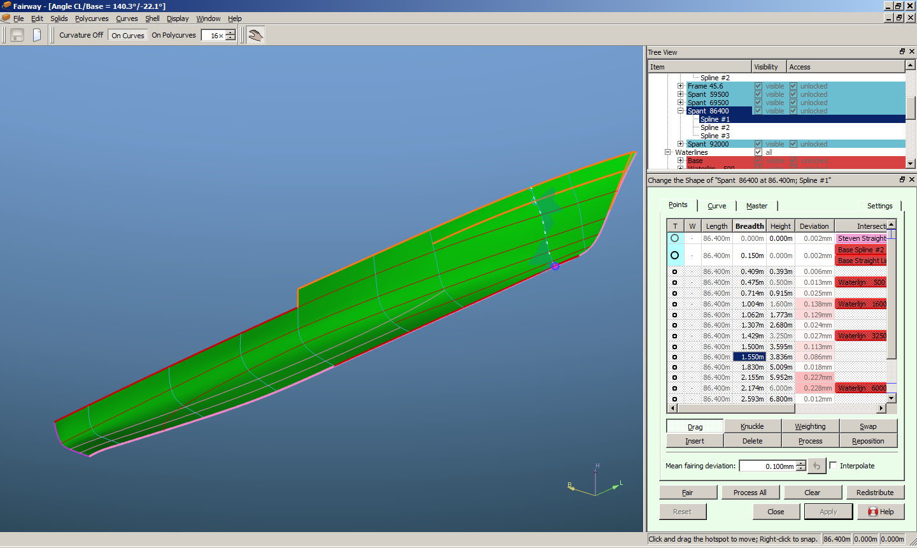
Fairway
Notes:
Therefore it is important, especially for the shipbuilding industry, to have a tool for geometric design that is efficient and specific to our problem domain. Fairway does provide a well working solution and it is able to do so by throwing NURBS surface patches completely out the window and doing things differently instead.

Slide 9
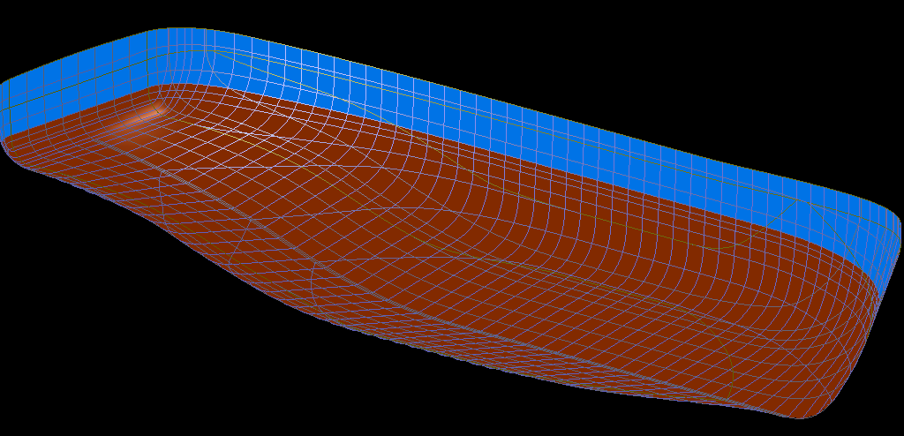
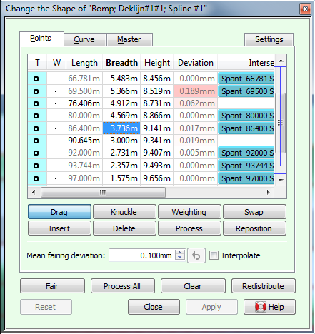
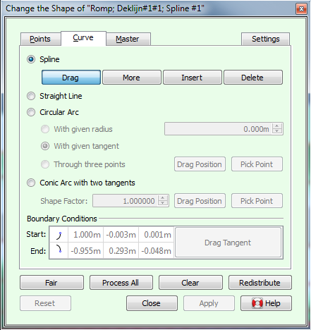
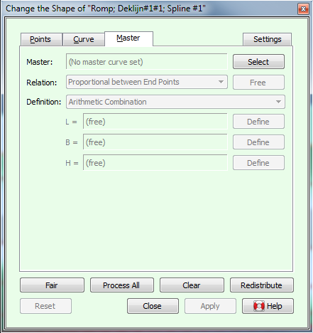
The Fairway way
Curves control the geometry
Control-point-free n-sided surface patches
Continuous surface
Network of arbitrary topology
Curve fairing
Notes:
Instead of working with a set of unrelated rectangular patches that are shaped by control points, Fairway defines a shape by means of a network of intersecting curves.
-
The curves in a Fairway model are the geometry-defining entities: the shape of a ship hull is manipulated
through the manipulation of curves, and
-
Fairway offers an extensive toolbox for the precise manipulation of curves.
-
The cells or meshes in this network are filled with a very different kind of surface patches, that are not restricted to being four-sided, have no control points at all and whose shape is automatically derived from the shape of the surrounding curves.
-
They connect seamlessly to form a watertight surface that stretches the complete hull. This surface can then be used for visualisation and interpolation of new curves. Together they form what we call in Fairway a solid — it unambiguously differentiates between what is inside and what is outside the hull.
-
Curves can run over long stretches of the solid in any way you like, as long as they start and end on another curve in the network.
So the challenges of working with NURBS patches (solving a puzzle, continuity across patches, control point distribution) are just non-existent in Fairway.
-
In addition to that, Fairway can allow curves to deviate from their intersection points with crossing curves by a configurable amount, which makes it possible to fair curves and thereby increase the surface quality in an iterative manner. This process is very much analogous to the way lines plans were faired by hand in earlier days, and a method that is simply not possible in your average MCAD system.
[[Sadly, inventing a better way of doing things does not give us paradise. We can’t fix the world on our own, and there are plenty occasions where we need to convert from and to the way others are still working. This is not always straight forward and is a continued focus of development as you’ll see.]]
This is as far as I’d like to take this introduction, as I think we now all know enough of the basics to appreciate the rest of this presentation and the live demonstration that will follow after the break.
AH - Apropos “Waterfall of new Fairway features”, the term fairway in nautical contexts of course means navigable waters. Some people take pride in pushing the boundaries of what can be considered navigable waters:

Slide 10
Notes:
So there’s your waterfall, let’s move on to the features.

Slide 11
A Selection of new features
Import and wireframes
Shell regions / plates
Shell rendering & surface quality
Surface export
hydrodynamics
Notes:
We don’t have time to cover all new featuers in Fairway, but there are five areas that I’d like to highlight.
In short:
Import and wireframes
Regions and surface rendering and -export
And hydrodynamics.

Slide 12
Import and wireframes
Solid
Connections
Curves
Fairway
Curves
Wireframe
Solid
Notes:
Because Fairway defines solid geometry based on curves, if you want to import existing geometry into Fairway, it needs to be in the form of curves. These can either be provided directly in DXF/IGES, or be extracted from NURBS surface patches.
-
Given a set of curves, an algorithm needs to find out what curves need to be connected (and where) so that a proper solid is unambiguously defined. We used to have a separate utility for this entire process, but without much opportunity for interaction.
-
What is new is that we have chopped this process up and integrated each of the bits directly in Fairway.
-
Now. when curves are imported into Fairway, they are collected in a group of curves which we call a wireframe.
-
Wireframes can be manipulated in various ways. One of the great advantages is that you can now use the graphical interface to correct inaccuracies and downright errors in the input. In our experience, only some 10% of files delivered to SARC are free of deficiencies and convert to solids without problems.
-
Once the wireframe is corrected it can be successfully converted to a proper Fairway solid. Bart Soede will demonstrate this live after the break.
So what else can you do with a wireframe?

Slide 13
Import and wireframes
Make and break connections
Common actions
Export of .hyd file (frame-based PIAS model)
Inspection and diagnostics
Sketch-wise ab initio design
Wireframe
Notes:
You can make and break connections between curves. Curves in a wireframe may be unconnected, partially connected, fully connected, or even connected in ways that are impossible in solids – most often as an intermediate state.
-
Apart from specialised actions for working with wireframes, the usual actions for manipulation of solids also work on wireframes, where appropriate.
-
Sometimes, you’ll want to import only frames just to produce a so called .hyd file for use in other PIAS modules. Bart Soede will demonstrate: that this can now be done directly, without converting the frames to solid at all.
-
Other times you do need a solid, for example for interpolation of new curves, for adjustments or for production-fairing and plate expansion. For this purpose there are graphical methods for inspection of a wireframe and for diagnostics in case the wireframe is not a valid representation of a solid, which will prevent conversion.
-
Of course, it is also possible to draw an elementary lines plan by hand, from the ground up. Some people may prefer to start their design this way, converting it to a solid at a later stage.

Slide 14
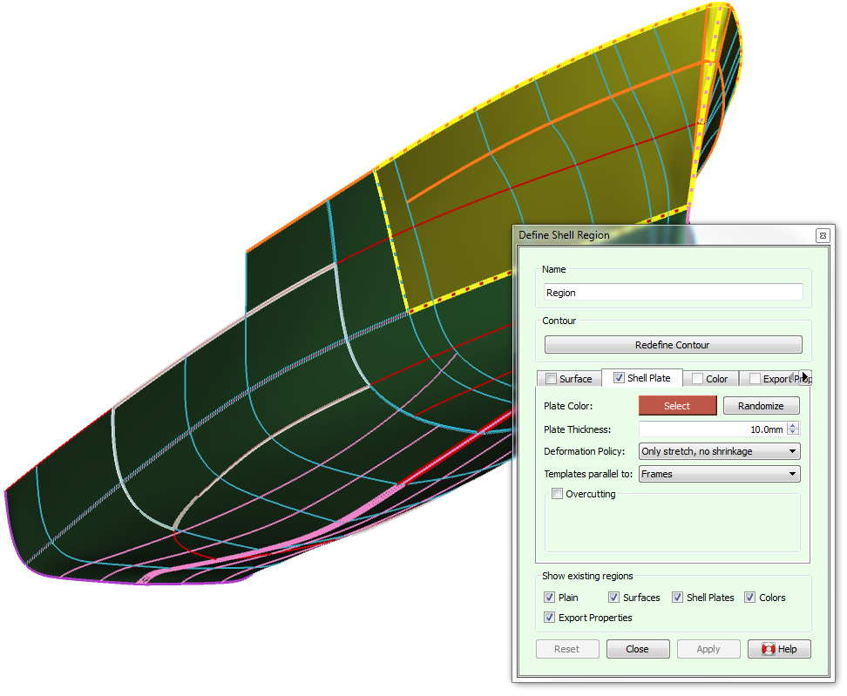
Shell regions / plates
Interactive boundary selection
Arbitrary shape
Seams and butts
Multiple properties
May overlap
Listed in tree view
Boundary validity – no locks
Notes:
Fairway has had the ability to define shell plating and compute plate expansions for many years. This functionality has largely been rewritten and generalised.
-
Shell regions are defined by clicking on the corners of the region in a clockwise order.
-
This allows for fast and easy definition of regions of arbitrary shape with visual feedback.
-
Automatic generation of regions between defined seams and butts is also available, as before.
-
After definition, a region can be given a particular purpose, such as 1) surface properties, 2) plate definition, 3) colour, or 4) regional settings for export.
-
Regions may overlap, which makes it possible to assign various purposes with different regions to the same area.
-
Defined regions appear in the three view under the Shell item.
-
Regions do not lock the underlying solid in any way. For example: you can still remove the polycurve that is part of a boundary of a region. This will mark the region as having an invalid boundary. Regions can exist without valid boundaries, their other properties won’t get lost. These regions can be fixed by simply redefining their boundary.

Slide 15
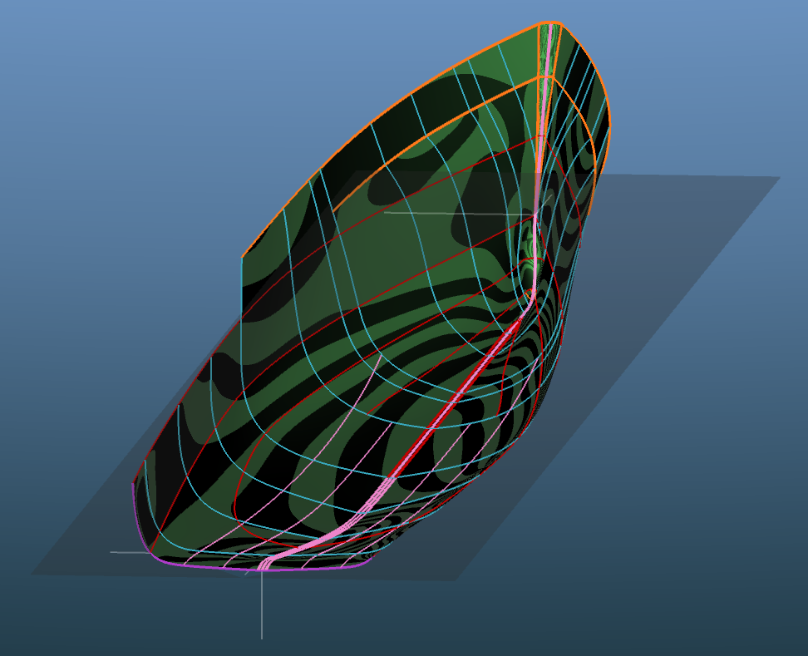
Shell rendering & quality
Phong
Striped Phong
Upcoming
Improved internal patch geometry
Plan
Control tangent ribbons
Passive curves
Notes:
Shortly after the previous SARC user day was over we implemented shell rendering as a background task in Fairway, meaning that the surface of the solid is continuously updated as you are working with the model.
-
The quality of that rendering has been dramatically improved.
-
We can now simulate reflections in the shell surface including reflected striping, to allow easy interpretation of the fairness of the surface.
In ship construction, curves rather than surfaces are used to define stiffeners and templates. The surfaces as modelled in Fairway have always been “fit for purpose”, which was primarily interpolation of new curves. Nevertheless, we are aware that surface quality is slowly becoming more important, not the least in hydrodynamic analysis.
-
We recently had an intern, Sayantam Dutta from India, who took his Master’s in computational mathematics with us, trying to further improve the shape of surface patches in Fairway. His work will likely find its way to customers in the near future.
-
Another option that we’d like to explore is to visualise and manipulate the so-called tangent ribbons, which will bring more control over the internal shape of patches so that we can use fewer curves to define a particular shape.
-
Currently, all curves take part it the definition of the surface shape. We now plan to implement passive curves, that will not take part in the definition but always follow the existing surface patches. A passive curve can be made active at any time. The number of entities required for hull modelling will be reduced, even more so in combination with control over tangent ribbons.

Slide 16
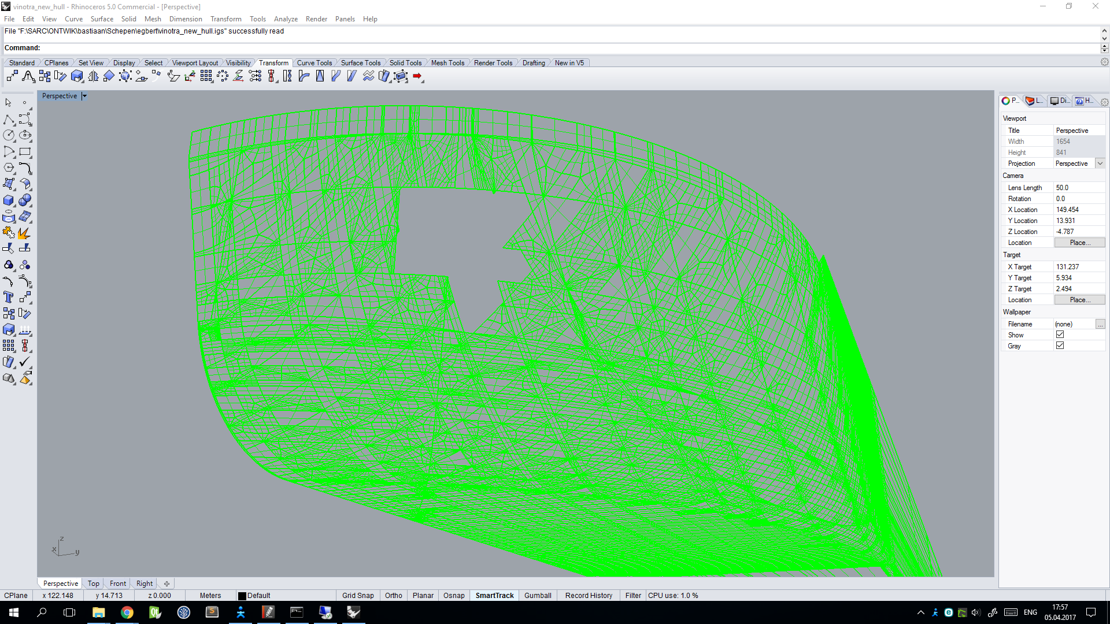
Surface export
Rhino
Fairway
Notes:
We have successfully eliminated NURBS surface patches from hull-modelling. However, we are still required to export our hull models to NURBS surface patches in IGES format for use in third-party software. So, what we have so successfully eliminated, still comes back to haunt us.
-
As all surface patches in Fairway are currently exported as separate NURBS surfaces, 20.000 NURBS surfaces in an export is not an exception for a dense network. This may be beyond the capacities of the receiving software. In addition, our current conversion to NURBS surfaces may yield models that are not watertight, which also may present problems for receiving software.
We recognise that these compatibility issues may present a problem to Fairway users. Apparently, receiving software will stick to NURBS surfaces. Thus, although completely unnecessary for the inner workings of Fairway, we have invested considerable research and development on improving NURBS surface export.
We are implementing large regions in a Fairway model to be covered with a single NURBS surface patch that will closely approximate the curves and surface within the respective region, and matches the region boundary curves exactly. Solving the puzzle of dividing the hull surface into purely four-sided regions may require a bit of user input initially. Please note: this is always the case in NURBS surface modellers. This new export feature will produce watertight models consisting of only a few NURBS surface patches. We expect this to greatly reduce the problems in third-party software and work hard to get this ready for release in Q3 2017.
While we are working on this, we have another MSc intern, Maria Ardavani from Greece, who is researching the possibilities for finding optimal partition of the hull in four-sided regions automatically. This could relieve the user from having to solve puzzles and define export regions by hand.

Slide 17
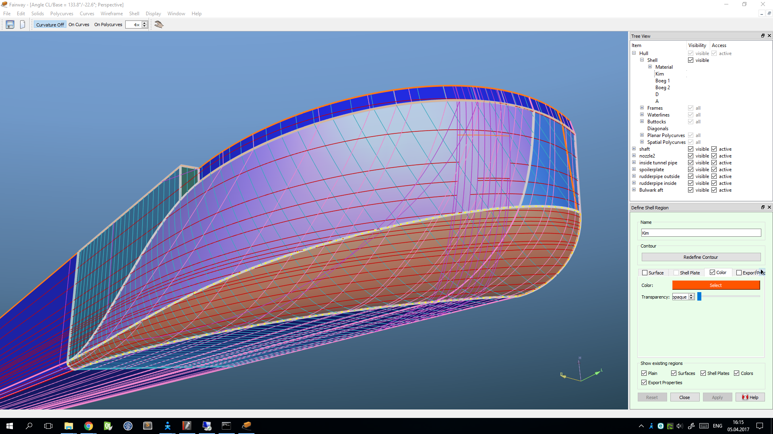
Notes:
So what we are working on is the ability to define large rectangular regions in a Fairway model, to be covered with a single NURBS surface patch. This patch will closely approximate the curves and surface within the respective region, and matches the region boundary curves exactly. Solving the puzzle of dividing the hull surface into purely four-sided regions may require a bit of user input initially. [[Please note: this is always the case in NURBS surface modellers.]] This new export feature will produce watertight models consisting of only a few NURBS surface patches. We expect this to greatly reduce the problems in third-party software and work hard to get this ready for release in Q3 this year.
While we are working on this, we have another Master of Science intern, Maria Ardavani from Greece, who is researching the possibilities for finding optimal partition of the hull in four-sided regions automatically. This could relieve the user from having to solve puzzles and define export regions by hand.

Slide 18
Hydrodynamics
Notes:
Traditionally, SARC has had a very strong focus on hydrostatics and validation of regulatory requirements. There is no doubt that hydrodynamic optimisation is receiving increased attention, and the tools and technology for computational fluid dynamics analysis are increasingly becoming more accessible, as elucidated in the keynote by Volker Bertram. I’d like to close this presentation with how we are preparing Fairway for this development.

Slide 19
Hydrodynamics
Variation
CFD
Selection
Geometry
Notes:
The problems of geometric design and hydrodynamic analysis have been solved, by means of Fairway and existing CFD solvers. What is necessary for hydrodynamic optimisation is a means of generating shape variations,
-
and connecting the systems. Automated optimisation requires in addition an algorithm
-
that can drive shape variations towards more optimal solutions.

Slide 20
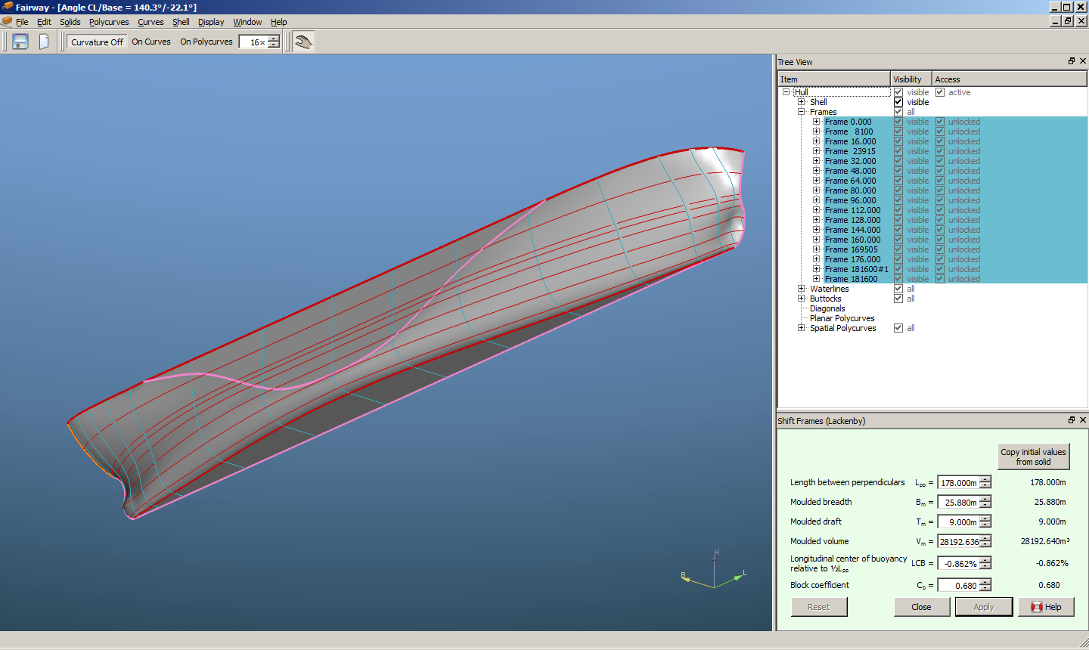
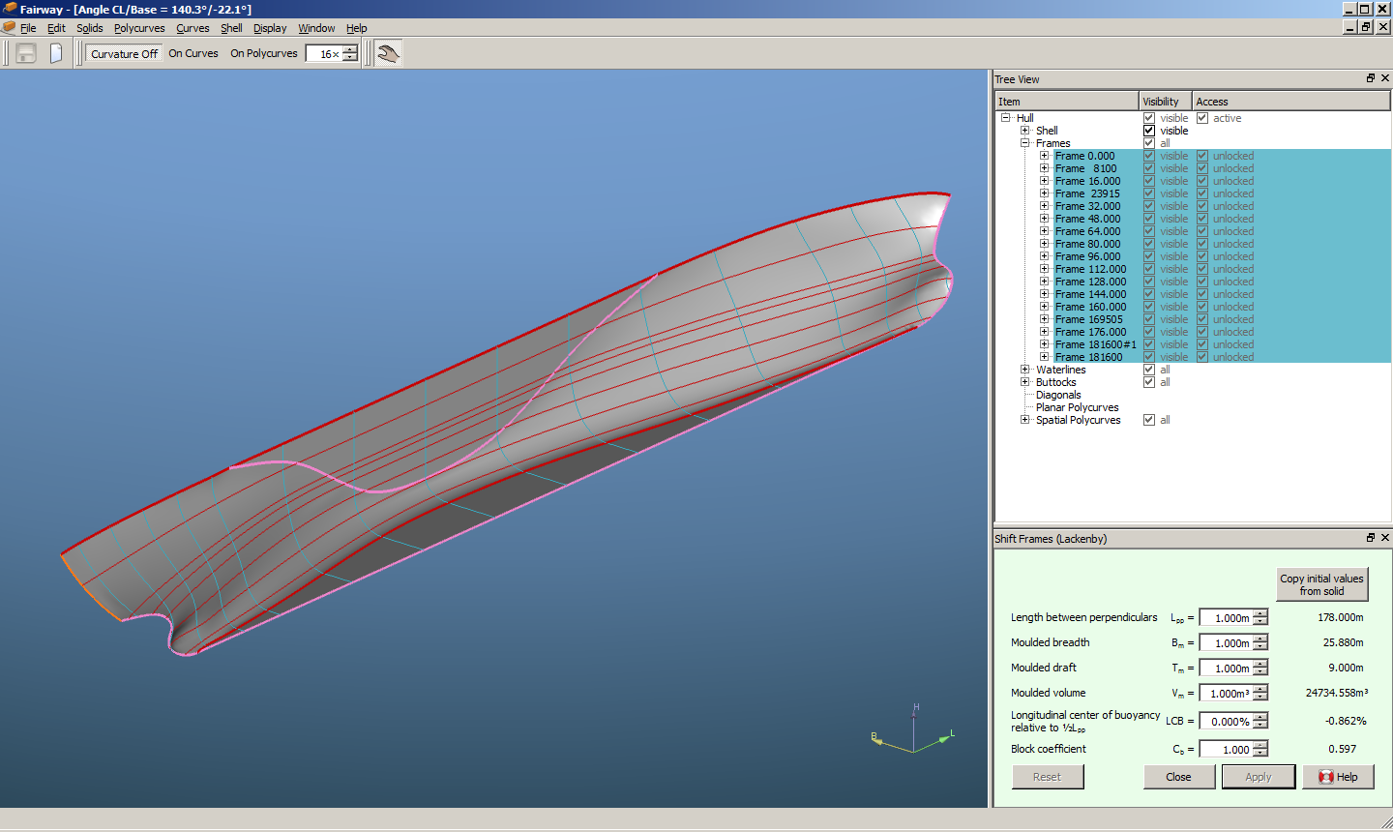
Hydrodynamics
Lackenby transformation
Notes:
Typical naval architectural shape variations are available right from the Fairway GUI, such as Lackenby transformation, with which a hull can be adjusted to specific design particulars such as LCB and C_b. Although since 1951 Lackenby has proven to be very powerful, this method affects the entire hull. However, for hydrodynamic optimisation more localised shape modifications are required.

Slide 21
Hydrodynamics
Spatial deformation
Notes:
Generating these kinds of shape variations in Fairway models was the subject of my PhD thesis from 2004. That research has resulted in a method for localised shape transformation based on a technique called spatial deformation. A simplified version of this transformation is currently in beta and Bart will demonstrate its potentials.

Slide 22
Hydrodynamics
Notes:
-
We are currently making plans together with another company you may have heard of: Friendship Systems in Potsdam, Germany.

Slide 23
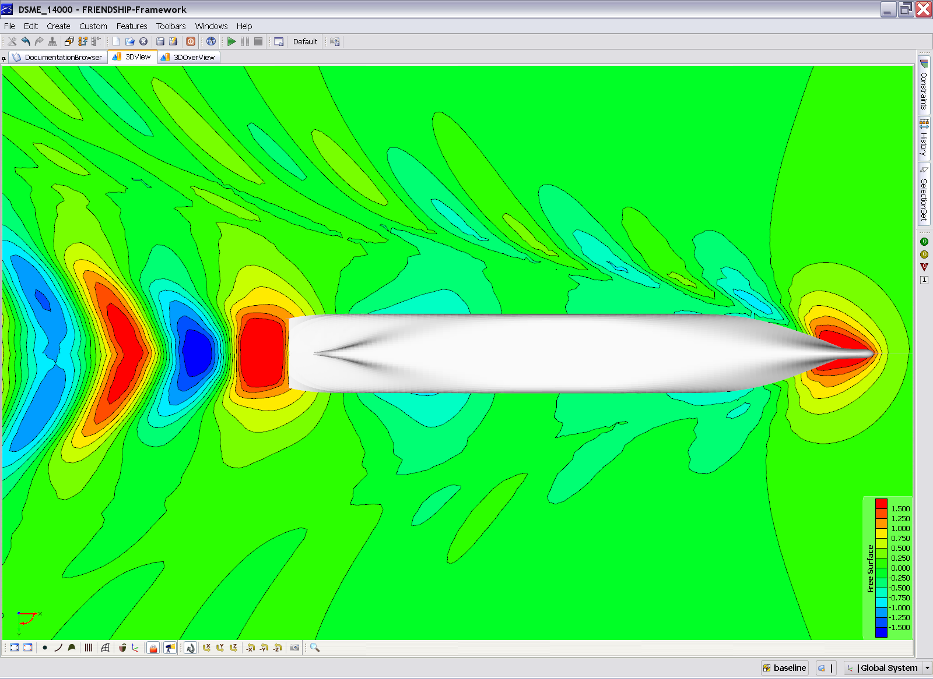
Hydrodynamics
CAESES
CFD
Baseline
Optimized design
Source: DSME
Notes:
With their software called CAESES they specialise in hydrodynamic optimisation, covering the synthesis of shape variations, meshing,
-
communication with CFD solvers,
-
and optimisation.

Slide 24
Hydrodynamics
CAESES
CFD
Fairway
CAESES
Notes:
What we are working on with Friendship Systems
-
is a protocol for lossless communication between Fairway and CAESES. This will make sure that the structure of a Fairway model remains intact during a hydrodynamic optimisation, without conversion issues to and from different formats. This will be a great advantage, as Fairway will retain all its powers over the model, and be able to make changes before, during and after the optimisation. Tentatively we estimate that this functionality will be available for general use by the end of this year.
That is all I have time for at this moment. Thank you very much for your attention!
I propose that we take a break now, under which you’ll be able to ask me any questions you might have. And if the question is of general interest, I can repeat it on stage just before Bart starts his demonstration of Fairway after the break.

