Slide 1
CPDES
SMART INTEROPERABILITY at CONOSHIP
Jan van der Zee
Notes:
Hi everybody.
First I will introduce myself: I am Jan van der Zee, Naval Architect and Project Manager at Conoship International (and also researcher, student supervisor and a bit of a system administrator (for CADMATIC software for example).
Today, I will treat the following subjects:
First, short introduction to our company and vessels
SMARTYards prototype application: implementation at Conoship (also Herbert, already told you a bit about it)
Our design process and highlight where the prototype is advantageous and I will mention the benefits.
Finally, screenshots of the prototype to show to you before Jan Broos and I are going to demonstrate the prototype Live for you.
Yes people, a live demonstration. I know, it is always a risk, but we have thrust in the technology we developed! ☺

Slide 2
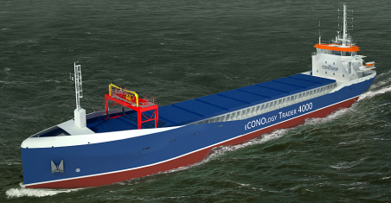

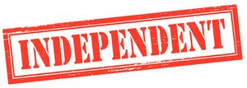




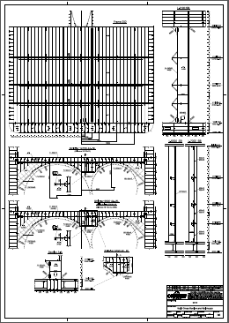
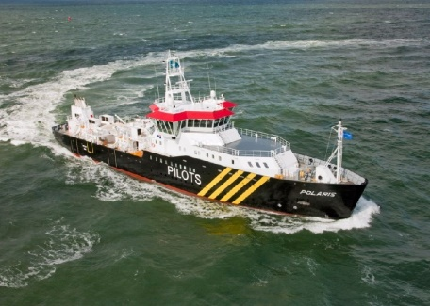
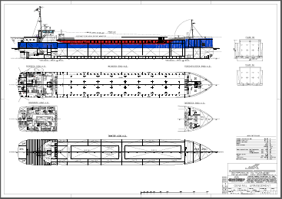
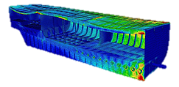
Innovative designs
1952
R&D
ECO SPEED
Engineering
<< TON/DAY
>2000
Design
Vessels built
Notes:
In 1952, Conoship International was found as a central design and purchase office for a group of Nothern Dutch shipyards. Throughout the years some yards disappeared or went bankrupt, FUSED with others or simply left the Conoship group. Nowadays, we are an independent company offering design and engineering services to shipyards and ship owners from all over the world.
Over 2000 vessels are built according to Conoship designs, with the recently delivered Pilot Station Vessel as an example in this sheet. of course, not 2000 Pilot Station Vessels were built!!! ☺ but also many other ships and ship types. In the next slides, I will show you a few more examples of built vessels.
Engineering of the vessels construction was never in our scope, but recently, we also started to offer engineering services. We are now able to provide clients with a complete Basic and Detailed Engineering package, including all production information needed to build a vessel.
Next to our design and engineering department, we also have an in-house Research and Development department and we are cooperating in many R&D projects like LeanShips and SMARTYards. As an example, Recently we cooperated in a project about the EEDI regulations..... We cooperated in preparing a IMO submission with adapted rules for small General Cargo Ships and it was GOEDGEKEURD.
Our main focus is creating and offering very innovative designs, for example the eCONOlogy trader series of small General Cargo Ships, featuring extreme low fuel consumption rates due to a clever integral design of aftship in combination with the complete propulsion train.

Slide 3
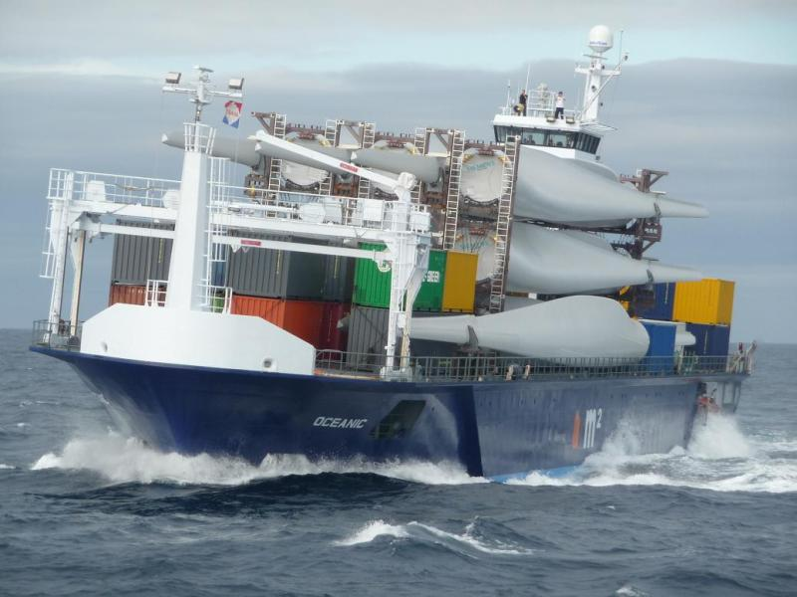
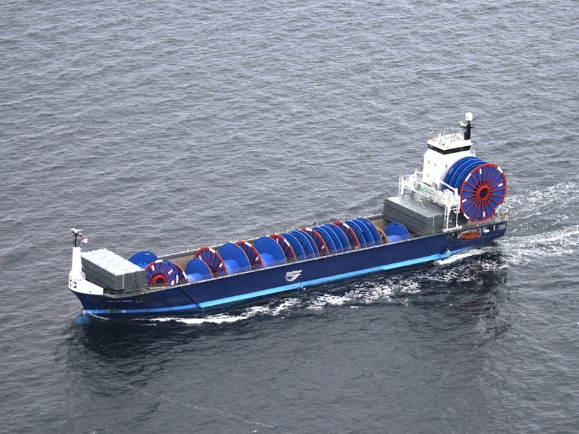
Conoship International B.V.
Notes:
Hartman Oceanic, a Multi Purpose cargo vessel of 85m Load Line length, featuring 1100 square meters of deck surface area, more than any other ship this type and size (about 800).
As you can see, it is being optimized and used for transporting all kinds of (offshore) project cargo and also for cable laying.

Slide 4
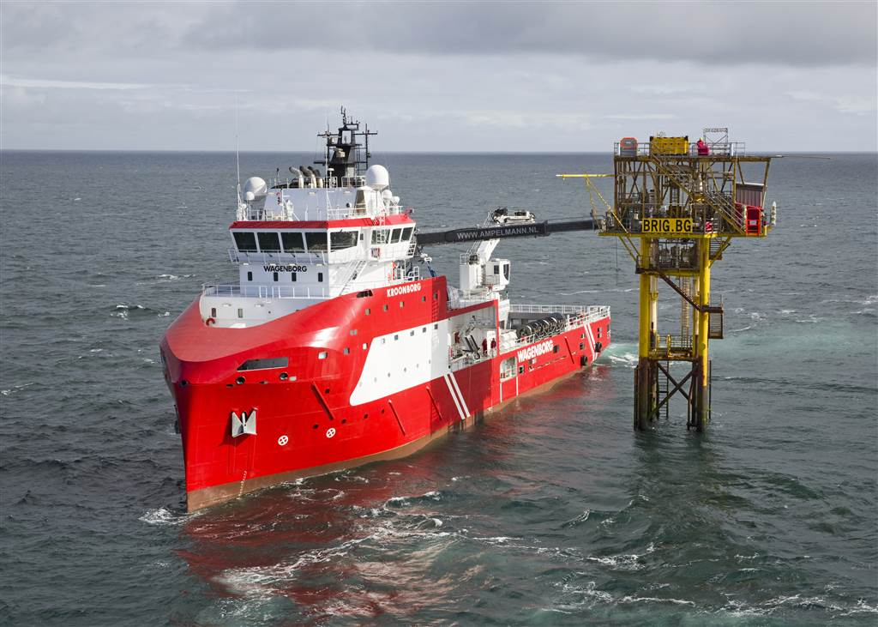
Conoship International B.V.
Notes:
I think most of the people here in this room have read and saw something about this vessel in the past year, and some even worked on the design of it, this is of course the brand new Walk-to-Work vessel of Wagenborg, built by Niestern Sander and designed in cooperation with us.
It features both an Ampelman motion compensated gangway to let maintenance crew walk to the offshore platforms, and a Bargemaster, a motion compensated crane to load parts and tools on to these platforms.

Slide 5
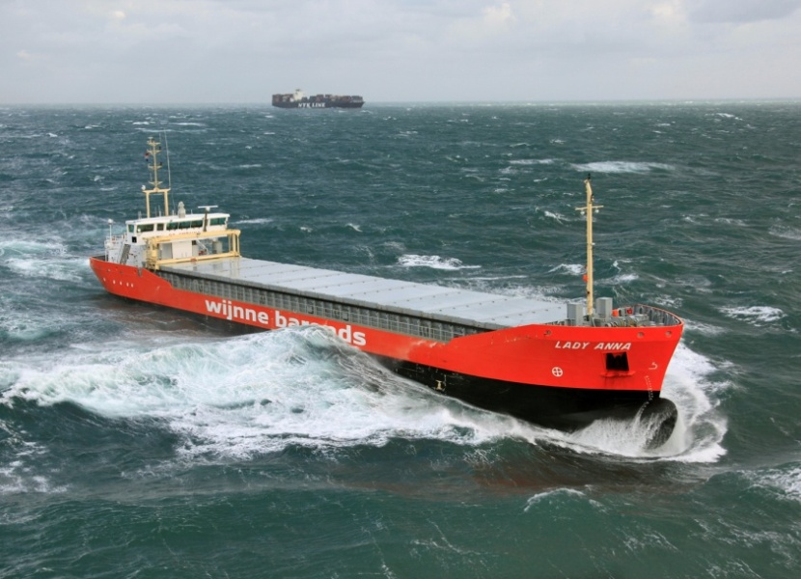
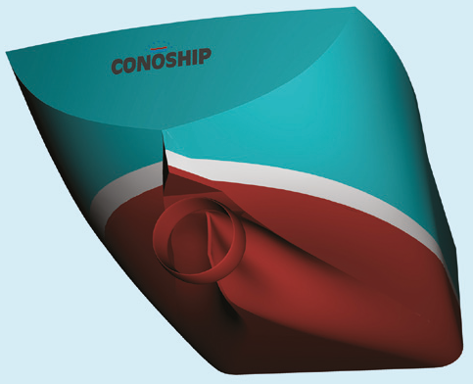
Conoship International B.V.
Notes:
This is the Lady Anna. It looks like a perfectly normal low airdraft General Cargo vessel. However, under the waterline, it features a completely optimized aftship and propulsion train. This is integral optimized using state-of-the-art CFD technology. This resulted in an installed engine power of 749 kW, a design speed of 10 knots and a fuel consumption of only 2.7 ton/day!
(Of course, it still features a propeller ;))

Slide 6
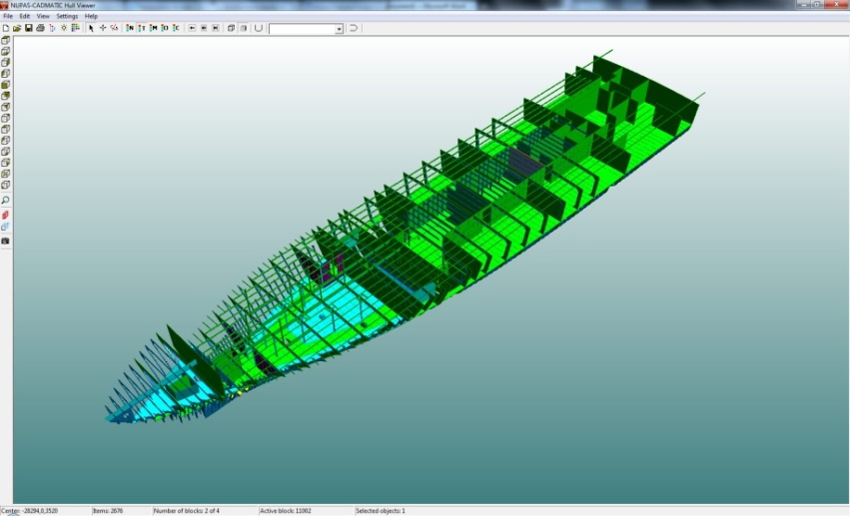
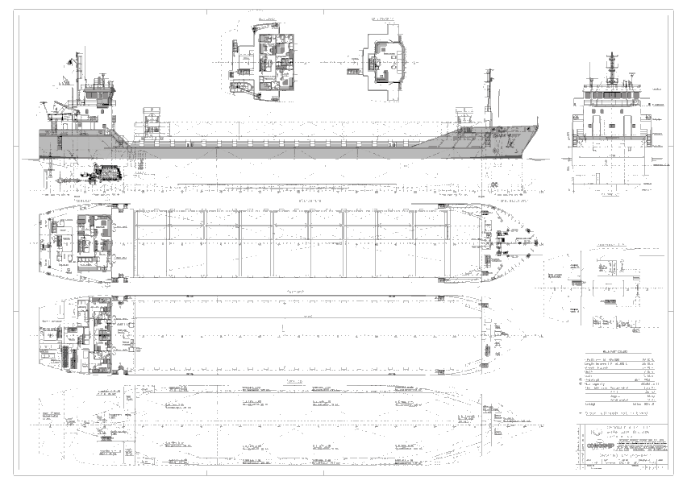
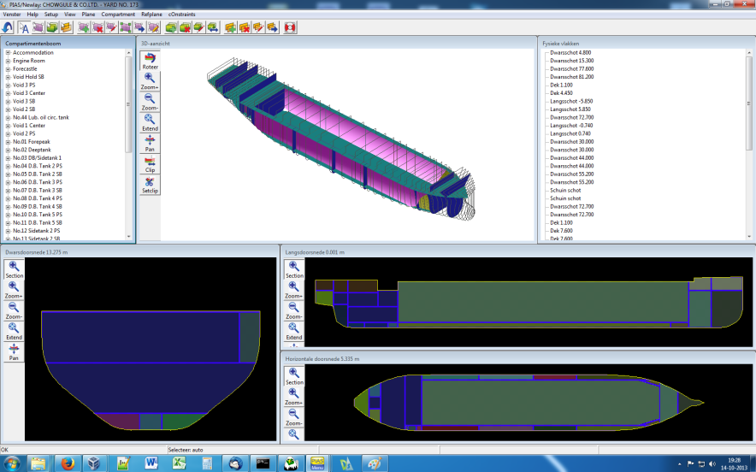
Conoship International B.V.
CADMATIC Hull & Eagle
CADMATIC Hull (HilTop)
PIAS
3D model of General
Arrangement
2D General Arrangement Plan
Stability model
Notes:
This scheme represents the set-up of the SMARTYards prototype application we use at Conoship.
First, the applications:
We use PIAS for all of our (damage)stability calculations. In the Newlay module of PIAS, the internal arrangement of the compartments is created by defining the watertight bulkheads & decks.
We use or own Eagle-based CAD-system for creating our 2D drawings like General Arrangement, Tank Arrangement, Damage Control Plan etc.
The Eagle system is also used to create hull forms. Recently, we also began to use Fairway for this purpose. With Fairway we are able to create 3D IGES surface models of the hull (in Eagle only 3D wireframe is possible), which can directly be used in CADMATIC-Hull.
CADMATIC-Hull is used for modelling the ships construction, but is also used to set-up the 3D GA model.
Now to the features of the prototype:
2-way design data exchange connection between the stability model (PIAS) and the 3D Gamodel (CADMATIC-Hull/Hiltop). The bulkheads & decks are exchanged between PIAS and CADMATIC
From the CADMATIC 3D Gamodel, initially, 2D views are generated based on the 3D model, position and borders of the 2D view are related to the 3D objects. (for the biggest part, this is a one-way activity). These 2D views together make up the Steel Plan, which is used as basis to elaborate the 2D drawings, which is done in mostly in our own Eagle system and partly in CADMATIC.
Third, there is a one-way connection between the stability model and 2D Cadmatic and Eagle. For the Tank Arrangement, the tank crosses and tank labels are generated in CADMATIC-Hull automatically based on compartment data downloaded from PIAS. (Uitleggen dat tanktabel al in Eagle gegenereerd kon worden en dat dat dus in Eagle gedaan wordt?)

Slide 7
Conoship International B.V.
Design phase:
Preliminary Design
Basic Design (pre contract)
Basic Design (post contract)
Notes:
To analyse the effects of the prototype on our design process, we identified three design phases:
Preliminary Design
Basic Design pre contract
Basic Design post contract.
In the preliminary design phase, we elaborate the design activities as shown in the flow chart shown here.
Examples of activities are: determining the main dimensions of the vessel, estimate LSW, transform a parent hull, create a sketch arrangement and calculate intact stability and trim.
In all of these activities, there is a lot of interaction between different applications. Most important interactions are indicated here, between CADMATIC and PIAS. Setting up a sketch and General Arrangement in combination with the hull development and intact stability.

Slide 8
Conoship International B.V.
Design phase:
Preliminary Design
Basic Design (pre contract)
Basic Design (post contract)
Notes:
In this design phase, the design is elaborated in more detail. Because the design model is defined in more detail, more design data is exchanged between the CADMATIC, PIAS and Eagle.
At some activities, it is indicated to shift these to the previous phase: because time already is saved in the preliminary design phase, this time can be used to start defining the compartment model in greater detail earlier in the design process. (show bottlenecks earlier in the process).
Basic Design scheme is not yet updated for our recent added Engineering/Construction activities.

Slide 9
Conoship International B.V.
Design phase:
Preliminary Design
Basic Design (pre contract)
Basic Design (post contract)
Notes:
This design phase is mainly about updating the documents based on results of class review and CFD calculations.
Interaction between the applications takes place during about the whole process.

Slide 10
Benefits of the Design Data Exchange prototype
Semi automated two way exchange of bulkheads & decks between PIAS and CADMATIC Hull:
  The user is in control of which design data is exchanged and when;
  A clear overview of differences between the PIAS and CADMATIC models.
Semi automated generation and updating of 2D Cadmatic Hull drawings based on bulkheads & decks.
The stability model (PIAS) is easily kept consistent with the CADMATIC Hull 3D model and 2D related drawings.
Damage stability can be performed earlier in the design process with more detail:
  Is more useful; less time spent exchanging data updating the 2D drawings.

Slide 11
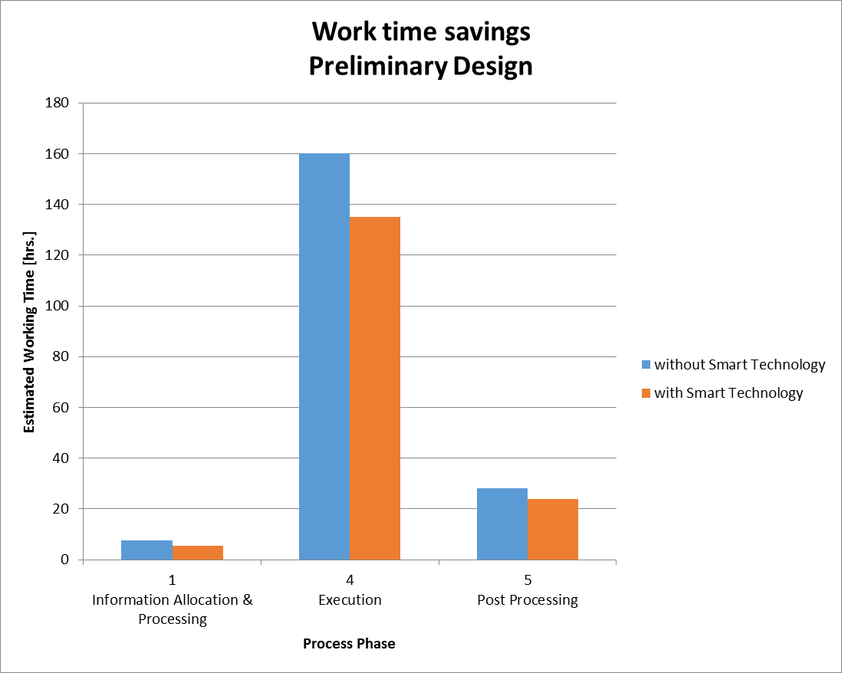
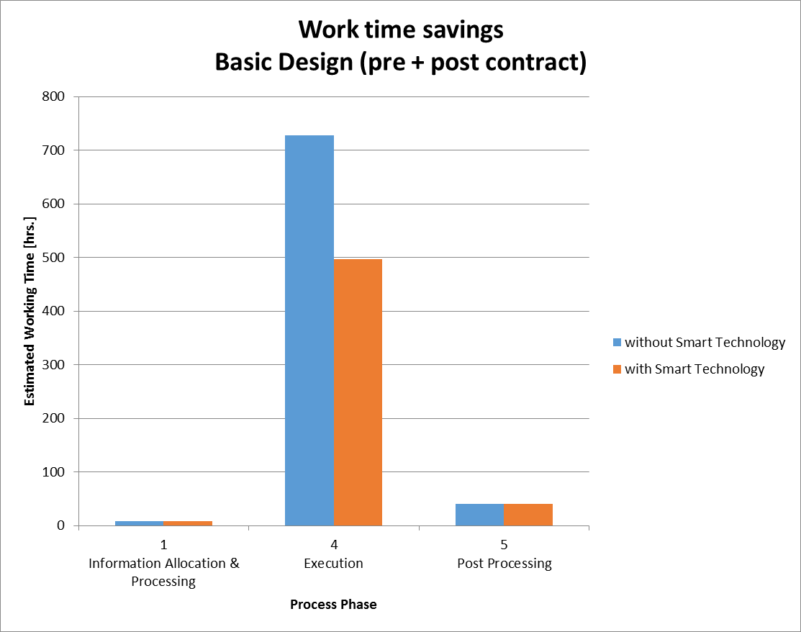
Benefits of the Design Data Exchange prototype
  Time is saved in the total design process
    Up to 15% in Preliminary Design
    Up to 30% in Basic Design
Notes:
More time is saved in the Basic Design phases because more design data is exchanged in these phases.
Savings in Basic Design phase include possibility of exchanging of special points data used in generating the DCP (already available in Eagle)

Slide 12
Benefits of the Design Data Exchange prototype
Time savings can be used to explore more design alternatives:
  This improves the quality of our designs.
The Steel model can be set-up very quickly in CADMATIC Hull based on HiLTop reference planes:
  More useful to set-up 3D construction model in Preliminary Design phase.
  This improves steel weight estimation in early design phase.

Slide 13
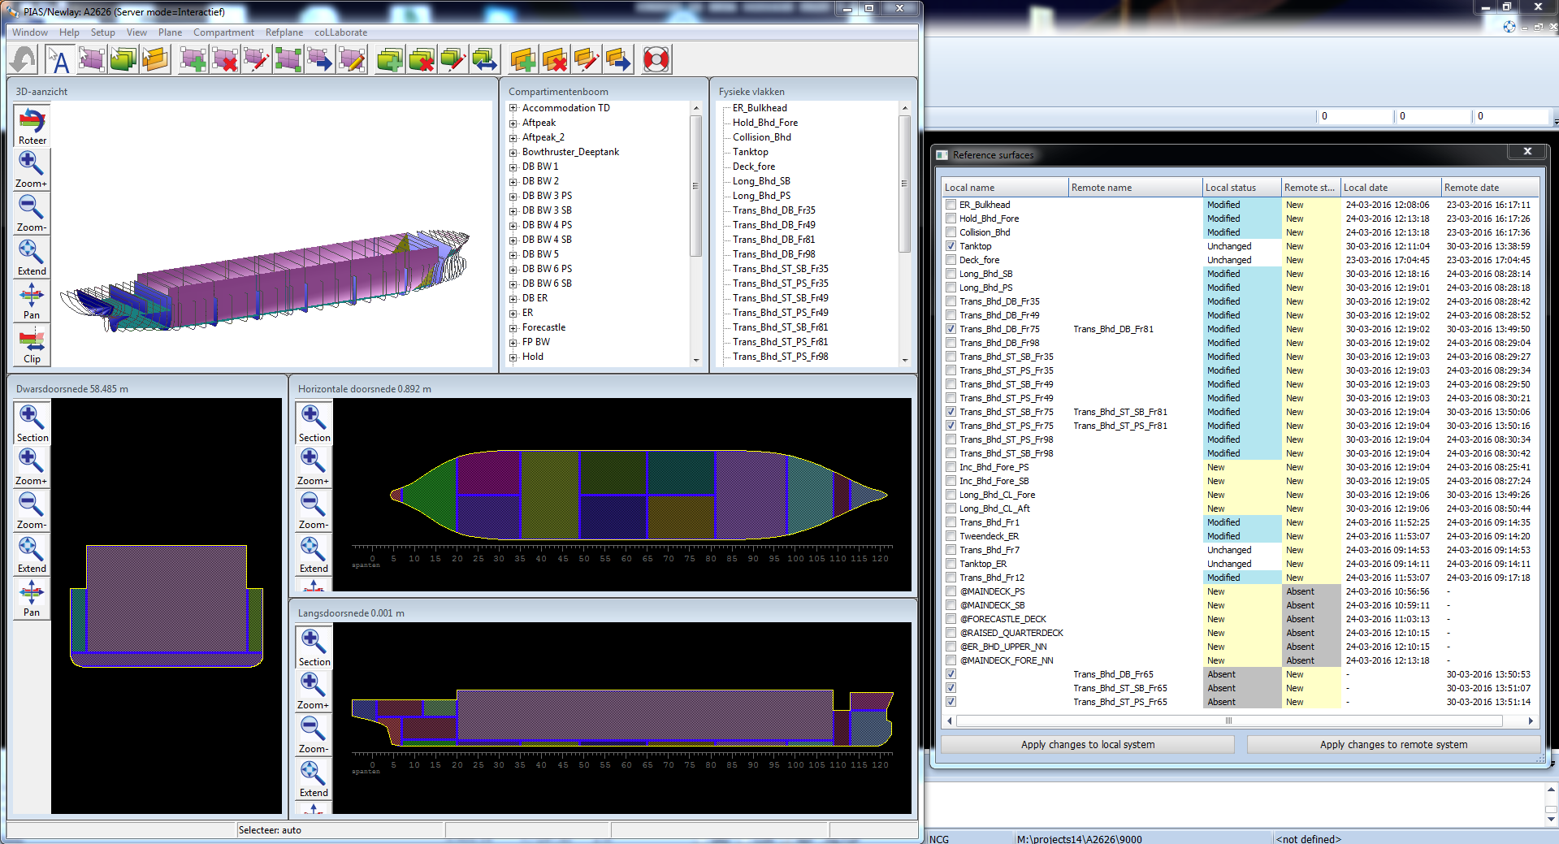
Semi automated two-way exchange of bulkheads & decks between
PIAS and CADMATIC Hull (1)
Notes:
In CADMATIC Hull (HIlTop) a list of available bulkheads and decks is requested from PIAS. This data is used to generate the list of Reference surfaces as shown here.
This list shows all of the planes present in the local system (CADMATIC Hull) as well as the remote system (PIAS) indicating the differences.
USER has FULL CONTROL over which surfaces he wants to exchange (difference between PIAS and CM Hull).

Slide 14
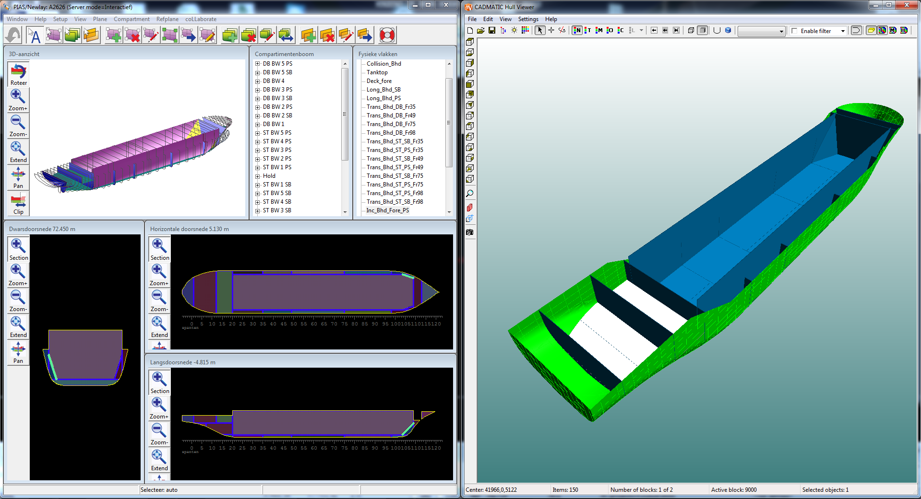
Semi automated two-way exchange of bulkheads & decks between
PIAS and CADMATIC Hull (2)
Notes:
When the reference planes are exchanged from PIAS to CM Hull, reference plates are created.
These can be shown in the Hull Viewer.
The user can create CM Hull specific planes, whatever is necessary.

Slide 15
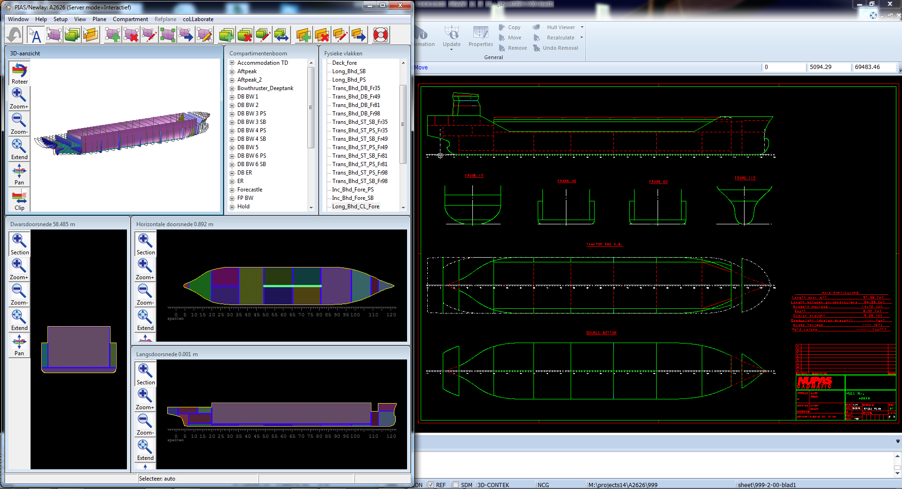
Semi automated generation and updating of 2D CADMATIC Hull drawings based on PIAS bulkheads & decks
Notes:
Next, 2D views are generated based on the reference planes in CM Hull. Position and view boundaries are related to the ref. Planes.
These 2D views are combined to create the combined views as shown on this screenshot. This makes up the Steel Plan.
(Sorry guys, but CADMATIC still didn’t remove the NUPAS stamp yet ;))

Slide 16
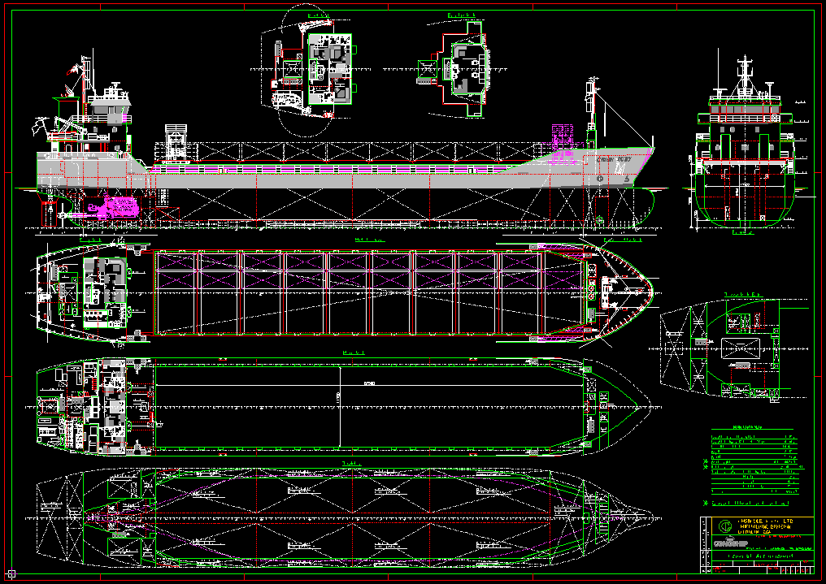
Elaborating the 2D General Arrangement in Eagle
Notes:
Generated Steel Plan is used as basis for elaborating the 2D General Arrangement plan.
This is done mostly in Eagle and partly in CADMATIC.
Whatever 3D outfitting/equipment objects are available in CADMATIC Hull can be placed in CADMATIC Hull and are also shown in the 2D drawings.
This means, the designer is very flexible in what he wants to do in 2D and what in 3D and when in the process.

Slide 17
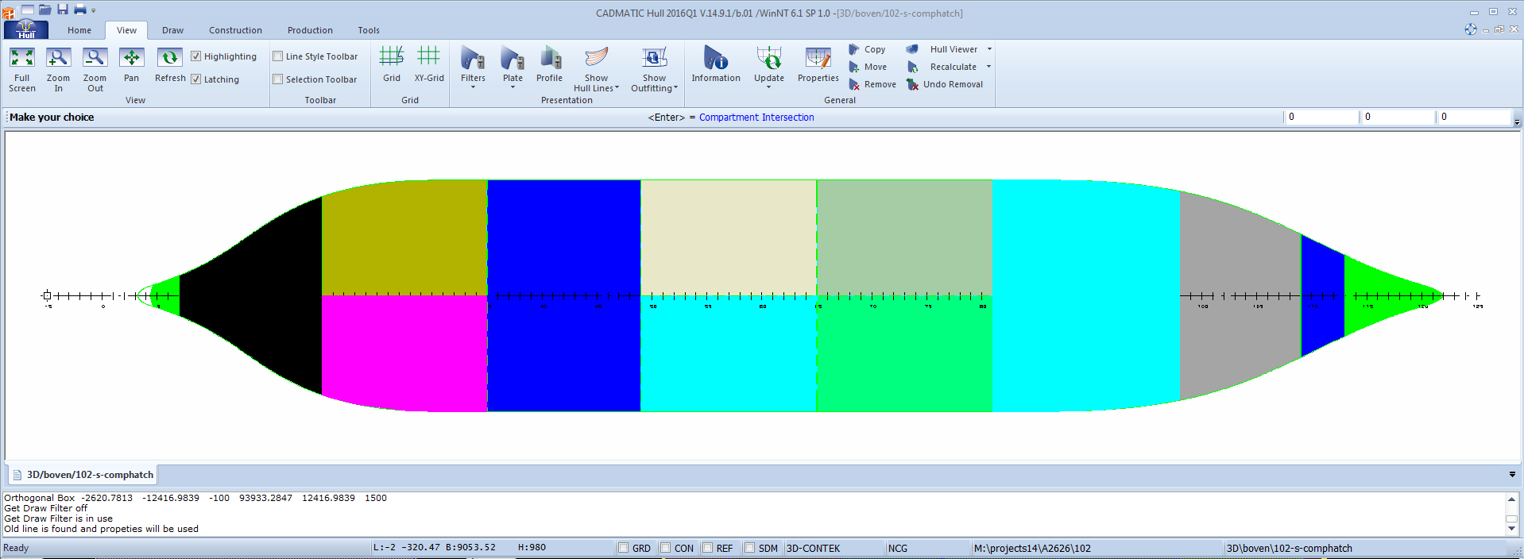
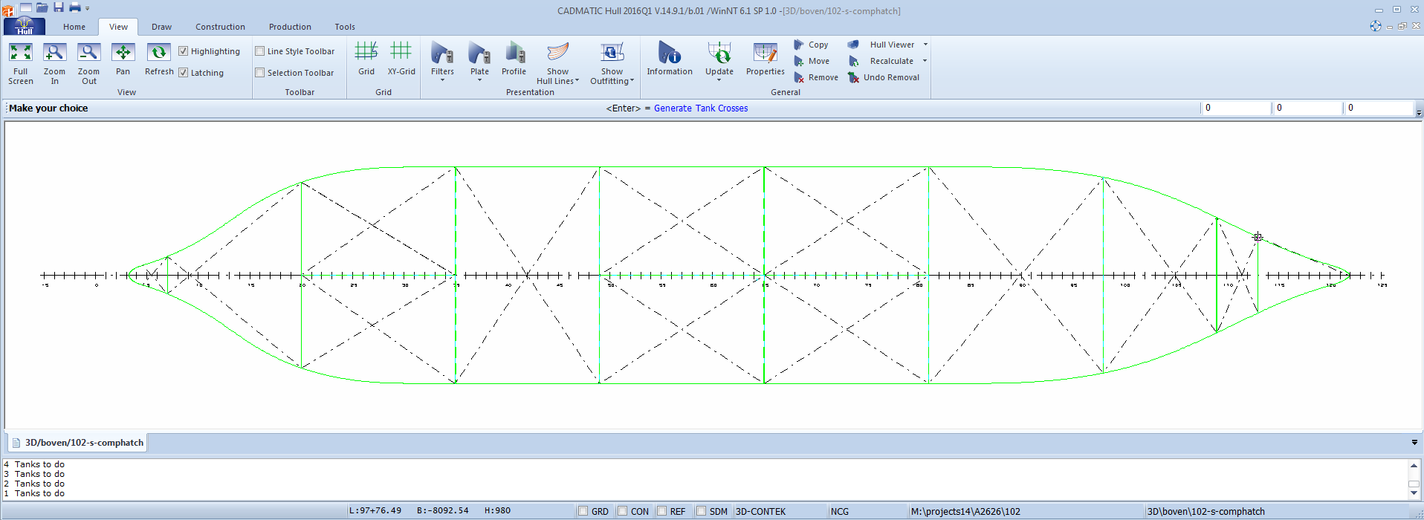
Elaborating the 2D Tank Arrangement in CADMATIC Hull & Eagle
Notes:
Generating tank crosses in CADMATIC Hull: CADMATIC Hull sends a request to PIAS for an intersection with compartment boundaries.
PIAS delivers this information on demand and CADMATIC Hull creates faces from this compartment data.
Anything can be done with these faces, for example to create the tank crosses (and tank labels).
In our own Eagle system, we already have macros for generating the tank table, Together with the CADMATIC Hull views, this will make up the Tank Arrangement drawing.

Slide 18
Demonstration of the
Design Data Exchange Prototype

Slide 19
Elaborating the design model in CADMATIC Hull
By using existing software functions like:
Hull library
Copy Manager
Auto Dimension
Outfitting library

Slide 20
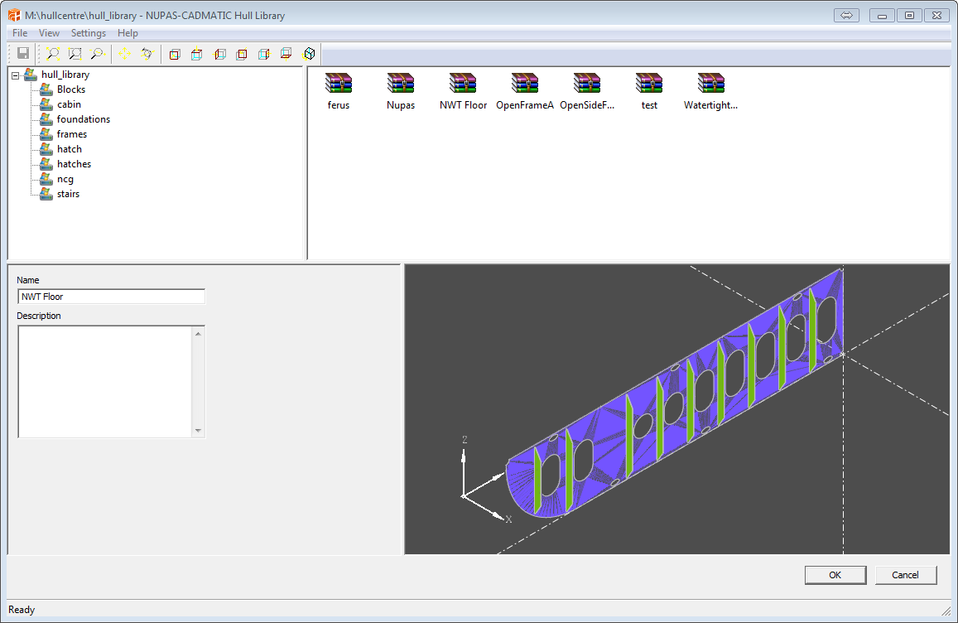
Hull Library

Slide 21
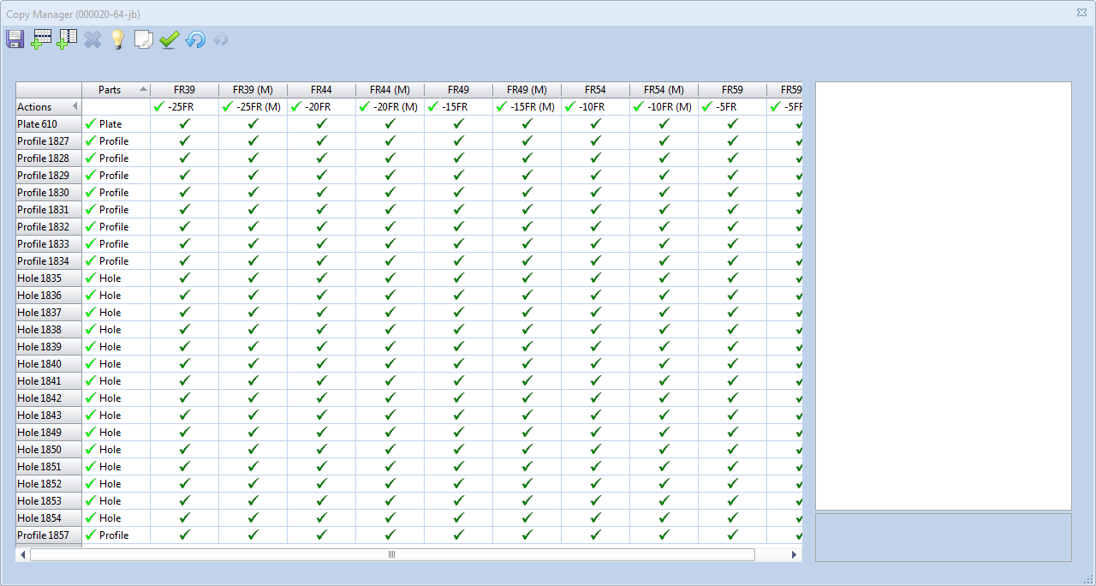
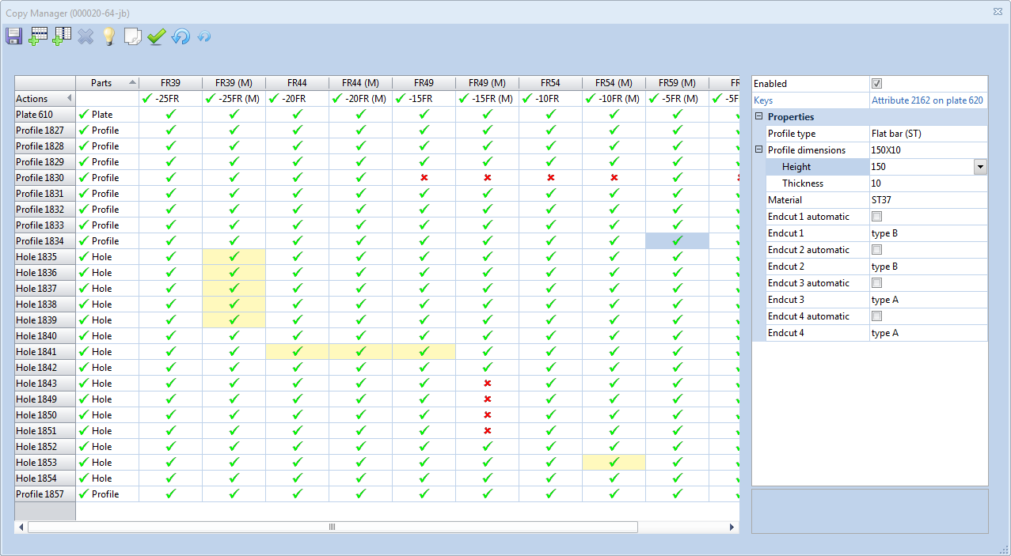
Copy Manager

Slide 22
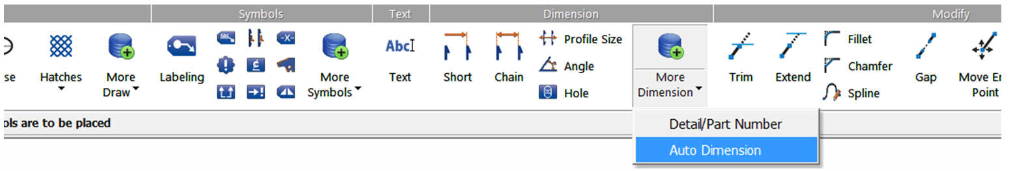
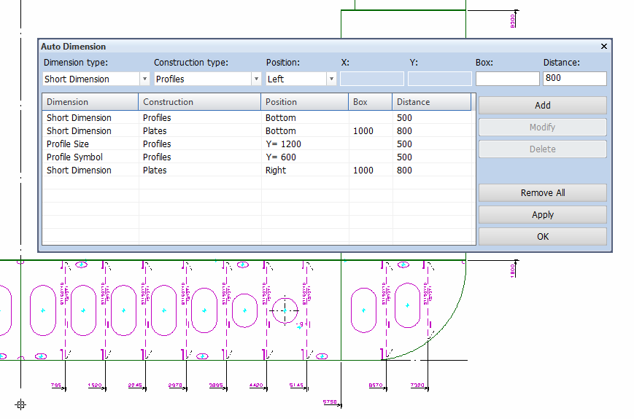
Auto Dimension

Slide 23
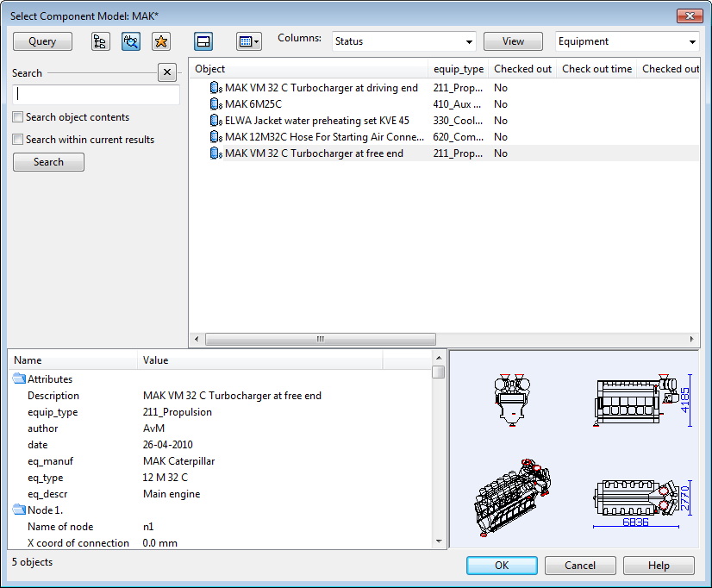
Outfitting Library

Slide 24
www.cadmatic.com
Thank you for your attention!

