Slide 1
ADN 2015
Novelties for inland waterway tankers

Slide 2
Content of this presentation
History of ADN 2015 rules
New requirements in ADN 2015 rules
How to comply with the ADN 2015 requirements
Practical problems

Slide 3
Why was an update required?
2011 Accident on river Rhine

Slide 4
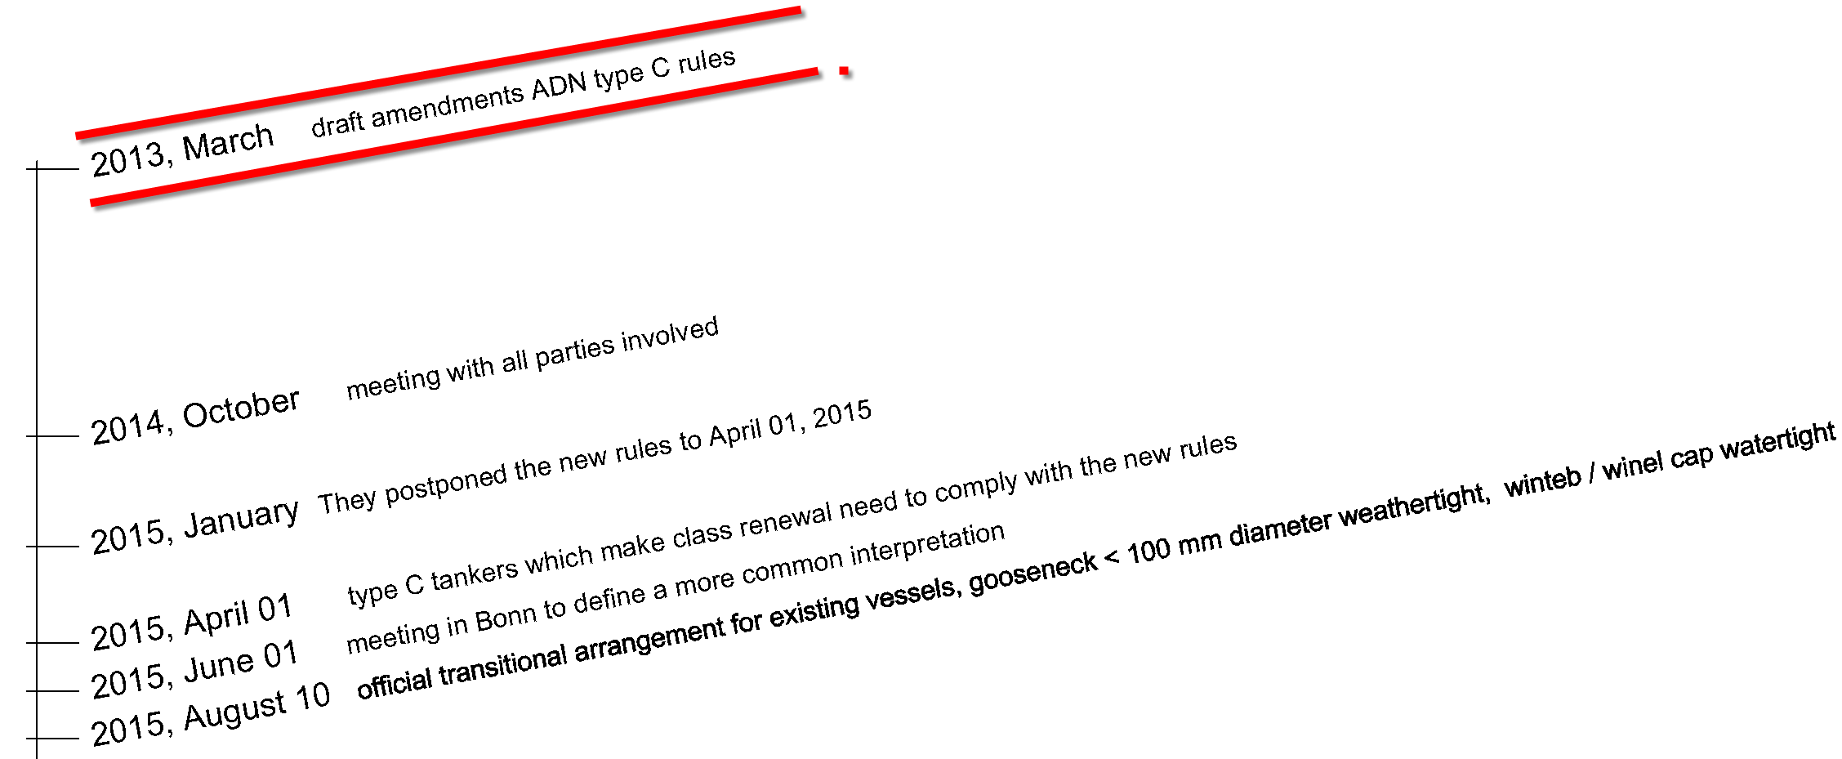
Timeline

Slide 5
March 2013, ECE/adn/18
draft amendments to the regulations annexed to ADN
Notes:
Whats new, also for all intermediate stages too many possibilities This is unpractical to put in a stablilty booklet, therefore the yellow part is required Also the new content of a stability booklet is close to a seagoing vessel included cross curves, different loading conditons, notes to the master, tc.

Slide 6
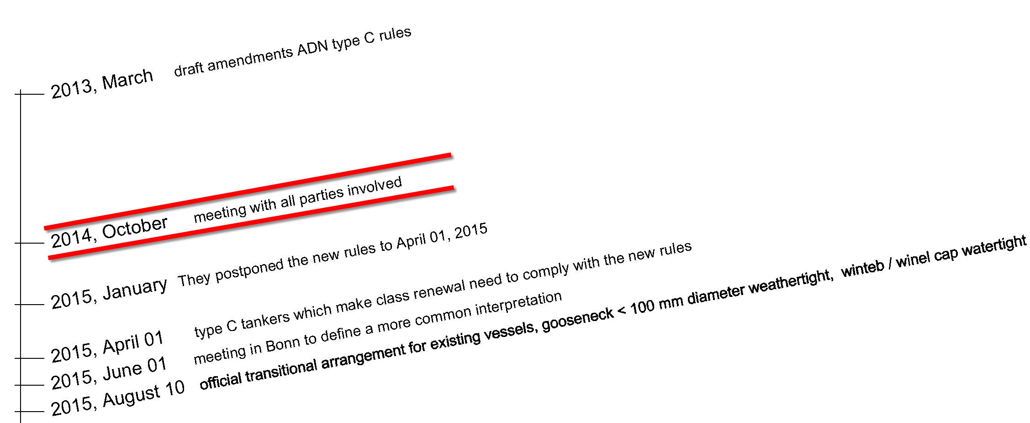
Timeline
Notes:
Three months before all ships need to comply with the new rules there was a meeting
By this meeting a lot of people were present like LR / DNVGL / BV / RINA / ship designers / software suppliers and also the Europeon Barge Union who represented the ship owners and shipping companies.
There were a lot of different interpretations between class societies therefore the discussion raised how to harmonise this interpretations.
Until know only a few vessels has ordered new booklets and locopias. Unfortunately we don’t knew the detailed definition and couldn’t prepare the ordered booklets and locopias.

Slide 7
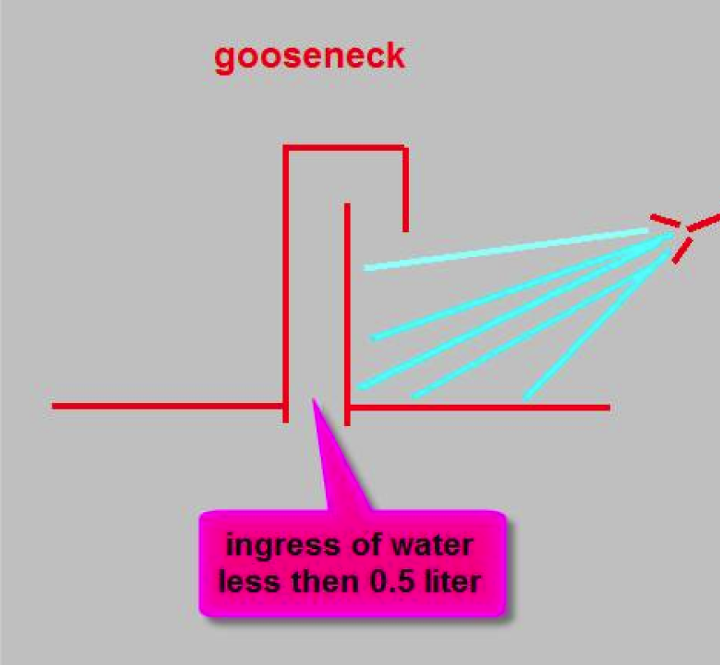
October 2014 input SARC for meeting
Opening definition (ECE/TRANS/WP.15/AC.2/2010/23(IACS)
Guideline 2006/87/EC weathertight = spray proof
Spray proof =
Less then 0.5 liter ingress of water after 3 minutes simulating heavy rain from 2 meter distance.
Notes:
I want to explain 1 example of the different interpretations between class societies, it’s regarding the openings. There was not one common definition for open, weathertight and watertight. This depended by flag which is very strange because the rules are valid for all countries in the European Union. So a gooseneck on a german vessel had another tightness then the same gooseneck on a dutch vessel. Hapilly everybody understood the importance for an equal definition valid for all countries in the Europion union.

Slide 8
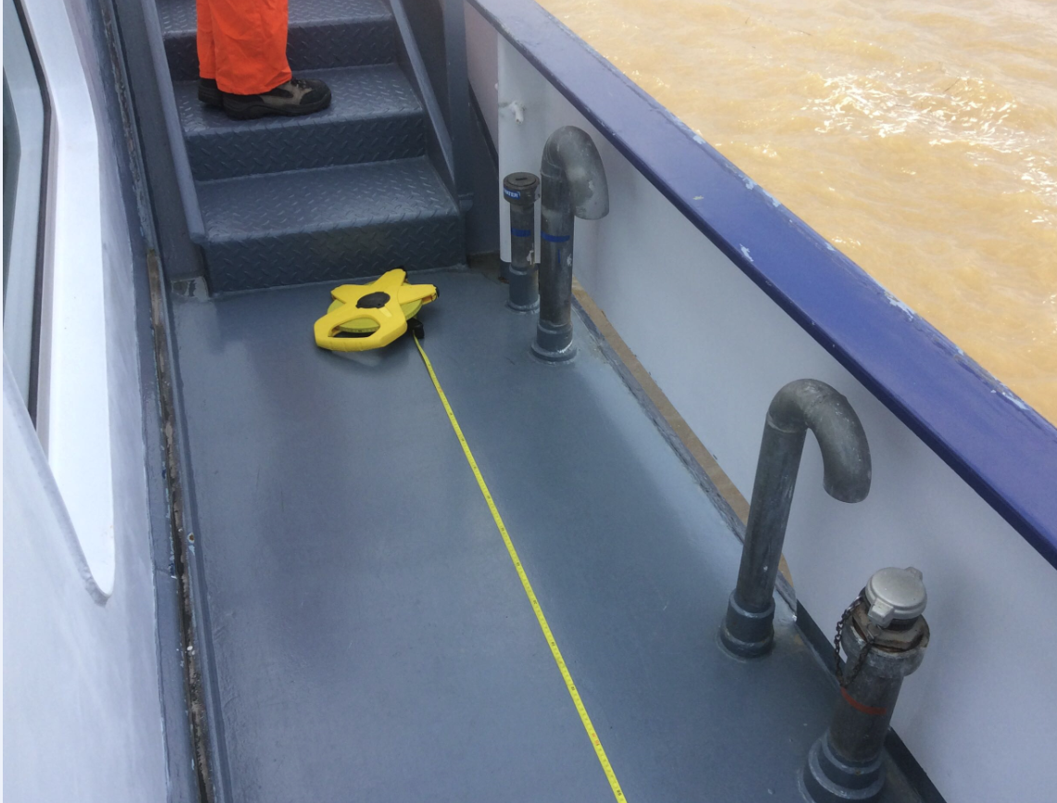
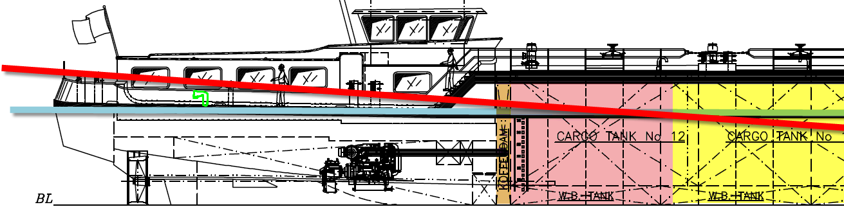
Influence of openings on (damage) stability
Notes:
But why is a small detail like an opening tightness so important.
Example damage stability, requirement opening is more then 10 cm above the damaged waterline.
With PIAS and LOCOPAIS it’s possible to add automatically the connect compartement to the damage case when this opening is less then 10 cm to the damaged waterline.
Then the result could be the vessel complies (when it is a small tank) or the vessel sink...

Slide 9
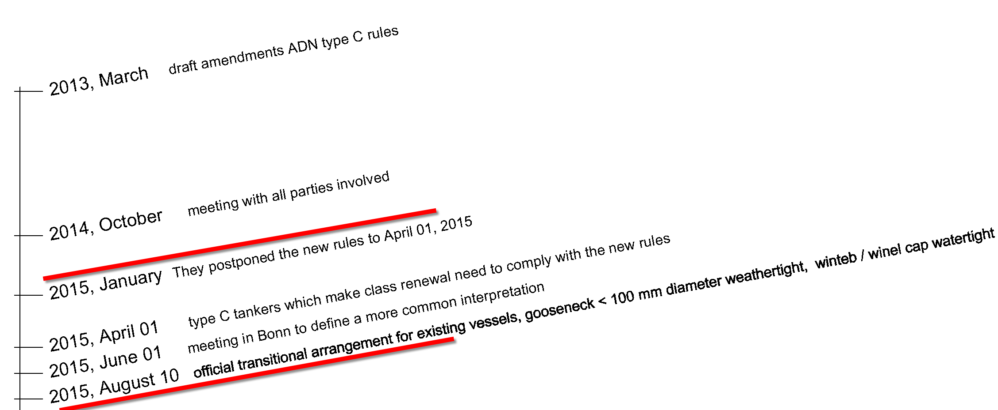
Timeline
Notes:
The conclusions of the meeting were: .that a more common approval procedure is needed, more time is needed and the best solution is that a vessel needs to comply with the new rules after renewal of the Certificate of approval (which is required each 5 year) this is accepted and valid since April 2015.
But the interpretation definition is dicussed in June and the official result was ready in August, 4 months to late.

Slide 10
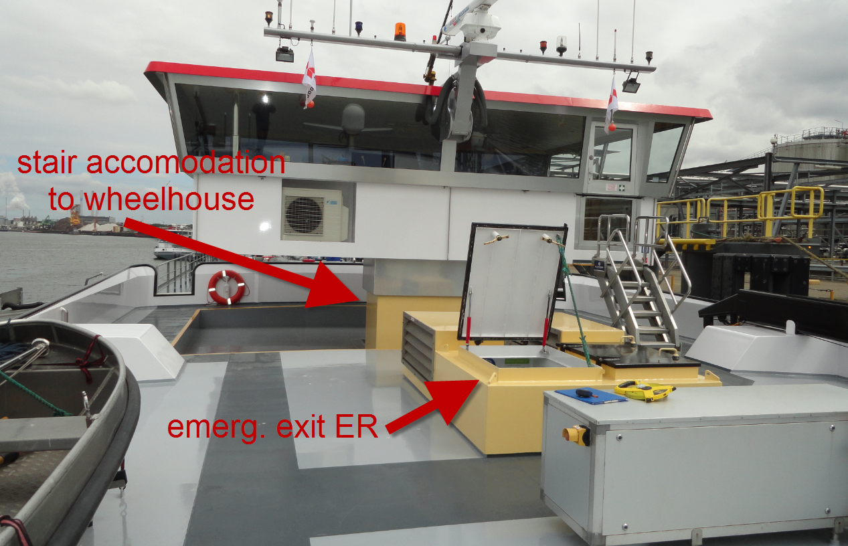
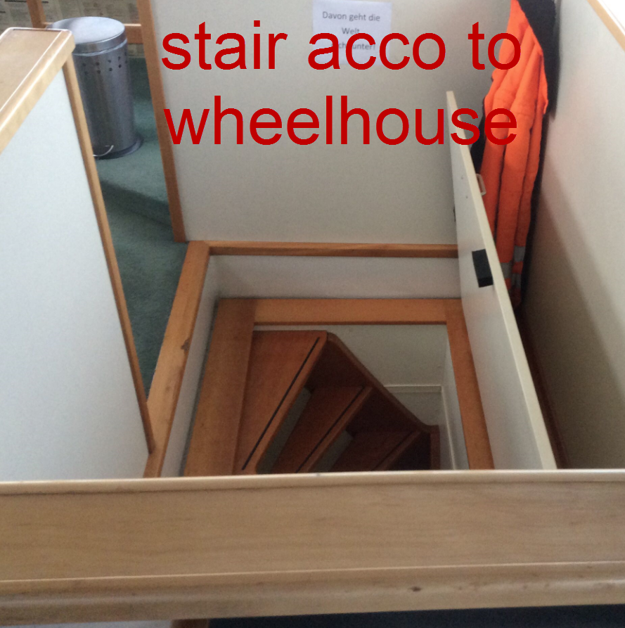
New requirements for ADN 2015
Openings (windows, exhausts, ventilation grids, goosenecks, etc)
Emergency exits
Content stability booklet
Calculation of longitudinal strength
Approved loading computer software
Also small details influence the (damage) stability

Slide 11
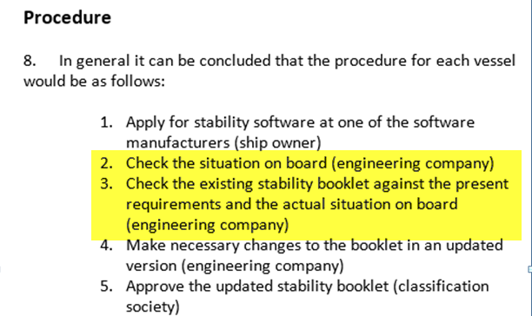
How to comply with the new rules

Slide 12
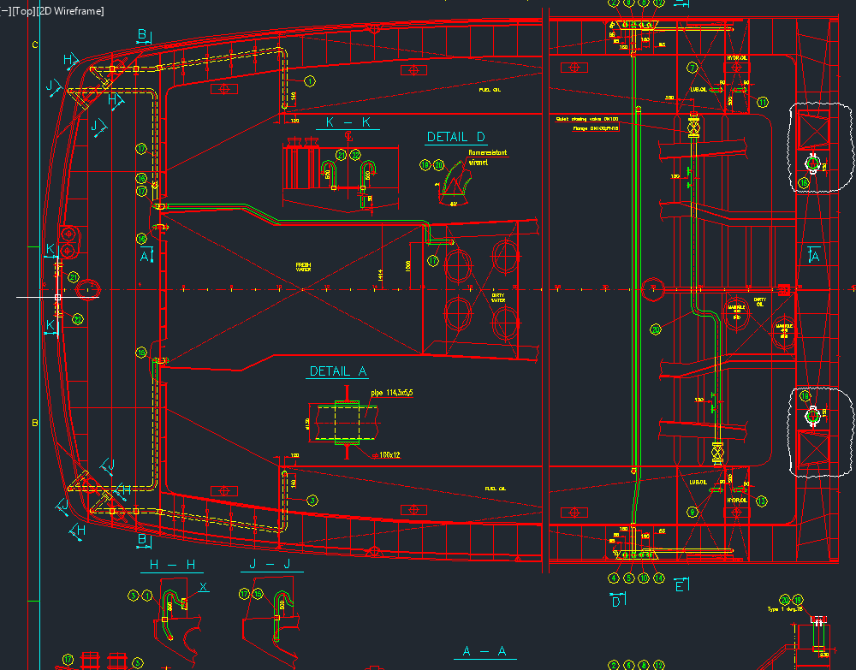
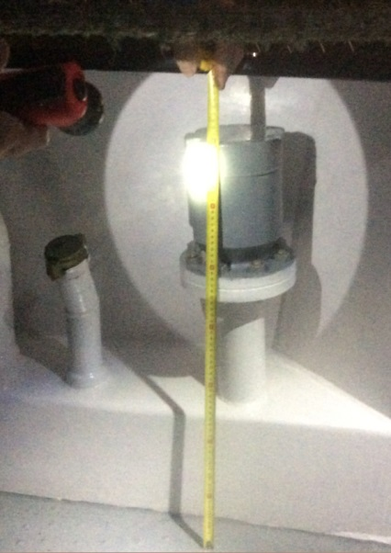
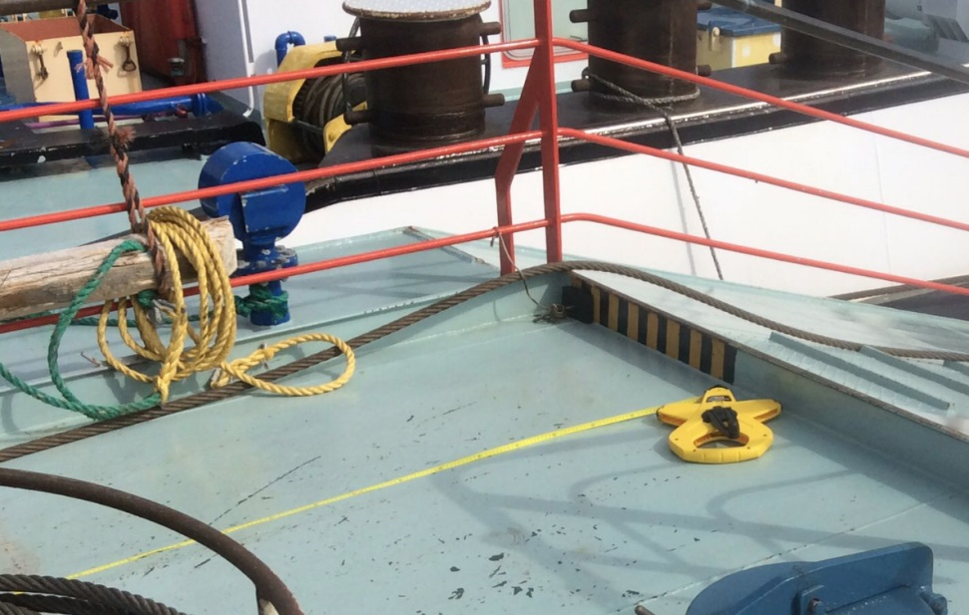
Board visit
Measure opening:
-position in the ship axis
-type
-connection

Slide 13
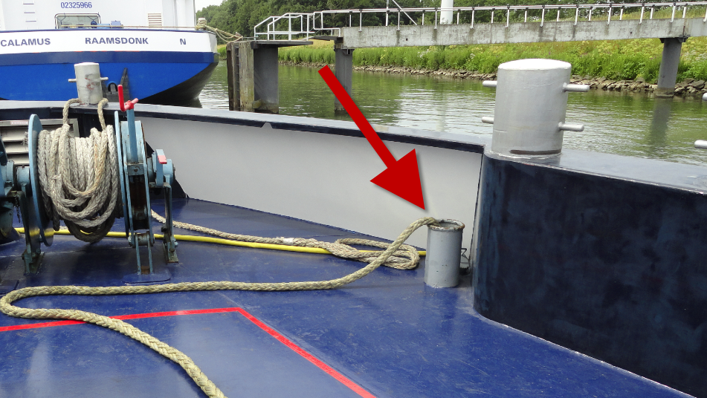
Missing openings on drawings
Available on drawings are all pipes and hatches which are part of the casco.
During finishing of the vessel in the Netherlands the yard add:
Windows
Aluminum doors
Ventilation grids
Rope pipes
These openings are not detailed
specified on drawings

Slide 14
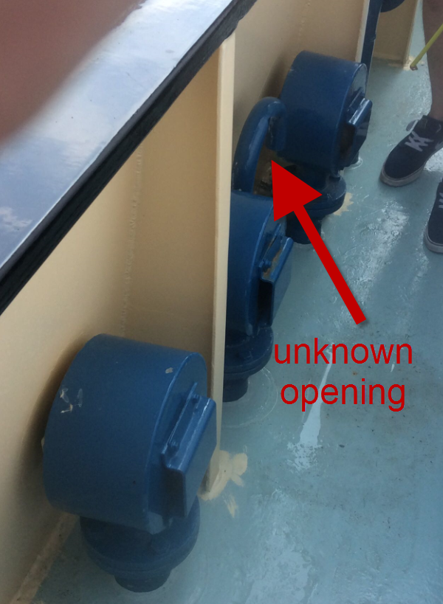
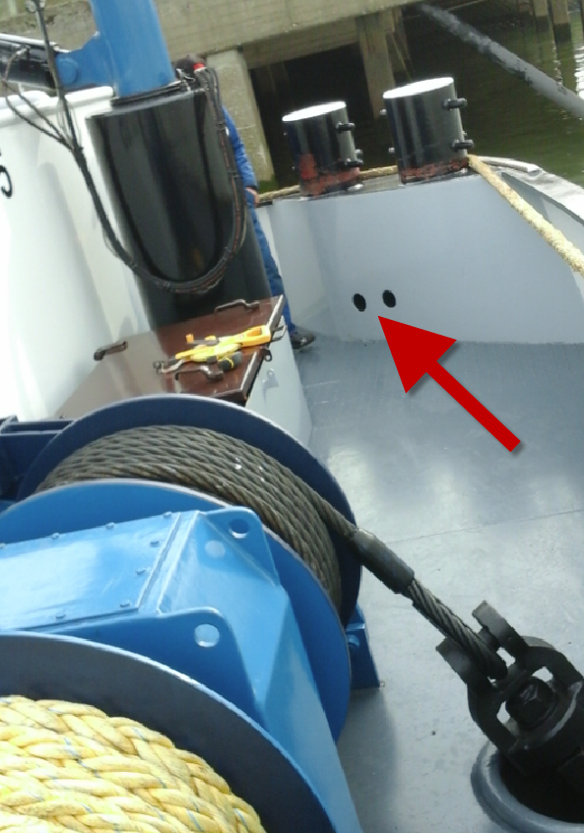
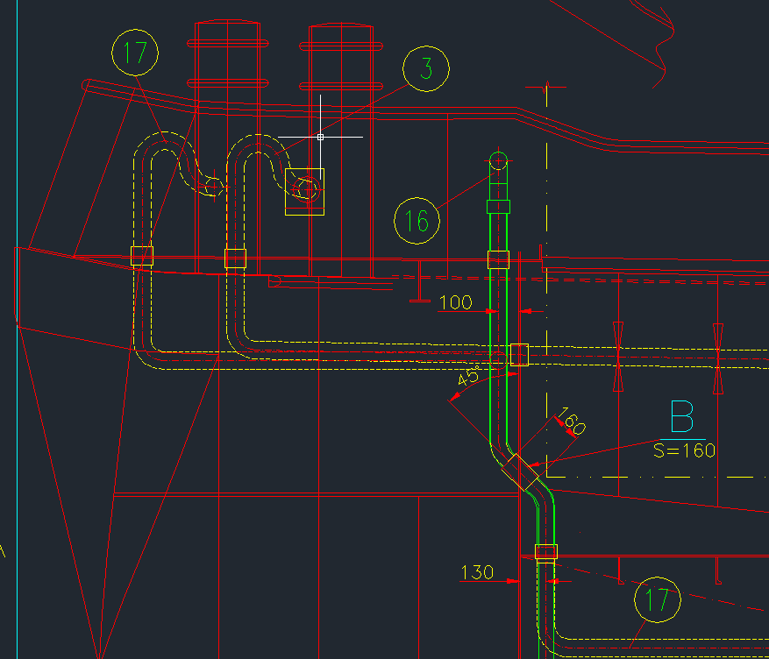
Where is this opening from?

Slide 15
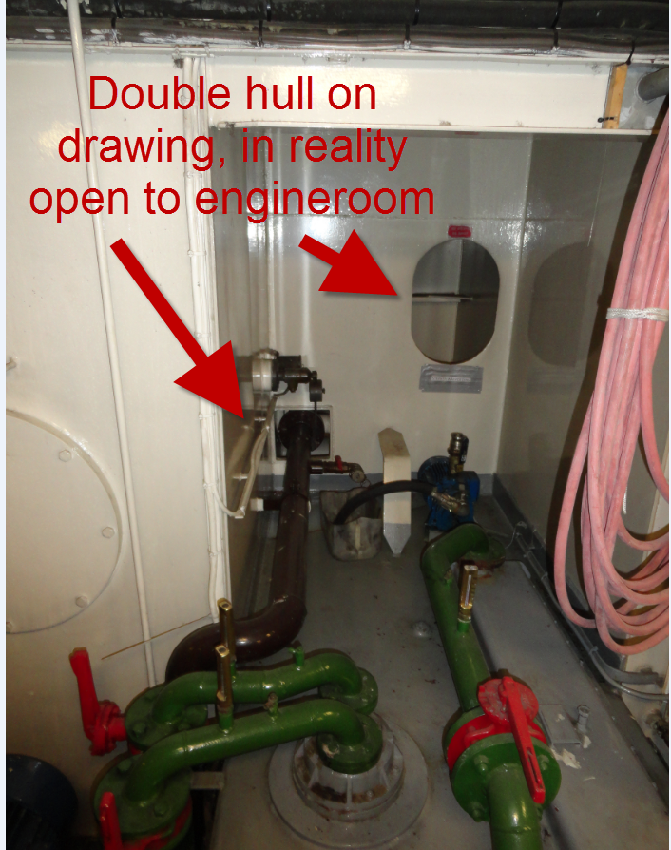
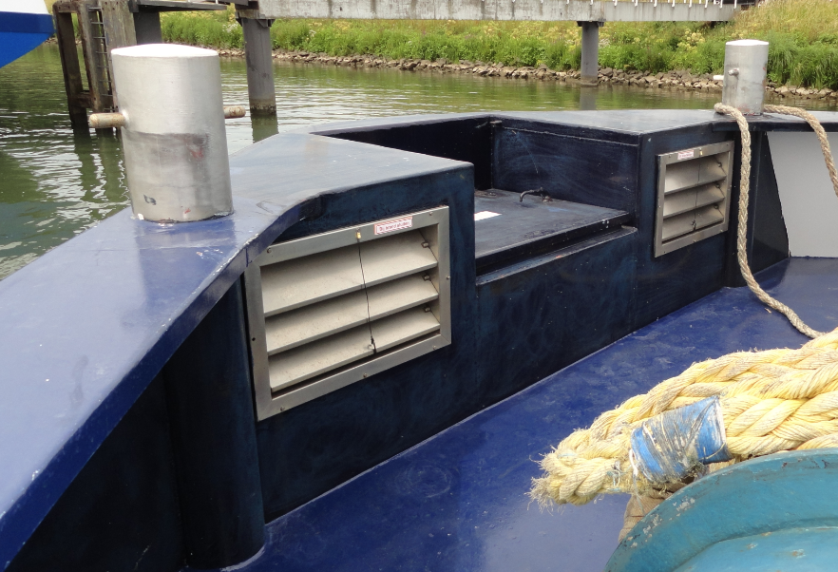
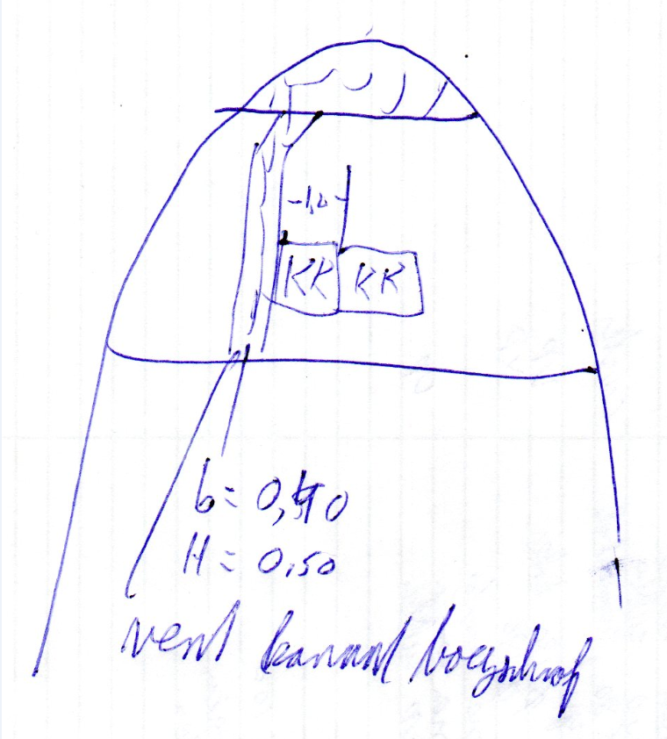
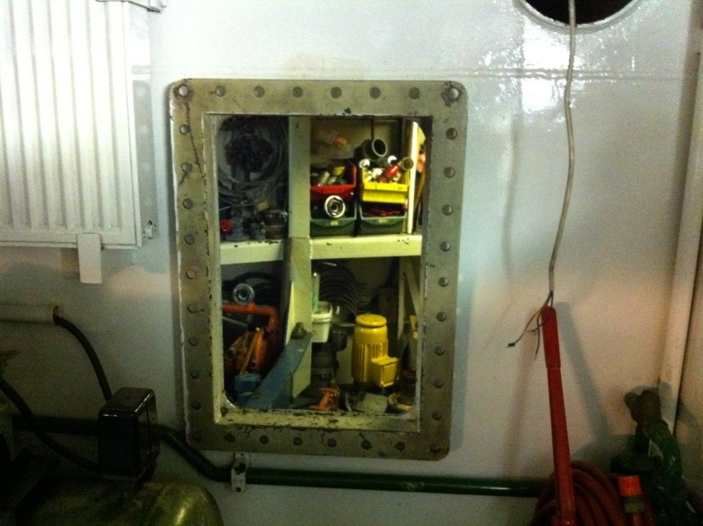
Verification watertight subdivision

Slide 16
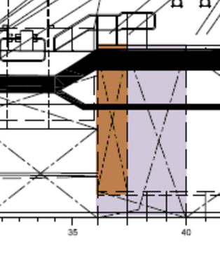
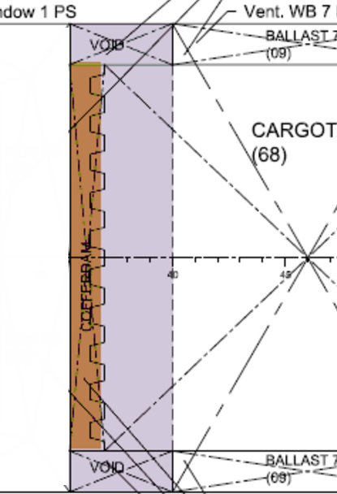
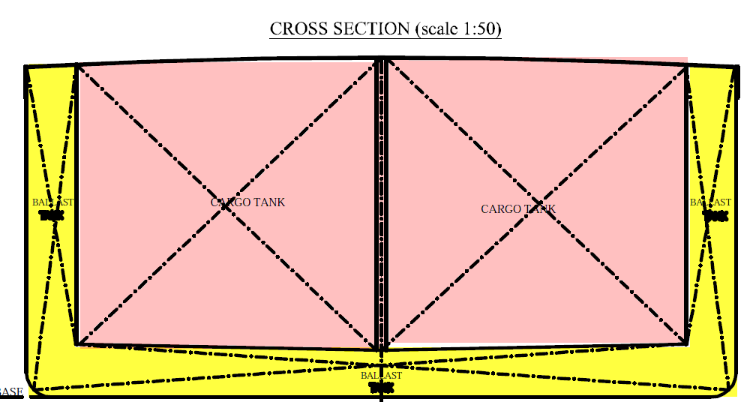
Not build according drawings/advice
Advice during design to create 9 U-tanks
(damage) stability booklet approved with 9 U-tanks.
Vessel is sailing for 10 years
During board visit we saw that the vessel has only 6 U-tanks…

Slide 17
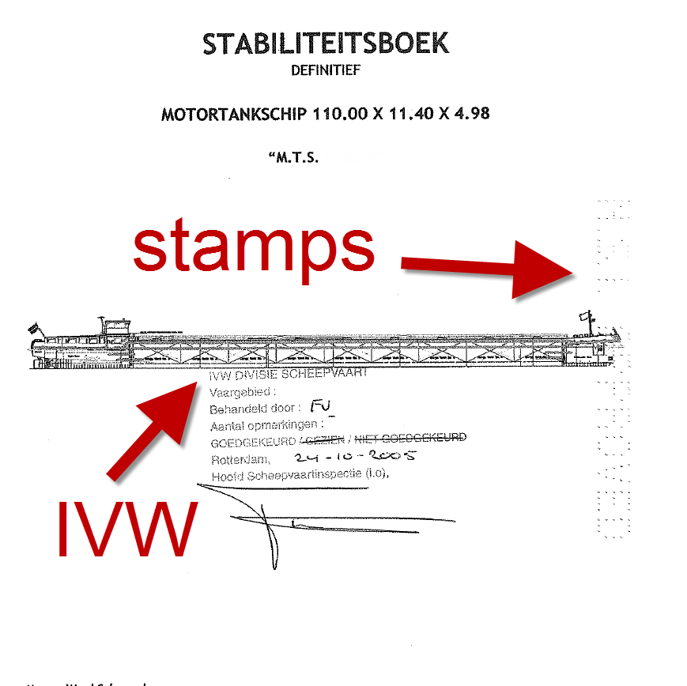
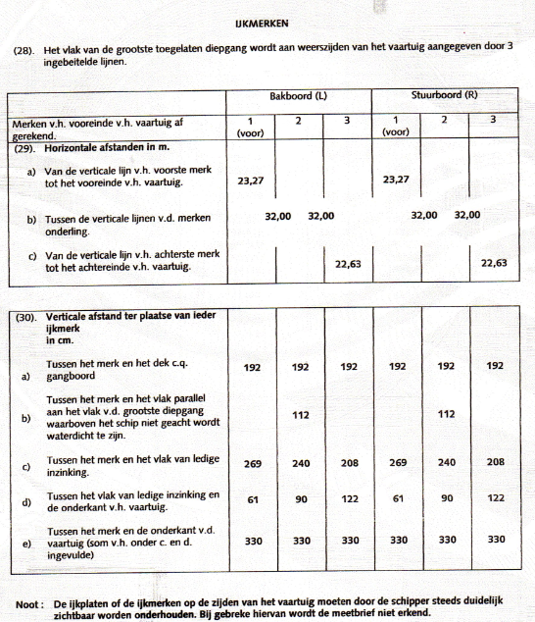
Other information

Slide 18
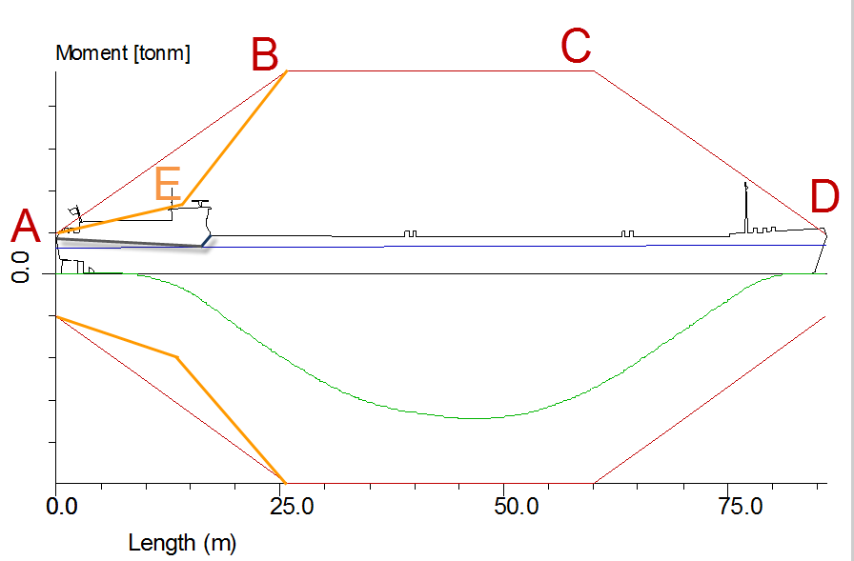
Allowable SWBM

Slide 19
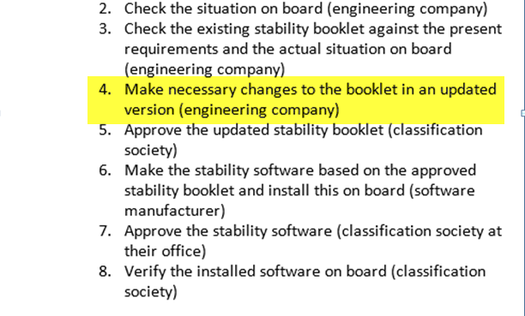
How to comply with the new rules

Slide 20
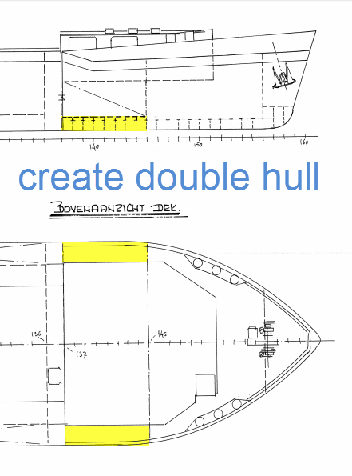
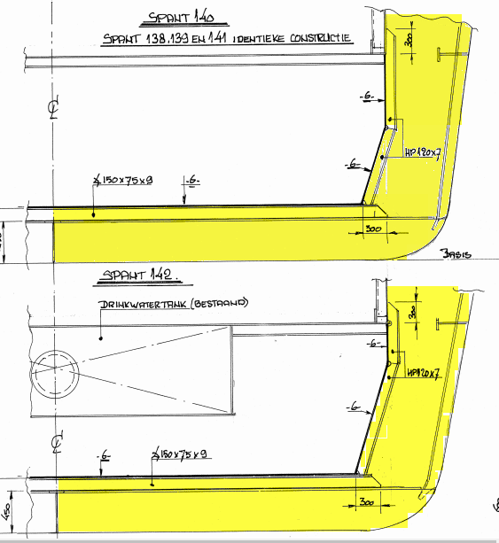
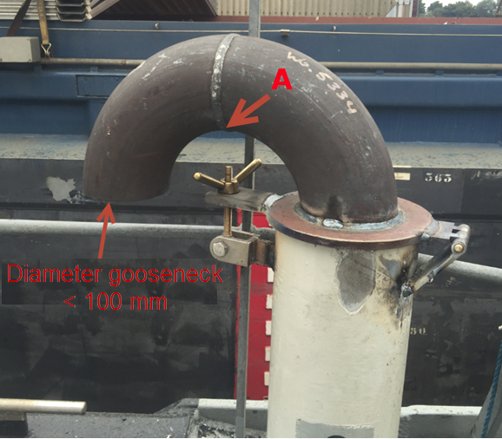
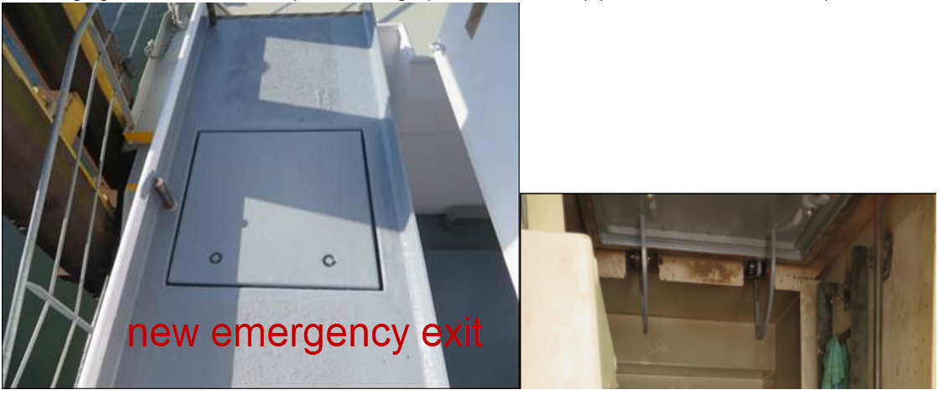
Advice to comply
Change openings
Recalculate maximum allowable SWBM
Change watertight subdivision
Create new emergency exit

Slide 21
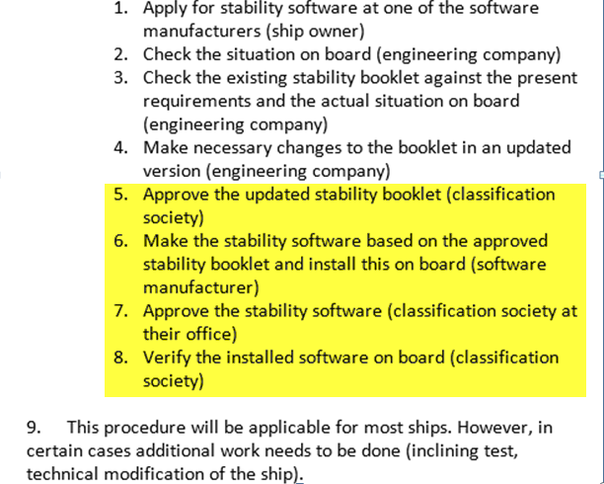
How to comply with the new rules

Slide 22
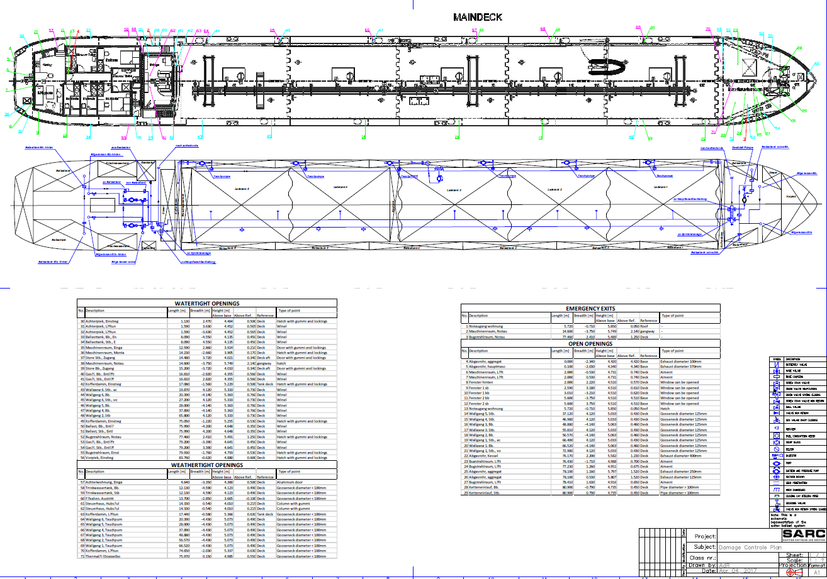
Damage control plan
Contains:
openings pos. and type
bilge / ballast scheme
watertight subdivision

Slide 23
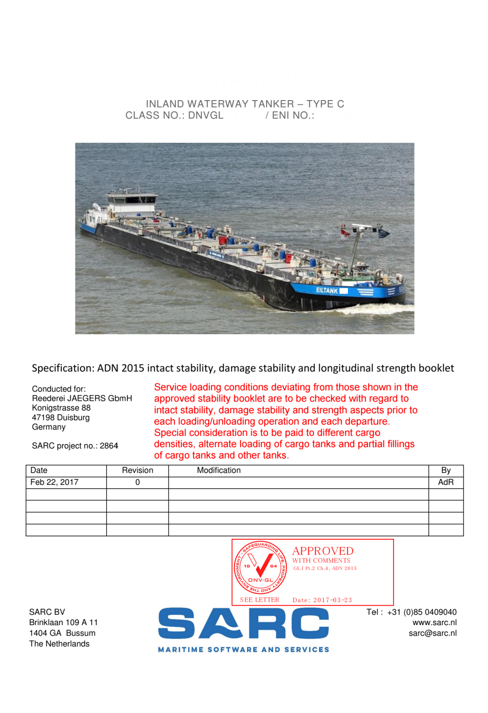
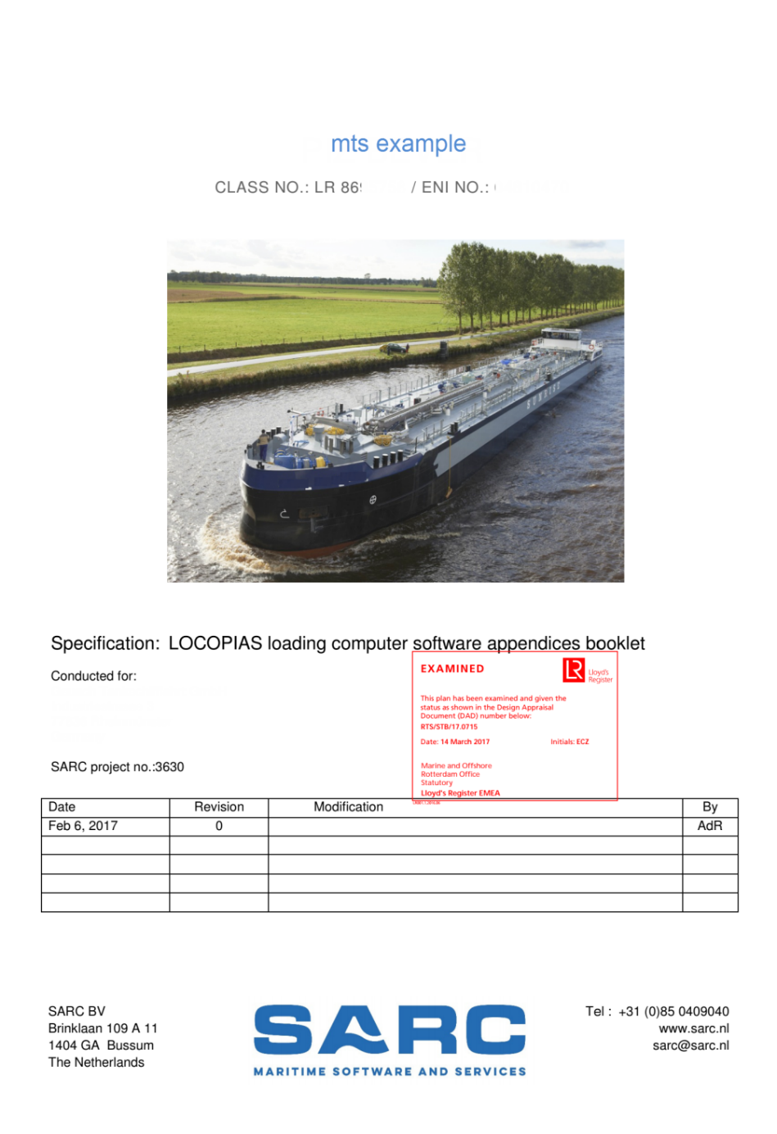
Stability booklet/ appendices booklet

Slide 24
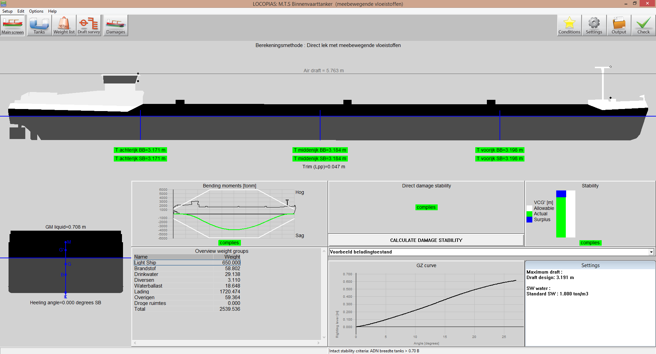
LOCOPIAS, airdraft points
Notes:
Airdraft points

Slide 25
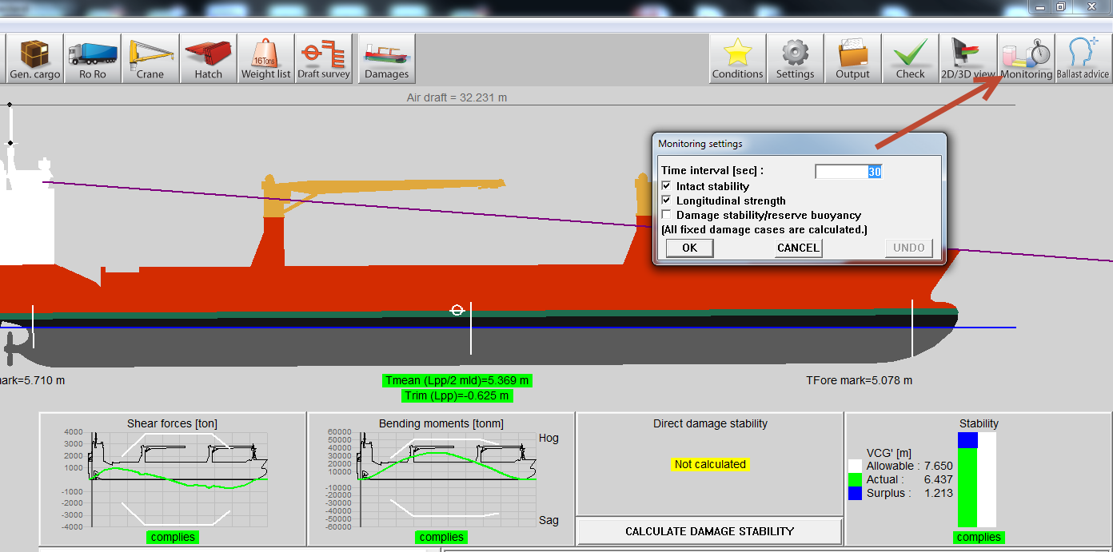
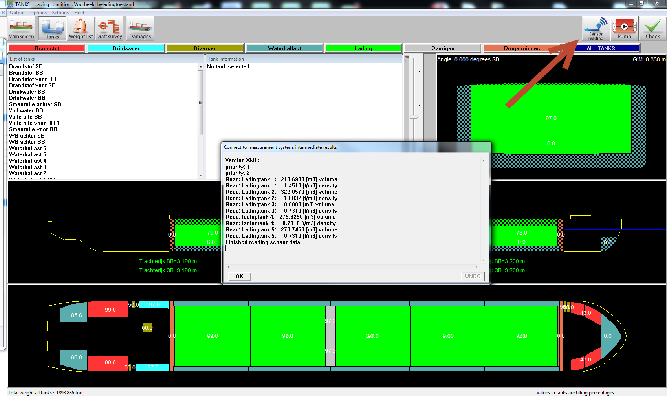
LOCOPIAS, tank measurement connection
Notes:
Airdraft points

Slide 26
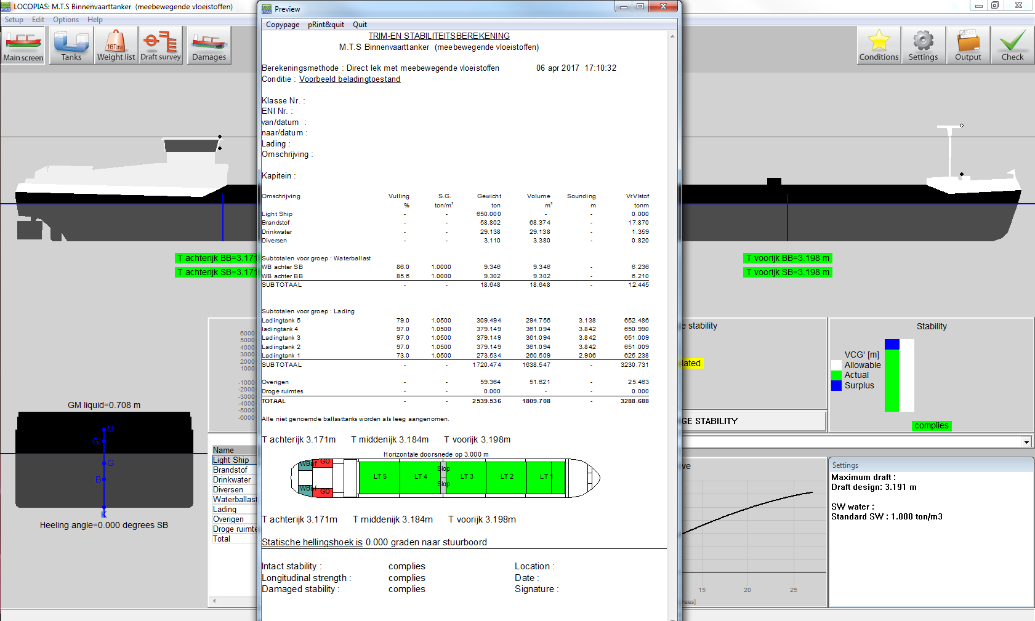
LOCOPIAS, short output
Notes:
Airdraft points

Slide 27
QUESTIONS ?

