Slide 1
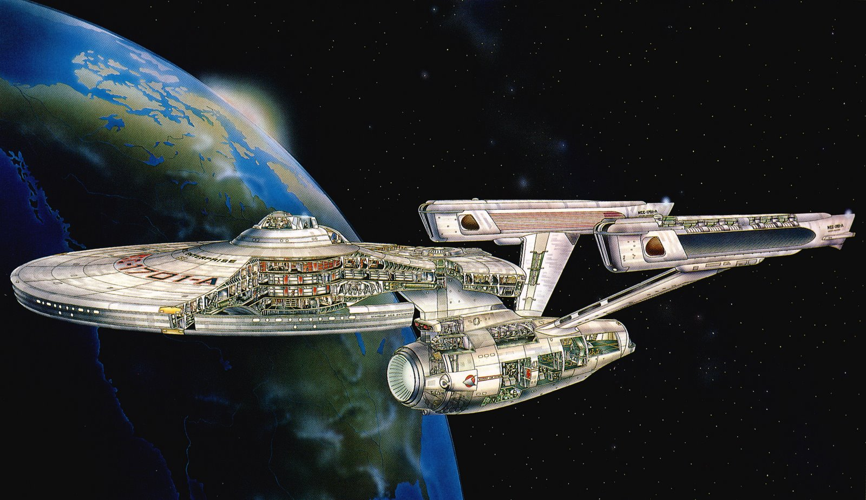
Ship Design – To Boldly Go…
Volker Bertram

Slide 2
Navigator
Ship design – Defying modelling?
Generate
Simulate
Visualize
Learn
Conclusion

Slide 3
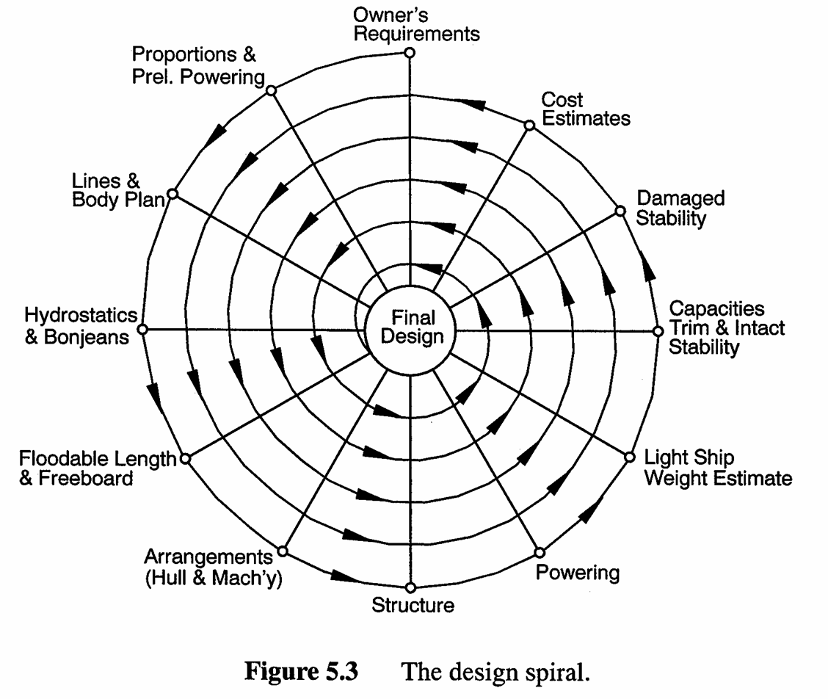
Ship design process modelled as a spiral

Slide 4
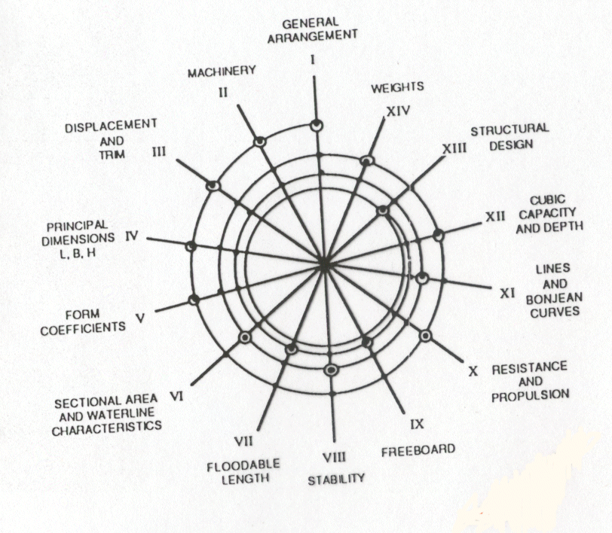
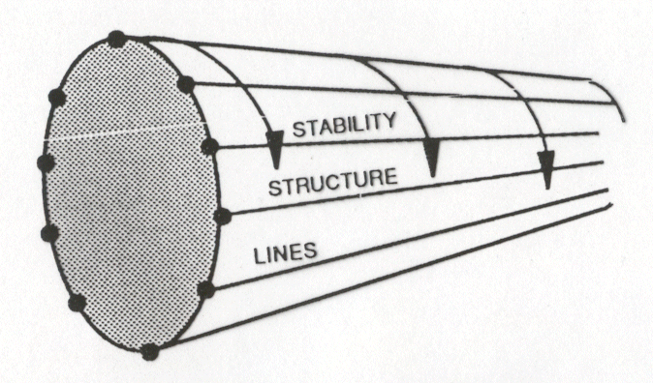
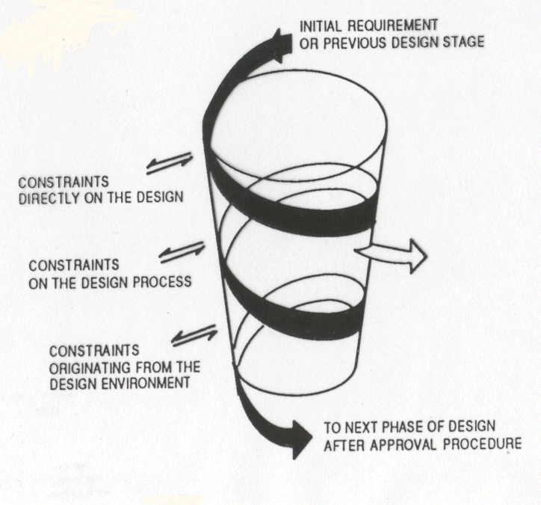
Spiral “refined” over the years
1991
1959
1981
Reality not
quite so
structured!

Slide 5
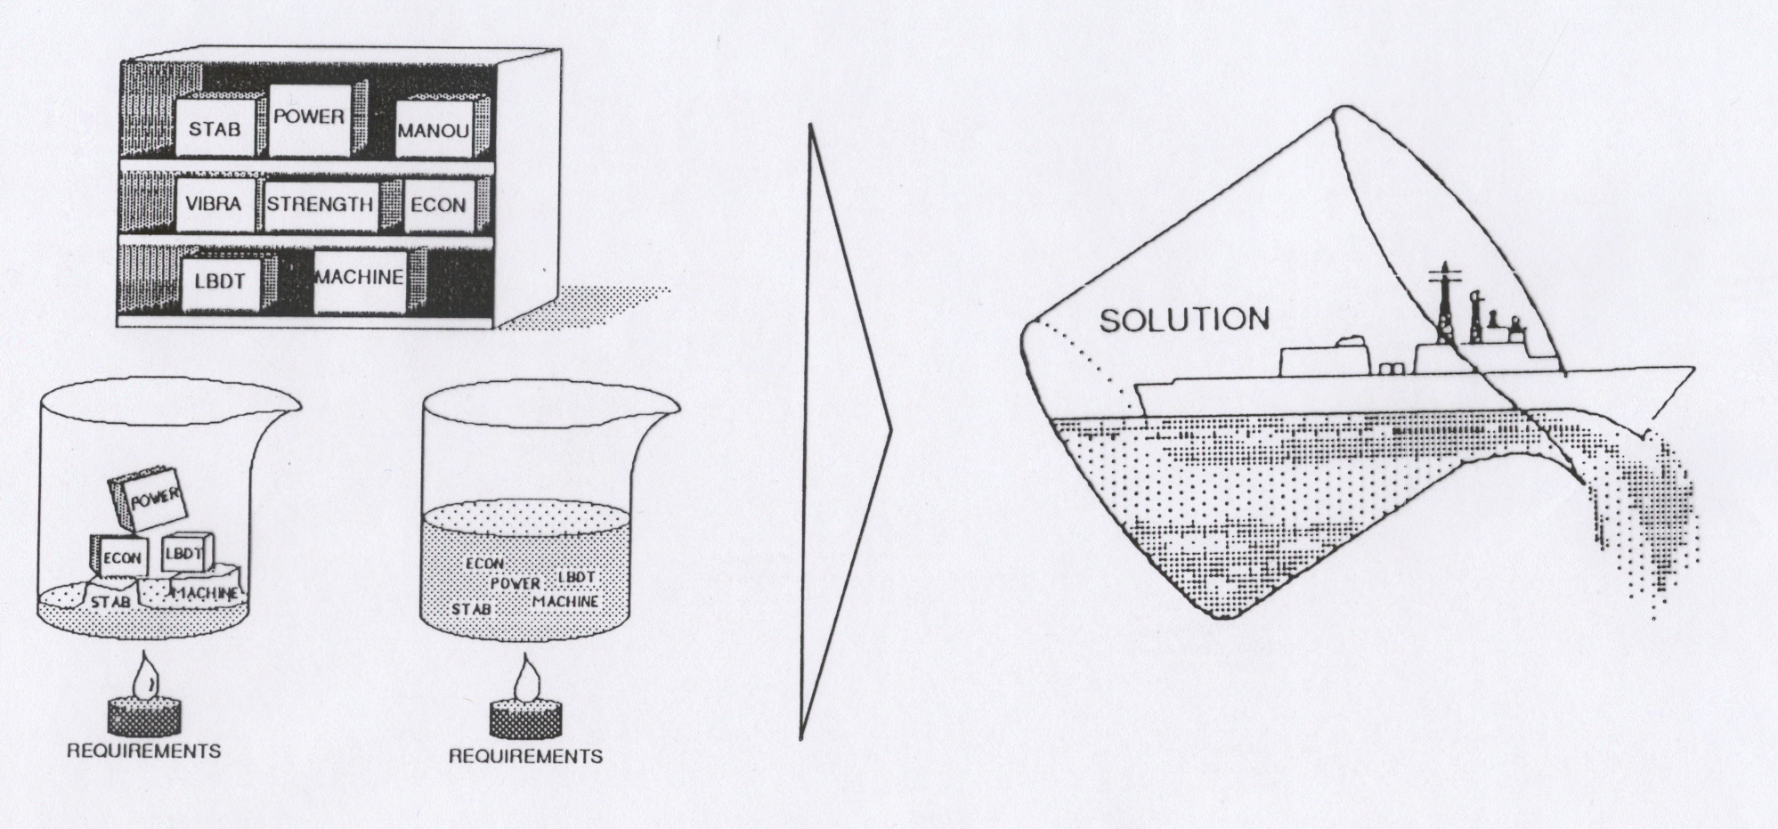
Some process models rather vague-philosophical
Consensus:
Ship design is iterative and
combines complex analyses and decisions
Source: Mistree et al. (1990)

Slide 6

After much studying and some alcohol, I found my own model

Slide 7
4 Basic functions play together
VISUALIZE
LEARN
GENERATE
ANALYZE

Slide 8


Slide 9
Navigator
Ship design – Defying modelling?
Generate
Simulate
Visualize
Learn
Conclusion

Slide 10
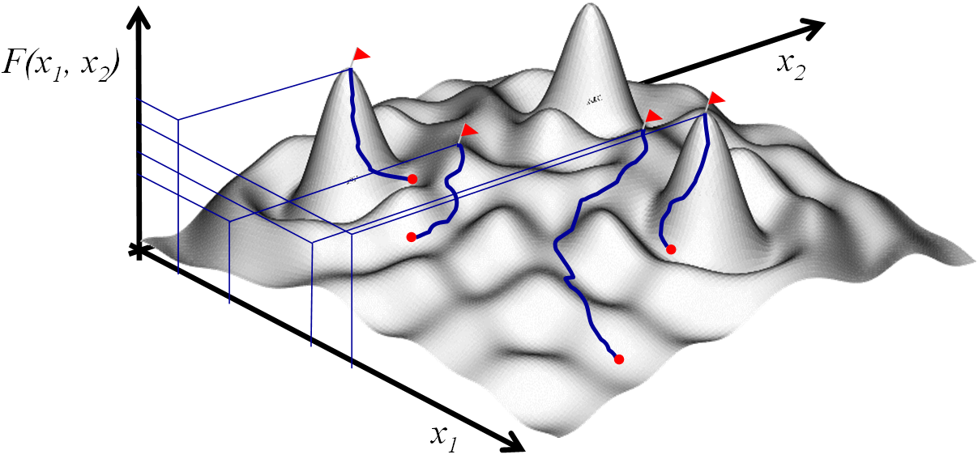
Essentially a human task
Requires creativity
Requires “seeing” the larger picture
Systematic variations can be done by computer

Slide 11

Setting up the optimization model not trivial

Slide 12
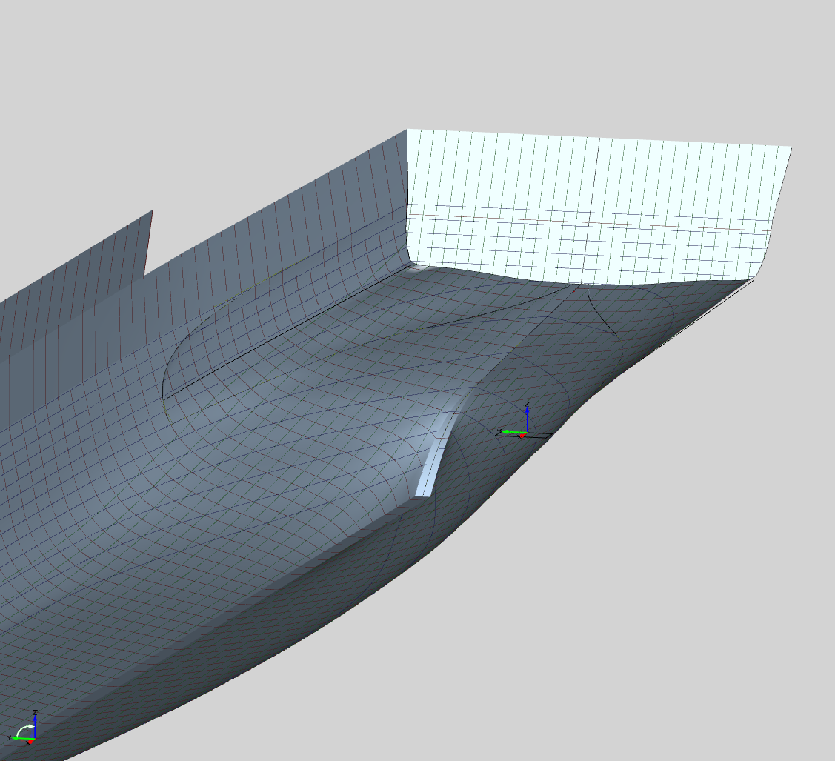
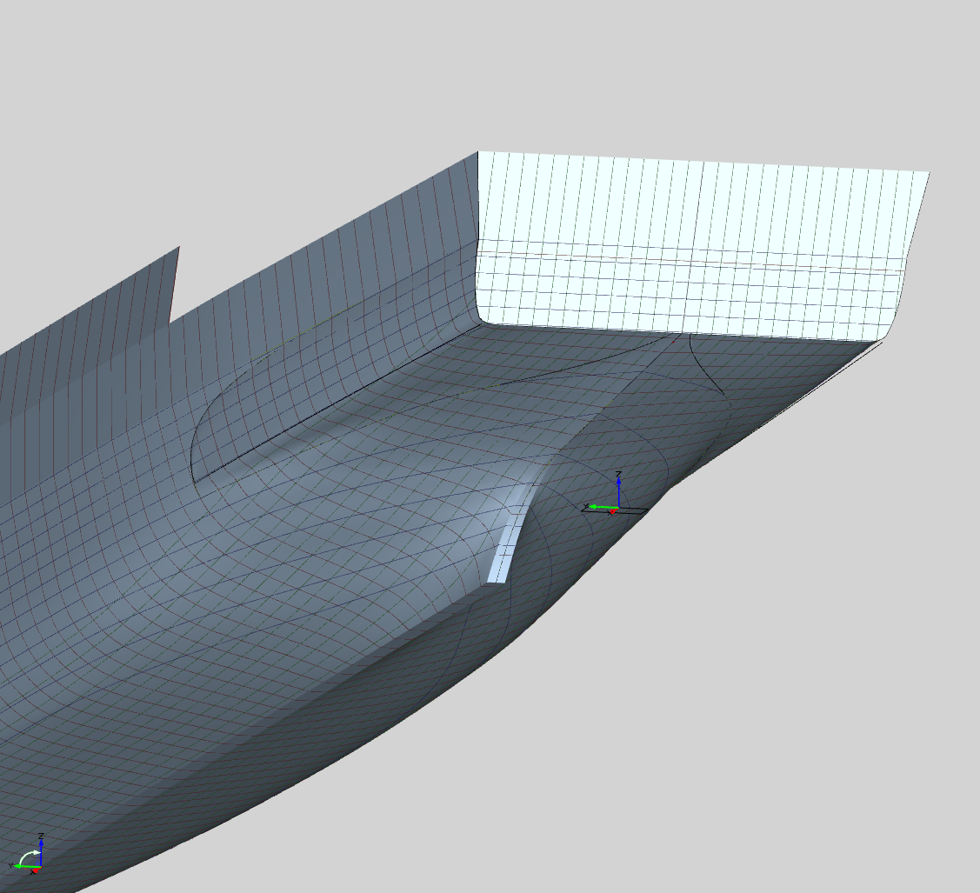




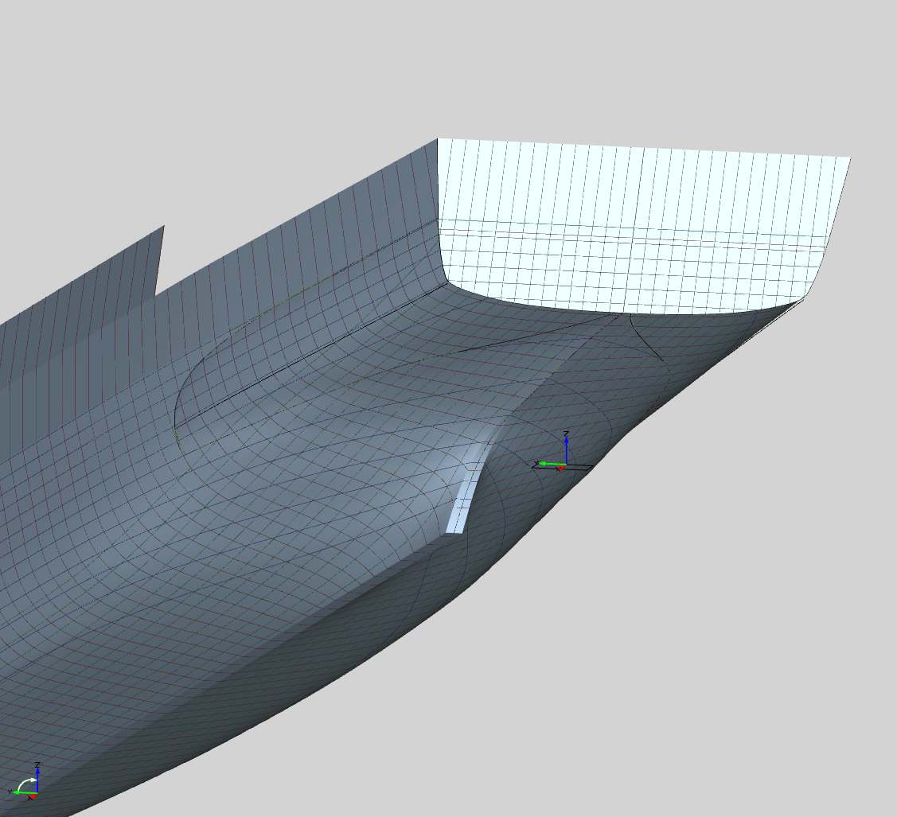
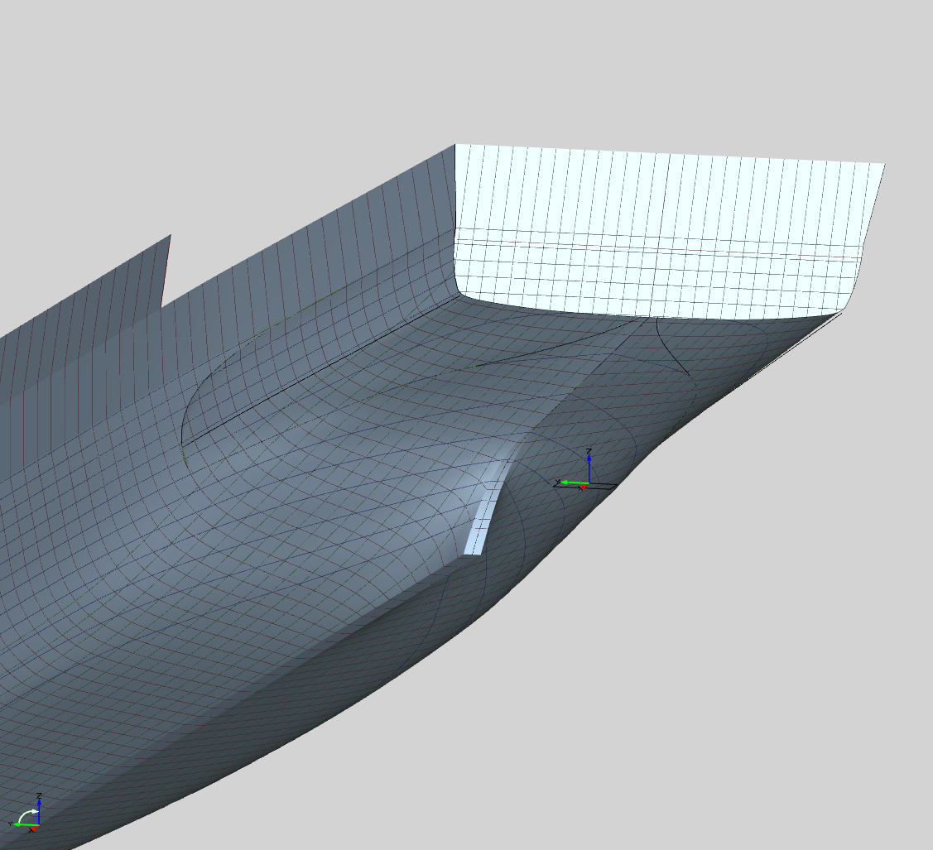
Parametric variations rule, OK?
Fine/Design & OMNIS
CAESES
…

Slide 13
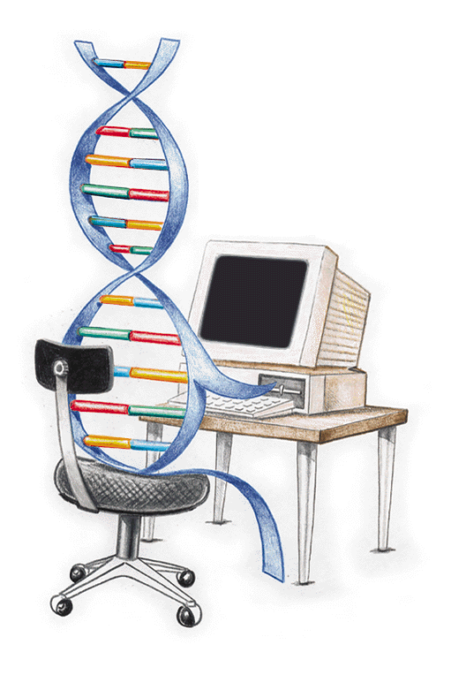
Genetic Algorithms are en vogue
evolutionary
quite slow, but easily parallelized
robust
easily available

Slide 14
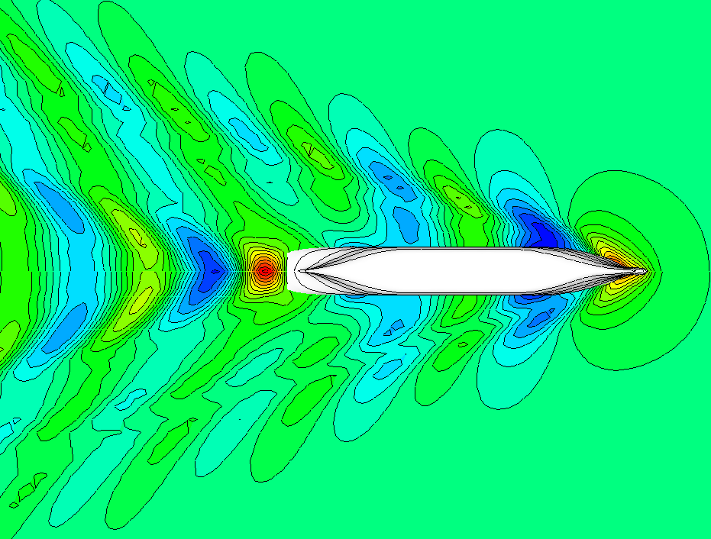
Optimization saves a lot of fuel
before
minimize annual fuel bill
25000 variants
5.5% saved (= 12 mUSD / ship)
after

Slide 15
Navigator
Ship design – Defying modelling?
Generate
Simulate
Visualize
Learn
Conclusion

Slide 16
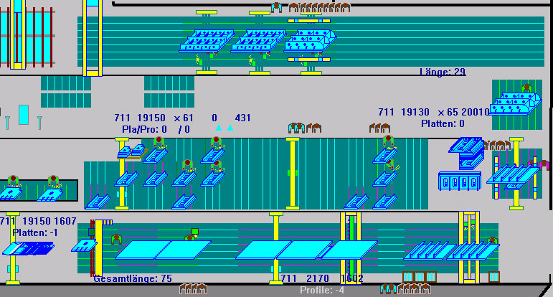
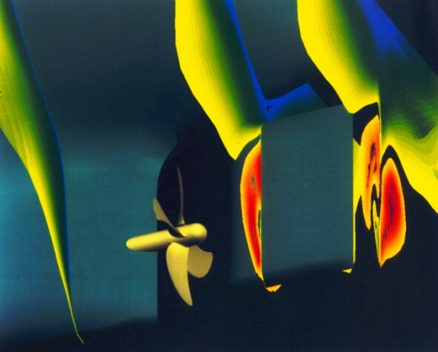
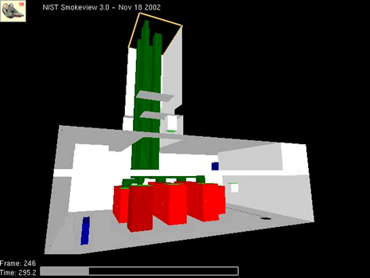
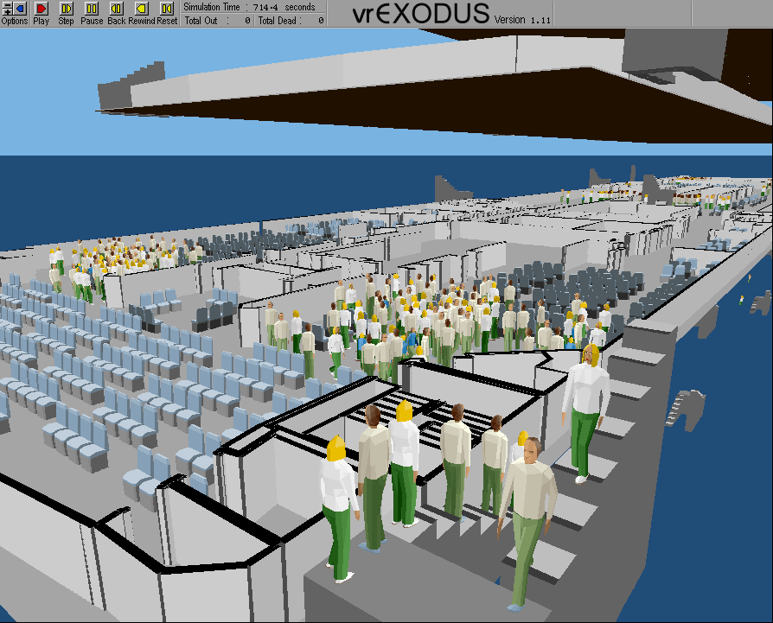
All sorts of simulations

Slide 17
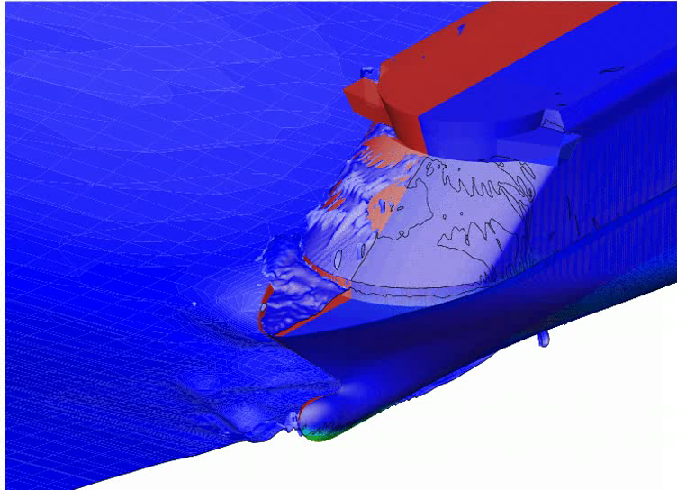
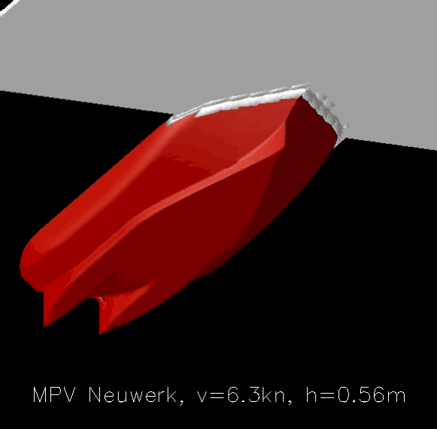
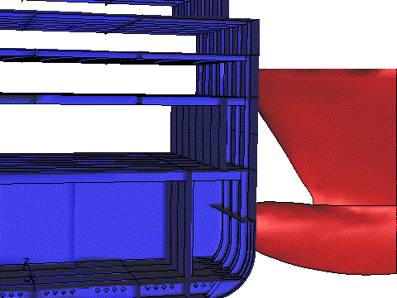
Trends towards 3d+t
Sources: DTU, Puntigliano

Slide 18
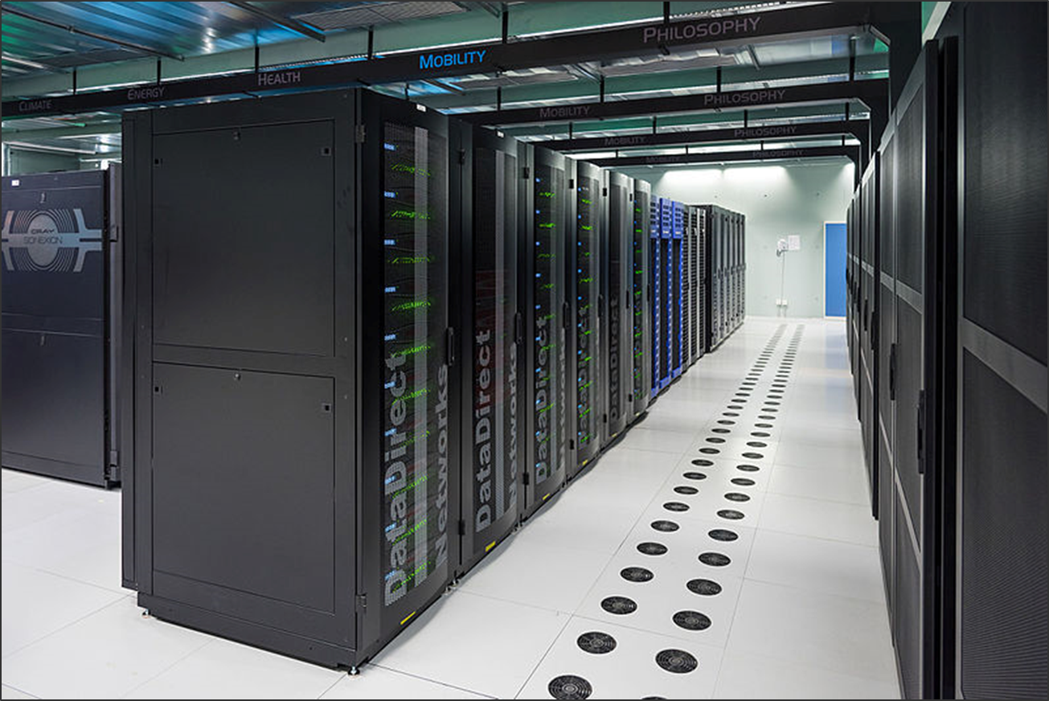

Increasingly “democratic” – Rent software, hardware, skill-up

Slide 19
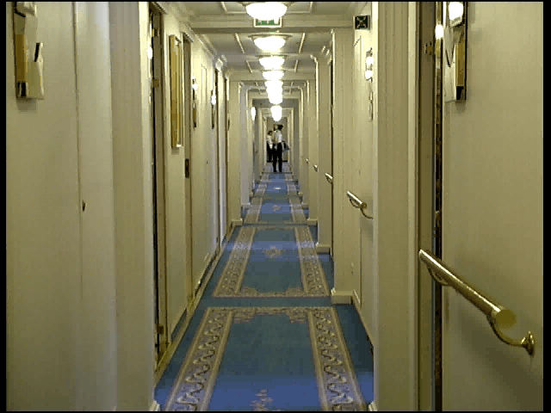
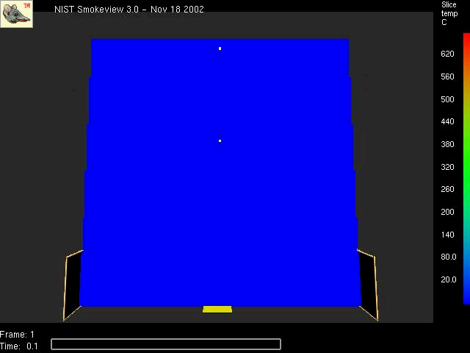
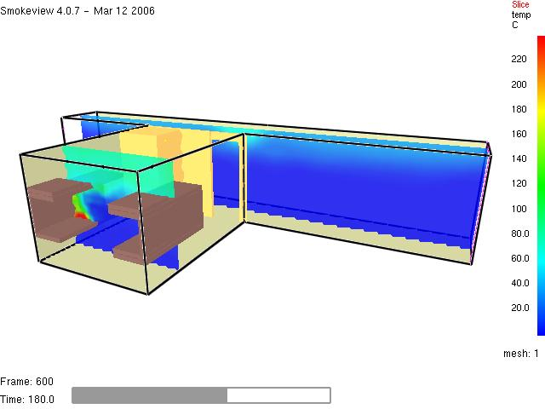

Trend towards combining simulations
Example: Fire & Evacuation simulation

Slide 20


“New” kid on the block – Energy flow simulations
Dynamic (= changing in time)
On-board energy optimization (in design & operation)
Bottlenecks & idle capacity
Consumer
management

Slide 21
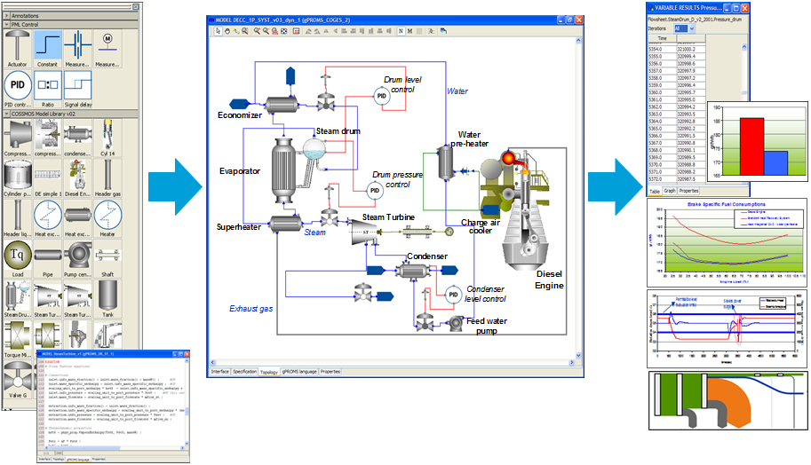
From object library to insight
Source: DNV GL COSSMOS

Slide 22
Navigator
Ship design – Defying modelling?
Generate
Simulate
Visualize
Learn
Conclusion

Slide 23
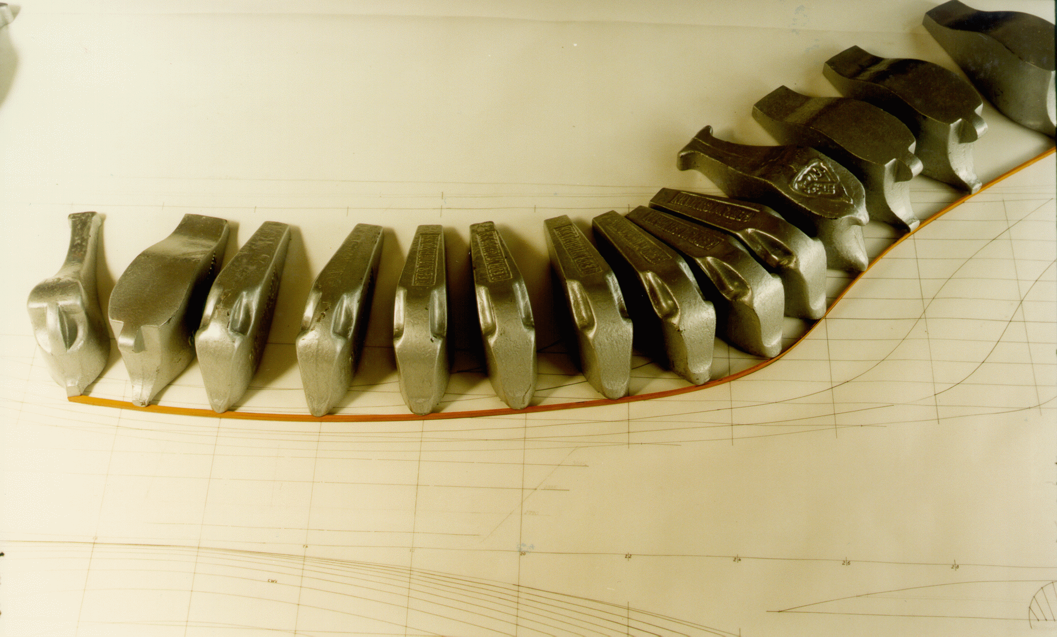
They taught us that ships are 2d curves
Source: TU Berlin

Slide 24
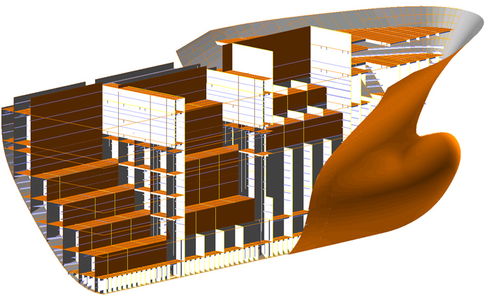
Ships are 3d objects: Model them 3-d !
handling volumes, areas and weights
interface with FEM and CFD simulation
interface with Virtual Reality
Source: NAPA

Slide 25

Sounds…
But…

Slide 26
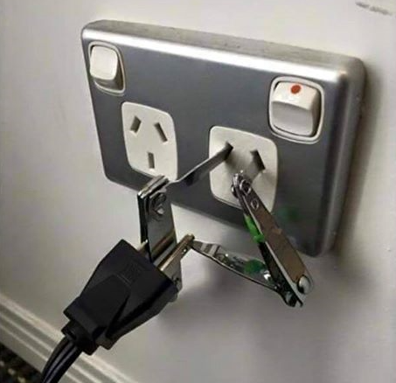
Never-ending story: Interfacing with heterogeneous software
Frequent ad-hoc
“solutions”

Slide 27
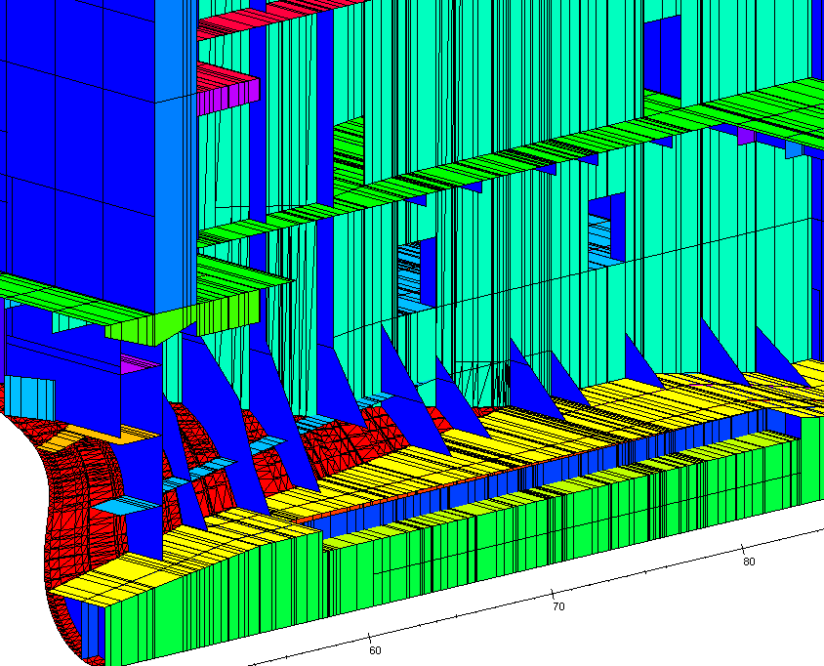
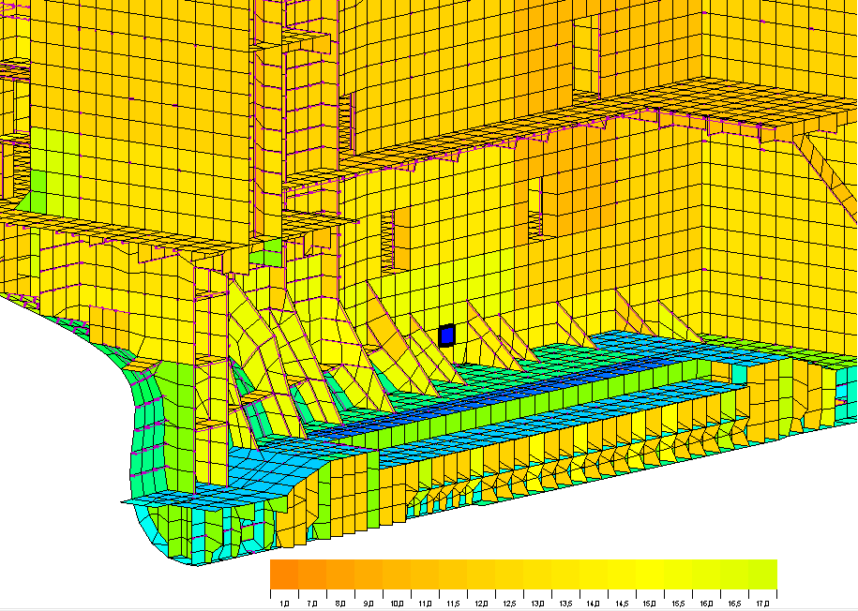
Major savings to be harvested
Example: 3d data exchange between design & approval software
4-6 weeks saved (Samsung)
POSEIDON NAPA Steel
Source: Cabos et al. (2015), COMPIT

Slide 28
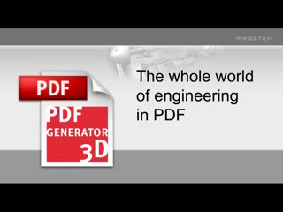
Interesting (for me) - 3d pdf
www.3dpdf.com

Slide 29
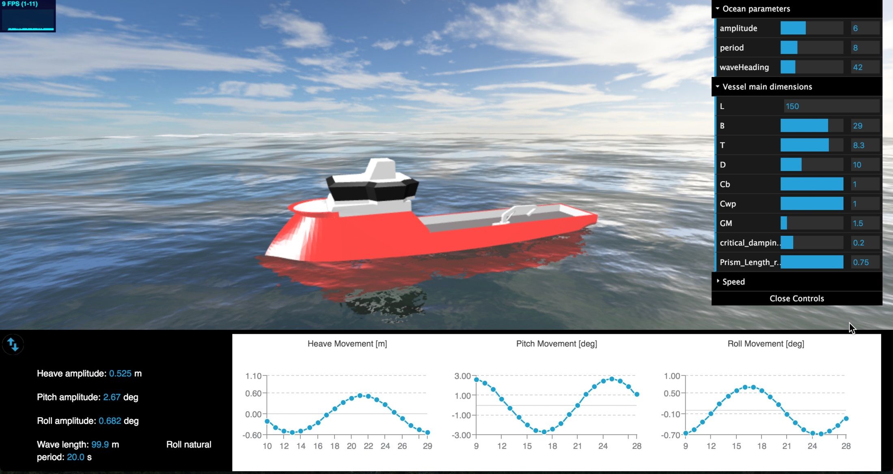
And then there is Virtual Reality…
Source: H. Gaspar (NTNU)

Slide 30
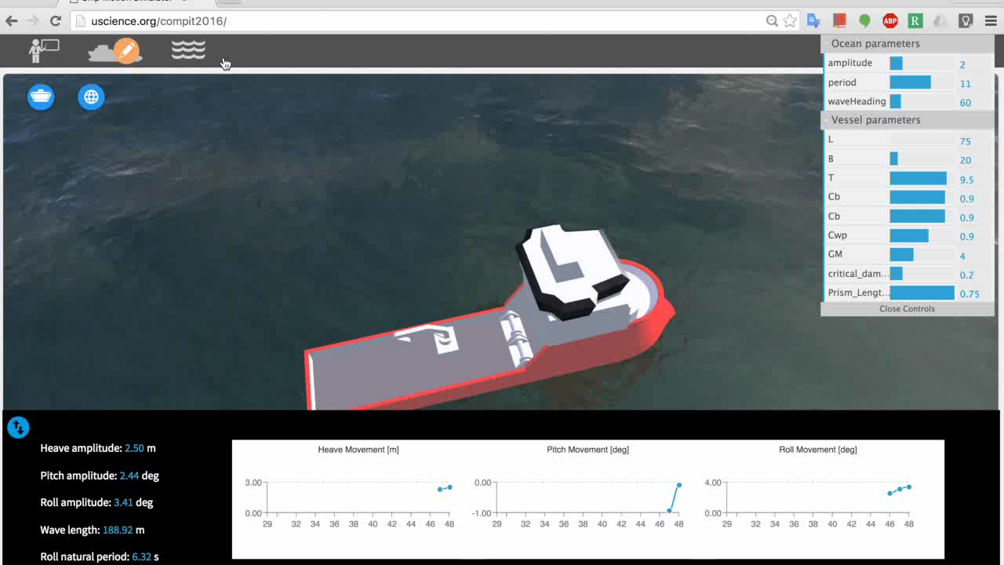
See how your design performs

Slide 31
Navigator
Ship design – Defying modelling?
Generate
Simulate
Visualize
Learn
Conclusion

Slide 32

Computers become more intelligent
expert systems
artificial neural nets
...

Slide 33
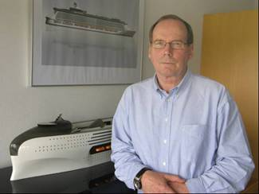


Expert systems – What a lovely idea
Expert
System
Domain Expert
User
Knowledge Engineer

Slide 34

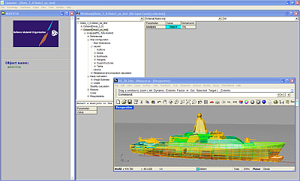
Best shot so far for design expert systems - QUAESTOR
Nice, but didn’t take off

Slide 35

Facebook says: It’s complicated...
Many attempts, many failure…
Knowledge changes fast
Knowledge not well documented
Process not well structured

Slide 36
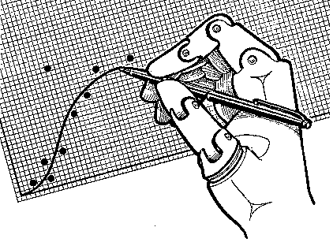
On the other hand – Machine Learning (meta-models)
design formulas
numerical design series
faster numerics
…
E.g. neural nets

Slide 37
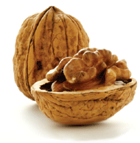
Neural nets in a nut shell
approximate arbitrary functions
we must specify input/output
(large) data sets needed for training
human knowledge increases efficiency
free software (e.g. ICE code by Faller)

Slide 38
Example: Power prediction for tugs
3500
tugs
semi-planing boats
fishing boats
...
3000
2500
2000
Power (kW)
1500
1000
500
0
1
2
3
4
5
6
7
8
9
10
11
12
13
14
15
16
installed
tugs
ANN

Slide 39
Navigator
Ship design – Defying modelling?
Generate
Simulate
Visualize
Learn
Conclusion

Slide 40

Technology is there - all you need to do is…
Be aware of the options
Employ them
Drive them

Slide 41

Questions ?
?

Slide 42
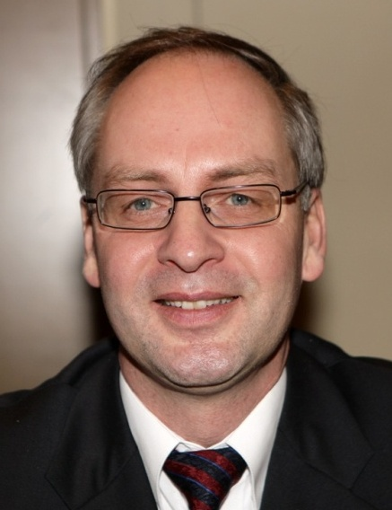
We are here to help you !
Volker Bertram
DNV GL – Maritime Services
volker.bertram@dnvgl.com
+49 40 36149 3457

